Slide 1

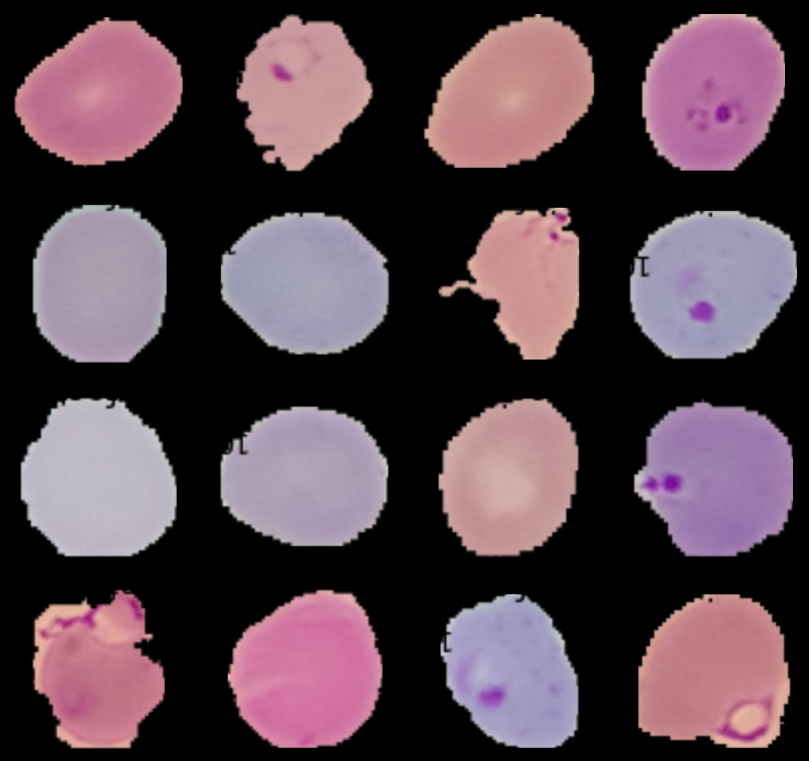
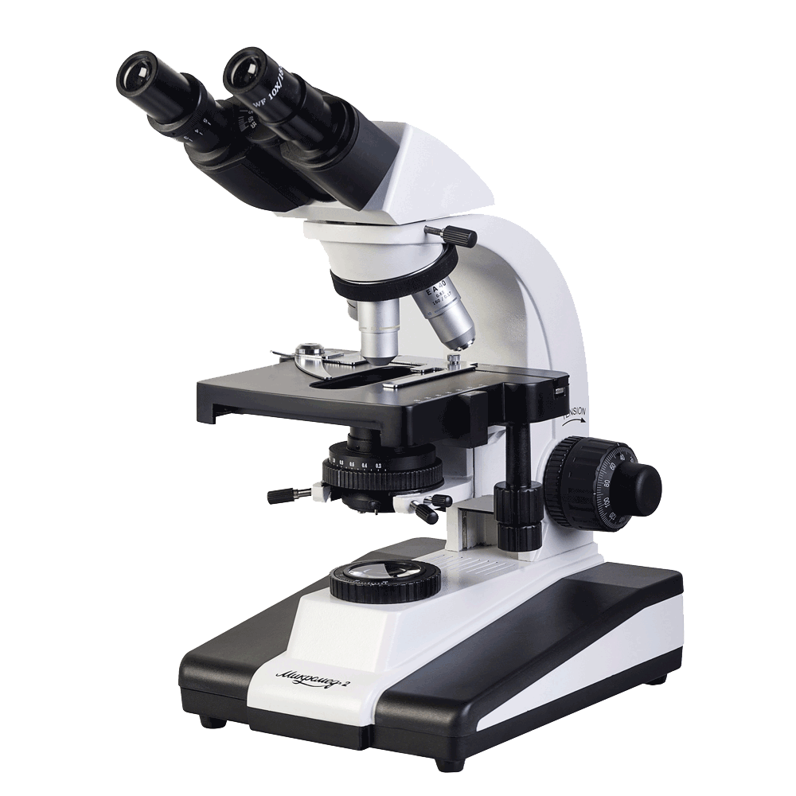
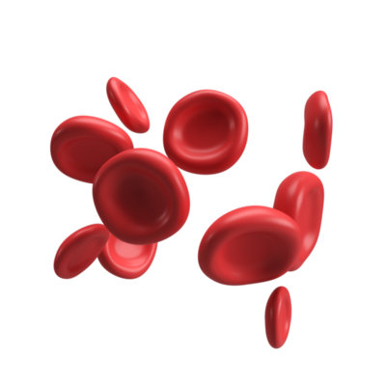
CNN LeNet for Malaria Pathology
Parasitized vs. Uninfected Red Blood Cells
+ve
+ve
+ve
+ve
+ve
+ve
+ve
+ve

Slide 2
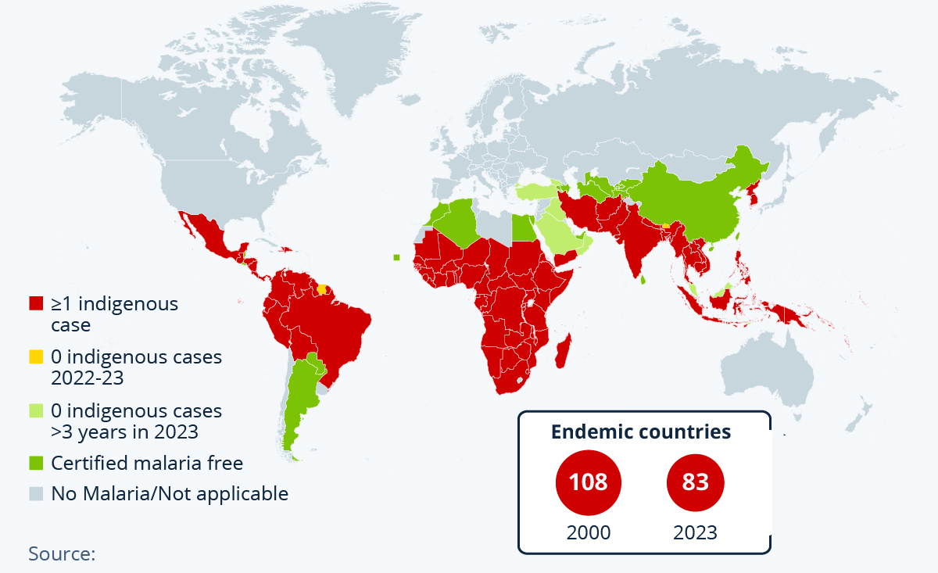

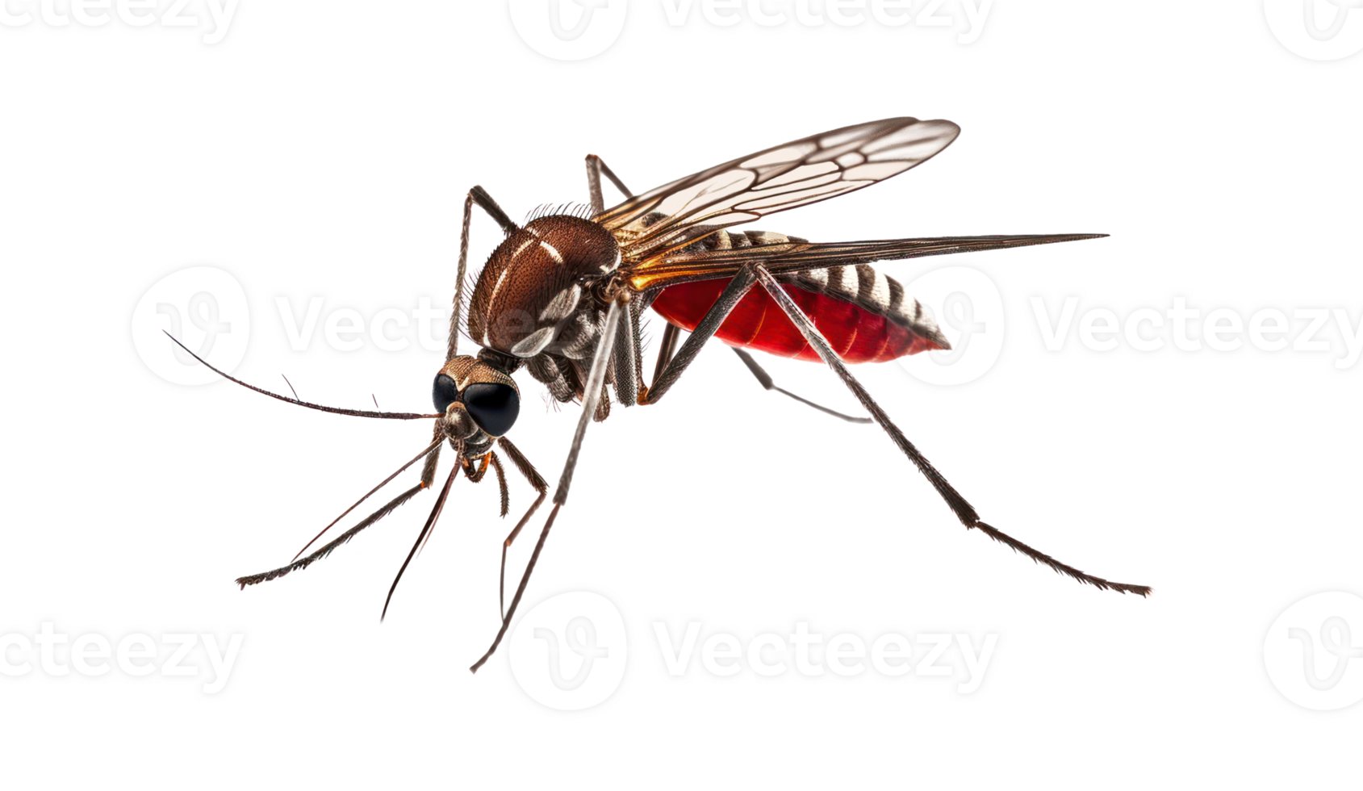

Malaria Endemic

Slide 3
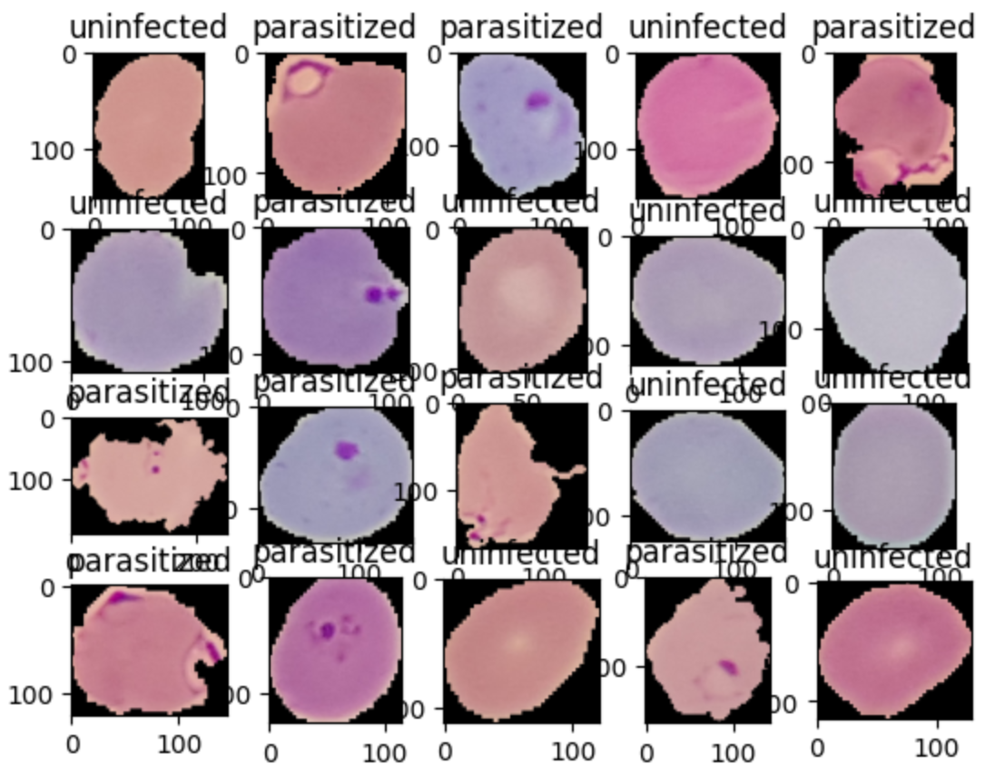

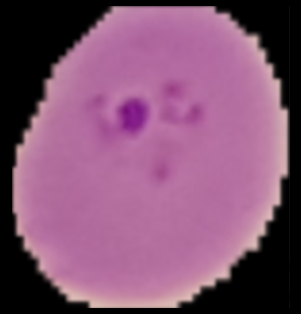
Dataset
Uninfected
Parasitized

Slide 4

CNN LeNet Model Architecture
224X224X3
Input Image:
224X224X3
Batch Normalization
Output
Probability
Maxpool: Poolsize: 2 Stride: 2
Dense Layer
Batch Normalization
Dense Layer
Batch Normalization
Batch Normalization
Maxpool: Poolsize: 2 Stride: 2
Dense Layer
Conv2D
Filters: 6; Strides: 1
Kernel size: 5; Padding: valid
Activation: ReLU
Conv2D
Filters: 16; Strides: 1
Kernel size: 5; Padding: valid
Activation: ReLU
Dense
Units: 100
Activation: ReLU
Dense
Units: 10
Activation: ReLU
Dense
Units: 1
Activation: Sigmoid
Flatten

Slide 5
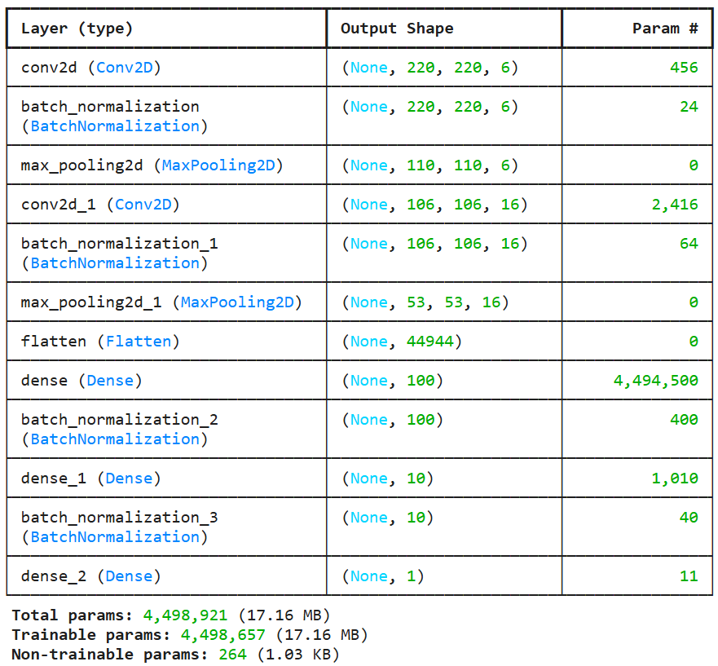
Model Summary, Parameters & Hyper-Parameters
Train–Test–Validation ratio: 0.8 / 0.1 / 0.1
Batch Size: 32
Optimizer: Adam
Learning rate: 0.01
Loss: Binary Crossentropy
Early Stopping: Training stabilized within 8–9 epochs

Slide 6
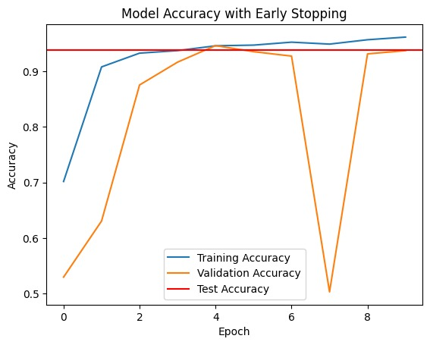
Results and Accuracy
Training accuracy = 96.3%
Validation stable & balanced
Test accuracy ~94%
Early stopping prevents overfitting
Reliable malaria detection with CNN

Slide 7
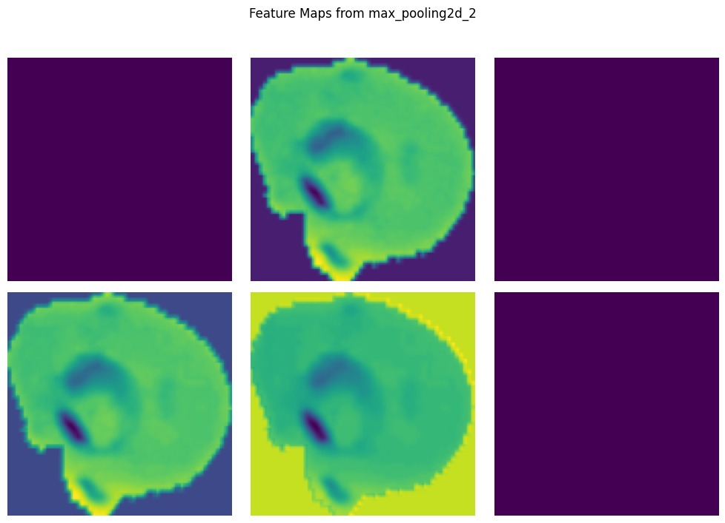
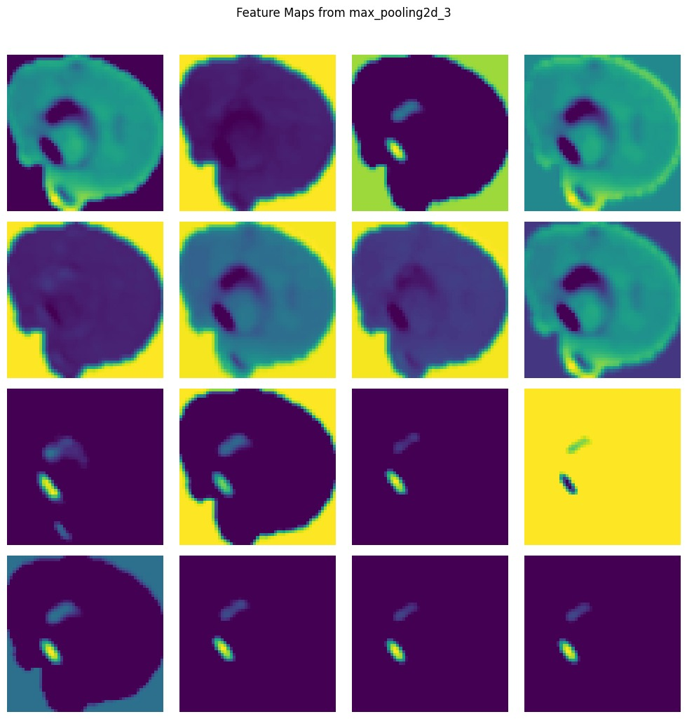
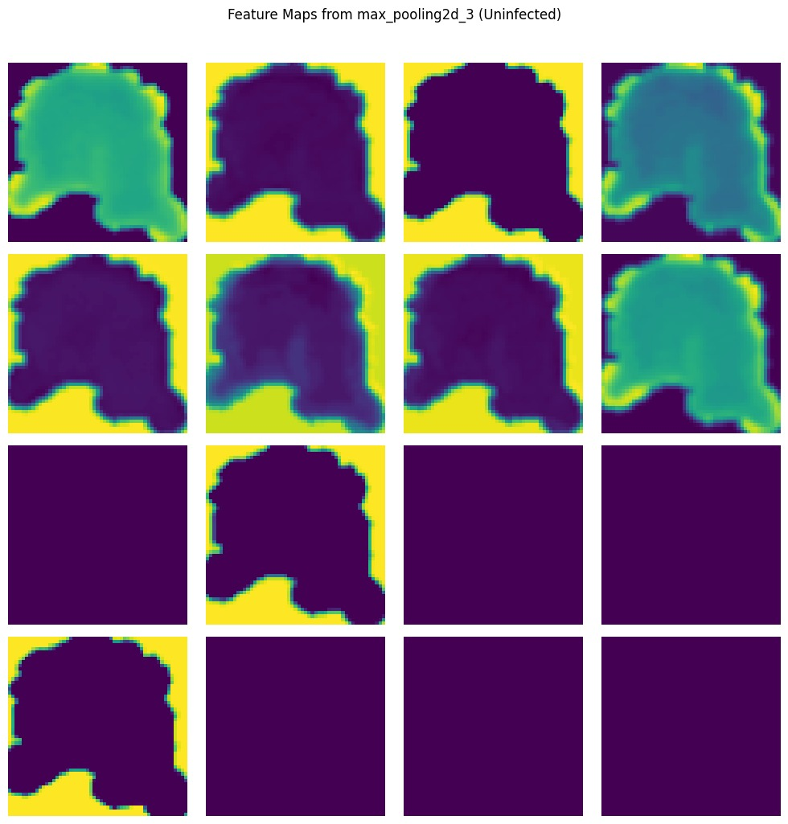
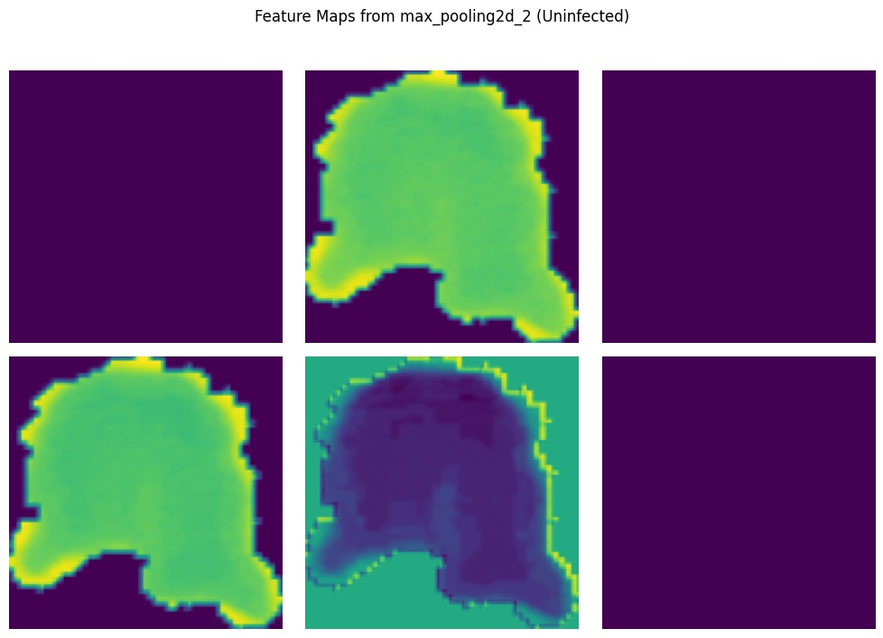
Sample Positive and Negative Activations
224X224X3
Input Image:
224X224X3
Batch Normalization
Output
Probability
Maxpool: Poolsize: 2 Stride: 2
Dense Layer
Batch Normalization
Dense Layer
Batch Normalization
Batch Normalization
Maxpool: Poolsize: 2 Stride: 2
Dense Layer
Conv2D
Filters: 6; Strides: 1
Kernel size: 5; Padding: valid
Activation: ReLU
Conv2D
Filters: 16; Strides: 1
Kernel size: 5; Padding: valid
Activation: ReLU
Dense
Units: 100
Activation: ReLU
Dense
Units: 10
Activation: ReLU
Dense
Units: 1
Activation: Sigmoid
Flatten

Slide 8
Conclusion and the Way Forward

