Slide 1
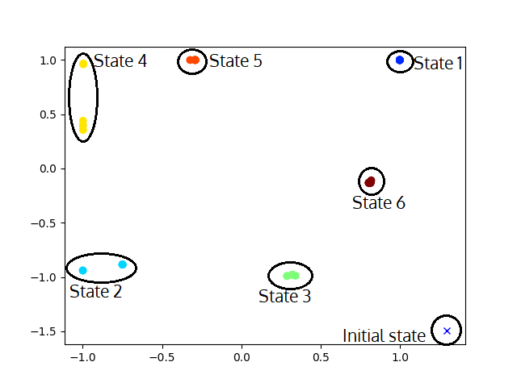
End State
E
V
V
P
P
S
T
B
S
X
X
T

Slide 2
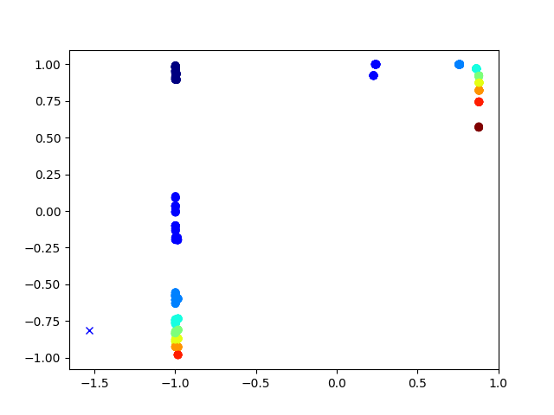
B
B
B
B
B
B
A
B
B
A
B
A
Index:
A
B
A
A
A
A

Slide 3
