Slide 1
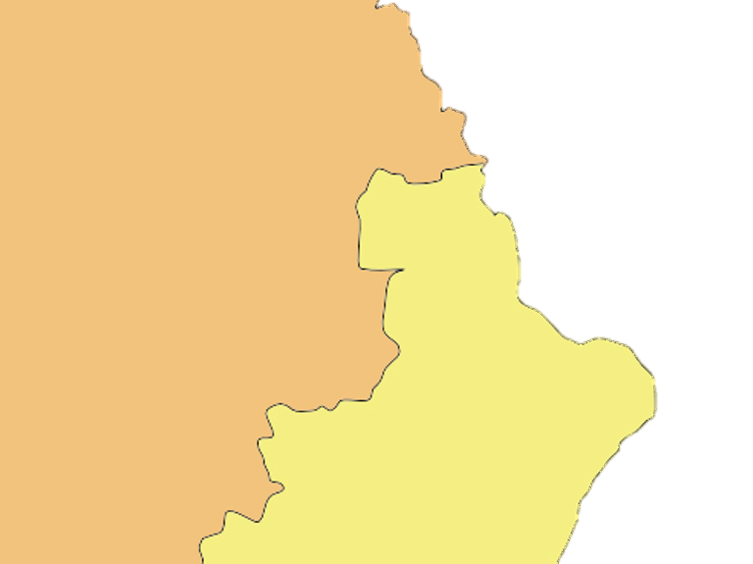
Oil Deposit
($100bn)
Hermania
Patris Sea
North
Broland
100Km

Slide 2
Hermania
Offers
nothing
Offers
Full $100bn
Offers
Some
Share
Broland
Accept => Settlement
Reject => War
Hermania
Hermania’s share: + $80bn
Broland’s share: + $20bn
Hermania
Loses War
Hermania
Wins War
Hermania’s prospect: - $15bn
Broland’s prospect: + $20bn
Hermania’s prospect: + $45bn
Broland’s prospect: - $20bn

