Slide 1
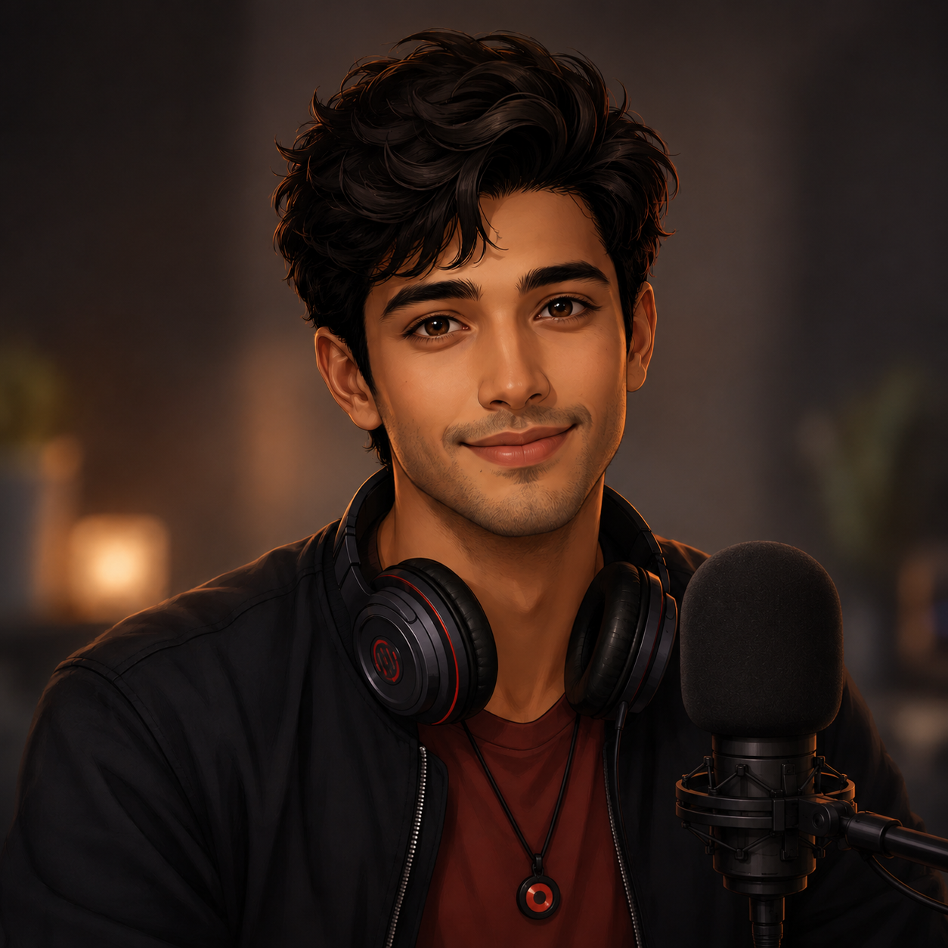
Syan Avatar

Slide 2
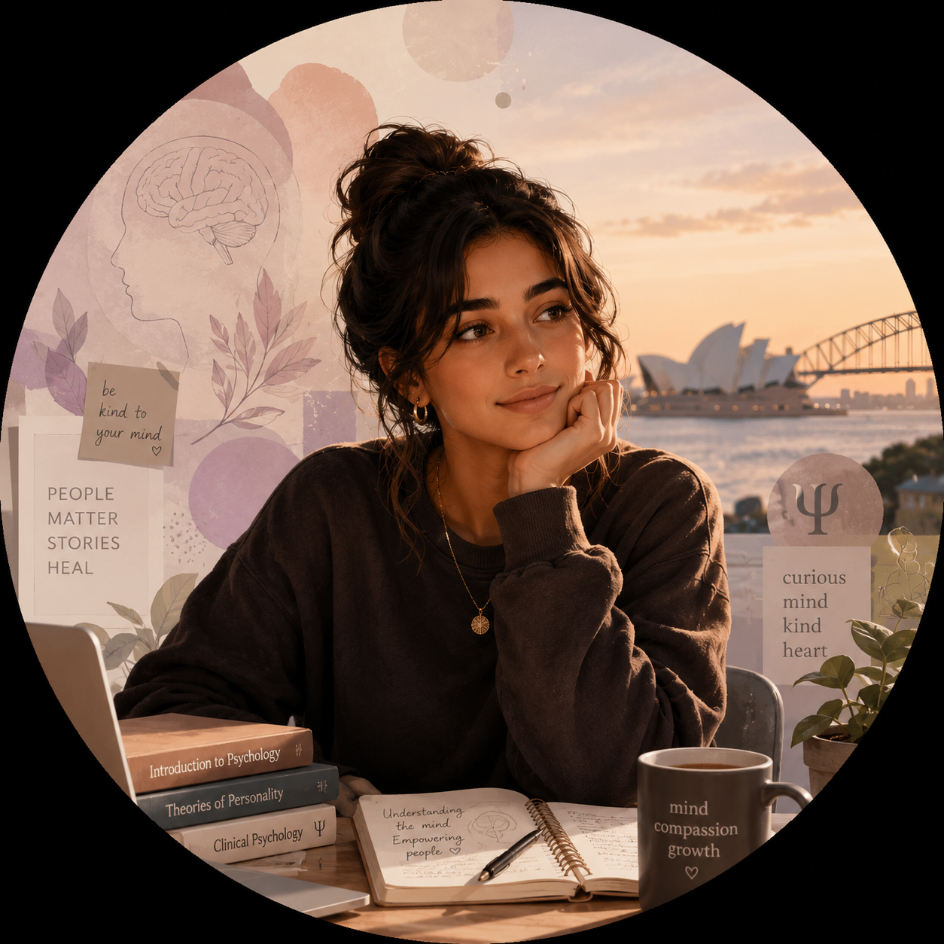
Sara, User Avatar
Sara 23,
Student (Psychology Bachelors), Sydney, Australia

Slide 3

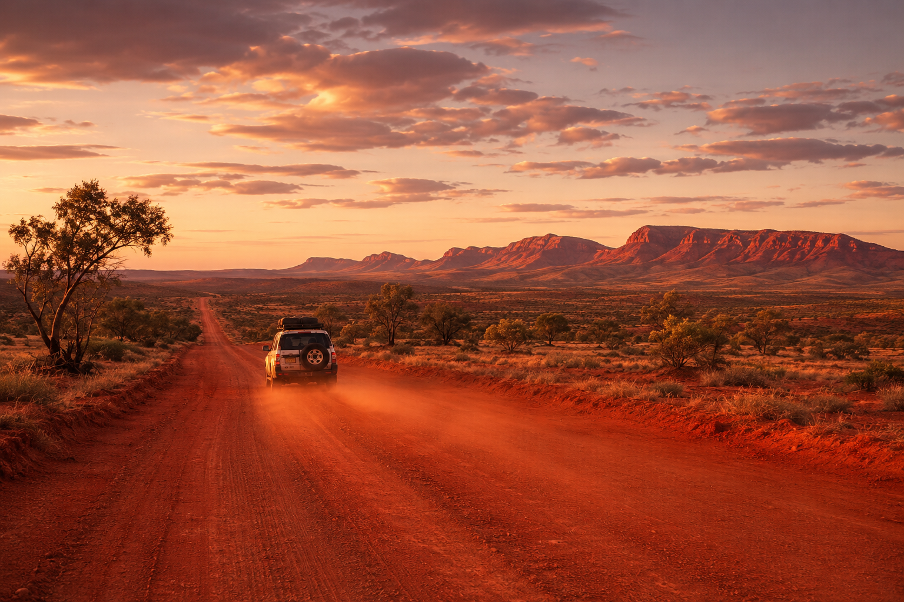




10:10 am
10-Oct-2026
Login with Google
RedDust
Listen to the music
that listens to your soul
RedDust

Slide 4
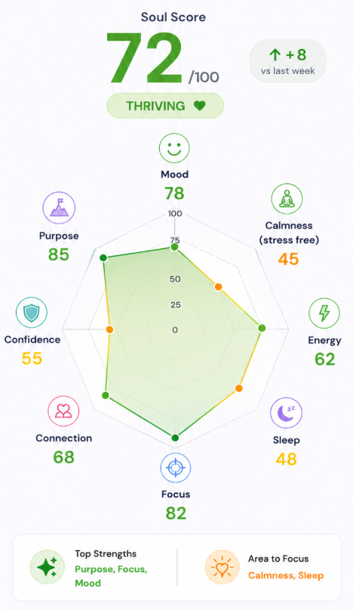
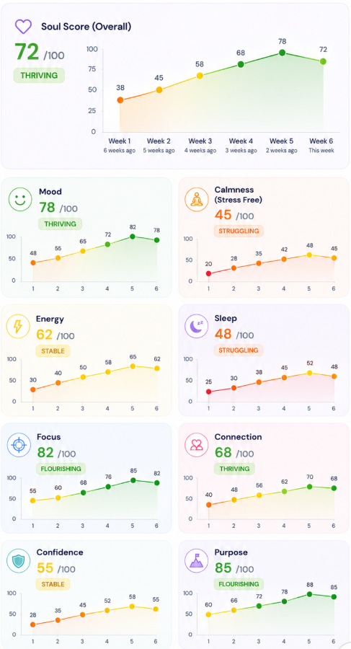




Hey Sara 💜 How are you feeling right now?
A bit tired.
New Question
Answer
With Syan
Soul Space
With Syan
Soul Space
With Syan
Soul Space

Slide 5
