Slide 1
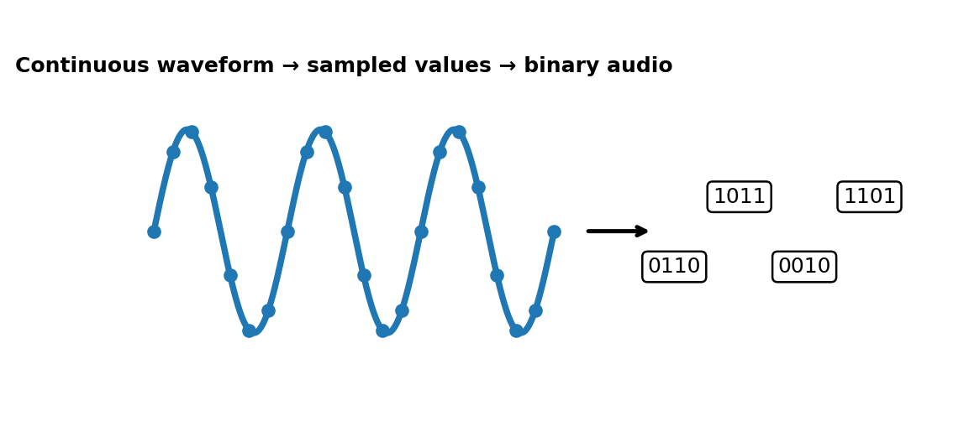
From Airwaves to Audio Files
The Physics and Mathematics of Digital Audio Sampling
Understanding the Nyquist Theorem, ADC Pipelines, and Quantisation

Slide 2
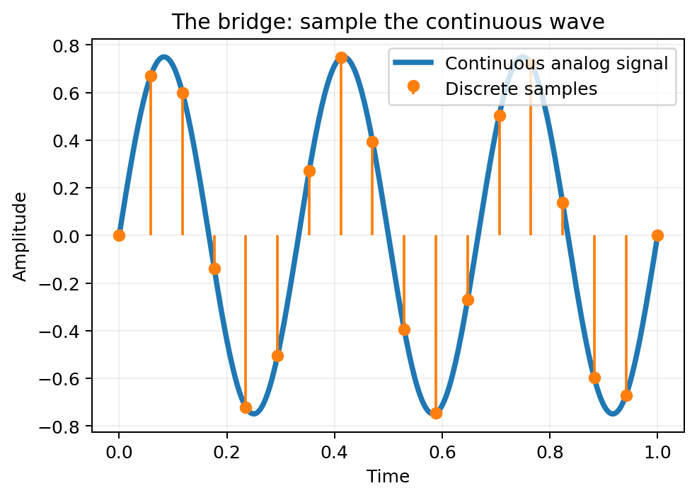
The Core Challenge: Continuous vs. Discrete
Physical Reality: True sound is an analog pressure wave, infinitely variable in both time and amplitude.
Digital Reality: Computational architectures only process binary code (discrete 0s and 1s).
The Bridge: Sampling acts as the mathematical and electrical link, slicing continuous waves into distinct numerical frames.
Information Integrity: The process must capture enough detail to allow exact wave reconstruction without raw data bloat.
Concept diagram

Slide 3
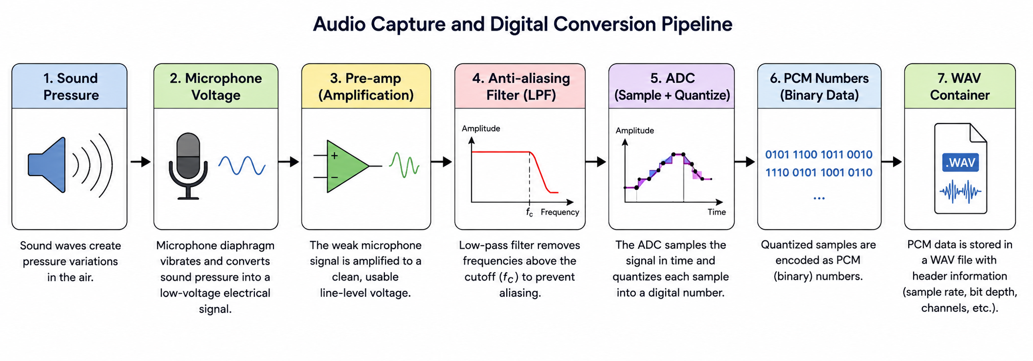
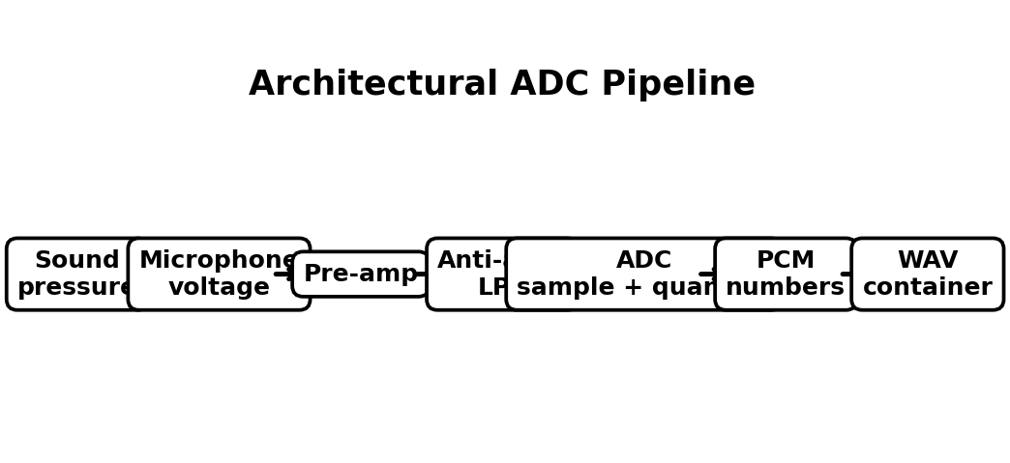
The Architectural ADC Pipeline
Acoustic Input: Physical sound pressure waves vibrate a microphone diaphragm, generating low-voltage electrical signals.
Pre-Amplification: The low-voltage microphone signal is boosted to a clean, usable line-level hardware voltage.
Anti-Aliasing Filter: A low-pass hardware filter violently strips away all frequencies above the chosen system limit.
The ADC Chip: The core integrated circuit handles both Sampling (chopping time) and Quantisation (chopping amplitude).
Storage & Packaging: The resulting structural binary stream is written directly into uncompressed .wav file containers.
Concept diagram

Slide 4
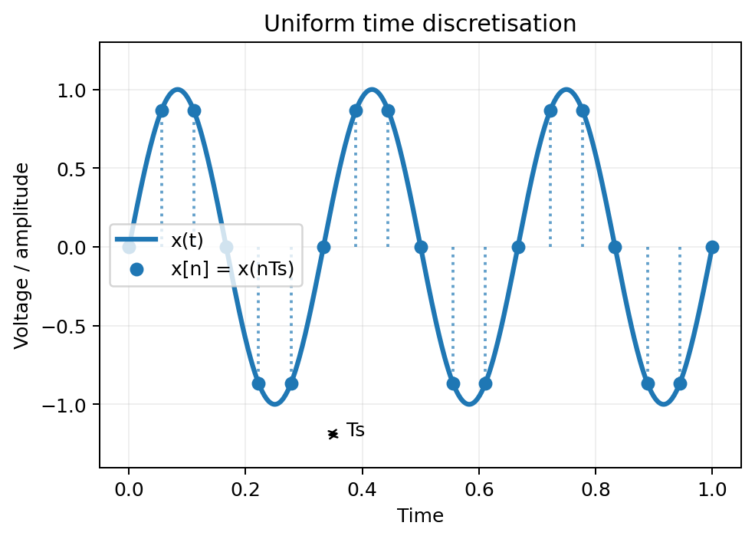
Step 1: Time Discretisation (Sampling)
Definition: Measuring the exact instantaneous voltage of an analog signal at uniform, highly precise intervals of time.
Sampling Interval (Ts): The fixed, unvarying time duration separating consecutive signal measurements.
Sampling Frequency (fs): The total number of snapshots captured per single second, measured strictly in Hertz (Hz).
Mathematical Transformation: Maps a continuous-time signal x(t) into a discrete sequence defined as x[n] = x(nTs).
Concept diagram

Slide 5
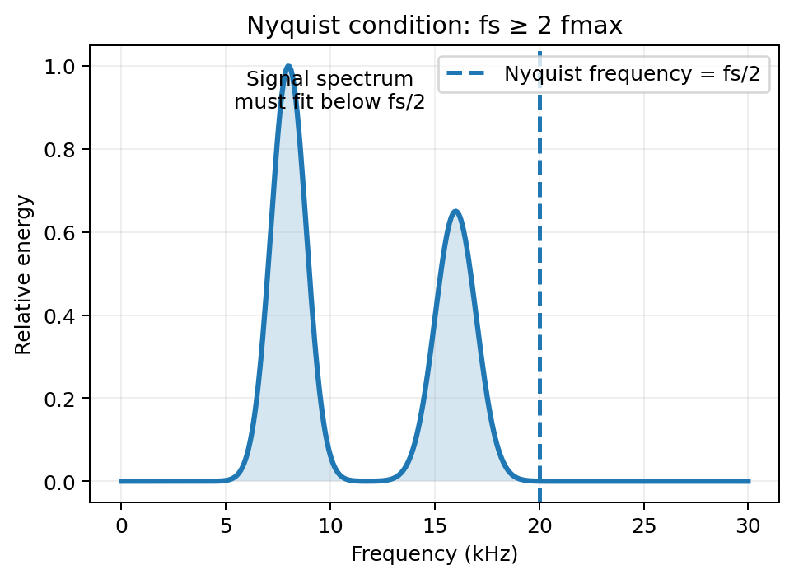
The Nyquist-Shannon Sampling Theorem
The Fundamental Rule: To perfectly reconstruct an analog signal, the sampling rate (fs) must be greater than twice the highest frequency component (fmax) contained within the signal.
The Formula: fs >= 2 * fmax
Nyquist Frequency: The absolute mathematical frequency ceiling of a digital system, equal to exactly half the sampling rate (fs / 2).
Reconstruction: If this condition is met, the original wave can be rebuilt with zero mathematical loss or structural interpolation errors.
Concept diagram

Slide 6
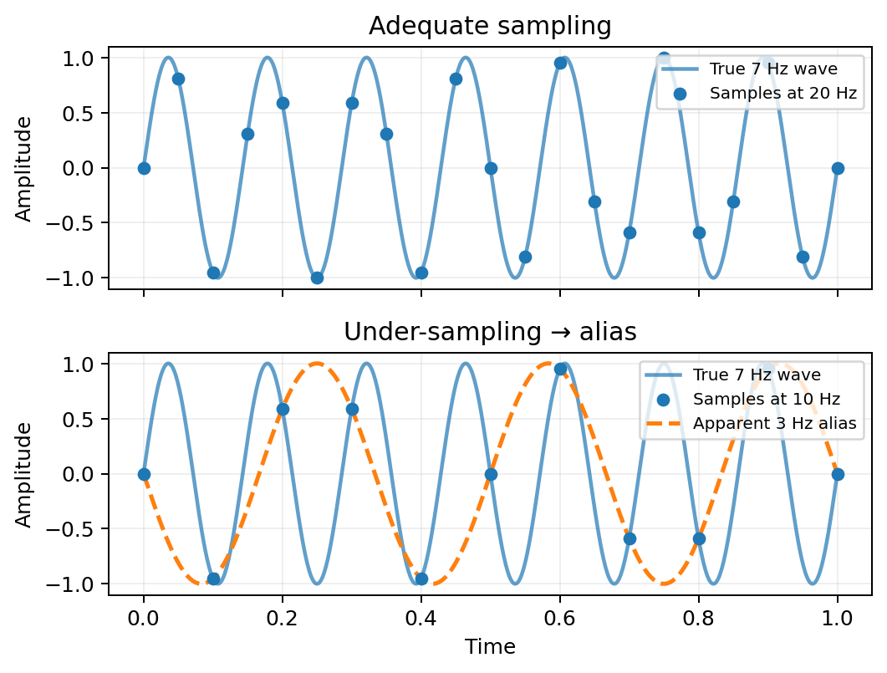
The Penalty of Failure: Aliasing
Under-sampling: Occurs when a sound wave changes faster than the digital system is configured to sample it (fs < 2 * fmax).
Spectral Folding: The high-frequency wave reflects back across the Nyquist limit, impersonating an artificial low-frequency wave.
Digital Distortion: Creates harsh, metallic noise that is permanently baked into the data stream and cannot be filtered out later.
Prevention: The hardware anti-aliasing filter forces strict compliance by cutting off illegal high frequencies prior to conversion.
Concept diagram

Slide 7
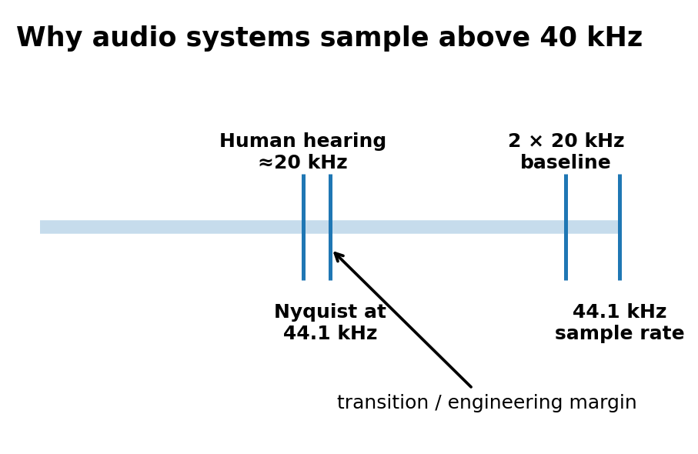
Real-World Engineering: Why 44.1 kHz?
Human Biological Limits: The healthy human auditory system can perceive frequency vibrations up to roughly 20,000 Hz (20 kHz).
The Nyquist Baseline: According to the theorem, capturing human hearing requires an absolute minimum baseline of 40 kHz.
The Transition Band: The extra 4,100 Hz provides critical breathing room for physical, real-world analog filters to roll off efficiently.
Industry Standardization: Established during the early digital audio era to sync seamlessly with global video formats.
Concept diagram

Slide 8
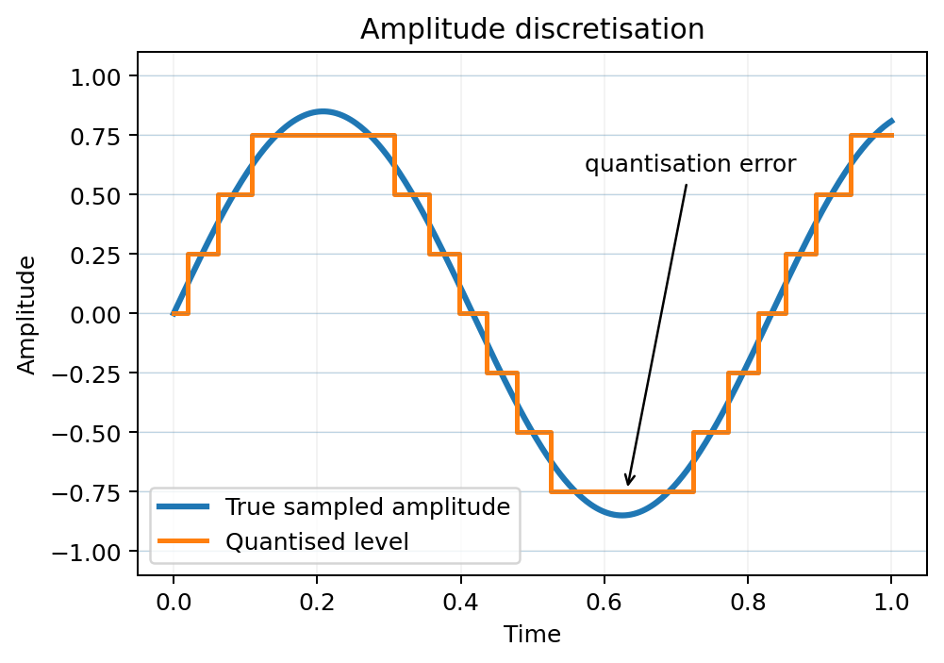
Step 2: Amplitude Discretisation (Quantisation)
The Axis Split: While sampling slices the horizontal axis (Time), quantisation slices the vertical axis (Voltage Level).
Bit Depth (Resolution): The exact number of bits dedicated to expressing the numeric value of each individual sample point.
Resolution Scale Levels:
- 16-Bit (CD Quality): Provides 2^16 = 65,536 distinct numerical amplitude steps.
- 24-Bit (Studio Master): Provides 2^24 = 16,777,216 distinct numerical amplitude steps.
Quantisation Error: The tiny mathematical rounding offset between the true wave voltage and the nearest grid line. This error generates a permanent low-level noise floor.
Concept diagram

Slide 9
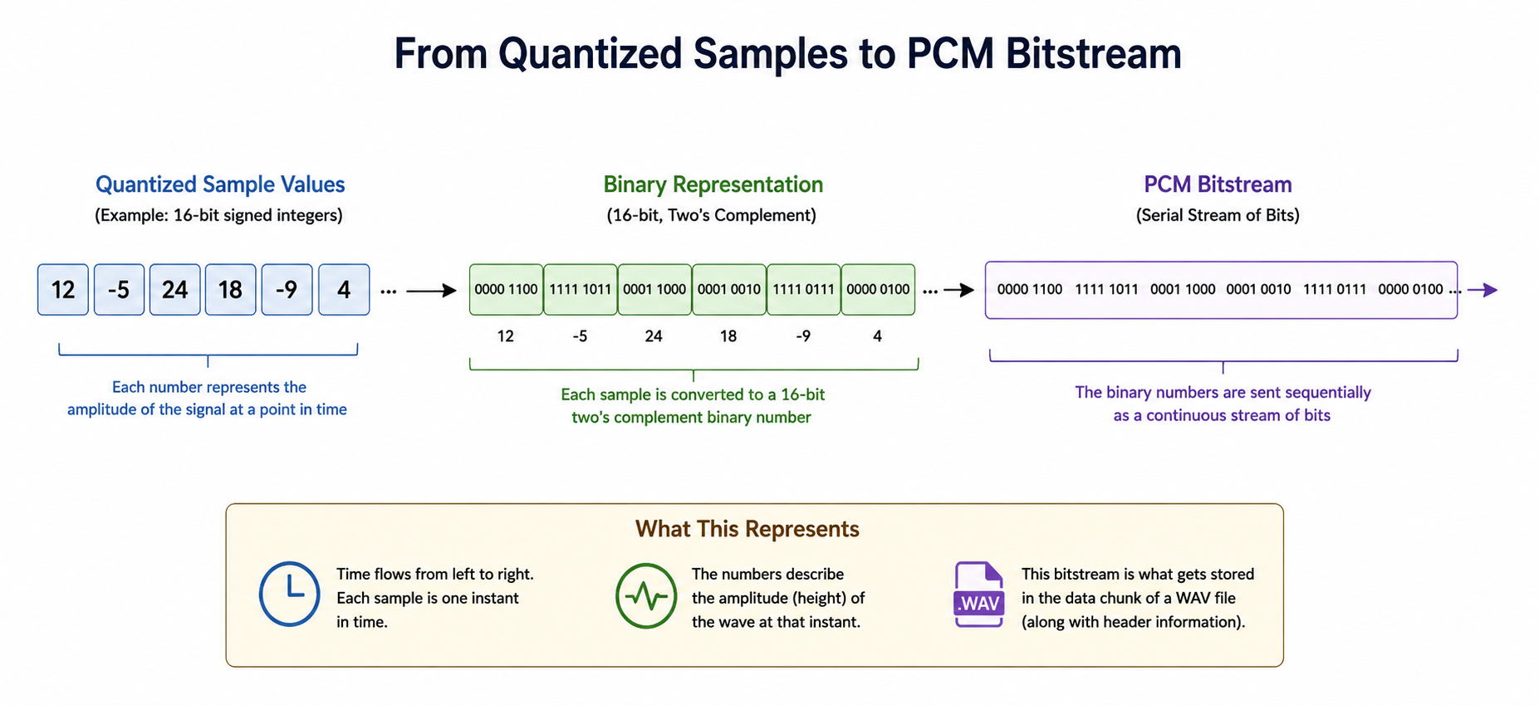
Pulse Code Modulation (PCM) & WAV Files
PCM Generation: The sequential stream of quantised integers is encoded directly into a continuous digital bitstream.
WAV Container Architecture:
- Header Chunk: Defines critical file identity parameters: sample rate, bit depth, and channel configurations (Mono/Stereo).
- Data Chunk: A massive, uncompressed sequential block of raw binary data representing audio amplitude over time.
Data Rate Formula: Bit Rate = Sample Rate * Bit Depth * Number of Channels
- CD Calculation: 44,100 Hz * 16 bits * 2 channels = 1,411.2 kbps constant data throughput.

Slide 10
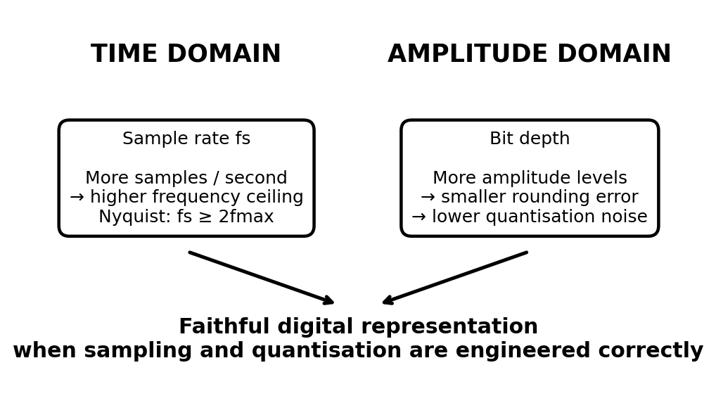
Conclusion: Key Engineering Principles
Time Domain Mastery: Elevating the sample rate extends the system's ability to record higher frequencies cleanly.
Amplitude Domain Mastery: Increasing the system bit depth drops the noise floor and expands total operational dynamic range.
Mathematical Perfection: When Nyquist criteria are fully satisfied, digital audio does not lose information—there are no jagged 'staircases' in the final output wave.
Concept diagram

Slide 11
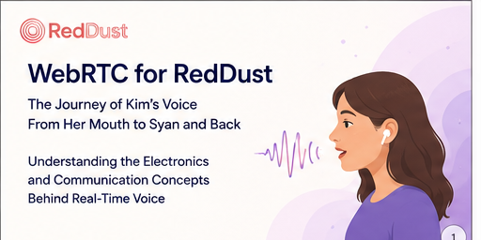

Slide 12
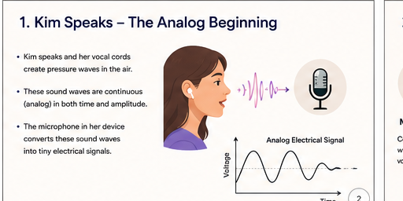

Slide 13
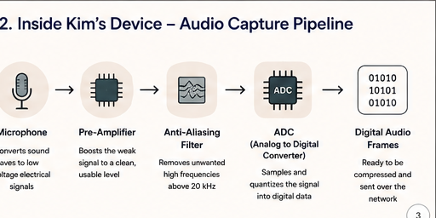

Slide 14
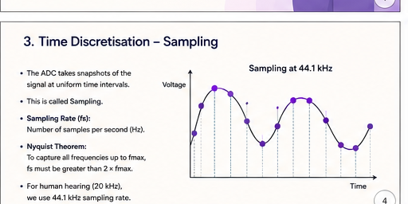

Slide 15
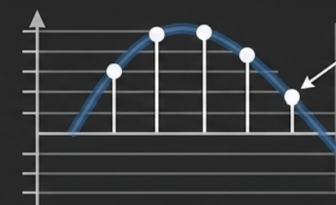
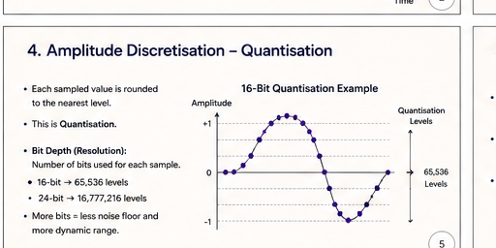

Slide 16
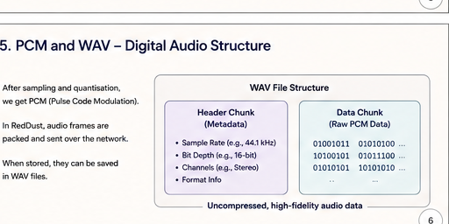

Slide 17
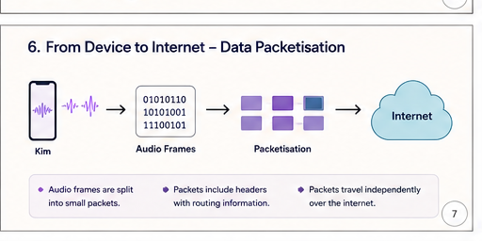

Slide 18
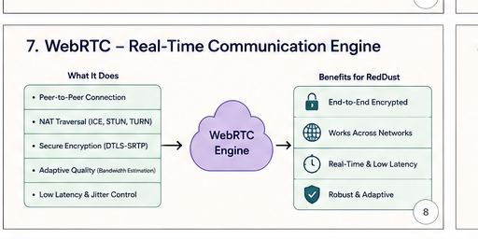
Network Address Translation
Interactive Connectivity Establishment
Session Traversal Utilities for NAT Traversal Using Relays around NAT
Datagram Transport Layer Security
Secure Real-time Transport Protocol

Slide 19
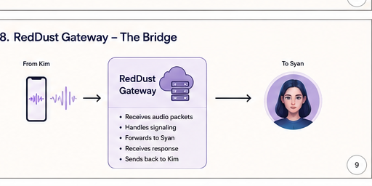


Slide 20
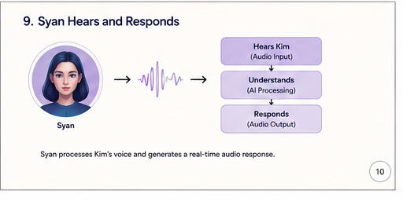

Slide 21
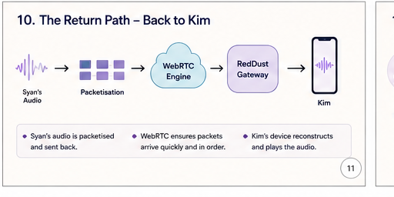

Slide 22
