Slide 1
RedDust – Customer Research
Idea validation presentation before survey
Listen to the music that listens to your soul.

Slide 2
The Problem
• Modern life is stressful, lonely and distracting
• Support is fragmented and often unavailable
• Music apps play music but don't understand you
• Wellbeing apps rarely personalise music

Slide 3
Our Vision
RedDust is an AI Wellbeing Companion and Personal Radio Jockey that understands you, recommends personalised music and conversations, and supports your wellbeing every day.

Slide 4

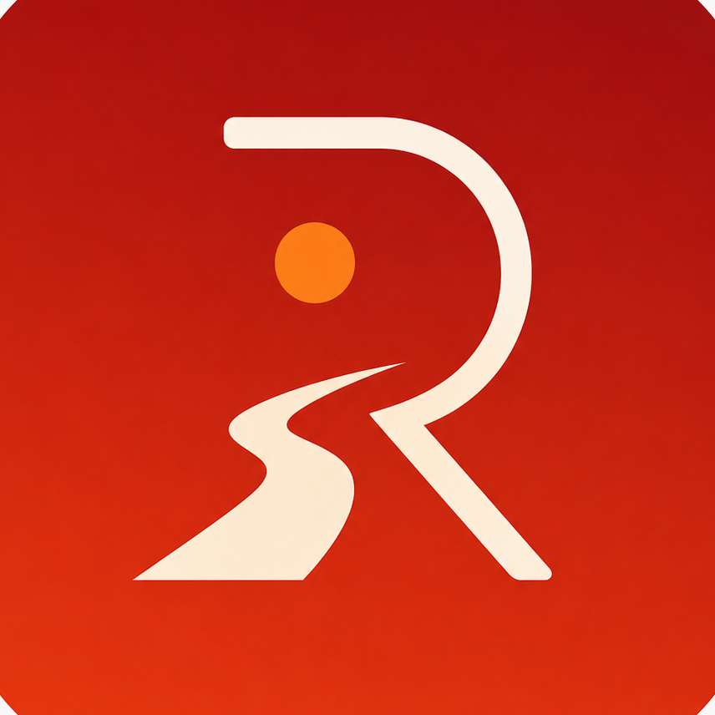
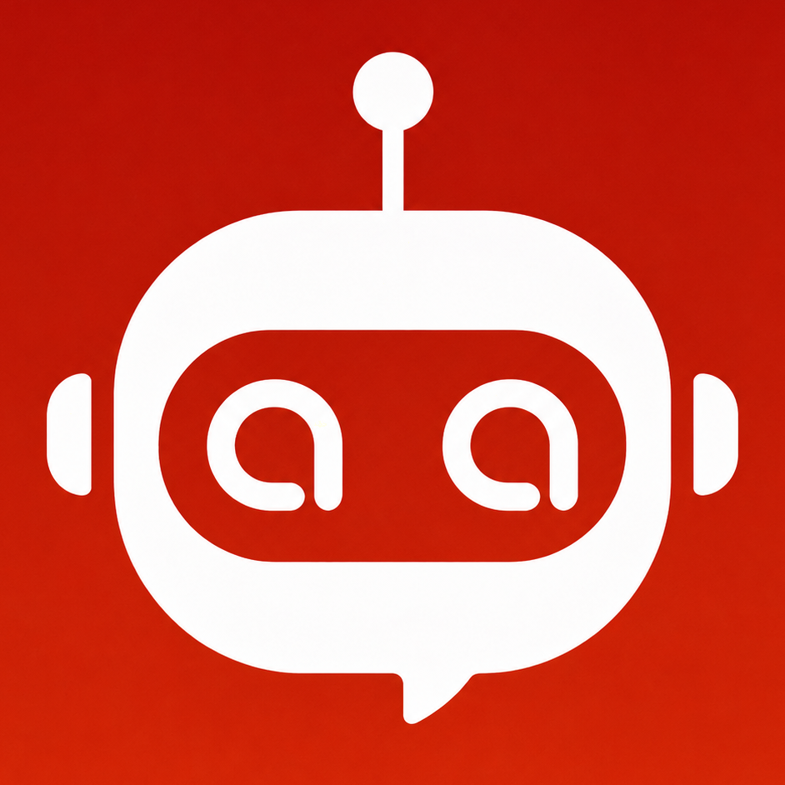
RedDust Listen to the radio that listens to your soul
AI-Powered Personalized Music and Wellbeing Platform
Vision: Creating personalized music that understands the listener - to energize, refresh, motivate, relax and uplift
Concept:
Personalized music recommendation and wellbeing companion that creates programs, not just playlists
Adapts to mood, situation, age, language and preferences
Supports music, karaoke, ambience and wellbeing
Powered by Syan Bot

Slide 5
How RedDust Works
• Talk naturally with Syan Bot
• Understand mood, activity & life situation
• Recommend personalised music & podcasts
• Learn continuously
• Track wellbeing over time

Slide 6

Syan Avatar

Slide 7

Sara, User Avatar
Sara 23,
Student (Psychology Bachelors), Sydney, Australia

Slide 8






10:10 am
10-Oct-2026
Login with Google
RedDust
Listen to the music
that listens to your soul
RedDust

Slide 9
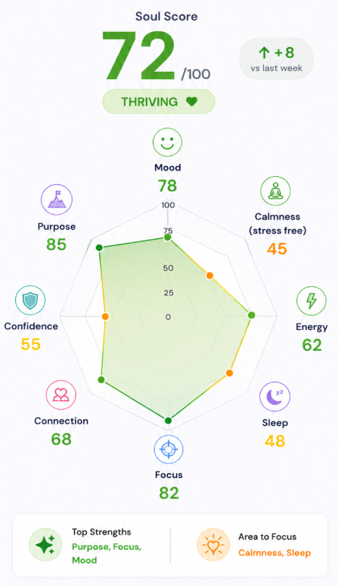
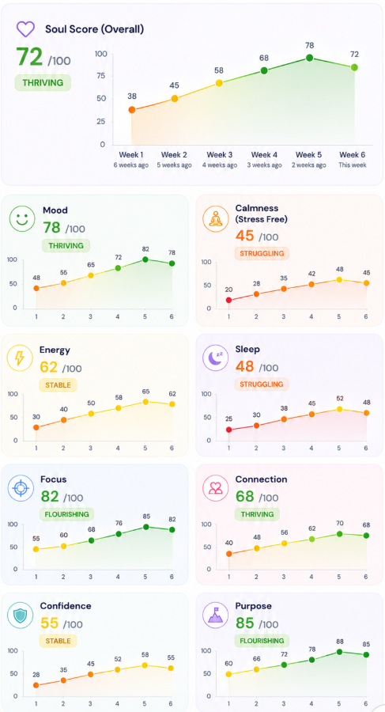




Hey Sara 💜 How are you feeling right now?
A bit tired.
New Question
Answer
With Syan
Soul Space
With Syan
Soul Space
With Syan
Soul Space

Slide 10
What Makes RedDust Different
• AI + Music + Wellbeing
• Personalised recommendations
• Dynamic Soul Score
• Explainable AI
• 24/7 companion

Slide 11
The Soul Score
Initially tracks Calmness, Energy, Focus, Motivation, Connection, Self-Belief, Purpose and Joy.
It adapts as your life changes.

Slide 12
Example Use Cases
• Exam preparation
• Daily commute
• Stress after work
• Exercise
• Relaxation before sleep

Slide 13
Privacy & Ethics
• You choose what to share
• Location is optional
• Not a medical device
• Not psychotherapy
• Everyday wellbeing companion

Slide 14
Why Your Feedback Matters
We are validating:
• The problem
• The solution
• The features
• Willingness to use and subscribe

Slide 15
Survey Instructions
Please answer honestly based only on this concept.
There are no right or wrong answers.
Your feedback will directly influence RedDust's design.

