Slide 1


Syan Bot Avatar
Sara Bot Avatar

Slide 2
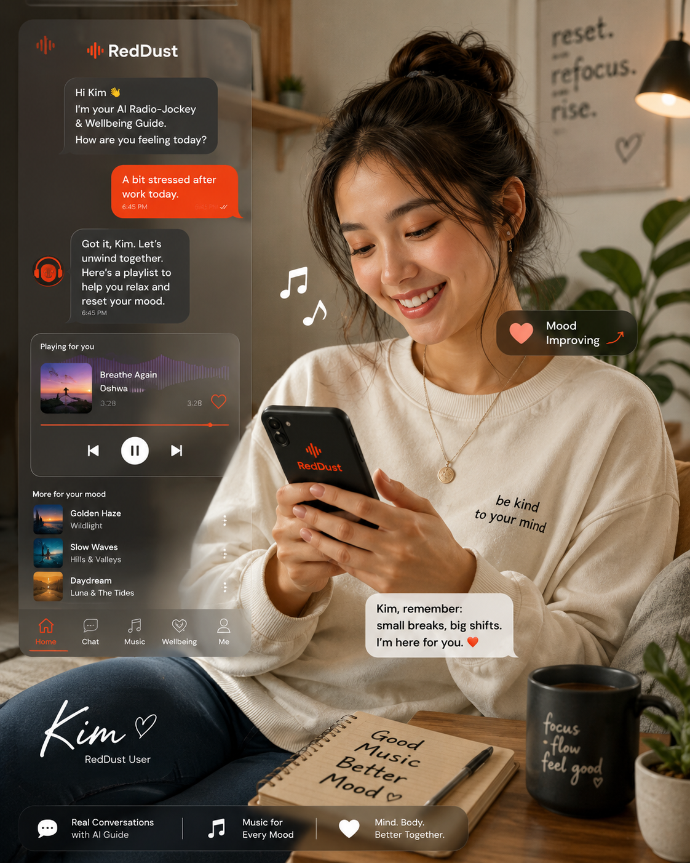
Kim, Sample User
Sara, User Avatar
Sara 23,
Student (Psychology Bachelors), Sydney, Australia

Slide 3






10:10 am
10-Oct-2026
Login with Google
RedDust
Listen to the music
that listens to your soul
RedDust

Slide 4

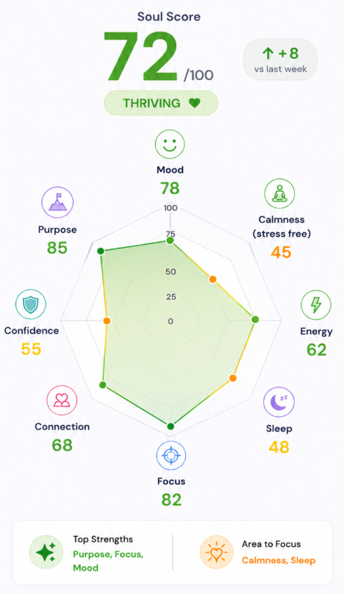
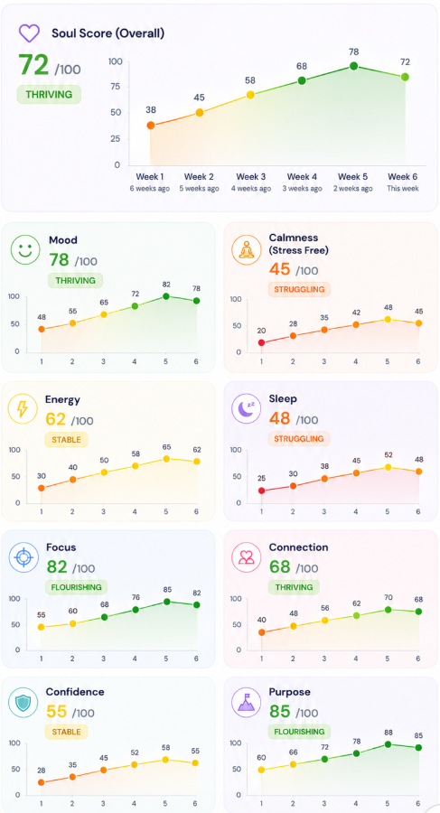


With Syan
Soul Space
With Syan
Soul Space
With Syan
Soul Space

Slide 5


Slide 6
Okay Syan, I am good and now play me my song 150
-165
100
127
-37
248
Kim
Kumar
FAST API
-1
0
1
-7
-3 2
Syan’s answer to Kim (session, context) against: Okay Syan, I am good and now play me my song,
Link of 2-3 recommended tracks (not been sent in the recent past unless specifically requested)
POST
Bobby
“Shh! Are you asleep?”
125
-125
10
17
-67
-48
Gemini Flash 3.1 Live + RAG
“I am glad to hear that, Like to listen to these?
Syan’s answer to Kim (session, context) against: Okay Syan, I am good and now play me my song,
Emotion
Link of 2-3 recommended tracks (not been sent in the recent past unless specifically requested)
John

Slide 7
10:10 am
10-Oct-2026
Login with Google
RedDust
Listen to the music
that listens to your soul
RedDust

Slide 8




With Syan
With Sara
Soul Space
With Syan
Soul Space
With Sara
Soul Space
With Syan
Soul Space

Slide 9
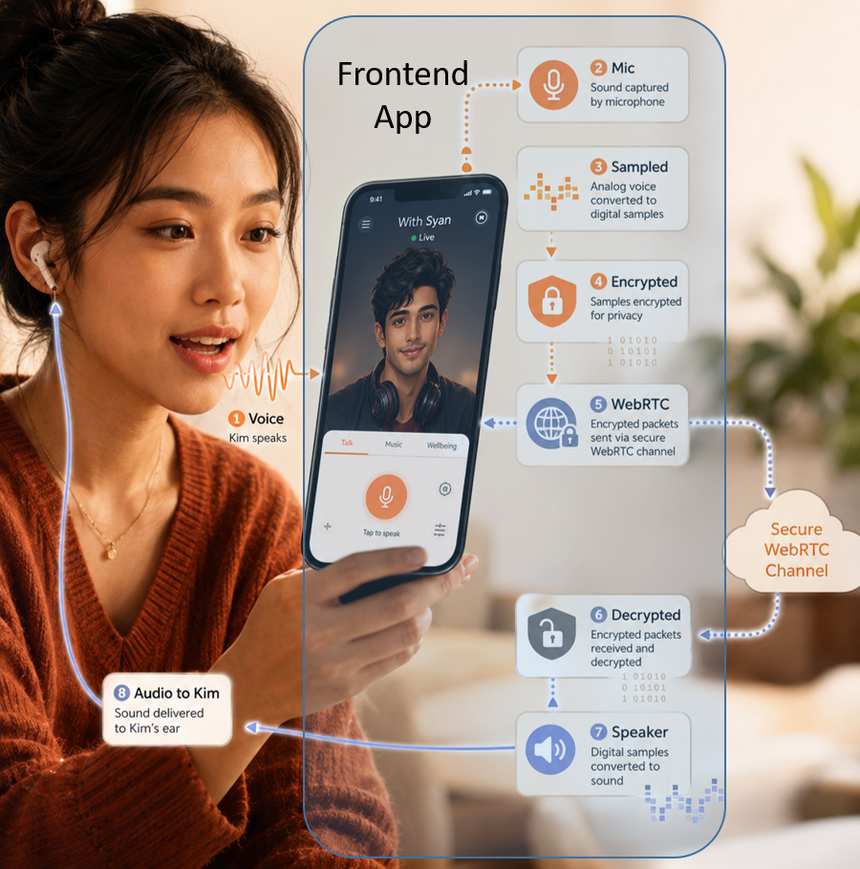




Session Context
=Encrypt(Hello!)
Hello!
12, 13, 29, 0, -67, -57, 128, -10
Duplex, Secure WebRTC
Channel through Internet
Hello
Gateway
How are you!
22, -13, 9, -10, 7, -5, 28, 0,
Hello!How are you!
Hello!How are you!
12, 13, 29, 0, -67, -57, 128, -10, 22, -13, 9, -10, 7, -5, 28, 0,
=Encrypt(Hello!How are you!)

Slide 10
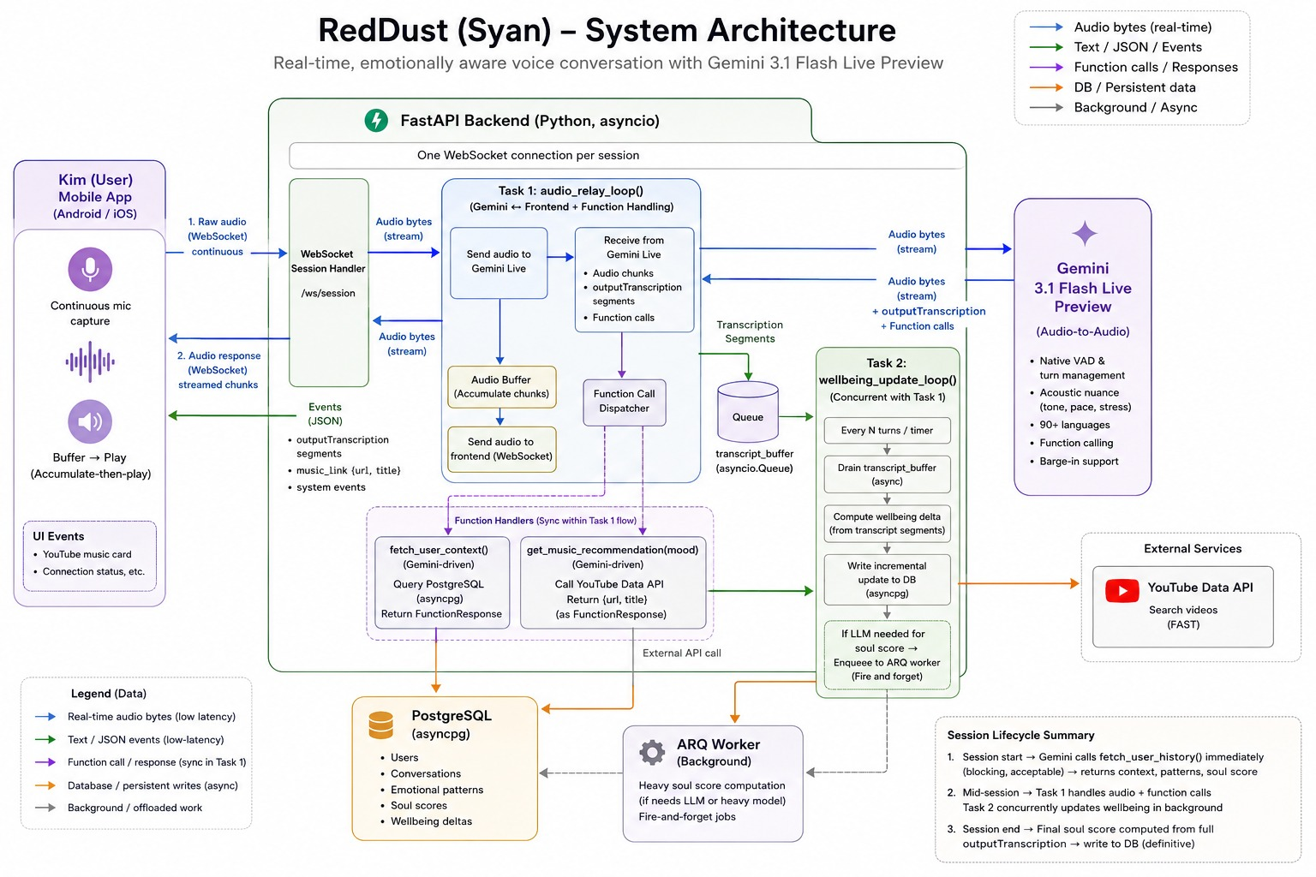

Slide 11
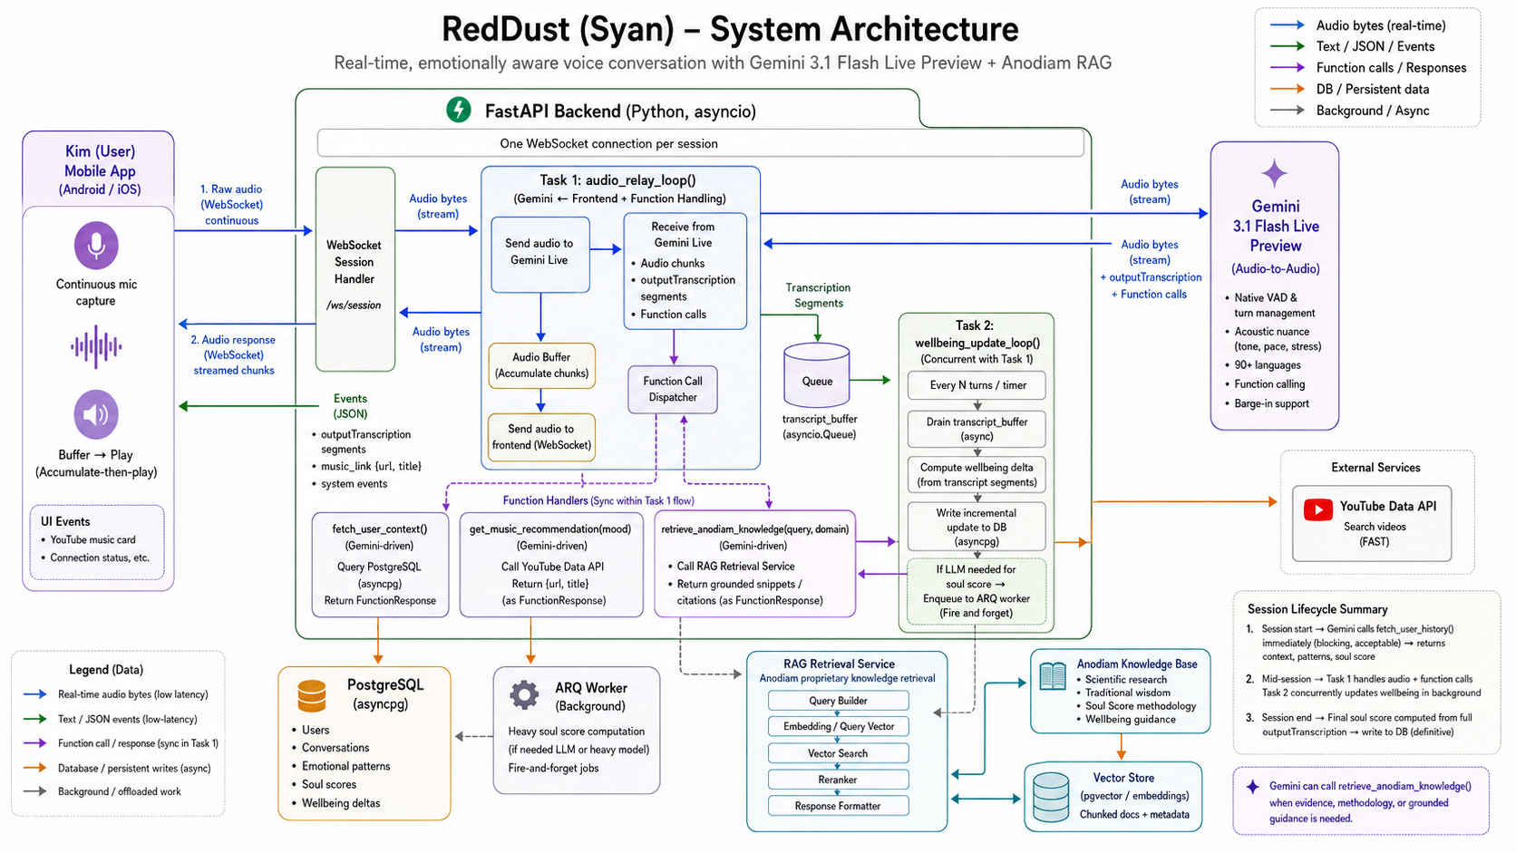

Slide 12
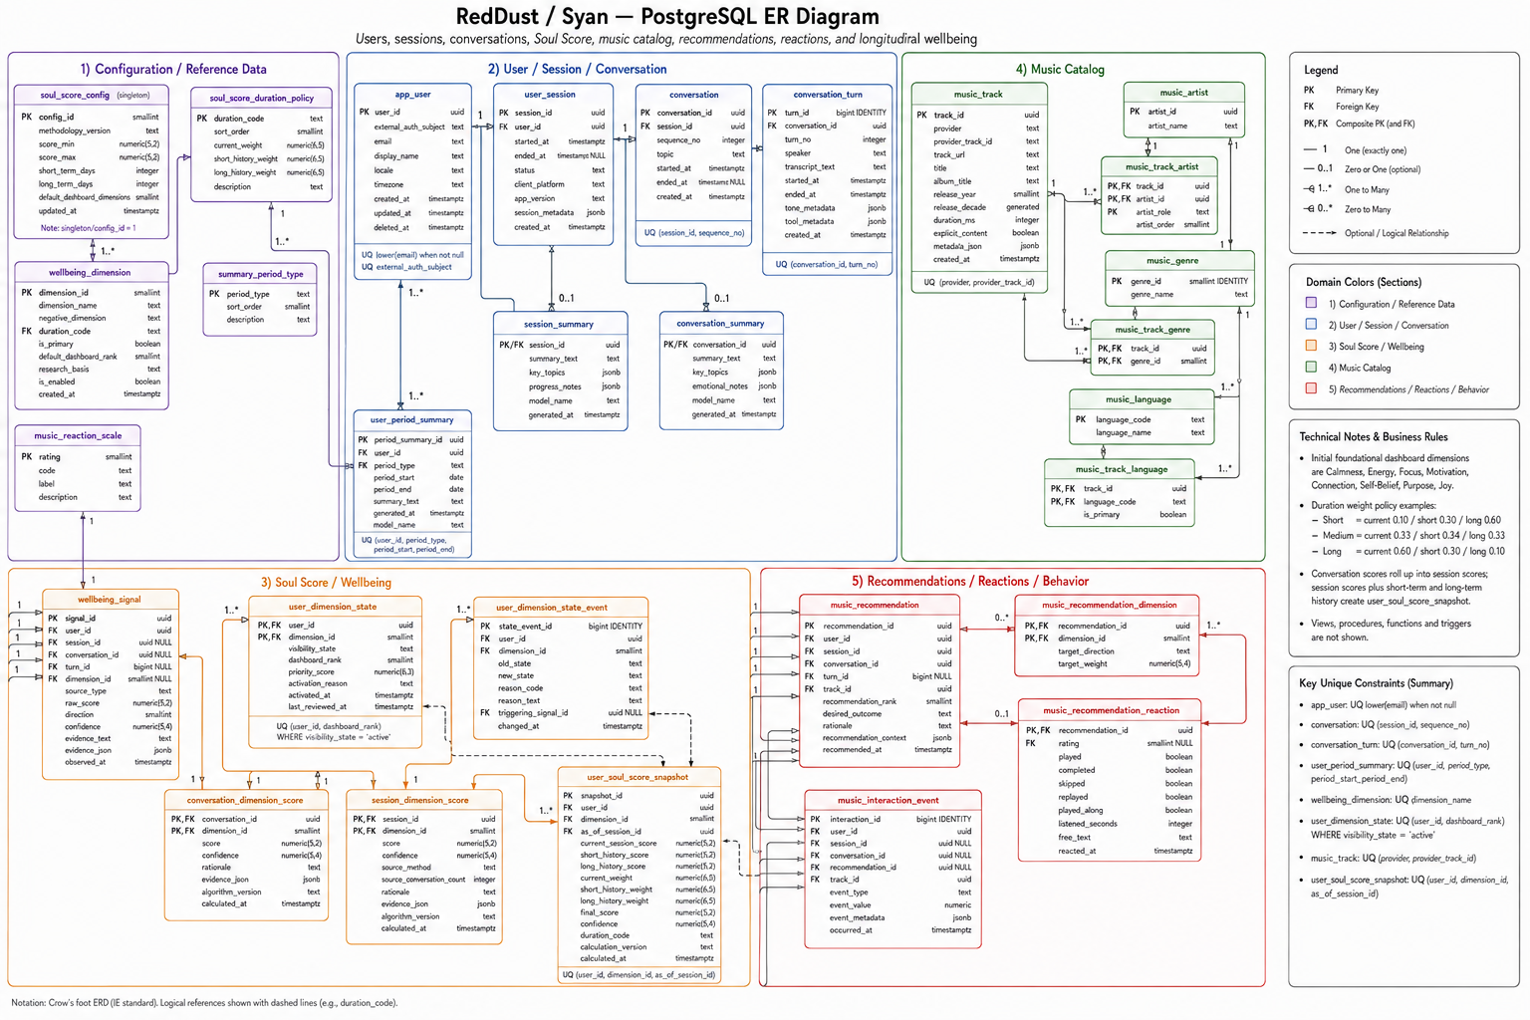

Slide 15
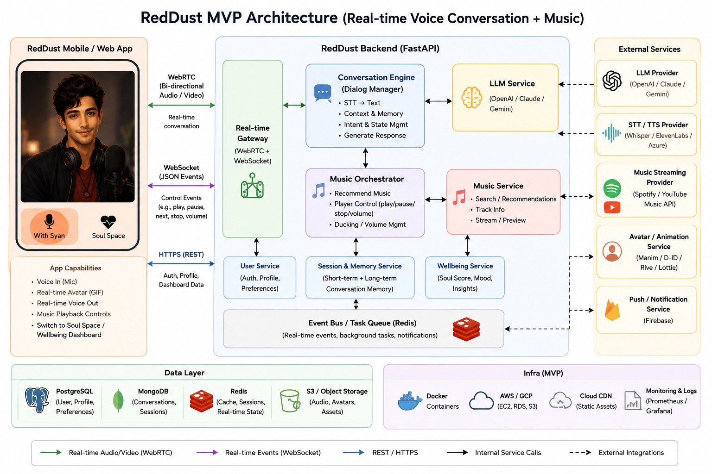


Slide 16
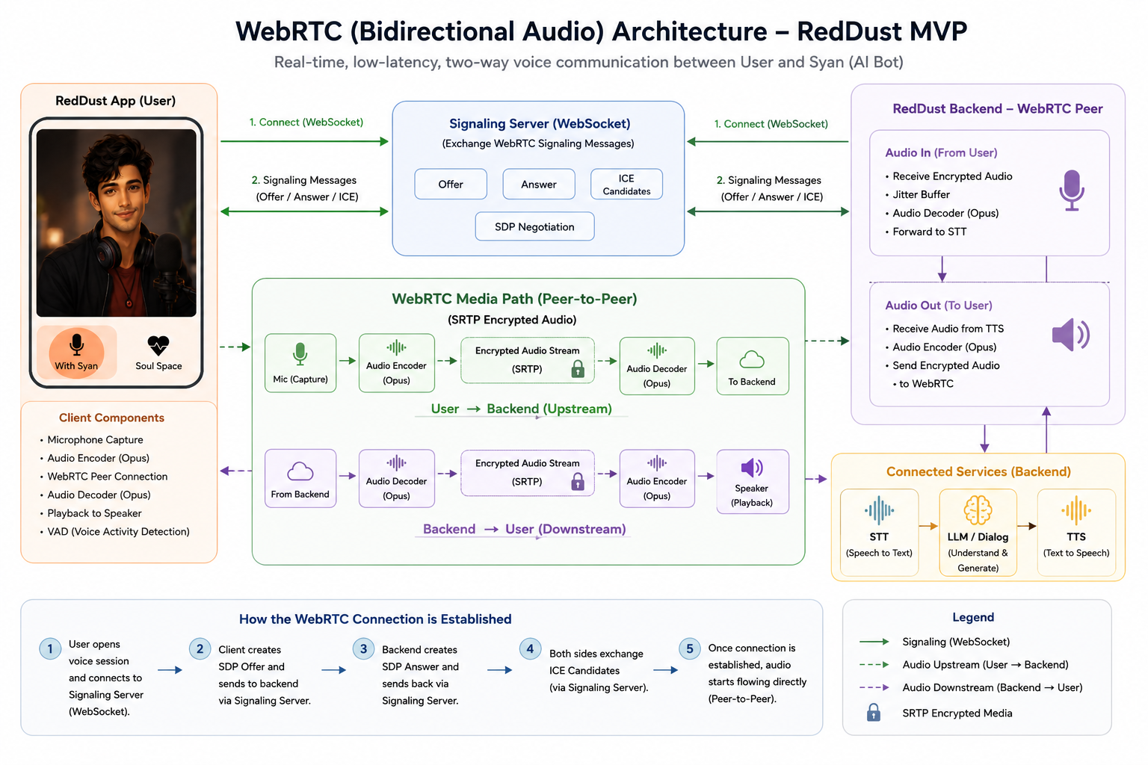

Slide 17
512
150
-165
100
127
-37
248
170
-185
120
147
-57
255

