Slide 1
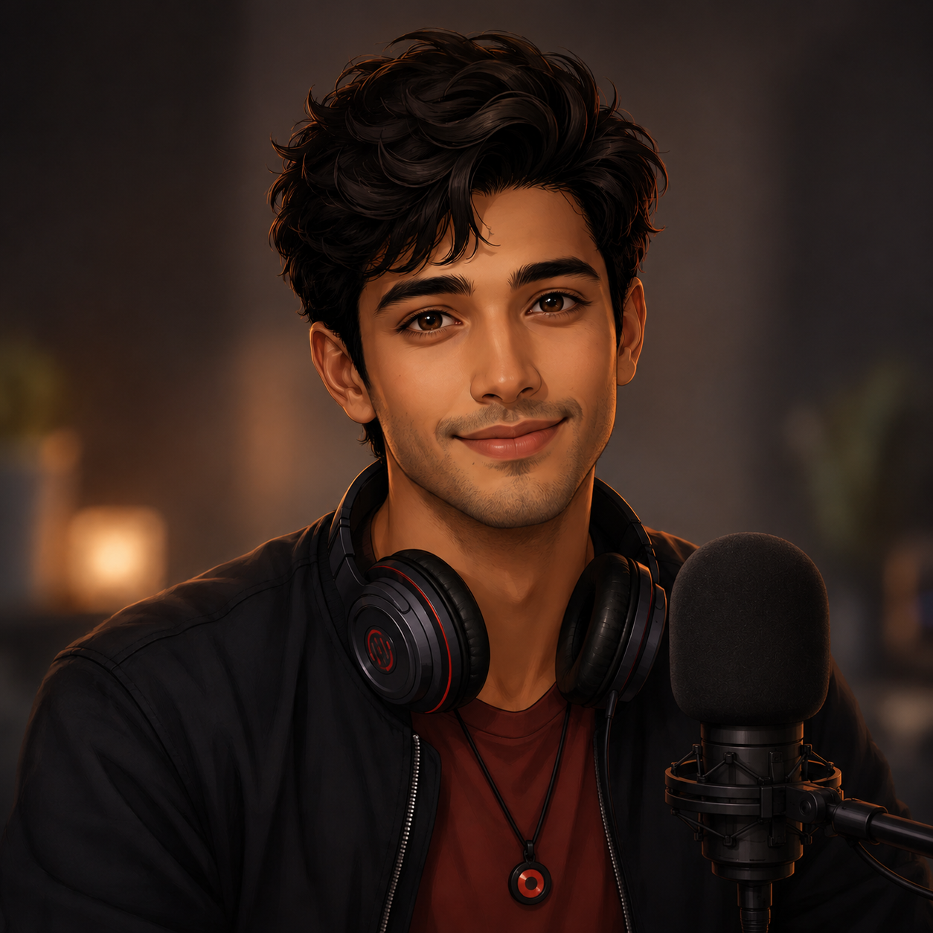
Syan Avatar

Slide 2
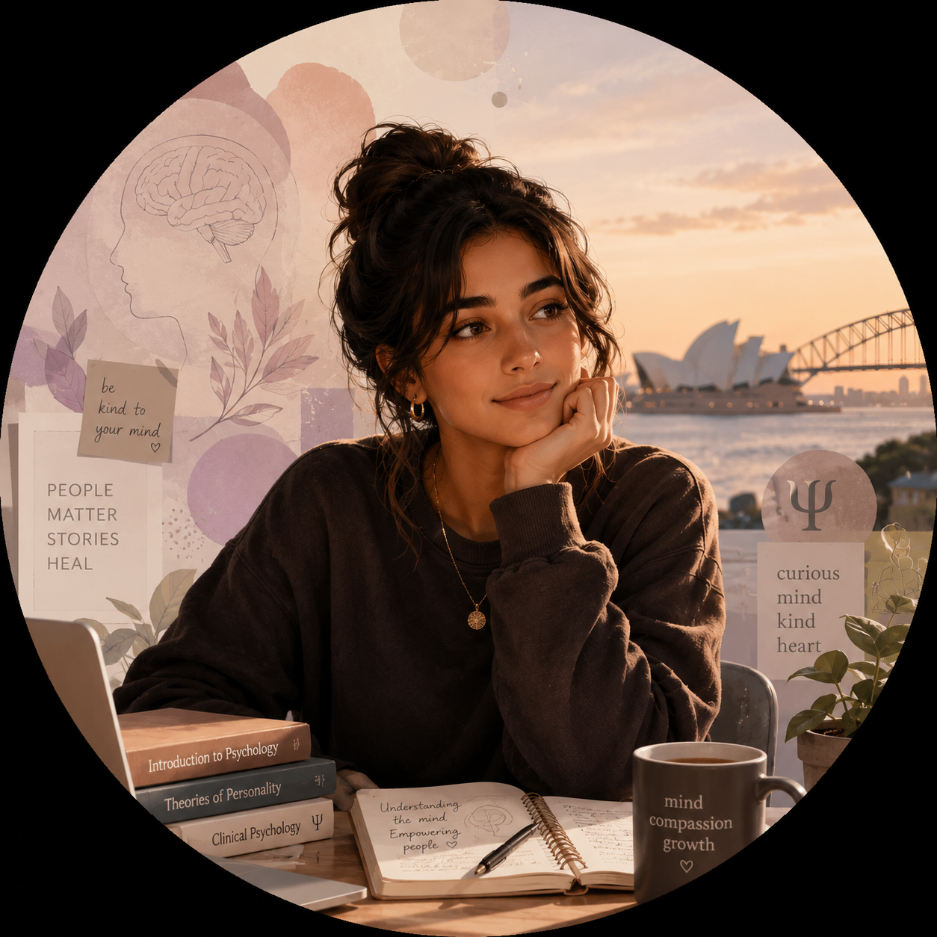
Sara, User Avatar
Sara 23,
Student (Psychology Bachelors), Sydney, Australia

Slide 3






10:10 am
10-Oct-2026
Login with Google
RedDust
Listen to the music
that listens to your soul
RedDust

Slide 4

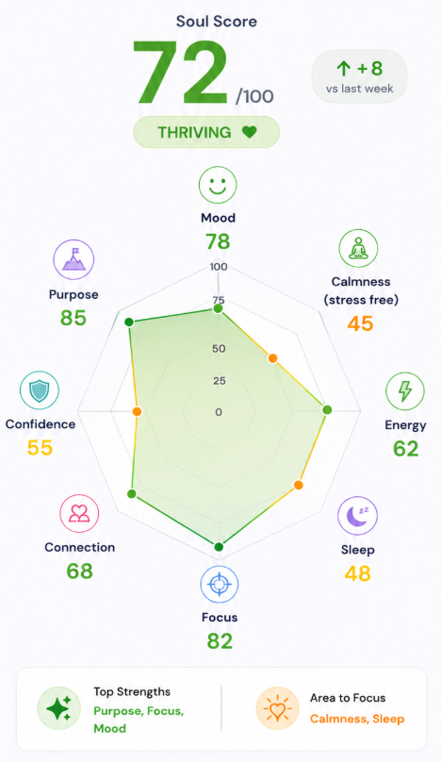
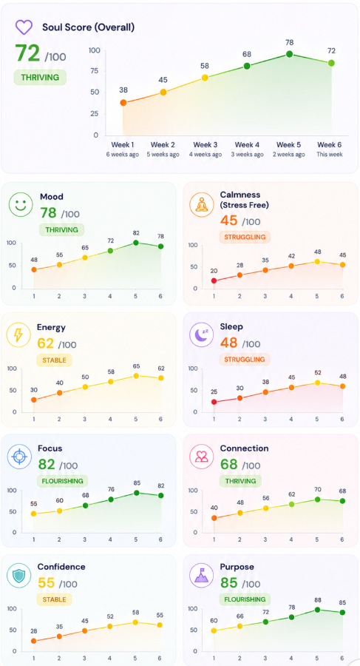


With Syan
Soul Space
With Syan
Soul Space
With Syan
Soul Space

Slide 5


Slide 6
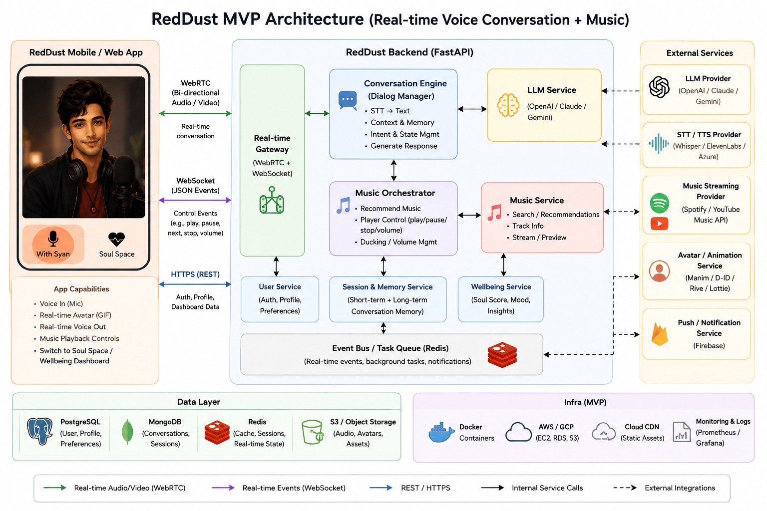

Slide 7
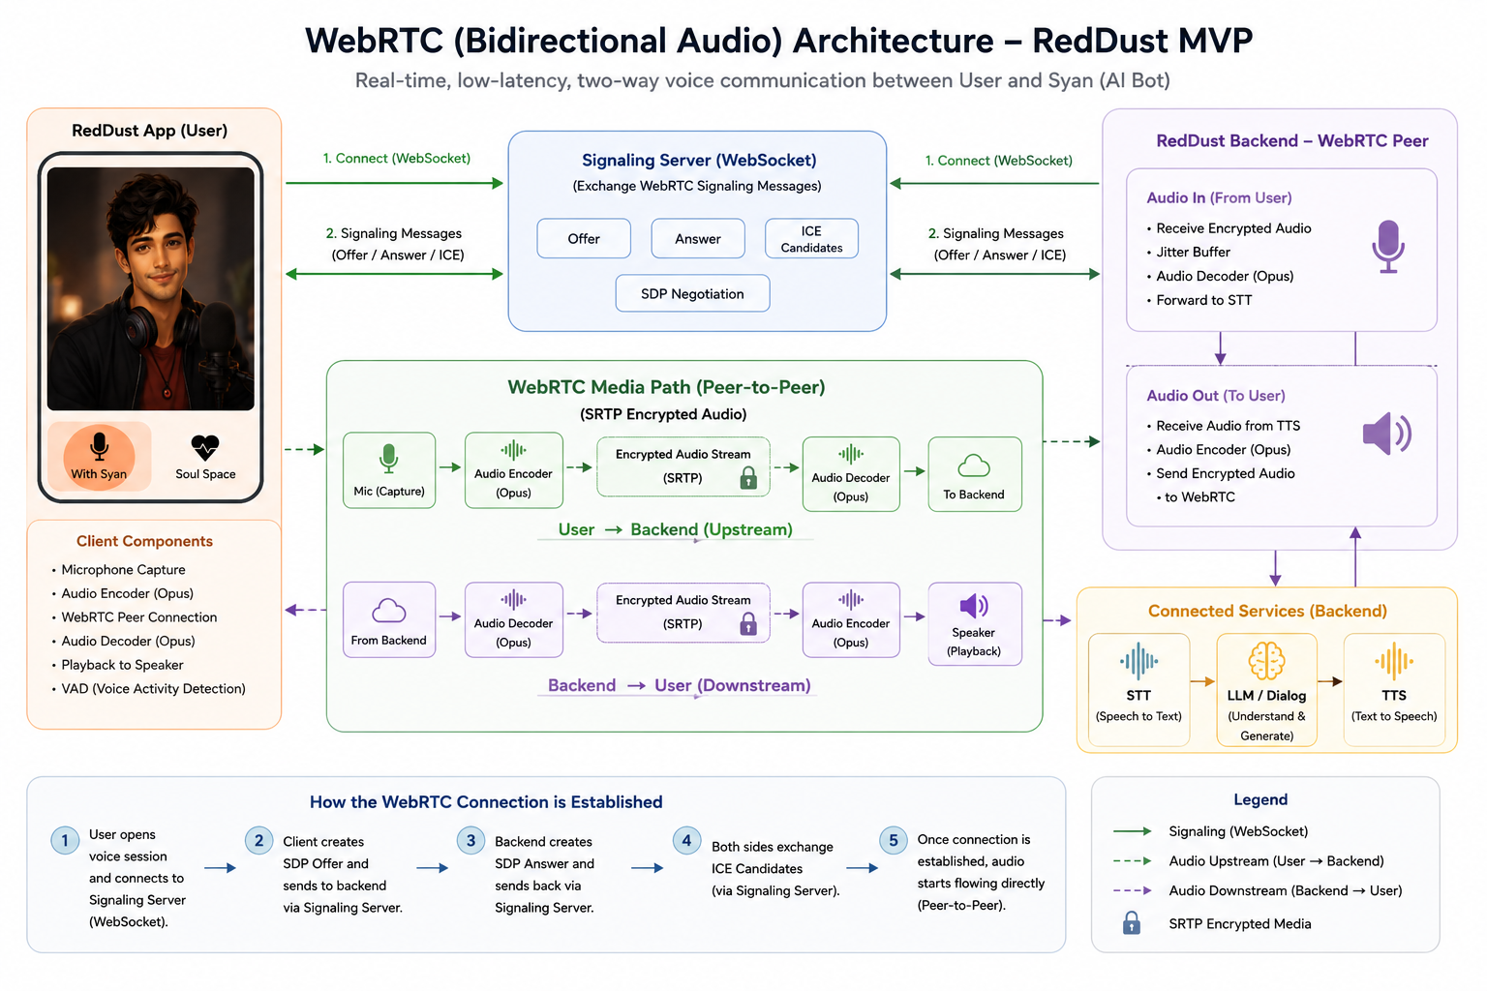

Slide 8
150
-165
100
127
-37
248
170
-185
120
147
-57
255

Slide 9
A
150
-165
100
127
-37
248
-1
0
1
-7
-3 2
“Nice to hear that, here is your song!”
B
“Shh! Are you asleep?”
125
-125
10
17
-67
-48
“I am glad to hear that, Like to listen to these?

