Slide 1

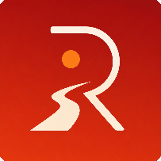
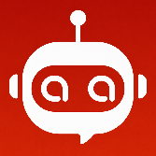
RedDust Listen to the radio that listens to your soul
AI Based RJ and Wellbeing Companion Helping people improve wellbeing, focus, resilience and motivation through personalized music and interaction
UNSW Founders’ Members:
Anirban Chakrabarty
Tanvi Multani
Anodiam Members:
Sayan Basak
Soubhanik Patra
Nathan Young
Mannat Gupta
Powered by Syan Bot

Slide 2
RedDust Listen to the radio that listens to your soul
Problem – Modern Life is Breaking Human Wellbeing
People increasingly struggle with:
Stress and anxiety
Loneliness and social isolation
Lack of motivation
Poor focus and productivity
Digital overload
Existing solutions are fragmented:
Music apps play songs
Wellness apps track wellbeing
AI assistants answer questions
None combine AI driven, personalized wellbeing with music-based intervention.
Powered by Syan Bot

Slide 3
RedDust Listen to the radio that listens to your soul
Solution – RedDust: AI Radio Jockey and Wellbeing Companion
It combines:
Conversational AI
Behavioral science
Personalized music
Mood and wellbeing tracking
RedDust understands:
Your mood
Current situation
Goals
Preferences
Listening history
And creates personalized experiences that guide you through your day.
Powered by Syan Bot

Slide 4
RedDust Listen to the radio that listens to your soul
Product Experience – A Day with RedDust
Morning:
“Help me focus for work."
RedDust Creates:
Focus playlist
Productivity guidance
Motivational check-in
Afternoon:
“I am feeling stressed."
RedDust Creates:
Stress recovery music
Guided reflection
Emotional support conversation
Evening:
“I want to relax."
RedDust Creates:
Relaxation journey
Personal radio experience
Sleep preparation playlist
Outcome: Improved mood, resilience and wellbeing throughout the day.
Powered by Syan Bot

Slide 5
RedDust Listen to the radio that listens to your soul
Why We Win
Unlike music streaming platforms, RedDust is not just recommending songs.
RedDust delivers:
AI-generated radio experiences
Mood-aware playlists
Personal wellbeing guidance
Family-friendly and child-safe modes
Mental health trend monitoring
Voice-based interaction
Music becomes a wellbeing intervention, not merely entertainment.
Powered by Syan Bot

Slide 6
RedDust Listen to the radio that listens to your soul
Market Opportunity
Initial Markets:
Students
Working professionals
Parents
Retirees
Expansion Markets:
Schools
Universities
Corporate wellbeing
Healthcare and aged care
Global Trends:
Digital wellbeing
AI companions
Mental health technology
Personalized content
Combined TAM exceeds tens of billions of dollars globally
Powered by Syan Bot

Slide 7
RedDust Listen to the radio that listens to your soul
Core Technology Platform
AI Layer
Large Language Models
Personalization Engine
Mood Detection
Recommendation Engine
Music Layer
Streaming integrations
Playlist generation
Smart ranking
Child-safe filtering
Wellbeing Layer
Wellbeing scoring
Behavioral insights
Progress tracking
Personalized interventions
Powered by Syan Bot

Slide 8
RedDust Listen to the radio that listens to your soul
Business Model
Freemium Consumer Model
Free:
Basic playlists
Limited AI interactions
Subscription + Trial Version:
Unlimited AI companion
Advanced wellbeing insights
Personal radio shows
Family accounts
Child-safe experiences
Future Revenue:
Schools
Corporate wellbeing
Healthcare partnerships
Premium content partnerships
Powered by Syan Bot

Slide 9
RedDust Listen to the radio that listens to your soul
Go-To-Market
Phase 1:
Beta users
Families
Students
Early adopters
Phase 2:
Social media growth
Influencer partnerships
Community-driven expansion
Phase 3:
Schools
Universities
Corporate wellness programs
Growth Channels:
LinkedIn
YouTube
TikTok
Parent communities
Powered by Syan Bot

Slide 10
RedDust Listen to the radio that listens to your soul
Vision
We believe music is one of humanity's most powerful tools for wellbeing.
Our Vision:
To become the world's most trusted AI wellbeing companion, helping millions of people improve happiness, resilience, productivity and quality of life through personalized conversations and music.
Seeking:
Strategic partners
Pilot customers
Investors
Advisors
RedDust – The future of AI-powered wellbeing.
Powered by Syan Bot

Slide 11
Syan Bot
LLM
RAG Docs
Chat
Primary I/P
Feedback
Chat Conversation .
Feedback
Reco
RJ Talk
Primary I/P
Reco
RJ Talk
WellBeing Checkin
Auth
Impersonation Test Bot
Recommended
Track List
WellBeing Checkin
User History
User Profile
User Profile
User History
Wellbeing Score User1.1
Wellbeing Score User1.2
…
Wellbeing Score User1.N
Wellbeing Matrix M users & N days
Wellbeing Score User2.1
Wellbeing Score User2.2
…
Wellbeing Score User2.N
Avg(WS1.p)<=Avg(WS2.p)<=…<=Avg(WSM.p)
STD(WS1)~=STD(WS2)~=…~=STD(WSM)
…
…
…
Wellbeing Score UserM.1
Wellbeing Score UserM.2
…
Wellbeing Score UserM.N

Slide 12





10:10 am
10-Oct-2026
Login with Google
RedDust
Listen to the music
that listens to your soul
RedDust

Slide 13




Hey Sara 💜 How are you feeling right now?
Hey Sara 💜 How are you feeling right now?
A bit tired.
A bit tired.
New Question
New Question
Answer
Answer
With Syan
Soul Space
With Syan
Soul Space

Slide 14



Gender
Locale
Full Name
Local Time
Login with Google
DoB
Current Date
Preferred Languages
High Priority first. Type in others.
English
Mandarin
Hindi
Spanish
Arabic
French
Bengali
Portuguese
Preferred Genres & Decades
High Priority first. Type in others.
Pop
Rock
Rap/ Hip Hop
Electro
Latin
80s
90s
Favorite Artists/ Bands
Most favorites first. Type in others.
Bob Marley
MJ
Kenny G
Black Pink
Kishore Kumar
Music
Wellbeing
Profile

Slide 15




Hey Sara 💜 How are you feeling right now?
A bit tired.
New Question
Answer
Music
Wellbeing
Profile
Music
Wellbeing
Profile

Slide 16
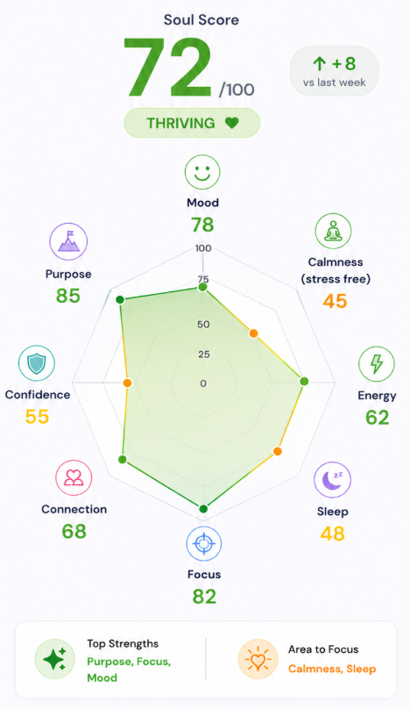
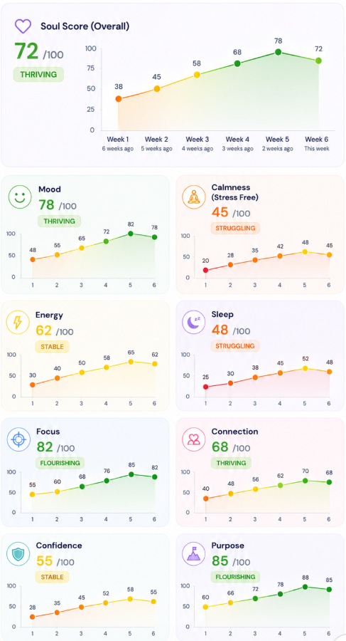

View Your Wellbeing Trend
Music
Wellbeing
Profile
Music
Wellbeing
Music
Profile

Slide 17
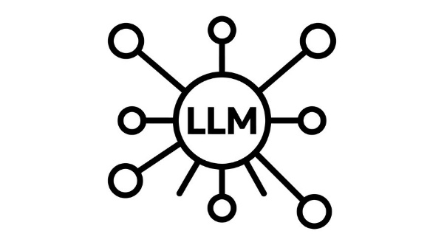
Json {Empty}
Hey Sara 💜 How are you feeling right now?
RAG
Json {Updated 1}
A bit tired.
Json {Updated 2}
Hey Sara 💜 How are you feeling right now?
Json {Empty}
Json {Updated 1}
A bit tired.
Json {Updated 2}
Hey Sara 💜 How are you feeling right now?
Music
Wellbeing
Profile

