Slide 1
Syan Bot
LLM
RAG Docs
Chat
Primary I/P
Feedback
Chat Conversation .
Feedback
Reco
RJ Talk
Primary I/P
Reco
RJ Talk
WellBeing Checkin
Auth
Impersonation Test Bot
Recommended
Track List
WellBeing Checkin
User History
User Profile
User Profile
User History
Wellbeing Score User1.1
Wellbeing Score User1.2
…
Wellbeing Score User1.N
Wellbeing Matrix M users & N days
Wellbeing Score User2.1
Wellbeing Score User2.2
…
Wellbeing Score User2.N
Avg(WS1.p)<=Avg(WS2.p)<=…<=Avg(WSM.p)
STD(WS1)~=STD(WS2)~=…~=STD(WSM)
…
…
…
Wellbeing Score UserM.1
Wellbeing Score UserM.2
…
Wellbeing Score UserM.N

Slide 2






10:10 am
10-Oct-2026
Login with Google
RedDust
Listen to the music
that listens to your soul
RedDust

Slide 3




Hey Sara 💜 How are you feeling right now?
Hey Sara 💜 How are you feeling right now?
A bit tired.
A bit tired.
New Question
New Question
Answer
Answer
With Syan
Soul Space
With Syan
Soul Space

Slide 4



Gender
Locale
Full Name
Local Time
Login with Google
DoB
Current Date
Preferred Languages
High Priority first. Type in others.
English
Mandarin
Hindi
Spanish
Arabic
French
Bengali
Portuguese
Preferred Genres & Decades
High Priority first. Type in others.
Pop
Rock
Rap/ Hip Hop
Electro
Latin
80s
90s
Favorite Artists/ Bands
Most favorites first. Type in others.
Bob Marley
MJ
Kenny G
Black Pink
Kishore Kumar
Music
Wellbeing
Profile

Slide 5




Hey Sara 💜 How are you feeling right now?
A bit tired.
New Question
Answer
Music
Wellbeing
Profile
Music
Wellbeing
Profile

Slide 6
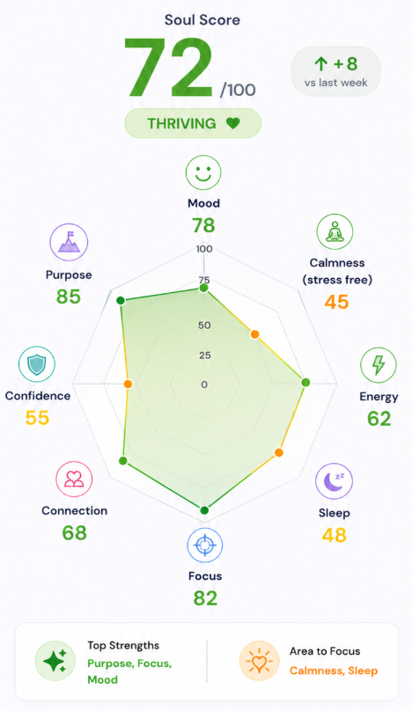
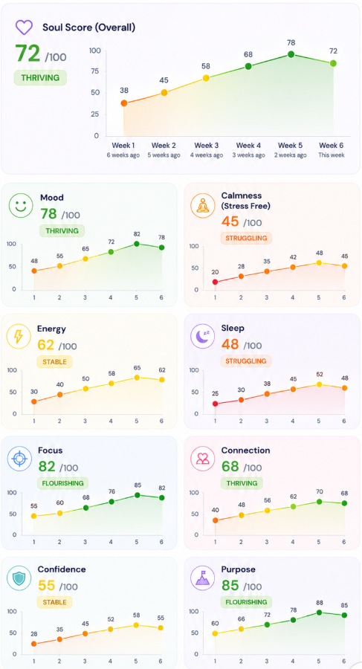

View Your Wellbeing Trend
Music
Wellbeing
Profile
Music
Wellbeing
Music
Profile

Slide 7

Json {Empty}
Hey Sara 💜 How are you feeling right now?
RAG
Json {Updated 1}
A bit tired.
Json {Updated 2}
Hey Sara 💜 How are you feeling right now?
Json {Empty}
Json {Updated 1}
A bit tired.
Json {Updated 2}
Hey Sara 💜 How are you feeling right now?
Music
Wellbeing
Profile

