Slide 1



Existing Application
Immediate Planned Enhancements
DNS Server
URL: https://celrevive.com/
New/ Enhanced API/ Services
Frontend Enhancements
Existing Frontend
API/ Backend Services
Questionnaire
User Image Analysis
Recommendation
User Profile Detail
Fix Existing Issues
Authentication UI
User Profile UI (Partial)
Shopping Cart (UX Issues)
Create Order (UX Issues)
Purchase - Card etc. (Issues)
Product Database (Ingredients
+ Base + Compatibility engine)
AI Image Analysis Service
AI Profile Analysis Service
Recommendation Service
Image, Questionnaire & Profile based
Complete User Profile Backend API
Authentication Service
User Profile API
Shopping Cart
Order Service
Purchase API
…

Slide 2
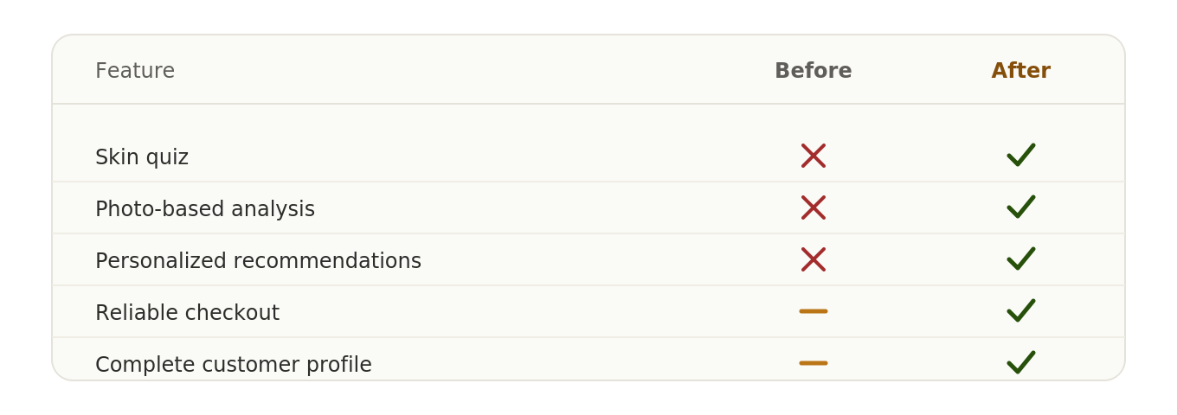


Slide 3
BEFORE
User devices
AFTER
DNS server
celrevive.com
User devices
DNS server
celrevive.com
Shopify frontend
Auth UI, cart, checkout (UX issues)
Shopify frontend
Auth UI, cart, checkout
Frontend enhancements
Questionnaire, image, recommendations
API / backend services
Auth, profile, cart, order, purchase
API / backend
Auth, profile, cart, orders
New / enhanced APIs
AI image + profile, recommendations
Known limitations: UX friction in shopping cart, order
creation, and card purchase flow
Milestone: AI-powered personalization live, existing UX
issues resolved end to end

Slide 4
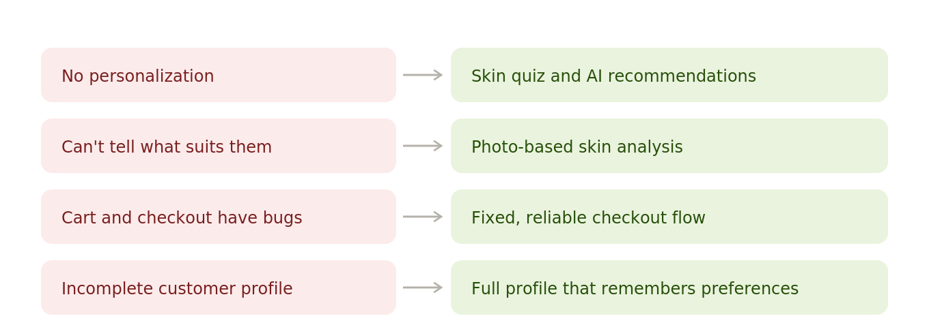


Slide 5









Personalized Formulation Architecture
OUR CORE IP
Photo + Questionnaire
AI Skin Analysis
Proprietary Formulation Engine
Personalized Formulation
Trust Layer
Customer selfie & skin profile
Gemini vision reads skin concerns
Matches concerns to the optimal active + base combination from a scientifically-scored ingredient library
Explained in plain language
Every decision logged & explainable
Joint Active–Base Matching
Compatibility Ranking
Automatic Safety Screening
AI Explainability & Auditing
Best ingredient set and base are selected together — not sequentially — for maximum efficacy.
Every base is scored against skin type, climate and sensitivity, not just filtered pass/fail.
Ingredient–ingredient incompatibilities and pH conflicts are caught before a formula is generated.
Every step is clear and explainable , setting the stage for scaling and improvements from collected data
CelRevive × Anodiam — Confidential

Slide 6
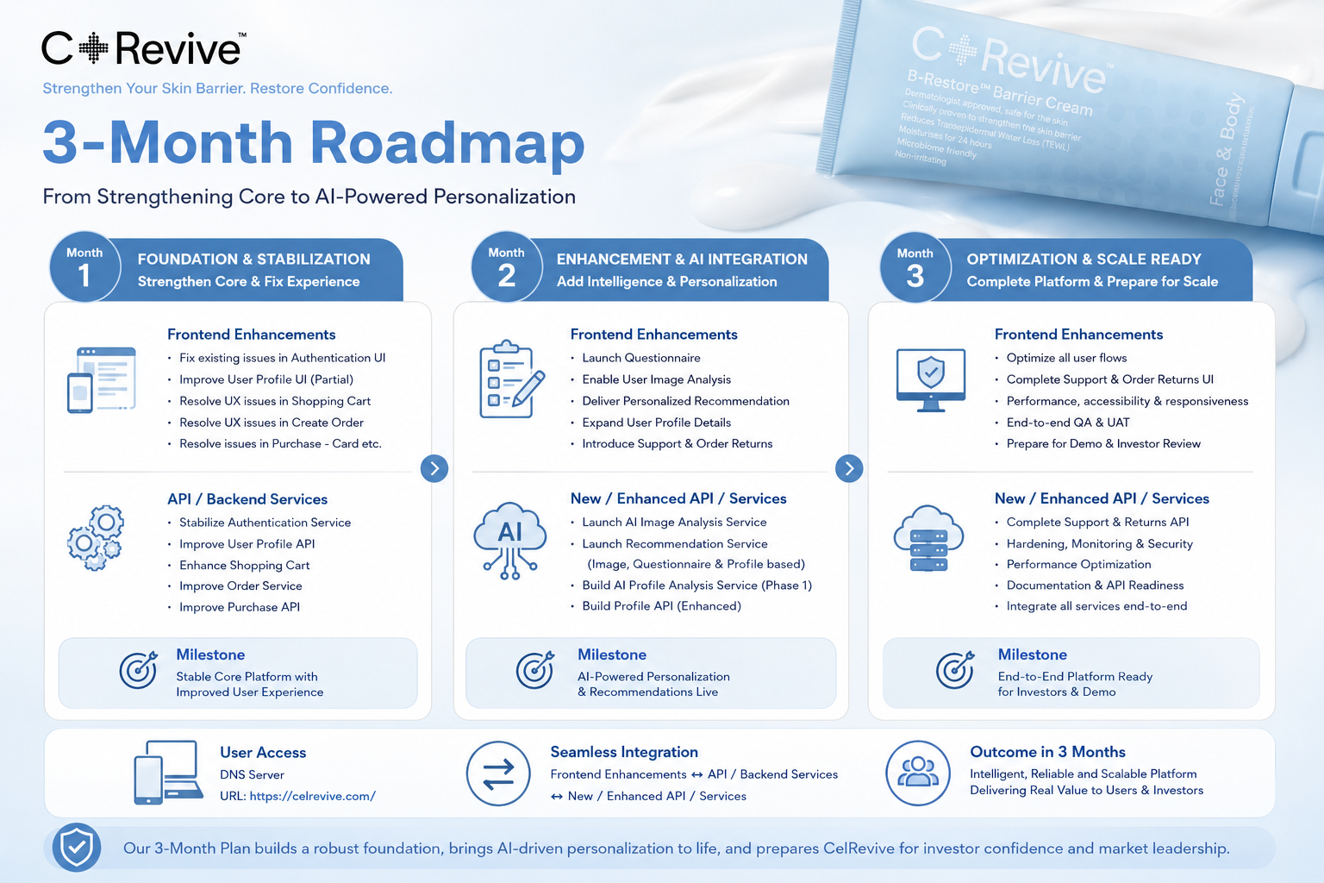

Slide 7
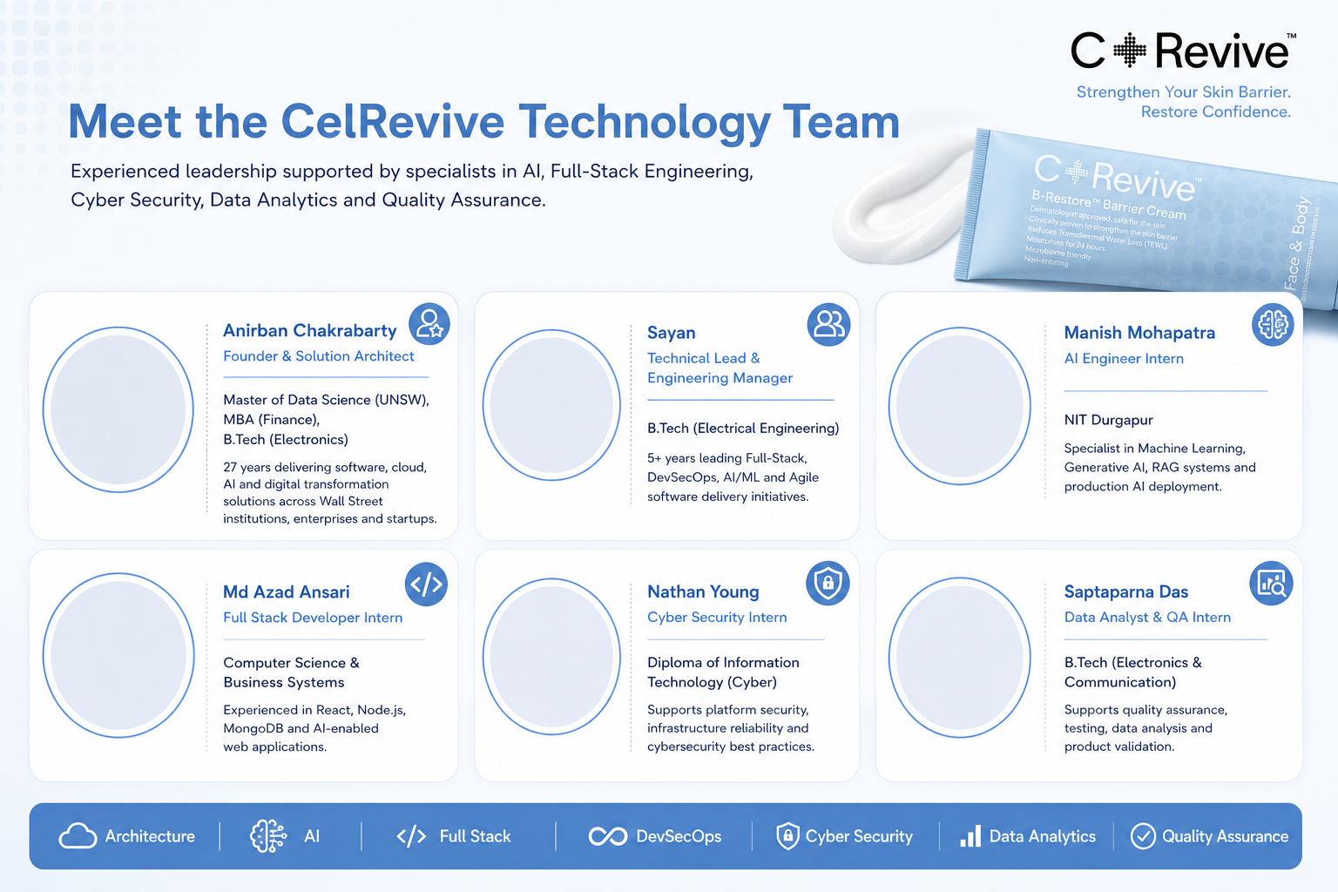







Slide 8
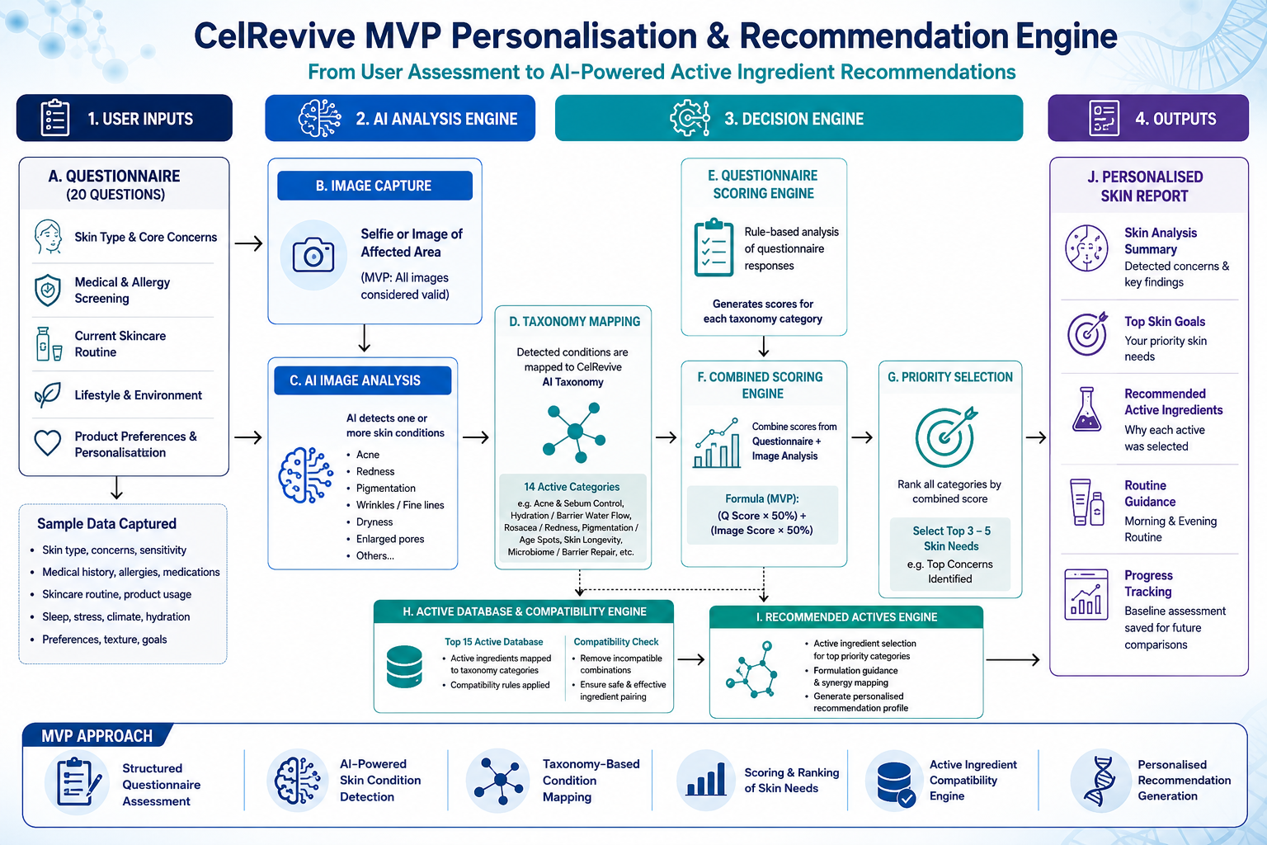

Slide 9
