Slide 1



DNS Server
URL: https://celrevive.com/
New/ Enhanced API/ Services
Frontend Enhancements
Existing Frontend
API/ Backend Services
AI Image Analysis Service
Recommendation Service
Image, Questionnaire & Profile based
AI Profile Analysis Service (?)
Profile API (?)
Support & Returns API (?)
Questionnaire
User Image Analysis
Recommendation
Profile Detail Out (?)
Support & Order Returns (?)
Fix Existing Issues (?)
Authentication UI
User Profile UI (Partial)
Shopping Cart (UX Issues)
Create Order (UX Issues)
Purchase - Card etc. (Issues)
Auth Service
User Profile API
Shopping Cart
Order Service
Purchase API
…

Slide 2
Questionnaire + answers {demographic, lifestyle, issues, etc.}
AI 1
skin_concerns (SC00--, SC20--)
skin type?
skin_concerns: {
skin_concern_id: 0, skin_concern_name: "Dry Skin“, certainity_pc: null, severity_pc: null,
skin_concern_id: 1, skin_concern_name: "Dehydrated Skin“, certainity_pc: null, severity_pc: null,
skin_concern_id: 2, skin_concern_name: "Compromised Skin Barrier“, certainity_pc: null, severity_pc: null,
skin_concern_id: 3, skin_concern_name: "Sensitive Skin“, certainity_pc: null, severity_pc: null,
}
prompt = “given the image in the <image_url > get me the <skin_concerns.certainity_pc> populated …”
ret_obj = get_info_from_ai(model_name, model_API_key, …, image_url, prompt_string)
Image {}
AI 2
skin_concerns (SC00--, SC20--)
Age, Skin_type,
Acne Sutable, Climate
base
skin_concern
benefits
active
Formula (Base + Active)
Recommendation

Slide 3




Questionnaire
LOGIN
Image
Concatenate 2 or 3 answers to questionnaire questions
All Skin Concerns:
Serum + Vitamin C + 8 hours

Slide 4
Questionnaire
LOGIN
Image
User
1
Visual AI
Answers
2
Visual Skin Concerns
+ AI Explanations
5
Formatting
Visual Skin Concerns:
SC00x + SC10y + …
6
To check out/ shopping cart

Slide 5
Questionnaire
LOGIN
Image
User
Answers
1
2
Visual AI
LLM
Visual Skin Concerns
+ AI Explanations
Questionnaire Skin Concerns + AI Explanations
3
Combined Skin Concerns + AI Explanations
4
LLM
CelRevive
RAG
All Skin Concerns:
SC00x + SC10y + SC20z + …
Actives:
Active a + Active b + …
Base:
Base n
AI Explanation:
Summation of
AI Explanation Texts
Price: $20
6
List of bases + AI Explanations
Actives + AI Explanations
  compatible to bases
  effective for skin concerns
Combined Skin Concerns + AI Explanations
5
To check out/ shopping cart
Formatting

Slide 6
Reorganized & Optimized Questionnaire
LOGIN
Image
User
Answers
1
2
Visual AI
LLM
Deterministic Rule Engine 1
Visual Skin Concerns
+ AI Explanations
Questionnaire Skin Concerns + AI Explanations
3
Combined Skin Concerns + AI Explanations
4
All Skin Concerns:
SC00x + SC10y + SC20z + …
Actives:
Active a + Active b + …
Base:
Base n
AI Explanation:
Summation of
AI Explanation Texts
Size based Price Options:
50gms - $N
100gms - $M
Deterministic Rule Engine 2
LLM
CelRevive
RAG Proprietary Knowledge
6
List of bases + AI Explanations
Actives + AI Explanations
  compatible to bases
  effective for skin concerns
Combined Skin Concerns + AI Explanations
5
To check out/ shopping cart
Formatting
Size selection

Slide 7
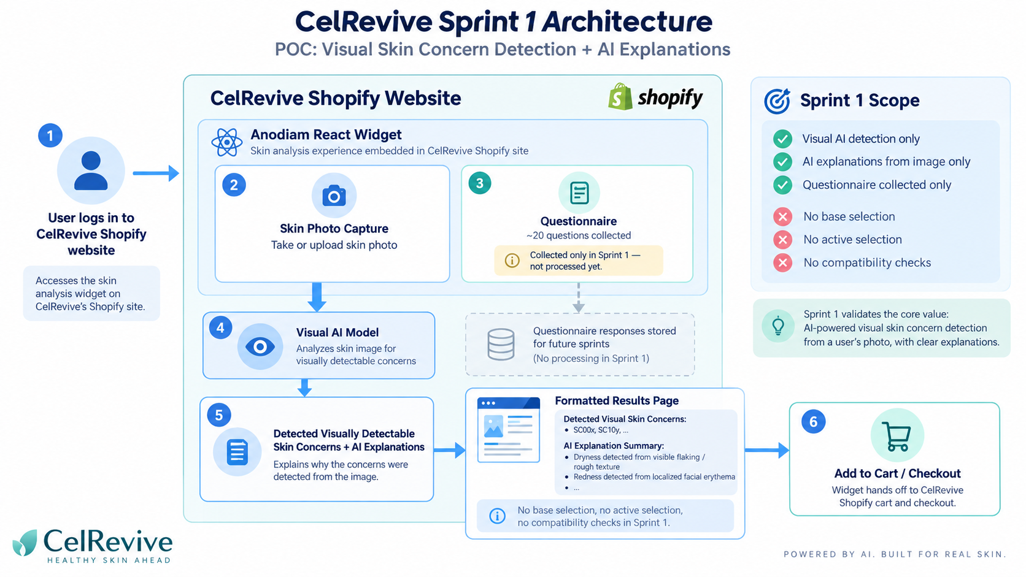

Slide 8
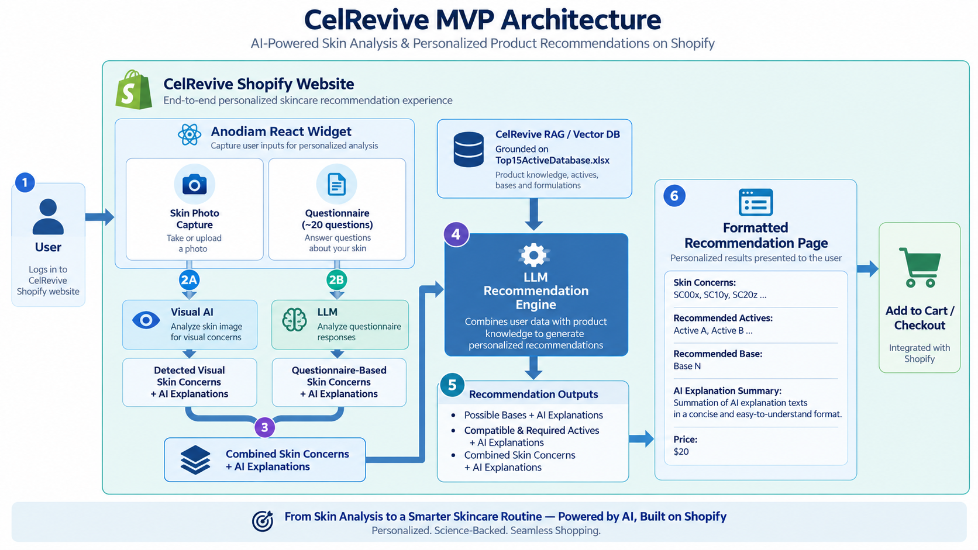

Slide 9
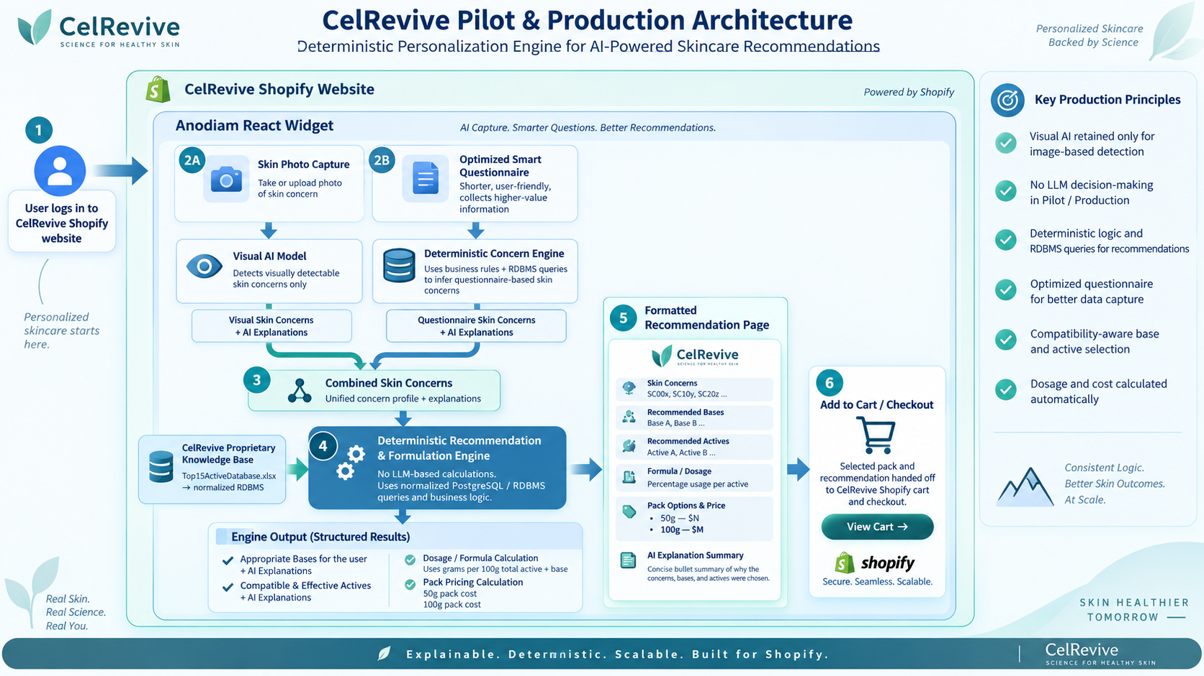

Slide 10
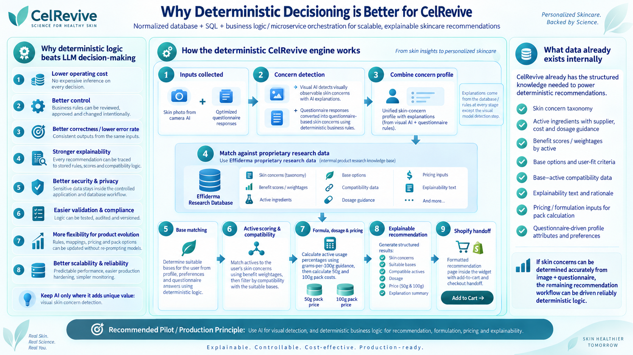

Slide 11
