Slide 1
Color Palette
Primary Colors
#01CED1
#311D6B
#FFFFFF
#FF6571
#FF37A1
Secondary Colors
#FFB63A
#00C5BC
#78D3CE
#3CD8DE
#FF403E
#37CAC3
#81DAFE
#868FE5
#37CAC3
#B1E5FF

Slide 2







Slide 3
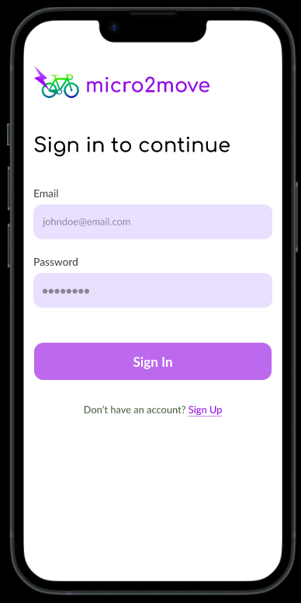

Landing Page - Mobile
Sign In as Admin
Hero Section
Sign in as Student
Sign in as Teacher
Sign in as Parent

Slide 4
ADMIN TRACK

Slide 5
Admin Sign In Page - Mobile
Sign in to Wellbeing Buddy
Change your password for safety
Sign in to Wellbeing Buddy
Email
Password
Email
Enter your email
Enter your new password
principal@springfield.edu
Password
Confirm Password
Password
Enter your password
Re-enter your new password
8Bo9j08h
*Incorrect email or password. Try again.
Sign In
Continue
Sign In

Slide 6



Admin Home Page No Details Uploaded State - Mobile
● ● ●
✕
● ● ●
School A
School A
Admin Full Name
Years
Years
Home
Manage School
Profile
Upload School details
Add Teachers
Upload Teacher info
Add Parents & Students
Upload Parent & Student info
*Click here to download a demo excel format
Upload
Continue

Slide 7
Admin Home Page Schools Details Upload - Mobile
● ● ●
● ● ●
● ● ●
School A
School A
School A
Years
Years
Years
Add Teachers
Add Teachers
Registration is under process…
Upload Success, click to re-upload
Upload Success, click to re-upload
✔
✔
Add Parents & Students
Add Parents & Students
Upload failed, click to re-
upload
Upload Success, click to re-
upload
X
✔
*Click here to download a demo excel format
*Click here to download a demo excel format
Do not close or go back
Continue
Continue

Slide 8
Admin Schools Details Upload Success - Mobile
● ● ●
● ● ●
● ● ●
School A
School A
School A
Years
Years
Years
✔
Registration Complete!
✔
Registration Complete!
✔
Download Complete!
Download the setup credentials below
Download the setup credentials below
Send the details to parents and teachers
By clicking Download, the school agrees to take full responsibility of security and distribution of the setup codes.
✔
By clicking Download, the school agrees to take full responsibility of security and distribution of the setup codes.
Didn't receive the file? Click here to download again
Download
Download
Close

Slide 9
Admin Schools Details Upload Failure - Mobile
● ● ●
● ● ●
School A
School A
Years
Years
Registration Failed!
Upload School details
!
Re-upload the details
Close
Upload

Slide 10
Admin Home Page School Details - Mobile
✕
● ● ●
School A
Admin Full Name
Years
Home
Manage School
Profile
5
6
7
8
Upload

Slide 11

Admin Manage School Page - Mobile
✕
● ● ●
● ● ●
School A
School A
Class 6-A
Admin Full Name
Year 6
Classes
Assigned Teacher
Home
Manage School
Profile
Mr. A
Class 6-A
Class 6-S
Students
Student A
Student B
Student C
Student D
Class 6-K
Class 6-W
Student E
Student F
Student G
Student H

Slide 12
Admin Profile - Mobile
● ● ●
✕
Admin Full Name
Admin Full Name
Home
Manage School
Profile
School A (read only)
Email (read only)
Logout

Slide 13
TEACHER TRACK

Slide 14
Teacher Sign In Page First Time - Mobile
Sign in to Wellbeing Buddy
Change your password for safety
Sign in to Wellbeing Buddy
Email
Password
Email
Enter your email
Enter your new password
chirag.a@mail.com
Password
Confirm Password
Password
Enter your password
Re-enter your new password
8Bo9j08h
*Incorrect email or password. Try again.
Sign In
Continue
Sign In

Slide 15
Teacher Home Page - Mobile
● ● ●
✕
Welcome Mr. A
Mr. A
Your classes
Home
Classes
Class 6-A
Class 7-A
Profile

Slide 16
Teacher Classes Page - Mobile
✕
● ● ●
Class 6-A
Mr. A
Students
Home
Classes
Student A
Student B
Student C
Student D
Profile
Student E
Student F
Student G
Student H

Slide 17
Teacher Profile Page - Mobile
✕
● ● ●
Mr. A
Mr. A
Home
Classes
School A (read only)
Email (read only)
Profile
Logout

Slide 18
PARENT TRACK

Slide 19
Parent Sign In Page - Mobile
Sign in to Wellbeing Buddy
Sign in to Wellbeing Buddy
Change your password for safety
Email
Email
Password
tedw@mail.com
Enter your email
Enter your new password
Password
Password
Confirm Password
abcjE08U
Enter your password
Re-enter your new password
Student’s username
Student’s username
jenny1w3
Enter your kid’s username
Continue
*Incorrect email, password or username. Try again.
Sign In
Sign In

Slide 20

Parent Home Page - Mobile
● ● ●
Welcome Ted
Home
Profile

Slide 21
Parent Profile Page - Mobile
● ● ●
Ted Wong
Home
Profile
Child’s Name (read only)
Parent’s Email (read only)
Logout

Slide 22
STUDENT TRACK
STUDENT TRACK

Slide 23
Student Sign In Page First Time - Mobile
Sign in to Wellbeing Buddy
Change your password for safety
Sign in to Wellbeing Buddy
New Password
username
Username
nina053
Enter your unique username
Enter your new Password...
Password
Password
Confirm New Password
8Bo9j08h
Enter your password
Re-enter your new Password...
*Incorrect username or password. Try again.
Sign In
Continue
Sign In

Slide 24
Student Home Page - Mobile
● ● ●
Welcome Nina
Home
Profile

Slide 25
Student Profile Page - Mobile
● ● ●
Nina
Home
Profile
School Name (read only)
Class (read only)
username (read only)
Logout

