Slide 1
Color Palette
Primary Colors
#01CED1
#311D6B
#FFFFFF
#FF6571
#FF37A1
Secondary Colors
#FFB63A
#00C5BC
#78D3CE
#3CD8DE
#FF403E
#37CAC3
#81DAFE
#868FE5
#37CAC3
#B1E5FF

Slide 2







Slide 3
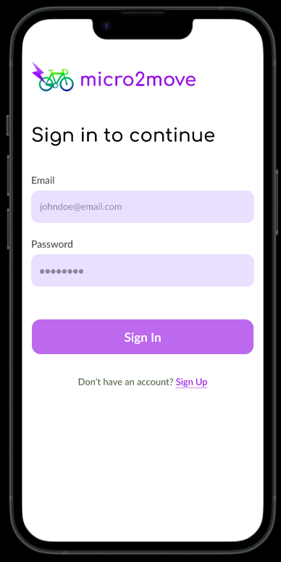


Slide 4
Landing Page - Mobile
WELLBEING
BUDDY
Admin Login
Hero Section
Sign in as Student
Sign in as Teacher
Sign in as Parent

Slide 5
ADMIN TRACK

Slide 6
Admin Sign In Page - Mobile
Sign in to Wellbeing Buddy
Change your password for safety
Sign in to Wellbeing Buddy
Email
Password
Email
Enter your email
Enter your new password
principal@springfield.edu
Password
Confirm Password
Password
Enter your password
Re-enter your new password
8Bo9j08h
*Incorrect email or password. Try again.
Sign In
Continue
Sign In

Slide 7
Admin Home Page No Details Uploaded State - Mobile
● ● ●
✕
● ● ●
School A
School A
Admin Full Name
Years
Years
Home
Manage School
Profile
Upload School details
Add Teachers
Upload Teacher info
Add Parents & Students
Upload Parent & Student info
*Click here to download a demo excel format
Upload
Continue

Slide 8
Admin Home Page Schools Details Upload - Mobile
● ● ●
● ● ●
● ● ●
School A
School A
School A
Years
Years
Years
Add Teachers
Add Teachers
Registration is under process…
Upload Success, click to re-upload
Upload Success, click to re-upload
✔
✔
Add Parents & Students
Add Parents & Students
Upload failed, click to re-
upload
Upload Success, click to re-
upload
X
✔
*Click here to download a demo excel format
*Click here to download a demo excel format
Do not close or go back
Continue
Continue

Slide 9
Admin Schools Details Upload Success - Mobile
● ● ●
● ● ●
● ● ●
School A
School A
School A
Years
Years
Years
✔
Registration Complete!
✔
Registration Complete!
✔
Download Complete!
Download the setup credentials below
Download the setup credentials below
Send the details to parents and teachers
By clicking Download, the school agrees to take full responsibility of security and distribution of the setup codes.
✔
By clicking Download, the school agrees to take full responsibility of security and distribution of the setup codes.
Didn't receive the file? Click here to download again
Download
Download
Close

Slide 10
Admin Schools Details Upload Failure - Mobile
● ● ●
● ● ●
School A
School A
Years
Years
Registration Failed!
Upload School details
!
Re-upload the details
Close
Upload

Slide 11
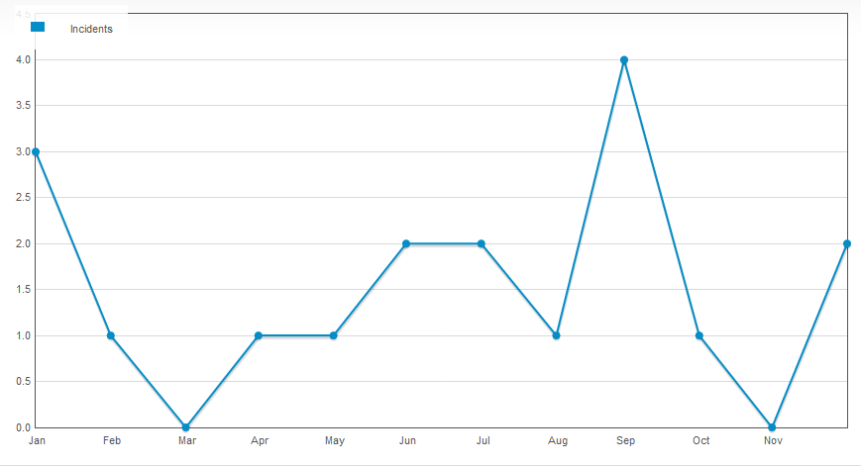
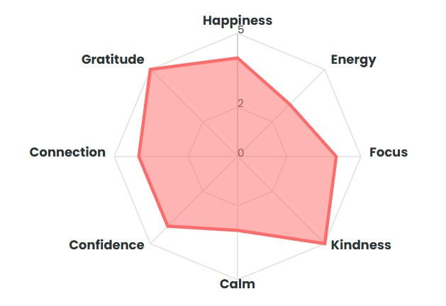
Admin Home Page School Details - Mobile
✕
● ● ●
School A
Admin Full Name
School A’s Overall all Wellbeing Report
Home
Manage School
Profile
Years
5
6
7
8
Upload

Slide 12

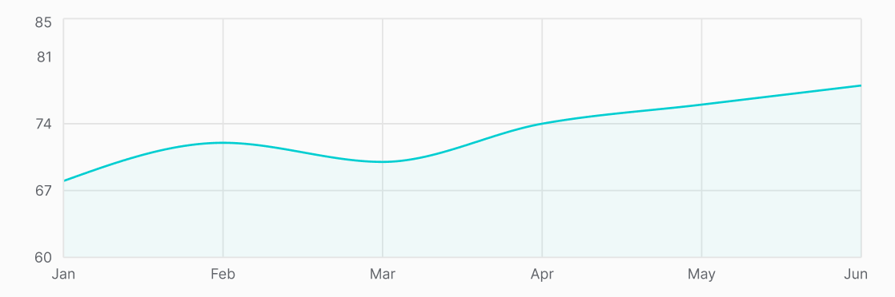
Admin Manage School Page - Mobile
● ● ●
● ● ●
Year 5
Year 5 Wellbeing Report
Class 1-A
Mr. A
Student A
Class 1-A
Select Start Date...
Select End Date...
Select Start Date...
Select End Date...
8
Classes
No of Students: 20
Avg Well8 Score: 230
Class 5-A
Class 5-S
No of Students Requiring Attention: 4
Student A
8
Select Start Date...
Select End Date...
Student B
9
Student C
3
Student D
2
Class 5-K
Class 5-W
Student E
5
Student F
7
Student G
8
Add / Update
Student H
6
Elo
Elo

Slide 13
Admin Profile - Mobile
● ● ●
✕
Admin Full Name
Admin Full Name
Home
Manage School
Profile
School A (read only)
Email (read only)
Logout

Slide 14
TEACHER TRACK

Slide 15
Teacher Sign In Page - Mobile
WELLBEING
BUDDY
● ● ●
WELLBEING
BUDDY
● ● ●
Enter your Email…
Enter your new Password...
Val
Confirm your new Password...
Enter your Password...
Val
Continue
Continue

Slide 16
Teacher Home Page - Mobile
✕
● ● ●
Welcome Mr. A
Mr. A
Your Wellbeing Dashboard
Home
Classes
Select Start Date...
Select End Date...
Your classes
Profile
Class 6-A
Class 7-A
Elo

Slide 17
Teacher Classes Page - Mobile
✕
● ● ●
● ● ●
Mr. A
Class 1-A
Mr. A
Student A
Class 1-A
Home
Classes
Profile
Select Start Date...
Select End Date...
8
No of Students: 20
Avg Well8 Score: 230
No of Students Requiring Attention: 4
Student A
8
Student B
9
Select Start Date...
Select End Date...
Student C
3
Student D
2
Student E
5
Student F
7
Student G
8
Student H
6
Elo
Elo

Slide 18
Teacher Profile Page - Mobile
✕
● ● ●
Mr. A
Mr. A
Home
Classes
School A (read only)
Email (read only)
Profile
Logout

Slide 19
PARENT TRACK

Slide 20
Parent Sign In Page - Mobile
Sign in to Wellbeing Buddy
Sign in to Wellbeing Buddy
Change your password for safety
Email
Email
Password
tedw@mail.com
Enter your email
Enter your new password
Password
Password
Confirm Password
abcjE08U
Enter your password
Re-enter your new password
Student’s username
Student’s username
jenny1w3
Enter your kid’s username
Continue
*Incorrect email, password or username. Try again.
Sign In
Sign In

Slide 21
Parent Sign In Page - Mobile
WELLBEING
BUDDY
● ● ●
Enter your email…
Enter your password ...
Continue

Slide 22
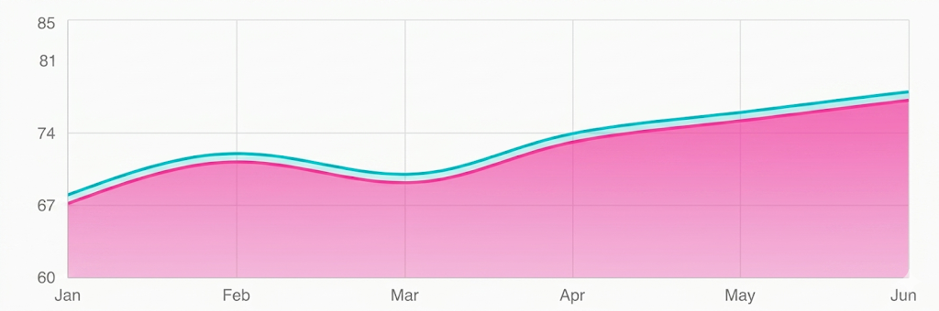
Parent Home Page - Mobile
● ● ●
Ted Wong
Home
Profile
8
8
Select Start Date...
Select End Date...
Elo

Slide 23
Parent Profile Page - Mobile
● ● ●
Ted Wong
Home
Profile
Child’s Name (read only)
Parent’s Email (read only)
Logout

Slide 24
STUDENT TRACK
TBD

Slide 25
Student Sign In Page First Time - Mobile
Sign in to Wellbeing Buddy
Change your password for safety
Sign in to Wellbeing Buddy
New Password
username
Username
nina053
Enter your unique username
Enter your new Password...
Password
Password
Confirm New Password
8Bo9j08h
Enter your password
Re-enter your new Password...
*Incorrect username or password. Try again.
Sign In
Continue
Sign In

Slide 26
Student Home Page - Mobile
WELLBEING
BUDDY
● ● ●
✕
Hi Rosa!
Wellness quote of the day (AI)
Home
My Journal
Meet Elo
Profile
Random wellness tips (AI)
Did
You Know?
Writing about your day takes things off of your mind!
See Your Journal
Need a friend to talk to? Meet your AI Buddy who can keep a secret ;)
Chat with Elo

Slide 27
Student My Journal -Mobile
WELLBEING
BUDDY
● ● ●
✕
Think out loud💭
Start typing…
Home
Meet Elo
Profile
How do you feel about that?
😊😒🤔…
Save
🤖 Elo Says…
AI generated response tailored to the above journal entry
Animated SVG for the block’s background
Rosa’s Journal
Date, Time
😊
AI generated title
Best day at scho…

Slide 28
Student Meet Elo - Mobile
WELLBEING
BUDDY
● ● ●
✕
Hey Rosa, I’m your AI mate Elo. Ask me Anything!
Home
My Journal
Meet Elo
Profile
Start chatting…

Slide 29
Student Meet Elo - Mobile
WELLBEING
BUDDY
● ● ●
✕
We are sad to see you go..😢
Home
My Journal
Meet Elo
Profile
Back to Home Page
Logout Anyway

