Slide 1

Minor Project On Memory Leak Detector For C
BACHELOR IN TECHNOLOGY IN COMPUTER SCIENCE AND ENGINEERING
University School of Information, Communication and Technology
(GURU GOBIND SINGH INDRAPRASTHA UNIVERSITY)
SUBMITTED TO: SUBMITTED BY:
Dr. Jaspreeti Singh Mohit Kumar
(Assistant Professor) 02116403217
USICT, GGSIPU (7th Semester)

Slide 2
project:-> design and implement Memory Leak Detector For C/C++
Memory leaks are one of the primary causes of software aging. Despite of recent countermeasures in C/C++ such as smart pointers, leak-related defects remain a troublesome issue in C/C++ code, especially in legacy applications. The project aims is to build a library that catches the memory leaks, if any, by the application. In this project, Our main focus will be on how to design and implement a garbage collector library called MLD (Memory Leak Detector) which when integrated to the application will provide the facility to catch leaked objects and report them. MLD library will be the generic library and has the ability to parse any application's data structures and manipulate them.
In order to implement a garbage collector for C programs which work on the principle of reachability of objects to detect memory leaks. Through this project, we will understand the limitation of such a garbage collector for C like programming languages (which have direct access to underlying memory addresses, unlike Java/python) and analyze its limitations and cost for being an inbuilt feature of C-like language.

Slide 3
Issue with C/C++
Since the advent of C/C++ Programming language, Memory management is one of the responsibilities which the developer has to deal with.
C/C++ Softwares often suffers from Two Memory related Problems :
1.Memory corruption
2.Memory leak
Unlike Java, C/C++ does not have the luxury for automatic garbage collection.
Java does not allow programmer to access the physical memory directly, but C/C++ does, not does java expose pointers directly to the developer/coder. Therefore Java applications do not suffer from Memory corruption either, but C/C++ does.
Pre-requisites
Knowledge of C Programming and Pointers.
Elementary Knowledge of OS Memory Management.
Any additional knowledge of internal workings of routines such as malloc, calloc, free, memcpy, and memset (that is, routines that deal with memory allocation, deallocation, and content modification) is a plus.

Slide 4
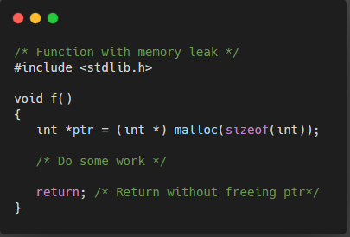
Memory Leak In computer science, a memory leak is a type of resource leak that occurs when a computer program incorrectly manages memory allocations in a way that memory which is no longer needed is not released. A memory leak may also happen when an object is stored in memory but cannot be accessed by the running code. A memory leak has symptoms similar to a number of other problems and generally can only be diagnosed by a programmer with access to the programs source code.
Brief Introduction / Problems with Memory Leak
A memory leak reduces the performance of the computer by reducing the amount of available memory. Eventually, in the worst case, too much of the available memory may become allocated and all or part of the system or device stops working correctly, the application fails, or the system slows down vastly due to thrashing.
In this Project we shall going to create a Tool called Memory Leak Detector (MLD) tool.
We Shall Implement this tool as the library and our C/C++ application will use this library for Memory Management.
MLD library will keep track of all the Heap Objects the application has created and how various heap objects holds references to one another.
MLD library will show the leaked objects , if any.

Slide 5
Low Level Block Diagram
Project Block Diagram and Architecture
C Application
Kernel/OS
1.Request Memory malloc/free
2.Memory Request Served
3.Memory Returned to Application for use

Slide 6
High Level Block Diagram
Project Block Diagram and Architecture
C Application
MLD
Library
1.Request Memory malloc/free
4.Update its internal Data Structure to Keep Track of Memory object used by the Application
5.Memory Returned to Appl. For use
2.Forward Memory Request to OS
3.Memory Request Served
Kernel/OS

Slide 7
Phases of The Project
Project Development Phases
1. Structure Database
MLD Library will Maintain the information about all structures which the application is using.
2. Object Database
MLD Library will Maintain the information about objects malloc’d by the application.
3. Memory Leak Detection Algorithm.
MLD Library Triggers Memory Leak Detection Algorithm on object Database to find the leaked objects.

Slide 8
Goals of Phase -1
MLD Library must know the information about all structures being used by the application.
It is the responsibility of the application to tell the MLD Library during initialization about all the structures it is using . This is called “Structure Registration”.
MLD Library will maintain the structure database (preferably a Linked List) to store application structure information.
Key to search in structure database is “name of structure”.
Structure Registration
Structure xyz information
C Application
MLD
Library
1.No of Fields.
2.What are the Fields name.
3.Data Type
4.Size
5.etc…
Store the structure information and its internal Data Structures.

Slide 9
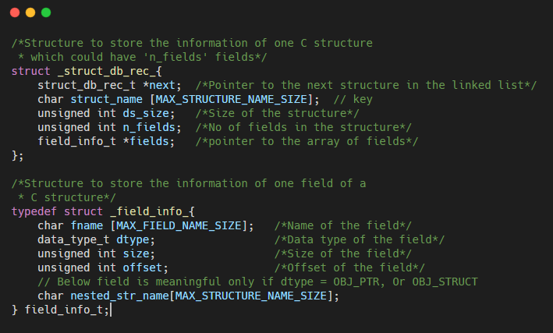
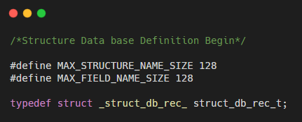
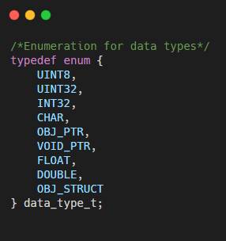
Modelling of Structure Database

Slide 10
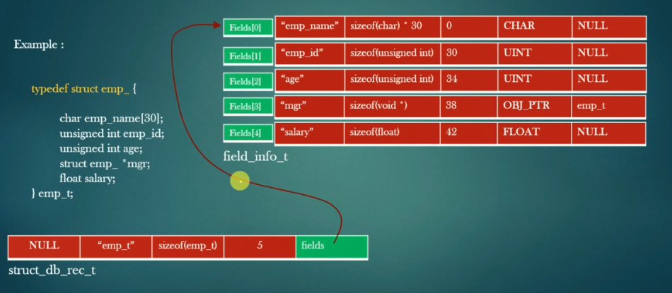
Structure Registration Example

Slide 11
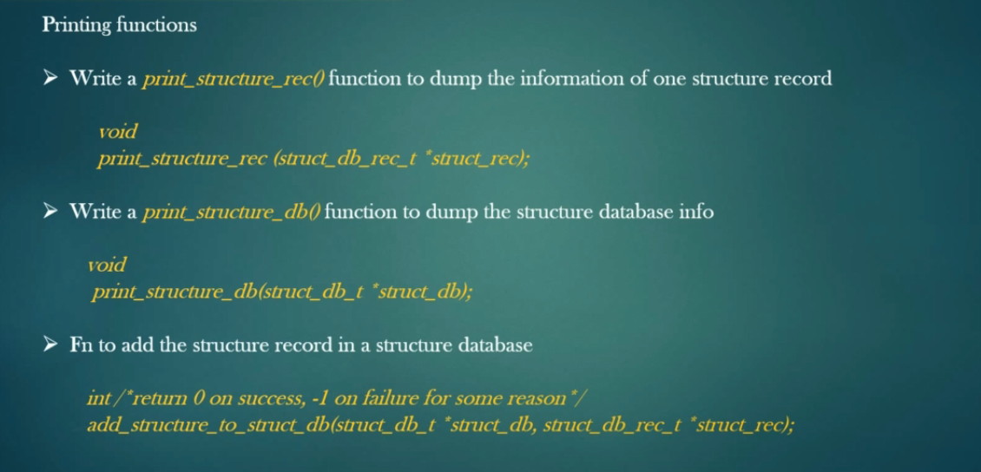
Designing MLD Structure Database

Slide 12
Goals of Phase -2
In this Phase Our MLD Library Will have all the information about all the objects the application has malloc’d.
Whenever the application malloc a new object, MLD Library will store the relevant information about this object such as
Corresponding structure details of the object.
Address of the object.
The object record holds the above information of the object.
Idea is, MLD Library must have all information about all the dynamic objects the application is using at any point of time.
MLD Library will maintains a database called object database to keep track of all dynamic objects being used by the application.

Slide 13
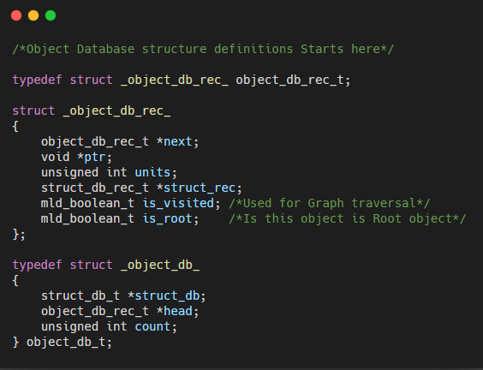
Object Database Modelling
//We will write our own calloc , let call it xcalloc
/*API to malloc the object*/
void *xcalloc(object_db_t *object_db, char *struct_name, int units);
//Ex. emp_t *emp = xcalloc(object_db, "emp_t", 1);
xcalloc does the following :
Allocate “units” units of contiguous memory for object of type “struct_name”.
Create the object record for new allocated object and add the object record in object database.
Link the object record with structure record for structure “struct_name”
Return the pointer to the allocated object.
Thus, xcalloc allocates memory for the object, but also create internal data structure in MLD Library so that MLD can keep track of the newly allocated object.

Slide 14
Let us suppose, the application create three objects: student_t *mohit = xcalloc(object_db , “student_t” , 1); emp_t *rohit = xcalloc(object_db , “emp_t” , 2); student_t *kapil = xcalloc(object_db , “student_t” , 1);
Design And Implement Object Database
Head
Pointer to student_t struct_db_rec_t
 | Add of mohit | 1
Pointer to emp_t struct_db_rec_t
 | Add of rohit | 2
Pointer to student_t struct_db_rec_t
NULL | Add of kapil | 1

Slide 15
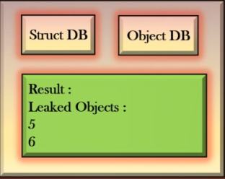
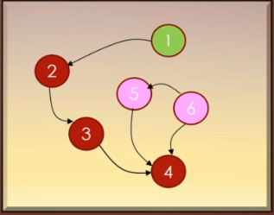
Goals of Phase -3
The purpose of MLD Library is to process object database , with the help of structure database and find Leaked application objects and report them.
We need to implement Memory Leak Detection Algorithm in MLD Library to accomplish this goal.
Struct DB
Object DB
MLD Algo
MLD Library
Application Data Structure
Leaked Object

Slide 16
Application of Data Structure as Disjoint set of Graphs
Leaked Objects are those objects which are not reachable from any other objects.
Finding the set of leaked objects is a graph problem.
Task:- Given a graph of nodes and edges , find all the nodes which are not reachable from any other nodes.
Application objects have references to one another, overall, all application objects combined take the shape of a graph.
The graph can be disjoint – it can be set of isolated graphs.
Each Isolated Individual graph has a special node called root of the graph.
We assume that our application Data Structures always takes the shape of disjoint set of graphs.
At any point of time we try to maintain the overall data structure as Directed Cyclic Graphs.

Slide 17
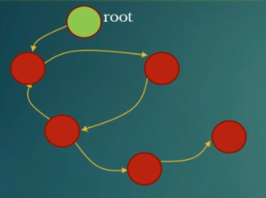
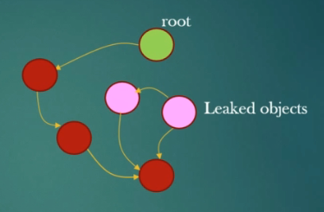
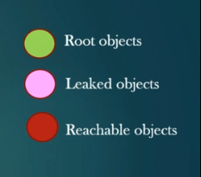
Leaked And Reachable Objects
Root objects are usually global or Static objects maintain by our application.
Every other malloc’d objects must be reachable from atleast one root object.
Malloc’d object which are not reachable are leaked objects.

Slide 18
MLD Algorithm Root Objects
Memory Leak Detection Algorithm
The Application has to tell MLD library the setoff all root objects.
MLD library must provide an API using which an application can register its root objects.
Application can create root objects in two ways.
As a Global root object.
As a Dynamic root object.
The Memory Leak Detection Algorithm begins from root objects.
Global objects are referenced by global variables in application, so we can assume that Global objects cannot be leaked.
Our MLD Library assumes dynamic root objects of the application are also never leaked by the application. If dynamic root objects are leaked by the application, our MLD algorithm will not report it since it starts Memory Leak Detection algorithm from root object assuming root objects are always reachable.

Slide 19
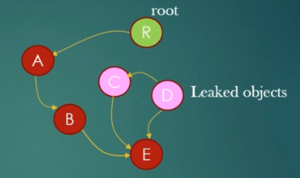
MLD Algorithm Dry Run
Memory Leak Detection Algorithm
Object | Is Visited | Is Root
A | 0 | 0
B | 0 | 0
C | 0 | 0
D | 0 | 0
E | 0 | 0
R | 0 | 1
F | 0 | 0
Z | 0 | 1
Object | Is Visited | Is Root
A | 1 | 0
B | 1 | 0
C | 0 | 0
D | 0 | 0
E | 1 | 0
R | 1 | 1
F | 1 | 0
Z | 1 | 1
Analysis :
MLD algorithm is recursive.
MLD algorithm is basically a DFS(Depth First Search) algorithm.
is_visited flag is used to avoid loops.
Initial State
Final State

Slide 20
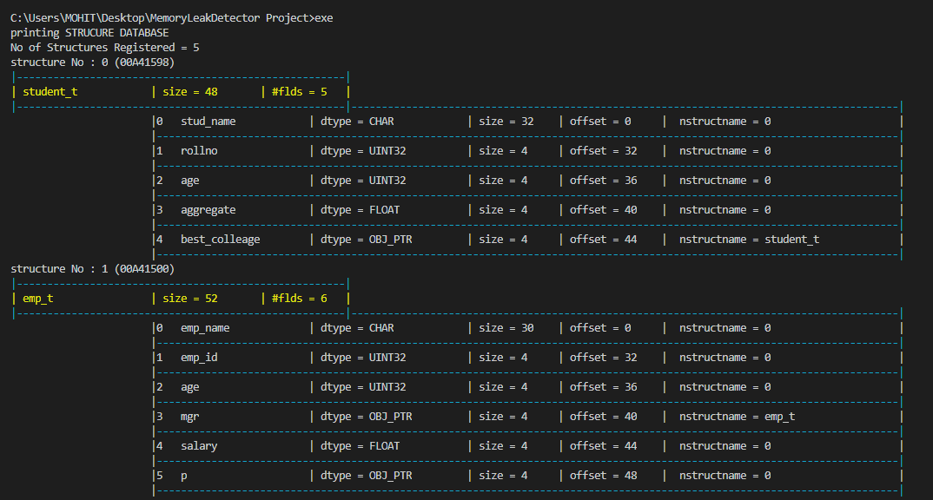
OUTPUT
Final Demo

Slide 21
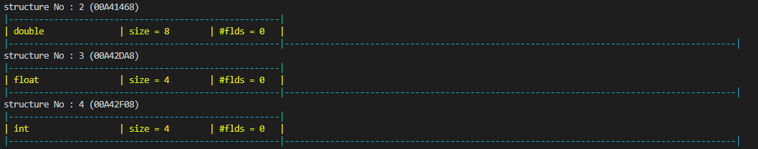
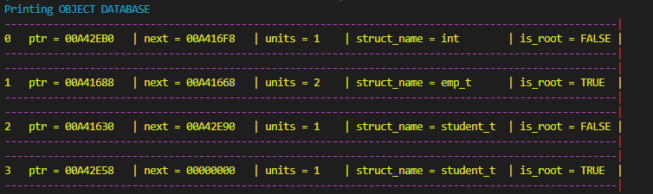
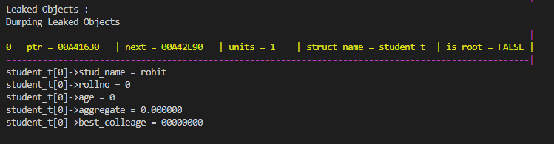
OUTPUT

