Slide 1

DESIGN PRINCIPLES
GETTING STARTED
WITH HTML & CSS

Slide 2

COMMUNICATION
Use of Colors, Mockup, Good Code Practices
Requirement for Web Design
Website Design Layout
Front-End Foundations
Tools to Build a Website
Type of Web Design
Latest Website Trend
Font-End Formations
Introduction to HTML5 and CSS3

Slide 3
COMMUNICATION
Requirement for Web Design
Visual Design.
Colors
Fonts
Image
Attention to Details

Slide 4
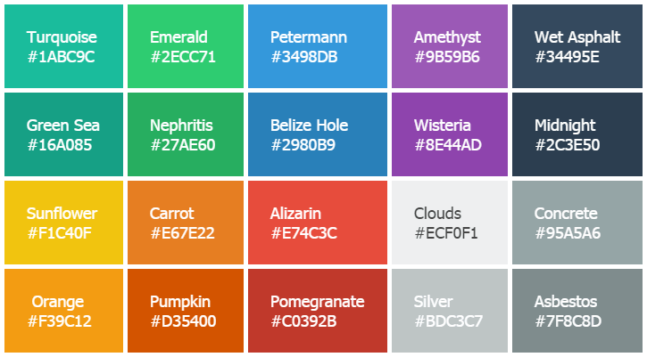

COMMUNICATION
Colors / Font
Font Type Font Type Font Type
Font Type Font Type Font Type

Slide 5



COMMUNICATION
Image / Attention to details.
Test: Which image will you use for a business website?
Image 1
Image 2
Test: What is the different between the two images

Slide 6
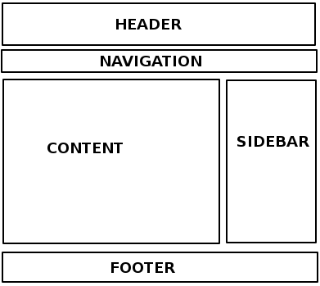
COMMUNICATION
Website Design Layout
Every website consist of Header, Navigation, Content, Sidebar, Footer

Slide 7
COMMUNICATION
Tools to Build a Website
Font Tool = Google Fonts, typespiration.com
Color = coolors.co
Icons = fontawesome.io
Animations CSS = daneden.github.io/animate.css
Design software like Photoshop and Illustrator.
Coding software like HTML and CSS. (Text Editor- Notepad++, Brackets, Sublime Text)
Html Test = https://www.w3schools.com/html/
Css Test = https://www.w3schools.com/html/html_css.asp

Slide 8
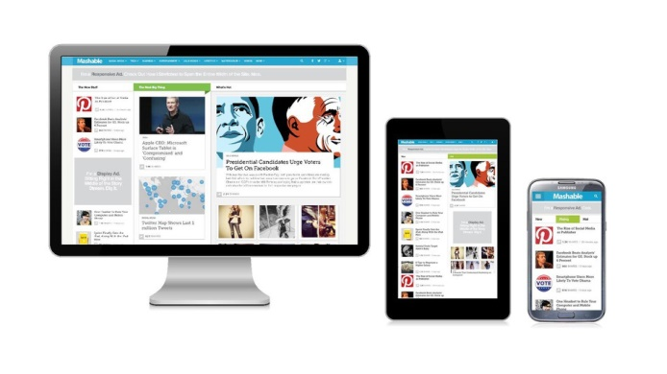
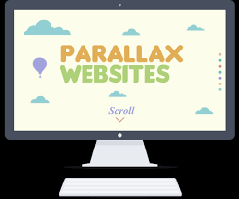
COMMUNICATION
Type of Web Design
Responsive Web Design
Responsive Web Design makes your web page look good on all devices (desktops, tablets, and phones).
Eg: https://html5up.net/alpha
Parallax Web Design
One web design scrolling webpage. the website layout sees the background of the web page moving at a slower rate to the foreground, creating a 3D effect as you scroll.
Eg: https://www.livemeshthemes.com/fusion/agency/

Slide 9
COMMUNICATION
Latest Website Trend
Custom Illustration
Eg: https://www.stride.com
Integrated Animations
Eg: https://www.inturn.co
Dynamic gradients
Eg: https://www.elje-group.com
Broken Grid Layout
Eg: https://www.beoplay.com/landingpages/ss17#intro
Page Transition
Eg: https://www.reed.be/
The Video Element
Eg: http://invisionapp.com/

Slide 10
COMMUNICATION
Introduction to HTML5 and CSS3
HTML5
HTML5 is a markup language used for structuring and presenting content on the World Wide Web. It is the fifth and current major version of the HTML standard.
https://www.w3schools.com/html/html5_intro.asp
CSS3
CSS3 is the latest evolution of the Cascading Style Sheets language and aims at extending CSS2.1. It brings a lot of long-awaited novelties, like rounded corners, shadows, gradients, transitions or animations, as well as new layouts like multi-columns, flexible box or grid layouts
https://www.w3schools.com/cssref/css3_pr_filter.asp

Slide 11
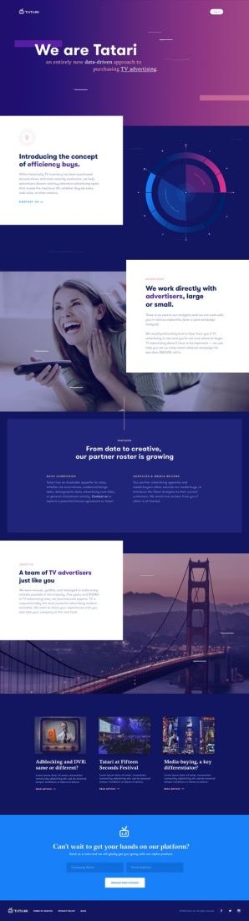
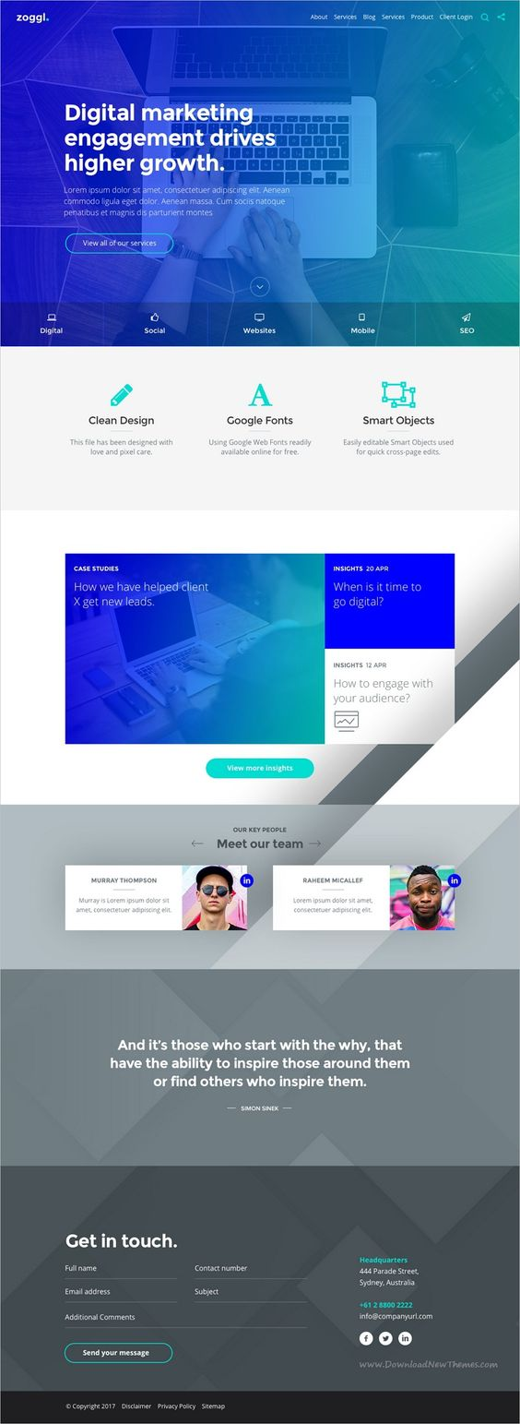
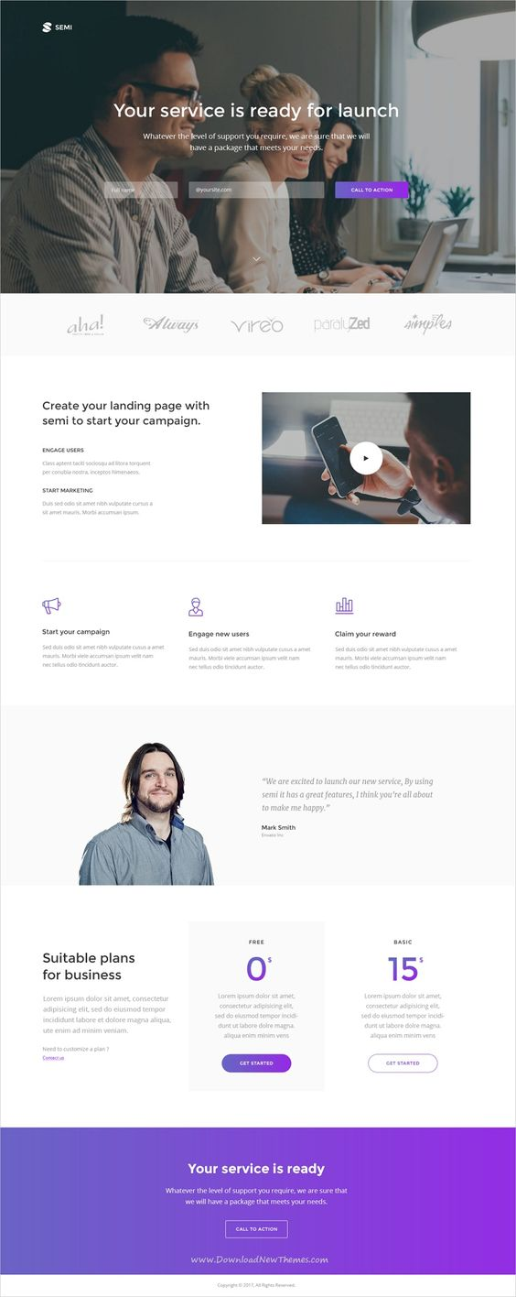
COMMUNICATION
Example of HTML5 and CSS3 Web Design

