Slide 1
ANOVA
Analysis of Variance
Most Useful when Conducting Experiments

Slide 2
ANOVA
Sometimes we want to know whether the mean level on one continuous variable (such as income) is different for each group relative to the others in a nominal variable (such as degree received).
We could use descriptive statistics (the mean income) to compare the groups (sociology BA vs. MA vs. PhD).
However, as sociologists, we usually want to use a sample to determine whether groups are different in the population.

Slide 3
ANOVA
ANOVA is an inferential statistics technique that allows you to compare the mean level on one interval-ratio variable (such as income) for each group relative to the others in a nominal variable (such as degree).
If you had only two groups to compare, ANOVA would give the same answer as an independent samples t-test.

Slide 4


ANOVA
One typically uses ANOVA in experiments because these typically involve comparing persons in experimental conditions with those in control conditions to see if the experimental conditions affect people.
Independent Dependent
Nominal Variable Interval-ratio Variable
Experimental Grouping Outcome Variable
For example: Is “Diff’rent Strokes” funnier than ”Charles in Charge?”
Experiment:
Do kids exposed to “Diff’rent Strokes” laugh more than those who watch “Charles in Charge?”
Expose Groups to a Show Record Amount of Laughter
We then use the sample to make inferences about the population.

Slide 5
ANOVA
What if three racial groups had incomes distributed like this in your sample?
All Groups
Groups Broken Down
Isn’t it conceivable that the differences are due to natural random variability between samples? Would you want to claim they are different in the population?
Income in $Ks
Income in $Ks

Slide 6
ANOVA
Now…What if three racial groups had incomes distributed like this in your sample?
All Groups Combined
Groups Separated Out
Doesn’t it now appear that the groups may be different regardless of sampling variability? Would you feel comfortable claiming the groups are different in the population?
Income in $Ks
Income in $Ks

Slide 7
ANOVA
In repeated sampling, if there were no group differences, that ratio “F” would be distributed in a particular way.
Distribution of “F” over repeated sampling, recording a new F every time.

Slide 8
ANOVA
The F distribution is like the normal curve, t distribution, and chi-squared distribution: we know that there is a critical F that demarcates the value beyond which the values of the rarest 5% of F’s will fall.
Critical F
Most extreme 5% of F’s
What if your sample’s F
were this large?

Slide 9
ANOVA
Null: Group means are equal; μ₁ = μ₂ = …= μ_{g}
Alternative: At least one group’s mean is different
So… if F is larger than the critical F:
Reject the Null in favor of the alternative!

Slide 10
ANOVA
If your F is in the most extreme 5% of F’s that could occur by chance if your two variables were unrelated, you have good evidence that your F might not have come from a population where the means for each group are equal.
So, essentially, ANOVA uses your sample to tell you whether, in the population, you have overlapping group distributions (no difference between means) or fairly distinct group distributions (differences between means).

Slide 11
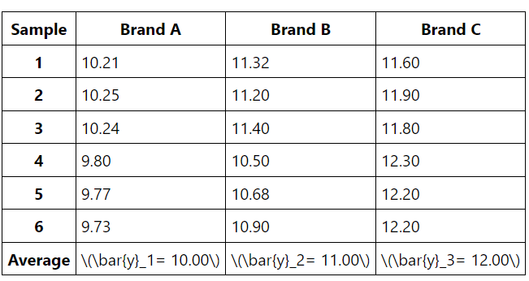
ANOVA
Application: Tar Content Comparisons
We want to see whether the tar contents (in milligrams) for three different brands of cigarettes are different. Two different labs took samples, Lab Precise and Lab Sloppy.
Lab Precise
Lab Precise took six samples from each of the three brands and got the following measurements:

Slide 12
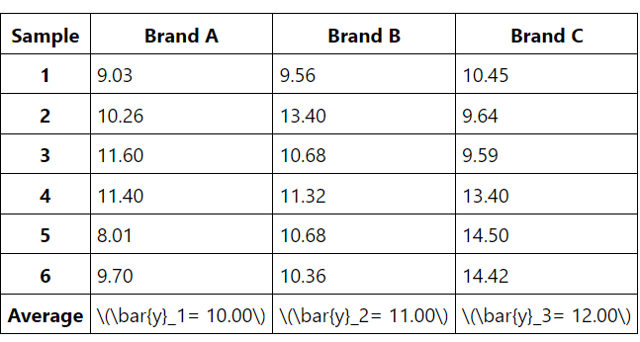
ANOVA
Lab Sloppy
Lab Sloppy also took six samples from each of the three brands and got the following measurements:

Slide 13
The sample means from the two labs turned out to be the same and thus the differences in the sample means from the two labs are zero.
From which data set can you draw more conclusive evidence that the means from the three populations are different?
We need to compare the between-sample-variation to the within-sample-variation. Since the between-sample-variation from Lab Sloppy is large compared to the within-sample-variation for data from Lab Precise, we will be more inclined to conclude that the three population means are different using the data from Lab Precise. Since such analysis is based on the analysis of variances for the data set, we call this statistical method the Analysis of Variance (or ANOVA).

Slide 14

THANK YOU

