Slide 1

Re-Habit
Paradox

Slide 2

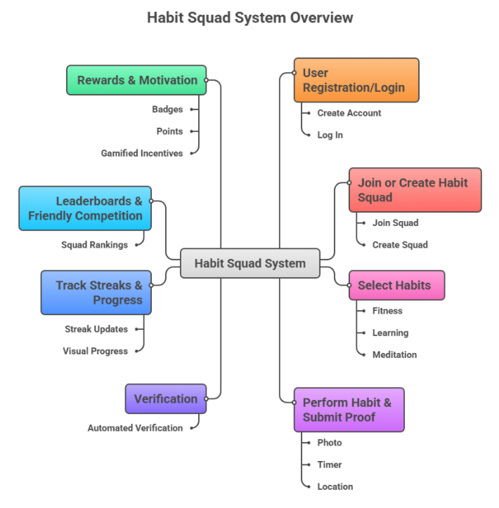

IDEA
ReHabit is a social platform that helps people build and stick to habits by combining community support with fun gamification.
Proof-of-completion keeps things honest.
Friendly competitions and leaderboards make staying consistent motivating with fun.
Offers real-time reminders, streak tracking, and progress visuals to keep users on track.
Focused on social motivation and gamified reinforcement, helping users turn good habits into lasting routines.

Slide 3










TECH
Flutter
For frontend (users can access in mobile devices).
Node.js + Express
Backend (Scalable and handles users account, streak)
Firebase Firestore
Database (Flexible and stores users info, logs, leaderboards).
Tensor Flow
AIML (Suggestions based on user behavior).
Heroku
Deployment(Keeps the app live & can be accessible globally).
Firebase Auth, Cloud, Storage, Analytics.
Authentication, Notifications, Storage, Dashboards.

Slide 4
BUSINESS SCOPE & IMPACT
Large Market Potential: Habit-building, fitness, wellness, and productivity apps are a rapidly growing global market.
Wide User Base: Suitable for students, professionals, fitness enthusiasts, and anyone aiming to develop positive routines.
Social & Gamified Engagement: Community-driven approach increases user retention compared to traditional habit apps.
Scalable Platform: Can expand from local groups to global communities.
Revenue: Premium features and partnerships with education platforms.
Social Impact: Promotes healthy habits, productivity, and mental well-being through social accountability.

Slide 5

Challenges & Future Scope
Challenges:
Keeping users consistently engaged over long periods.
Ensuring privacy and security of user data.
Balancing gamification so it motivates without creating stress.
Preventing fake proof submissions or cheating streaks.
Scaling squads and leaderboards for millions of users.
Future Scope:
Integrate AI-based habit recommendations personalized for each user.
Introduce corporate wellness programs and team challenges.
Expand to global communities with multi-language support.
Offer advanced analytics for users and squads to track progress and trends.
Add wearable device integration (smartwatch, fitness tracker) for automatic tracking.

Slide 6

THANK YOU

Slide 7

Instructions
Technology Stack: Frontend, Backend, Database
  The presentation should contain no more than six (6) slides excluding Instructions.
  Please stick to the template given for the PPT.
  Save the presentation with your Team Name.
  Save the presentation file in PDF format, and upload it to Unstop. No other formats are encouraged.
Your paragraph text

