Slide 1


SMART INDIA HACKATHON 2025
MindSpark
Problem Statement ID - 25050
Problem Statement Title - Smart Traffic
Management System for Urban Congestion.
Theme - Transport & Logistics
PS Category - Software
Team ID - 83450
Team Name - MindSpark
a

Slide 2
FlowAI
MindSpark
IDEA / SOLUTION:
AI-Powered system that optimizes traffic signal timings using real-time CCTV & IoT data.
Predicts traffic 3-5 minutes ahead and prevent jams instead for reacting late.
Emergency Vehicles gets priority with minimum delay.
Self-learning system, adapts daily and improves continuously at managing city traffic.
Achieves > 10% reduction in commute time in simulated environment.
Privacy & Efficiency, it will run on edge devices and works offline without internet.
SYSTEM ARCHITECTURE:
CCTV Camera Feed
AI Detection System
Decision Engine
Traffic Signal Controller
Dashboard for Authorities
INNOVATION & UNIQUENESS:
Not just reactive but also predictive.
Data Insights for city planning & pollution control.
Emergency & pedestrian priority.
Cost effective rollouts by reusing the existing CCTV’s and signals, will reduce deployment cost by up to 70%.

Slide 3
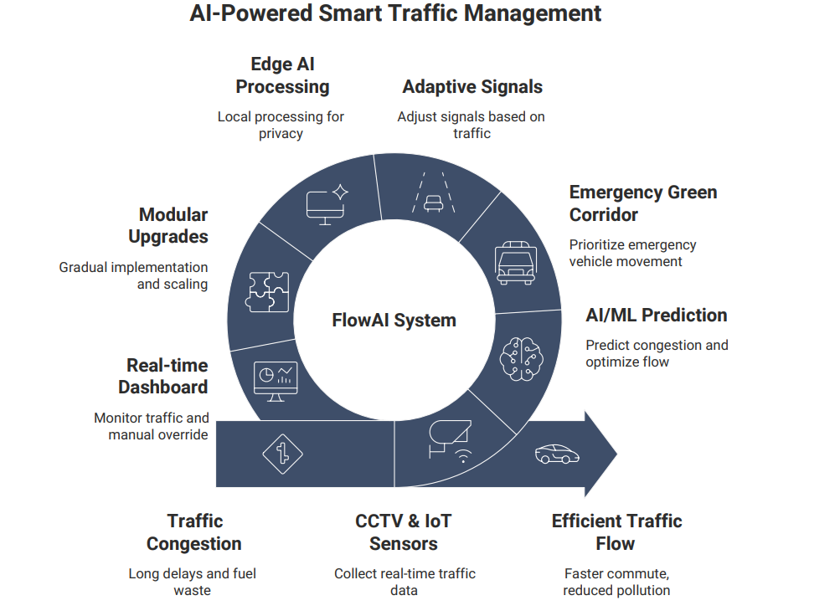
TECHNICAL APPROACH
MindSpark
Programming Languages:a
Python
JavaScript
Frameworks & Libraries:
Streamlit (Python library for dashboard).
Flask (backend).
YOLO (For Object detection).
TensorFlow
OpenCV (AI/ML)
Hardware:
Raspberry Pi – Edge IoT Device
Databases & Cloud Services:
PostgreSQL (Data).
AWS (Scalability)

Slide 4
FEASIBILITY AND VIABILITY
MindSpark
Analysis of the feasibility of the idea
Technical Feasibility:
Uses proven AI/vision tools.
Modular System
Economic Feasibility:
Start small at critical junctions - Pilot first approach.
Less Fuel – Less Pollution.
Operational Feasibility:
Runs on local devices, requires minimal training for authorities
Provides Dashboard + manual override, traffic police still in control.
Potential challenges and risks
High Deployment Costs
Data Privacy & Security
AI Reliability & Accuracy
Lane Starvation
Infrastructure Dependency
Strategies for overcoming these challenges
Reuse existing CCTVs.
Edge AI processing.
Hybrid Approach AI + Manual override.
Minimum Green Guarantee.
Local Power backup + edge devices run offline.

Slide 5
IMPACT AND BENEFITS
MindSpark
Potential impact on the target audience:
Citizens: Faster & smoother daily commutes, less
stress from long traffic waits and improved road
safety with fairer signals
Emergency Services: Priority green corridors reduce response time, saving lives.
Traffic Authorities: Real-time visibility for traffic conditions, data-driven decision making for Urban plannings.
Environment and Society: Reduces vehicular emissions, clean air and supports India’s smart cities mission.
Benefits of the solution:
Social benefits: Improved quality of life through time saving.
Economic benefits: Reduces fuel wastage and avoids need for Flyovers, metro projects.
Environment benefits: Less CO2 emission and contributes to sustainable urban mobility.
Technology benefits: Modular system is easy to scale and upgrade.

Slide 6
RESEARCH AND REFERENCES
MindSpark
References:
https://github.com/juztmsd777777/Traffic-signal-management-system
https://rjpn.org/ijcspub/viewpaperforall.php?paper=IJCSP25B1059
https://litslink.com/blog/ai-and-transportation
C.R. Goenawan, Autonomous Smart Traffic Management System Using Artificial Intelligence CNN and LSTM.
Comparison Table:
Feature | Existing system | FlowAI
Real-time adaptive signal control | No | Yes
Predictive congestion Forecasting | No | Yes
Emergency vehicle priority | No | Yes
Works Offline | Yes | Yes

