Slide 1
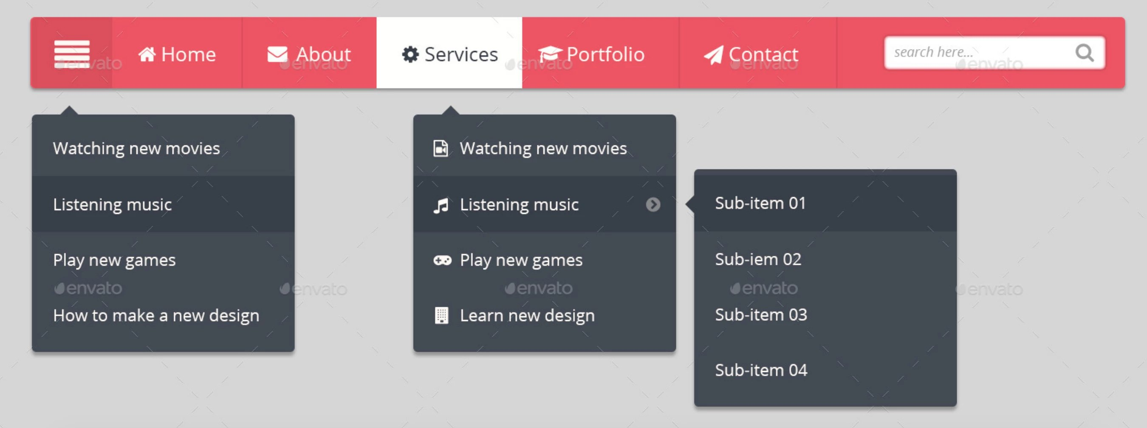
html
0) header>div>nav>ul
1) li>i
2) li>i,span
3) li>div>input>i
4) .Sub-item>ul>li>a, before
5) .Sub-menu>ul>li>I,span,I before
7) .menu>ul>li>a, before
1
2
0
3
4
6
7

Slide 2
Class
1
2
0) header>.nav-wrap>nav>ul
0
3
1) li . menu-list-wrap not-hover>I
4) .menu>ul>li>a, before
4
5
6
2) li>i,span
5) .Sub-menu>ul>li>I,span,I before
6) .Sub-item>ul>li>a, before
3) li .search-wrap not-hover>div>input>i

Slide 3
attribute
1
2
0) header>.nav-wrap>nav>ul
0
3
1) li . menu-list-wrap not-hover>I
4) .menu>ul>li>a, before
4
5
6
2) li>i,span
5) .Sub-menu>ul>li>I,span,I before
6) .Sub-item>ul>li>a, before
3) li .search-wrap not-hover>div>input>i

