Slide 1
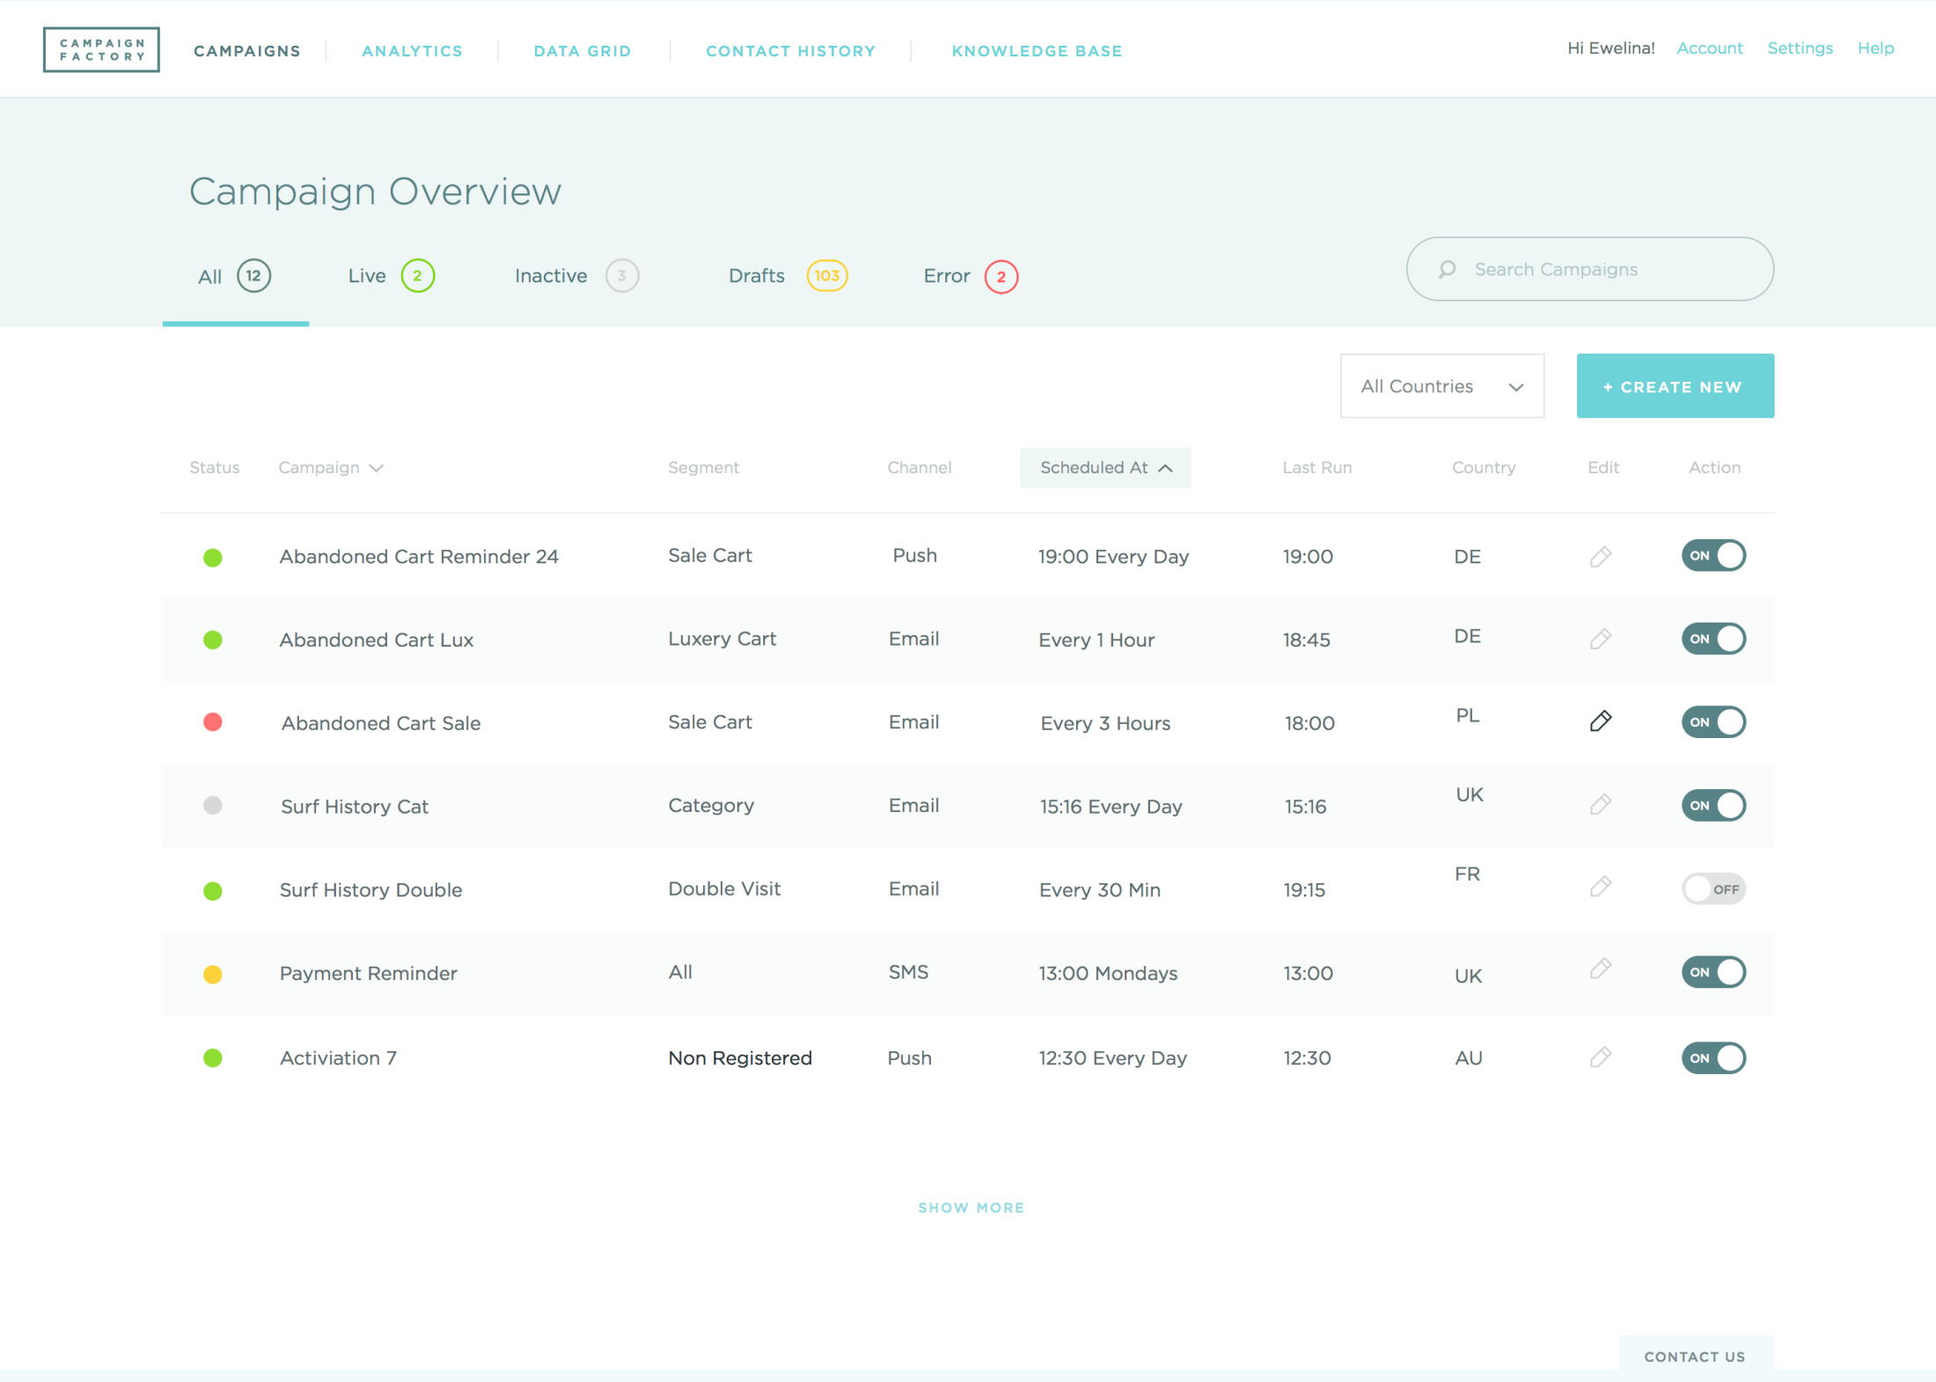
Header
nav
Div – logo-wrapper
img
Div – right-menu-wrapper
ul
li 4개
Dv – left-menu-wrapper
ul
li 5개

Slide 2
Contents
Input text
i
fillter
H1
ul
Li
Button
i

Slide 3
table
Select
button
buttonicon
Button icon
radio
button

