Slide 1

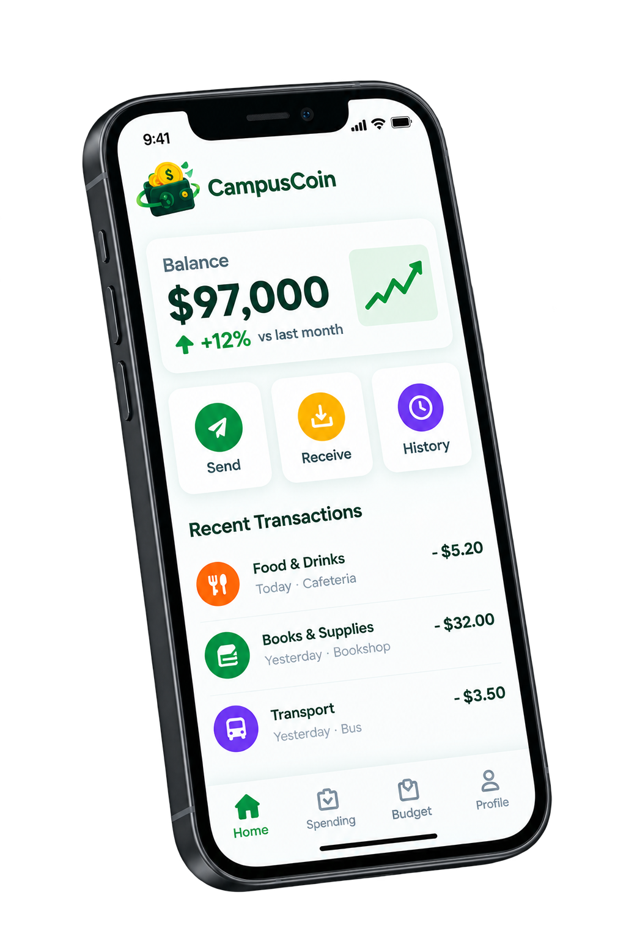

CampusCoin
STUDENT FINANCE PLATFORM
A smart budgeting app built for students —
no bank account or credit card required.
Team Flandek
November 2026
Full-Stack Web App
8 Currencies
AI-Powered
100% Free
No Bank Needed
"Smart money, Brighter Future."

Slide 2

CampusCoin
PROBLEM → SOLUTION
THE PROBLEM
OUR ANSWER
Students struggle with money
every semester.
Built for campus life.
No bank needed.
No Visibility
Allowances, gigs, scholarships — no single place to track it all.
01
02
03
Track
Plan
Improve
Wrong Tools
Log income and expenses in seconds with campus-tuned categories.
Set monthly budgets and savings goals with live progress tracking.
AI insights and personalised tips from your actual spending habits.
Existing apps assume a bank account and salary. Most students have neither.
No Guidance
Nobody teaches finance in school. Students only notice overspending at month-end.
"100% of students handle money.
0% of them were taught how."
8 Currencies
No Bank Account

Slide 3
CampusCoin
10 FEATURES
WHAT WE BUILT
Everything a student needs. Nothing they don't.
▦
₿
📅
📈
🤖
Dashboard
Transactions
Budgets
Reports
AI Assistant
Balance, income, expenses & budgets at a glance
Add, edit, search, filter, delete & restore
Monthly limits with live progress bars
6-month trends, heatmap, 5 export formats
Proposes changes — you approve first
🏆
🔄
↑
💡
🔔
Savings Goals
Recurring
Import & Export
Saving Tips
Notifications
Target + deadline + milestone badges
Auto-post daily/weekly/monthly transactions
CSV, Excel, ODS, JSON in — 5 formats out
Personalised tips from real spending
Budget alerts & announcements in one feed

Slide 4
CampusCoin
AI + TECH STACK
AI ASSISTANT
TECH STACK
Ask anything.
Let it do the work.
FRONTEND
React 18 + TypeScript 5.6
UI + types
Vite 6 + Tailwind 3.4
Build + styles
Framer Motion + Recharts
Animations + charts
SheetJS 0.20
Excel/CSV
BACKEND & INFRASTRUCTURE
SAFEGUARD
Node.js + Express 5
API server
The AI never saves anything without your explicit approval. Every proposed change is shown first.
MongoDB Atlas + Mongoose
Database
JWT + bcrypt + helmet
Auth + security
Groq (primary)
Gemini (fallback)
pdfkit + nodemailer
PDF + email
40+ endpoints
Daily backup
Vercel (frontend + fn)
Hosting

Slide 5
CampusCoin
ADMIN + DEPLOYMENT
ADMIN CONSOLE
TEST RESULTS · 1 NOV 2026
Full platform management, built in.
Live, tested,
production-ready.
FRONTEND
campuscointw7.vercel.app
API
campuscoin-backend.vercel.app/api/v1
Registration & login
✓ Pass
01
02
03
04
17 student pages
✓ Pass
Overview
Users
Announce
Support
Transactions (CRUD + restore)
✓ Pass
Platform stats & shortcuts
Create, suspend, reset, delete, roles
Broadcast & tip library
Real-time student chat
Budgets & savings goals
✓ Pass
05
06
07
NW
Reports + all exports
✓ Pass
Statistics
System
Categories
This Build
Active users, top categories
Email health & backups
Default category library
Create accounts · Route guard
AI chat + insights
✓ Pass
CSV import
✓ Pass
Admin console
✓ Pass
Responsive 390px–1440px
✓ Pass
PDF export
🔧 Fixed

Slide 6
CampusCoin
REFLECTIONS
HONEST ASSESSMENT
Limitations & what we'd improve next.
No native mobile app
The web app is fully responsive, but a native iOS/Android app would make on-the-go logging faster.
→ Build with React Native + push notifications.
Thank
You
No offline mode
Requires internet — students without data can't log expenses in the moment.
→ Add service worker + IndexedDB sync (PWA).
Single-user only
campuscointw7.vercel.app
No shared budgets for housemates or groups splitting expenses.
"Smart money, Brighter Future."
→ Introduce shared group budgets and expense splitting.
Team Flandek
AI depends on third-party APIs
Groq & Gemini are external — falls back to rule-based answers if both are down.
November 2026
→ Embed a lightweight on-device model for offline AI.

