Slide 1
Retail sales forecasting with calendar payday proxies
Anojan Gnanasegaram | MSc Data Science
Verified hourly study plus upcoming-day research extensions
One independent convenience store; recorded net revenue
Results and limitations generated from executed outputs

Slide 2
Chronological experimental design
Training: 2025. Validation: January–March 2026. Test: April–14 July 2026.
Daily forecasts issued at local midnight, before target-day sales.
Prophet, XGBoost and LSTM each run with and without payroll proxies.
Hybrid combines base predictions using shared validation-fitted weights.
Missing hours are not zero sales. Complete recording is unverified.

Slide 3
Upcoming-day results on the same 105 recorded days
Model | MAE GBP/day | RMSE GBP/day
Prophet Without Payday | 185.17 | 238.65
Prophet With Payday | 184.16 | 237.65
XGBoost Without Payday | 324.71 | 435.54
XGBoost With Payday | 325.70 | 437.26
LSTM Without Payday | 264.47 | 350.56
LSTM With Payday | 263.16 | 350.36
Hybrid Without Payday | 237.74 | 311.22
Hybrid With Payday | 234.94 | 309.12
Naive | 266.91 | 333.49
Weekly Seasonal Naive | 199.14 | 253.15

Slide 4
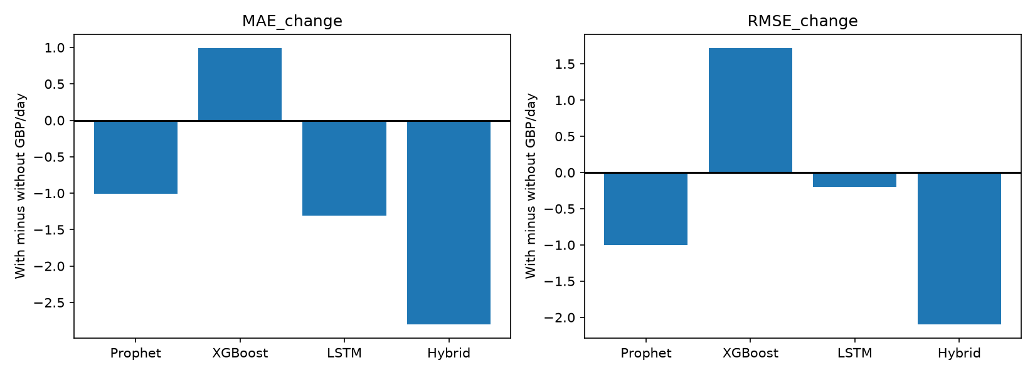
Payroll proxies can improve or worsen forecasts

Slide 5
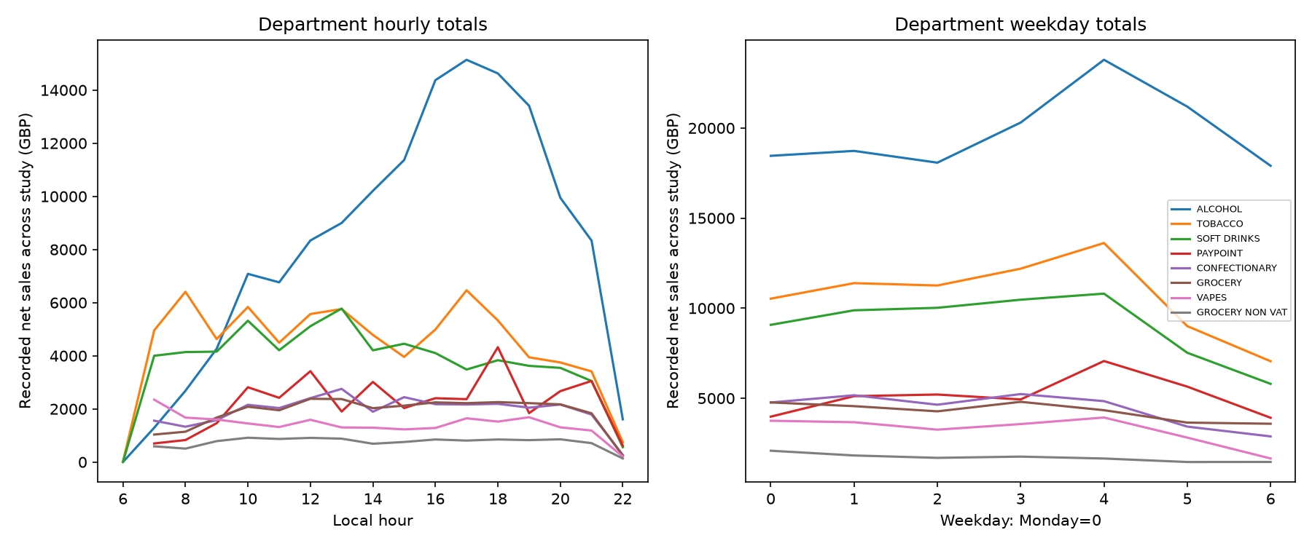
Department behaviour is analysed from recorded sales

Slide 6
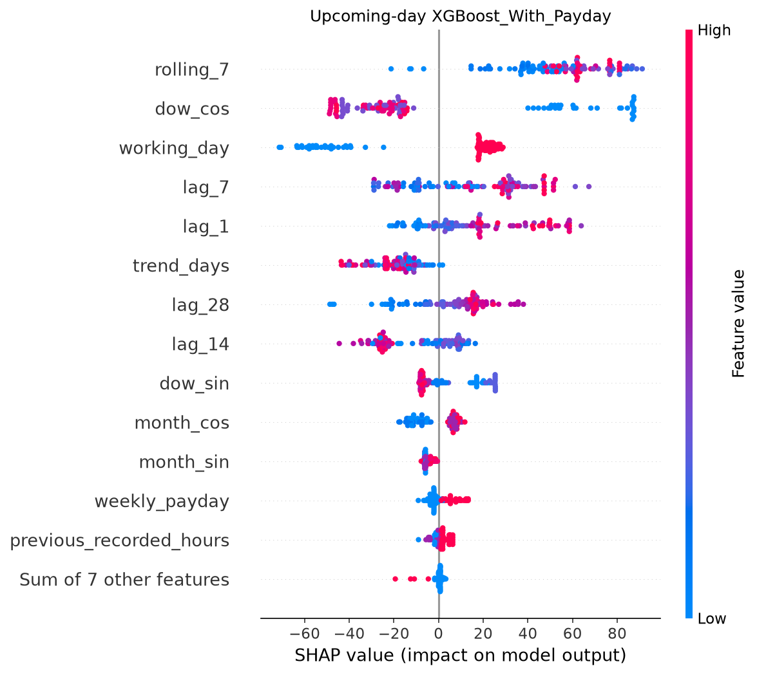
XGBoost explanations describe prediction contributions

Slide 7
What the evidence supports and what remains unknown
England bank holidays and working-day indicators are included.
Payroll features are illustrative monthly, weekly and last-working-day proxies.
Block-bootstrap intervals, temporal folds and LSTM seeds assess uncertainty.
Planning scenarios flag high-revenue days; no measured stockout or staffing savings.
Actual paydays, recording completeness and governance require external evidence.
The hybrid is a weighted ensemble, not a sequential residual cascade.

