Slide 1
NachOS File System
121005 Anokhi Gandhi
121038 Priyanka Shah

Slide 2
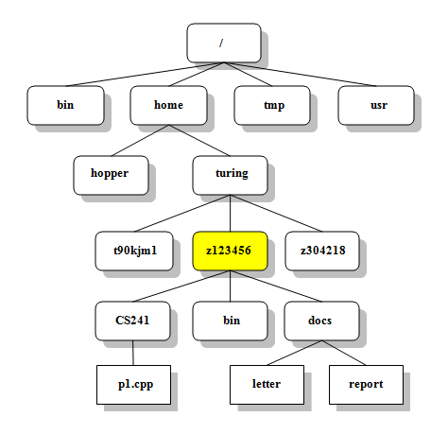
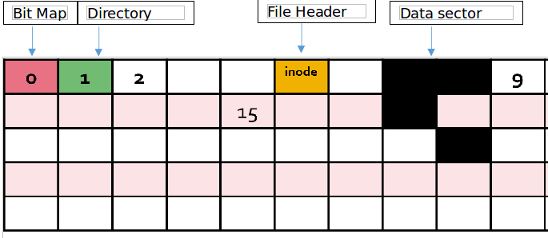
Unix File Structure
Nachos File Structure

Slide 3
Brief of File Codes of Nachos File System
1. filesys.h – filesys.cc
2. openfile.h – openfile.cc
3. synchdisk.h - synchdisk.cc
4. filehdr.h – filehdr.cc
5. directory.h – directory.cc
6. system.h – system.cc
7. bitmap.h – bitmap.cc

Slide 4
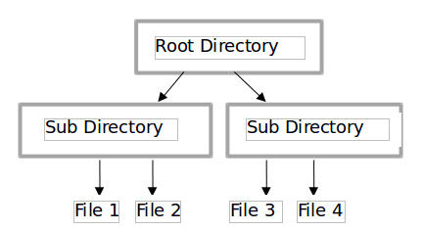
Functions Implemented
1. Creating a file
2. Writing to a file
3. Limitation on file name
4. Hierarchical Implementation of file system

Slide 5
Limitations and Further Implementation
1. Fixed file size.
2. Fixed number of files that can be created-due to assumed initial size of Nachos file system.
3. Allows opening of a single directory-has a single file header and bitmap file.

Slide 6
References
1. https://www.prismnet.com/~mcmahon/Unix_Tutorial/file_structure.html
2. http://www.tutorialspoint.com/unix/unix-file-system.htm
3. http://www.ida.liu.se/~TDDB63/material/begguide/filesystem.html
4. http://www.slideshare.net/jobo.zh/nachos-filesystem-presentation-823345
5. http://www.cas.mcmaster.ca/~qiao/courses/cs3mh3/roadmaps/3.4/filesys.html
6. http://www.cs.rit.edu/~mpv/course/os2/FileSystems.html

Slide 7
THANK YOU

