Slide 1



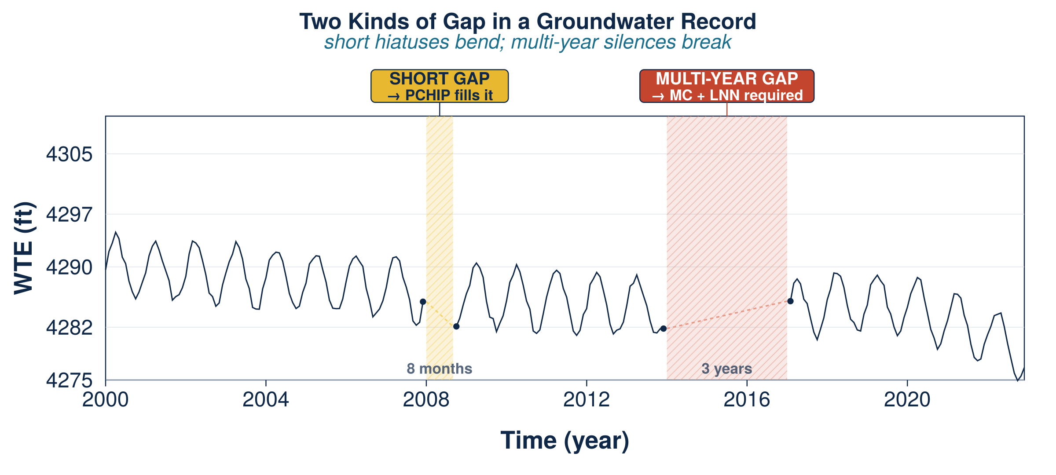
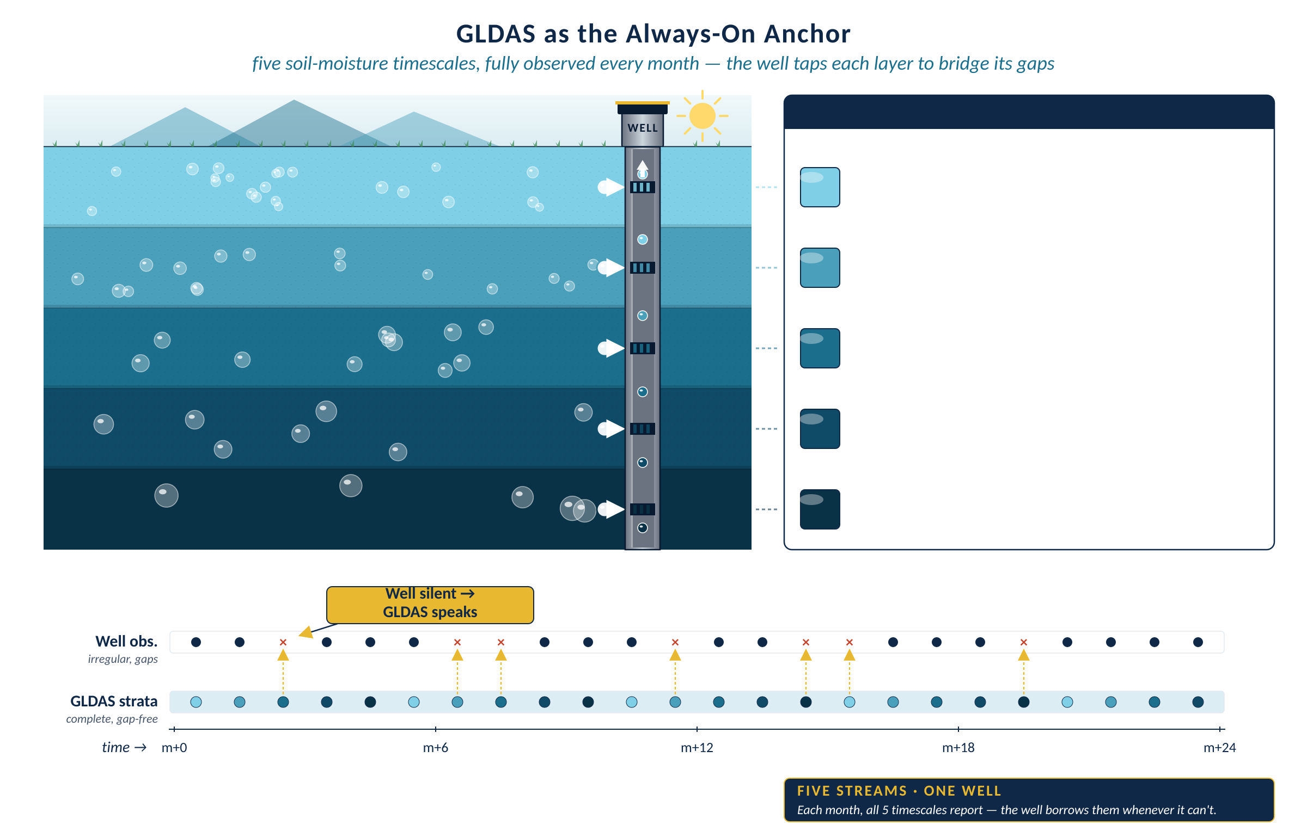
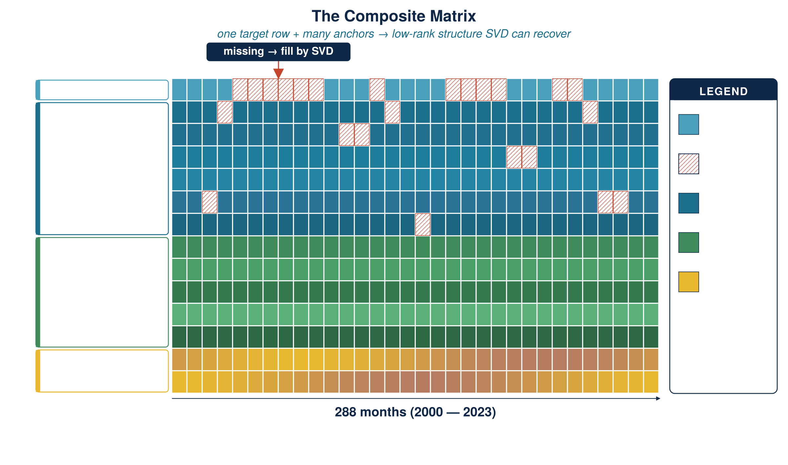
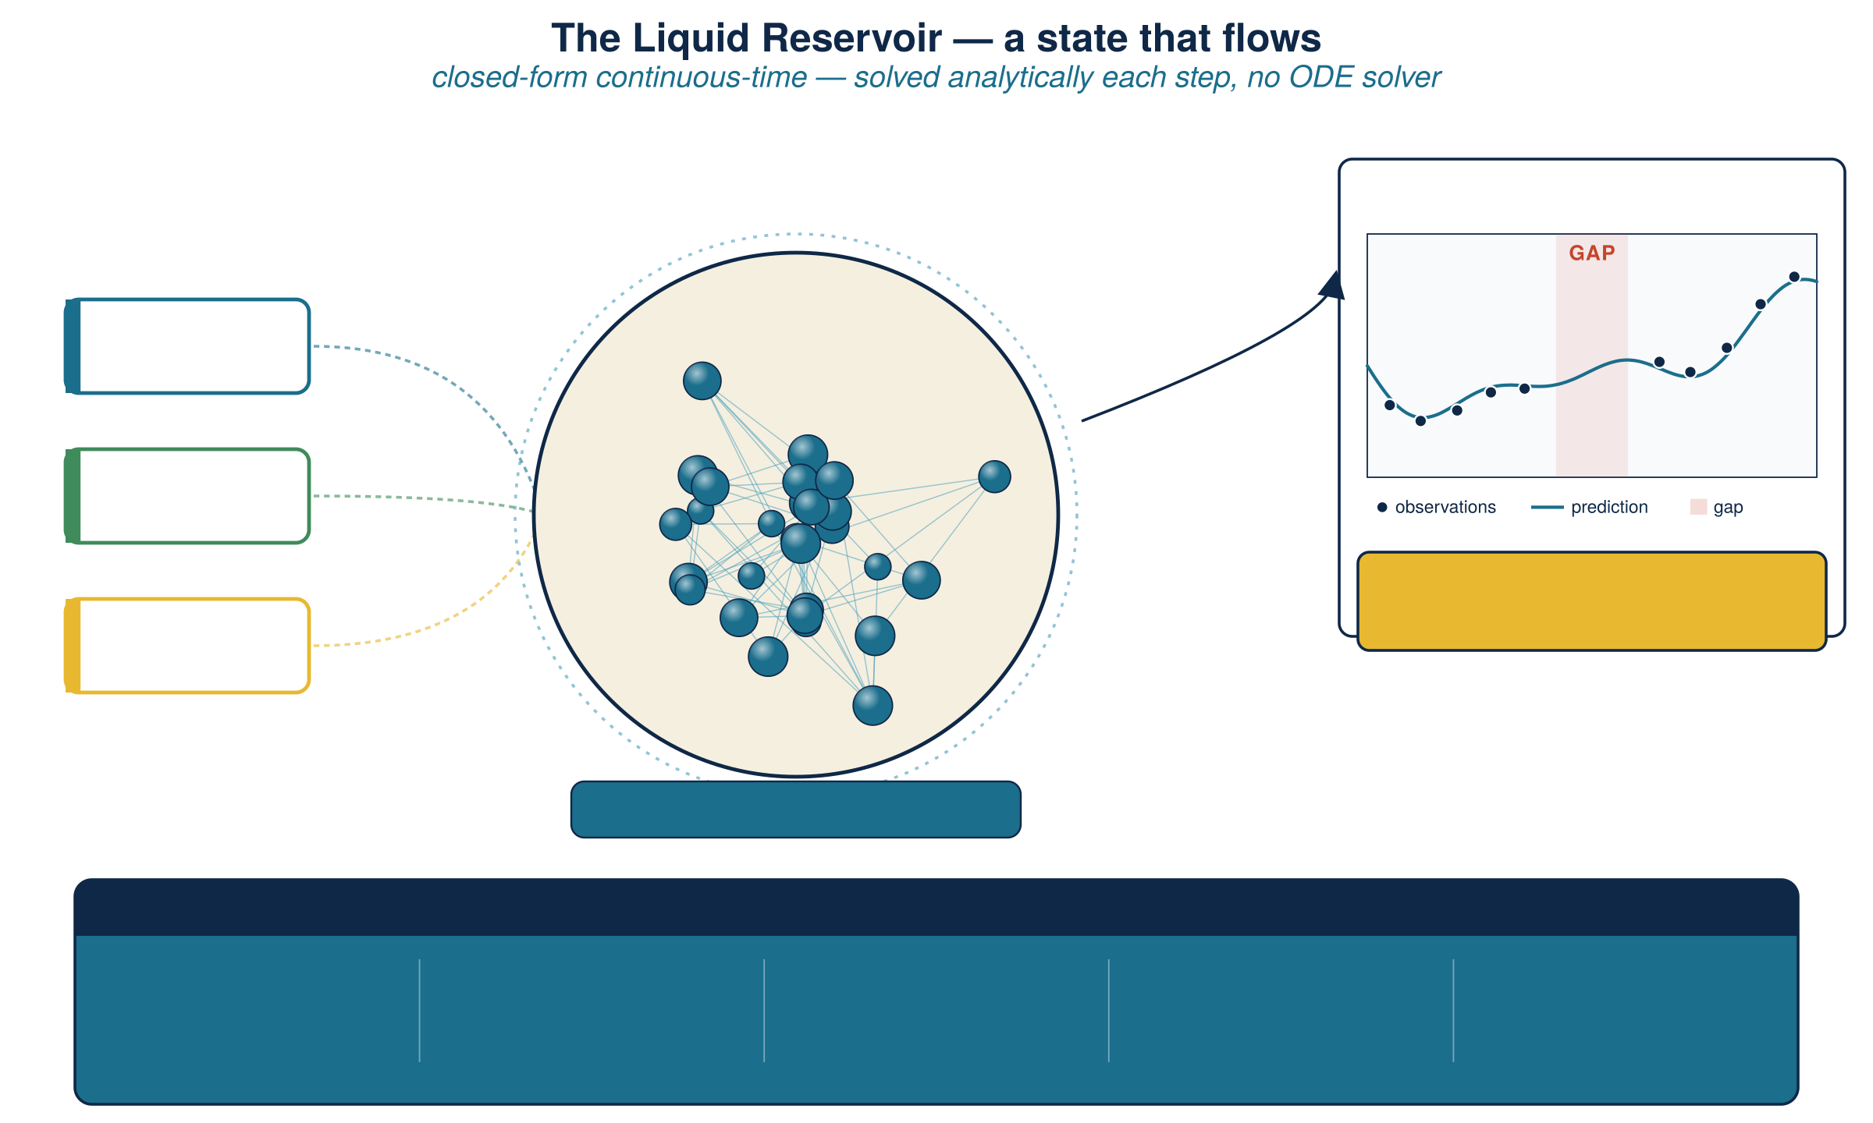

Liquid Neural Network–Based Imputation of Missing Groundwater Time Series Under Sparse Observations
Henok Teklu¹, Norman L. Jones¹, Gustavious P. Williams¹
¹Brigham Young University · Department of Civil & Construction Engineering
1
The Problem
4
How GLDAS Anchors the Model
Groundwater monitoring wells are the primary source of water-table elevation (WTE) data, yet public databases worldwide suffer from temporal gaps spanning months to years.
GLDAS is NASA satellite-derived soil moisture. We treat its five channels — one raw monthly plus four rolling averages (1, 3, 5, 10 years) — as parallel timescale strata. Every stratum reports every month: the SVD taps them whenever a well falls silent.
5 AUXILIARY CHANNELS
soilw
raw monthly
soilw_yr01
1-year avg
soilw_yr03
3-year avg
soilw_yr05
5-year avg
soilw_yr10
10-year avg
2
Matrix Completion
Wells share patterns — seasonal cycles, drought responses, recharge trends — so the well × time matrix is approximately low-rank. Iterative SVD (SoftImpute) simultaneously recovers missing entries from observed entries across wells.
5
The Combined Pipeline
Target well observed values + gaps
STAGE 1 · PCHIP
15 donor wells top-correlated, Pearson-weighted
Shape-preserving interpolation for short gaps. Densifies the network for better donor correlations.
5 GLDAS rows monthly + 1/3/5/10-yr rolling avgs
sin / cos 12-mo seasonal encoding
STAGE 2 · Matrix Completion
ARCHI selects the top-15 donors. SoftImpute on composite matrix with adaptive SVD rank (3–12).
Target well
STAGE 3 · LNN Refinement
to be imputed
Target obs.
Continuous-time CFC dynamics. MC output drives the reservoir; readout trained on real observations only.
well measurements
15 donor wells
Gap
Pearson-weighted neighbors
to impute
Donor wells
spatial context
Design principle
MC supplies spatial context (what do nearby wells say?). LNN supplies temporal dynamics (how does the system evolve between observations?). Neither alone delivers what the coupled framework does.
GLDAS aux.
climate anchor
5 GLDAS aux. rows
Seasonal
monthly + 1/3/5/10-yr avgs
sin / cos cycle
6
Cross-Validation Results
sin / cos seasonal
12-month period
592 wells · Great Salt Lake Basin · 2000–2023
0.85
KGE @ 50% removed
0.82
KGE @ 5-yr gap
3
Liquid Neural Network
50 trials per missing-rate level
20 trials per gap-length level
Random missing data (50 trials / level)
A Closed-form Continuous-time (CFC) Liquid Neural Network (Hasani et al., 2022) models the hidden state as a continuous flow, solved analytically at each step — no numerical ODE solver required. The leak rate λ sets memory horizon. Inputs concatenate MC output, GLDAS soil moisture, and seasonal encoding. The ridge readout is trained ONLY on observed values — MC drives the reservoir through gap periods.
% Removed | KGE | R² | RMSE (ft)
5% | 0.837 | 0.771 | 2.53
20% | 0.853 | 0.787 | 2.64
30% | 0.844 | 0.770 | 2.79
50% | 0.847 | 0.788 | 2.74
Consecutive-year gaps (20 trials / level)
Gap length | KGE | R² | RMSE (ft)
1 year | 0.783 | 0.703 | 2.98
3 years | 0.802 | 0.730 | 3.02
5 years | 0.815 | 0.744 | 2.91
Input vector u(t)
Reservoir state x(t)
Model output — continuous
MC output
7
Conclusions & Applicability
spatial context
GLDAS
①
First hybrid MC+LNN framework for groundwater: MC for cross-well correlations, LNN for continuous-time dynamics on climate auxiliaries.
soil moisture
Ridge readout
sin / cos
trained ONLY on observed values
②
KGE > 0.84 (random ≤50%) and KGE > 0.78 (gaps ≤5 yr) — substantially exceeding prior ELM methods (beyond 2-yr gaps).
seasonality
PCHIP densification lifts the full pipeline by 10–19% KGE via stronger donor correlations.
closed-form continuous-time state
③
AUTO-TUNED PER WELL
④
Plug-and-play: needs only incomplete well records + public GLDAS. No calibration.
TRIALS
RESERVOIR
LEAK RATE
ENSEMBLE
OBJECTIVE
8
10–80
0.05–0.95
3 seeds
KGE
each well's hyperparameters optimized independently via Optuna
ACKNOWLEDGMENTS
CORRESPONDING AUTHOR
Funding for this project was provided by the National Oceanic and Atmospheric Administration (NOAA), awarded to the Cooperative Institute for Research on Hydrology (CIROH) through the NOAA Cooperative Agreement with The University of Alabama. Grant number: A24-0421-S001.
Henok Teklu
anom37@byu.edu
Brigham Young University

