Slide 1
Technical Institute Certification Program
By: Amelie Yen, Wary Vega, and Xander Fry

Slide 2
Concept
Certain jobs in construction related work have a plethora of different job types, as well as requiring operations of many different types of equipment. People looking to work in construction or those who are already in it but want to transition to a different job type in the field, all would need to get the proper training and certification to be equipped for the job. Training institutions provide this, and our web application provides a way for faculty to track students and their certifications.

Slide 3
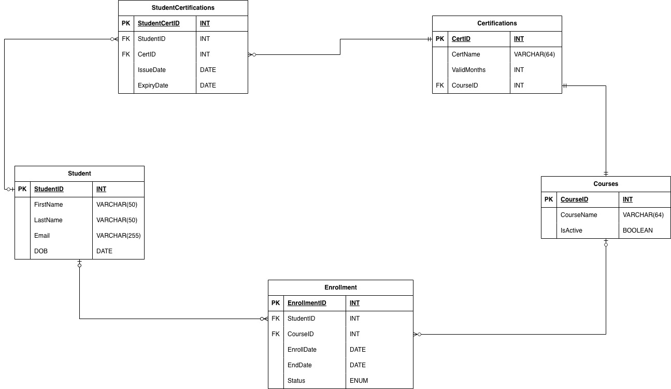
ERD

Slide 4
Application Functions
Our web application for the technical institute certification program has the following functions:
SELECT/QUERY: Faculty can look up student, course, and certification data.
INSERT: Faculty can add new students, courses, or certifications.
UPDATE: Faculty can update student, course, and certification information.
DELETE: Faculty can remove students, courses, or certifications as needed.

Slide 5
DEMO

