Slide 1
Artificial Intelligence Numpy, Pandas, visualization Techademy Summer Session June 01, 2020 – June 26, 2020
Presented By: Anoop Mishra, Dilanga Abeyrathna
The University of Nebraska at Omaha

Slide 2

RULES:
NO mobile phones
No texting
No video games

Slide 3
Data
Data: information processed
Types: Structure and unstructure
Examples: text, images, audio
Data Science: Detailed study of the flow of information
Role of Statistics: concerns the collection, organization, analysis, interpretation and presentation of data (Reference: https://en.wikipedia.org/wiki/Statistics)

Slide 4
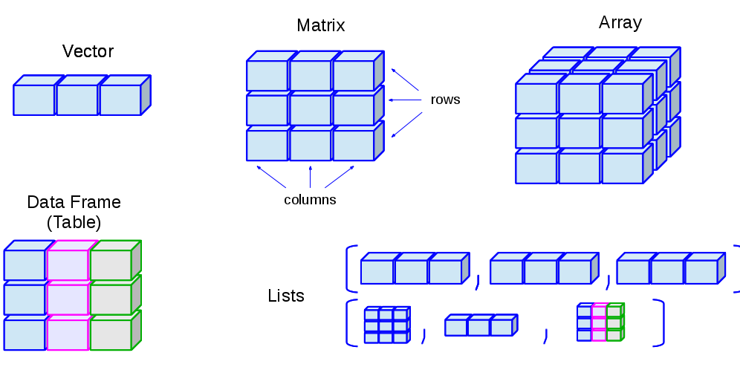
Data Representation
Thanks to links

Slide 5
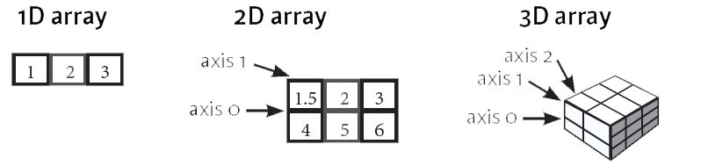
Numpy
Numerical Python: Core scientific library for scientific computing
Different from lists
Arrays: grid having same-type values, x = (1,2,3,4)
Numpy array: multi-dimensional array (ndarray) that contains same datatype and size
Thanks to links

Slide 6
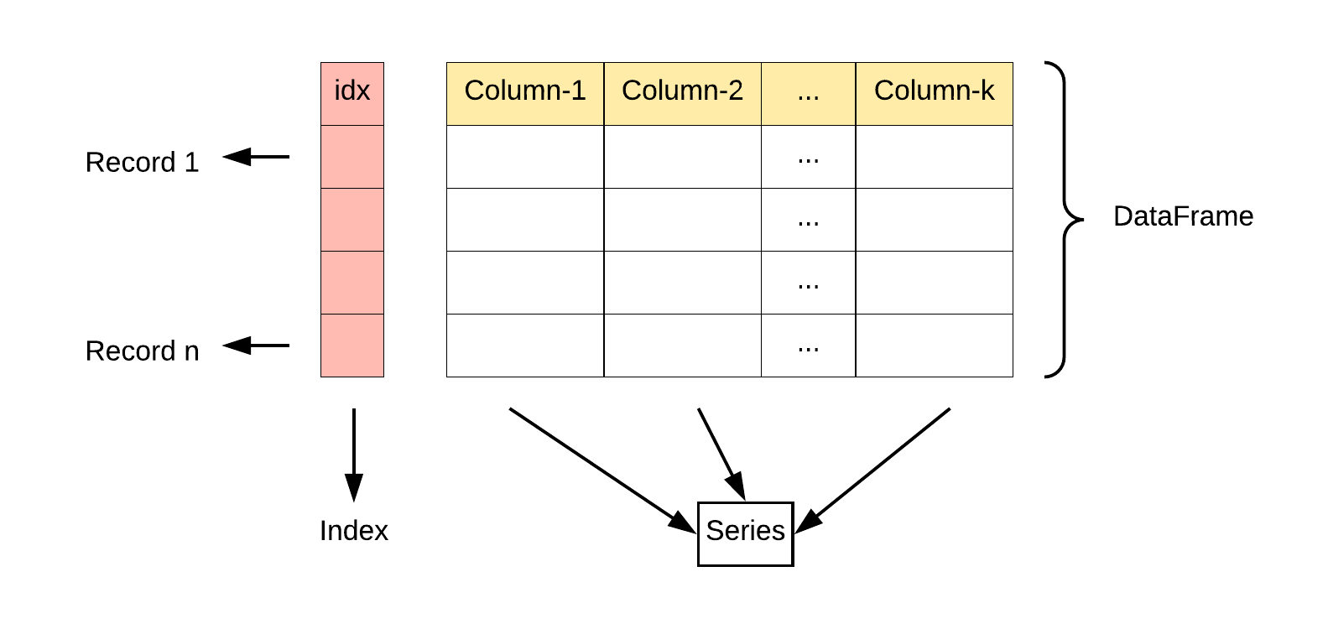
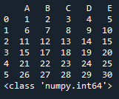
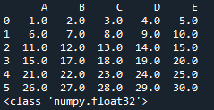
Dataframes
DataFrames: A numpy 2D-array having rows and columns

Slide 7
Pandas
Pandas: software library developed in python
Used for data manipulation and analysis
Provides high performance
Thanks to links

Slide 8
Tutorials Link
Numpy: https://numpy.org/devdocs/user/quickstart.html
Python Data_analysis book: https://colab.research.google.com/github/jakevdp/PythonDataScienceHandbook/blob/master/notebooks/Index.ipynb
Thanks to links

