Slide 1




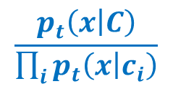

$$p_{t}(x|C)$$
$$\frac{p_{t}\left(x | C\right)}{\prod_{i}{p_{t}\left(x | c_{i}\right)}}$$
$$p_{t}(x|c_{1})$$
$$p_{t}(x|c_{1})$$
$$x_{t}$$
$$x_{t}$$

