Slide 1
LoRaWAN-Blockchain
By Valentin Roch, Carolina Pereira and Noah Godel

Slide 2
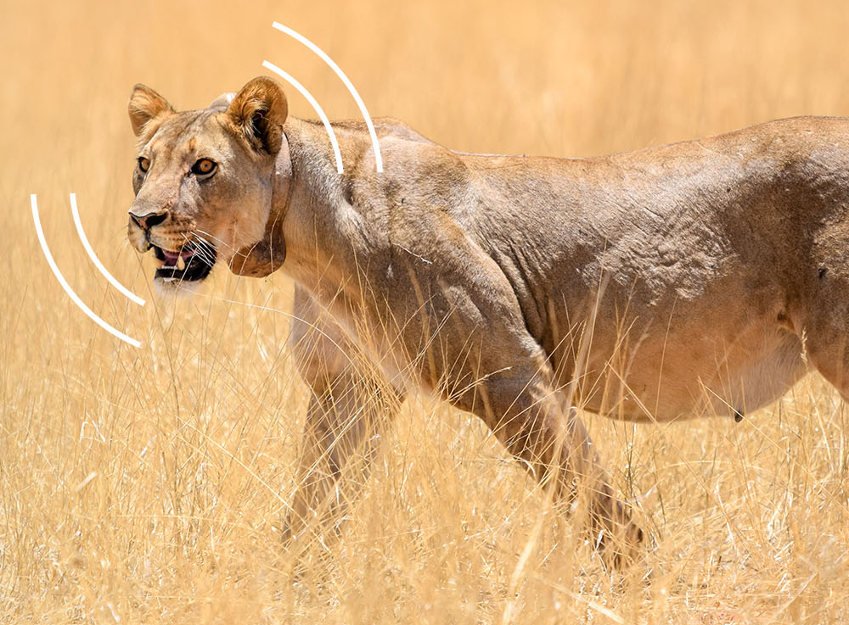
What?
Software solution for wildlife tracking

Slide 3
Why?
Currently used devices are very expensive, difficult to use, heavy and have a short battery life (they have to be replaced, risk for the animal)
LoRaWAN devices are smaller, lighter, range and longer battery life

Slide 4
Target?
Wildlife managers (whole solution)
Tourism, etc (web interface access)

Slide 5
How?
Linking blockchain and LoRaWAN technologies
gateway
Blockchain service
emitter node
emitter node
Web interface
emitter node

