Slide 1
Steganography

Slide 2
Outline
Overview
  Introduction to Steganography
  Steganography’s history and modern-day importance
  Common terms
Steganography in various digital media
  Common Digital Steganography Variants
  Application

Slide 3
What is Steganography?
The word means concealed writing (Greek word steganos – “covered or protected” and Latin graphia - “writing”).
It is the art and science of hiding messages so that no one suspects the existence of the message.

Slide 4
Basic Terminology
Carrier or Cover File – A file in which hidden information will be stored.
Stego-Medium – The medium in which the information is hidden.
Payload or Embedded file/text – The information which is to be hidden.
Steganalysis – The process of detecting hidden information inside a file.

Slide 5
History
Uses of Steganography can be traced back to 440 BC. Since then it has been used in form of:
  Wax tablets
  Messenger’s shaved heads
  Microdots
  Variation in letter typeface (font)
  Special inks during Second World War.

Slide 6
Modern day uses
Watermarking published works
Prevent counterfeiting
Image Authentication
Covert Ops
  Espionage
  Journalism

Slide 7
Not so good uses
Terrorism
Organised crime
Malware delivery

Slide 8
Steganography vs Cryptography
Cryptography aims to make information unreadable.
Steganography even conceales the existence of the message.

Slide 9
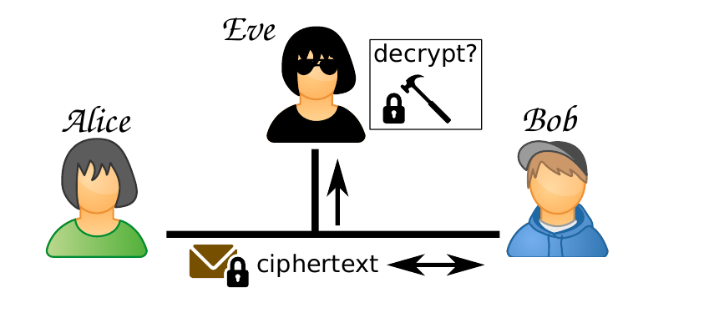
Framework for Analyzing Cryptographic Systems
Goals
  Alice & Bob: Communicate through unbreakable ciphertext
  Eve: Break Alice and Bob’s encryption

Slide 10
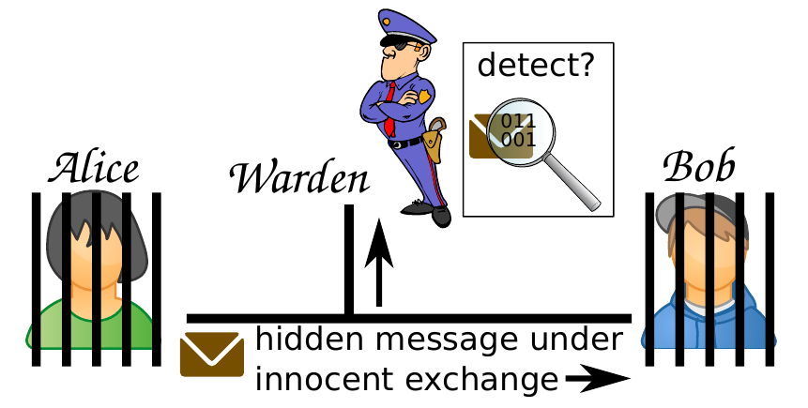
Framework for Analyzing Steganographic Systems
New Goals:
  Alice & Bob: Exchange secret messages that cannot be detected
  Warden: Detect the presence of secret messages in cover

Slide 11
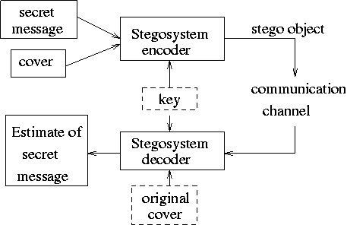
Basic Steganography Model

Slide 12
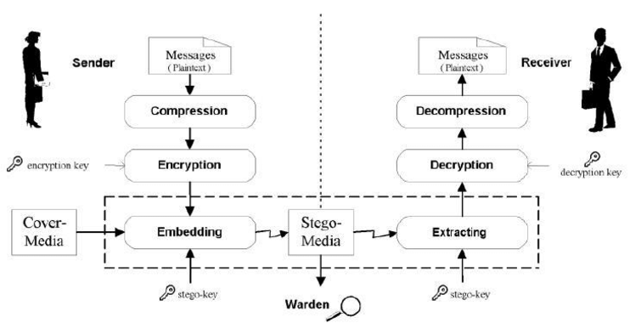
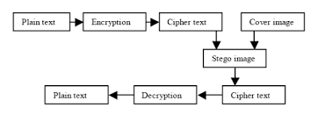
Combined Crypto-Steganography

Slide 13
Types of Steganography
Steganography
Text
Audio
Video
Image
Network

Slide 14
Text
Open space methods
  Line shift coding
  Word shifting coding
Semantic methods
  Synonyms
  Spellings

Slide 15
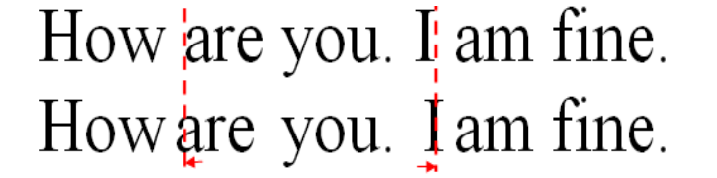
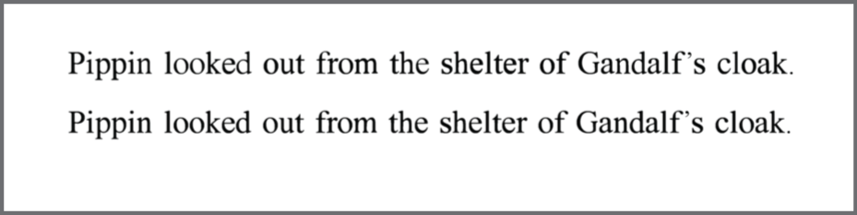
Text Stego examples

Slide 16
Text Stego examples
Apparently neutral’s protest is thoroughly discounted and ignored. Isman hard hit. Blockade issue affects pretext for embargo on by-products, ejecting suets and vegetable oils.
The message:
Pershing sails from NY June 1.

Slide 17
Audio
Audio wave Modulation
LSB embedding
Message embedded in Audio Spectrograph

Slide 18
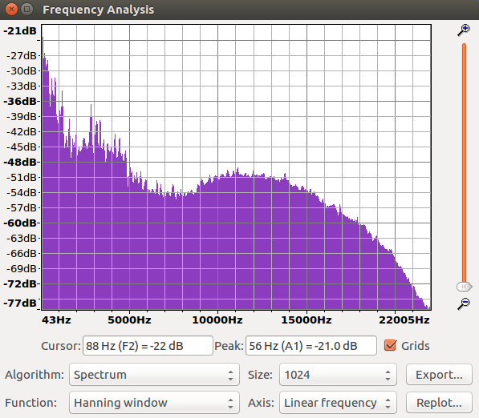
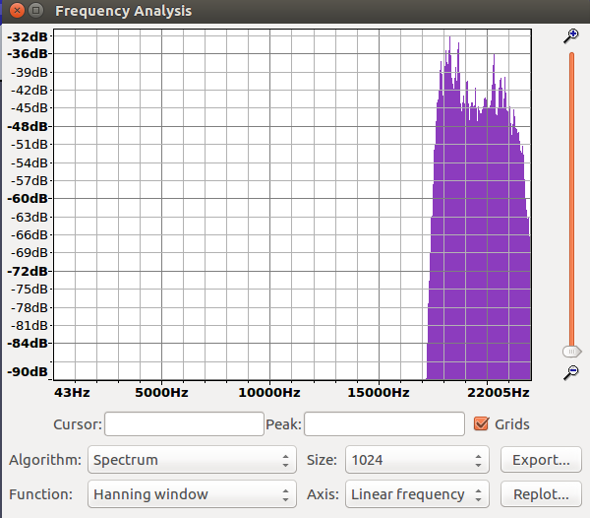
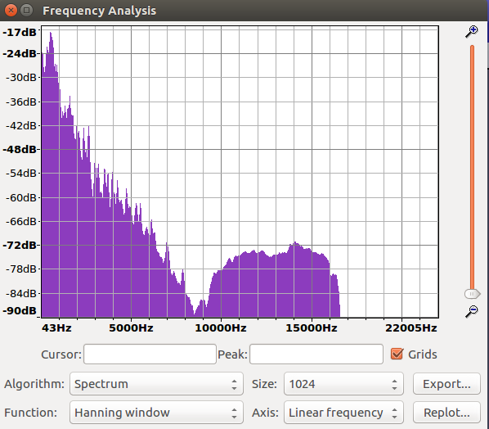
Audio example:
Frequency modulation
Secret Audio Payload
Modulated payload
Carrier

Slide 19
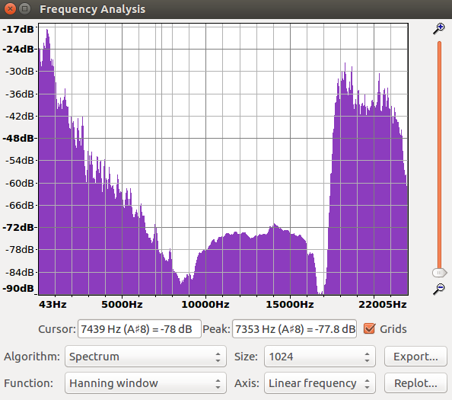
Carrier + Modulated Payload

Slide 20
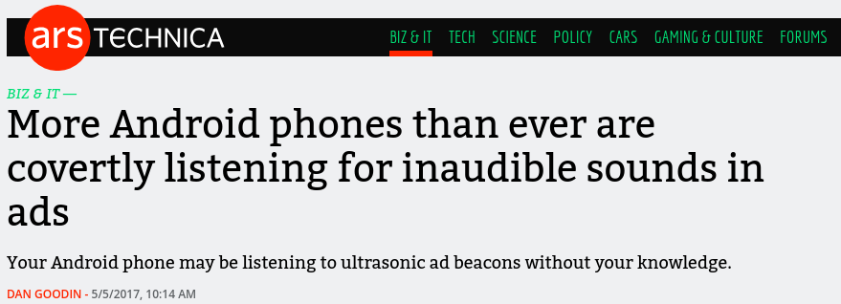
Case 1:
SilverPush, Gurugram based Advert Company used audio “Beacons” to track behaviour

Slide 21
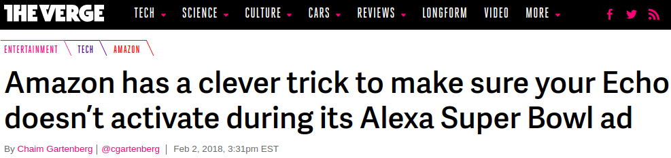
Case 2:

Slide 22
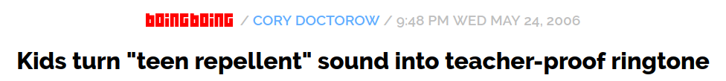
Case 3:

Slide 23
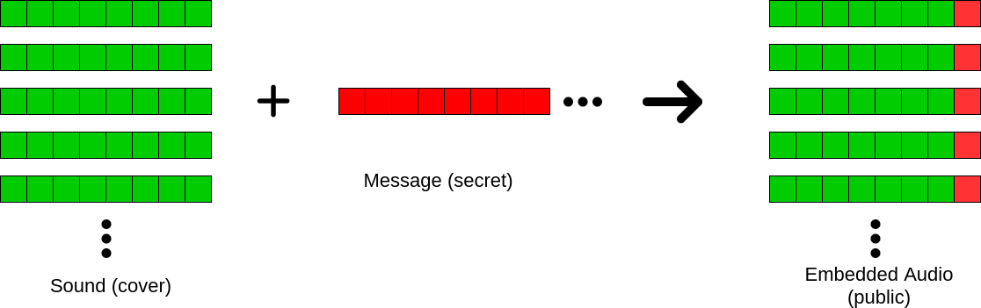
LSB method

Slide 24
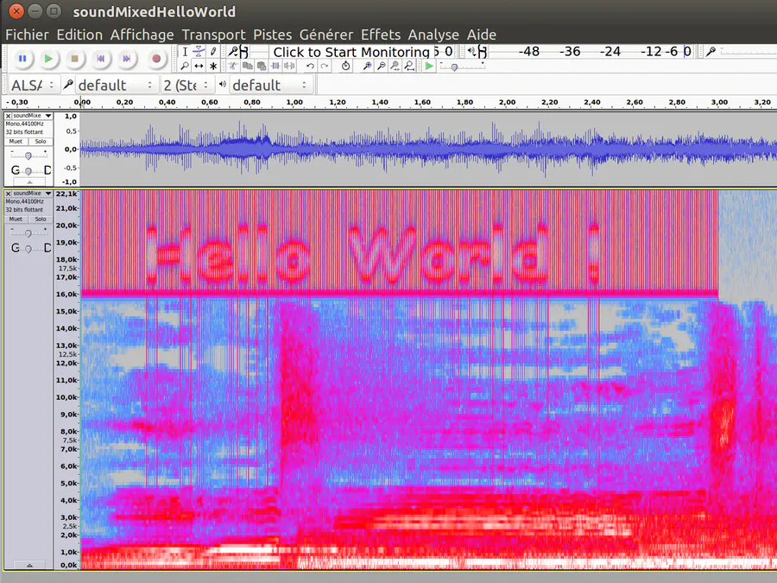
Embedding in audio spectrograph

Slide 25
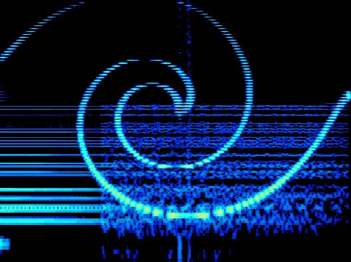
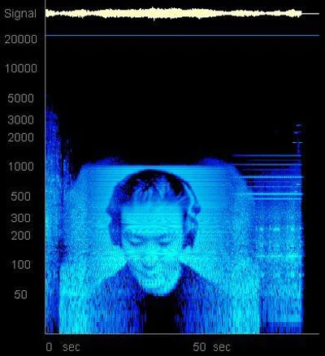
Windowlicker by Aphex Twin
Transitions by DJ Sonix

Slide 26
Videos
Embedding Files
Watermarking Screeners

Slide 27
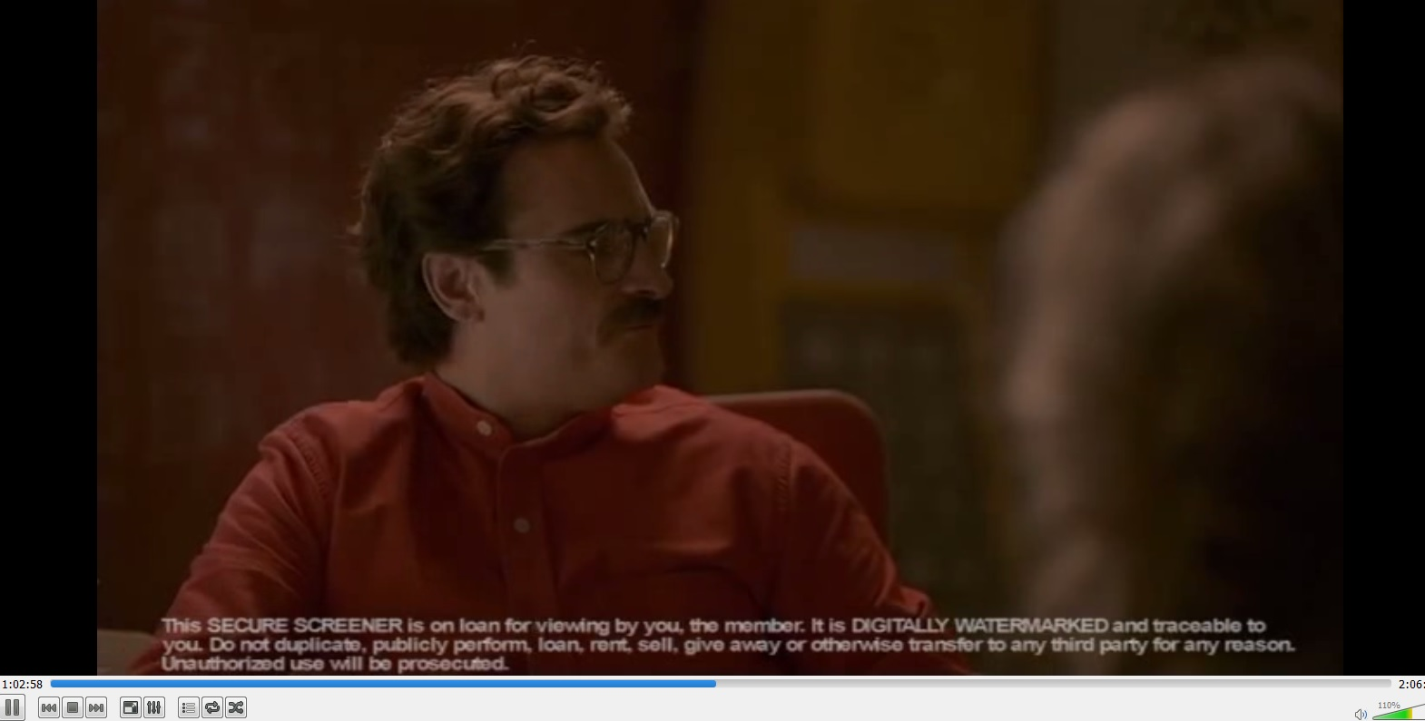
Screeners

Slide 28
Images
LSB
DCT – Discrete Cosine Transform Stego
EXIF Metadata

Slide 29
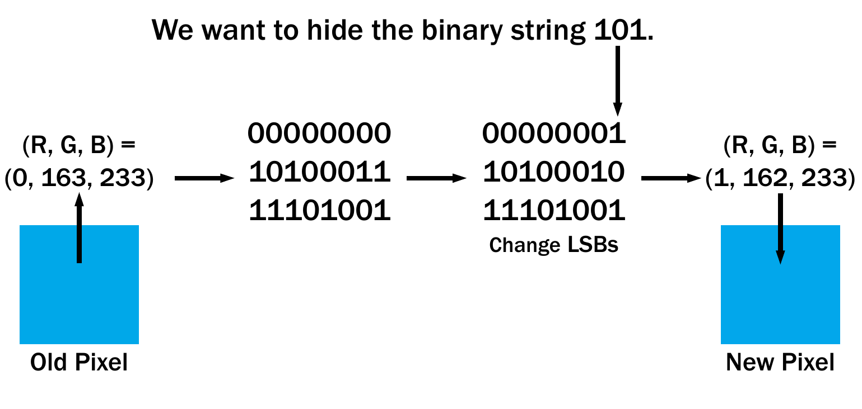
LSB Steganography (Hypothetical) Example

Slide 30
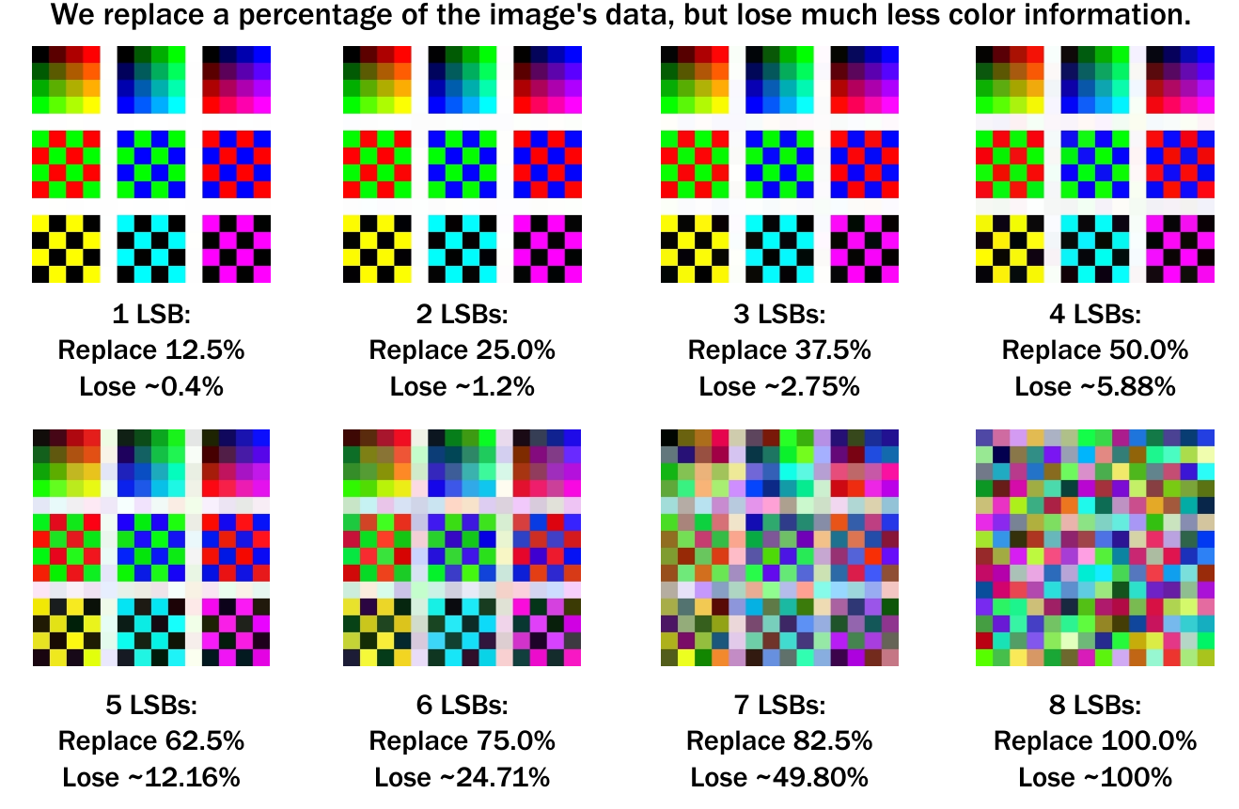
How Many Bits To Use?

Slide 31


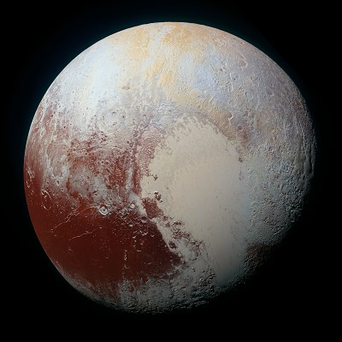
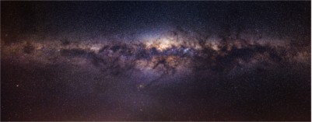
Using 2 LSBs:
Twitter Profile Picture (400x400)
We can hide:
  120,000 Bytes
  ~117.19 KiB
1080p Desktop Background (1920x1080)
We can hide:
  1,555,200 Bytes
  ~1.48 MiB
NASA Image of Pluto (8000x8000)
We can hide:
  48,000,000 Bytes
  ~45.78 MiB
Panorama of Milky Way (16702x6568)
We can hide:
  82,274,052 Bytes
  ~78.46 MiB

Slide 32
Detecting LSB Steganography
LSB Steganography depends on altering the LSBs
of each color value.
We can isolate these LSBs and display them
alone through linear normalization.
This is called a visual attack.

Slide 33
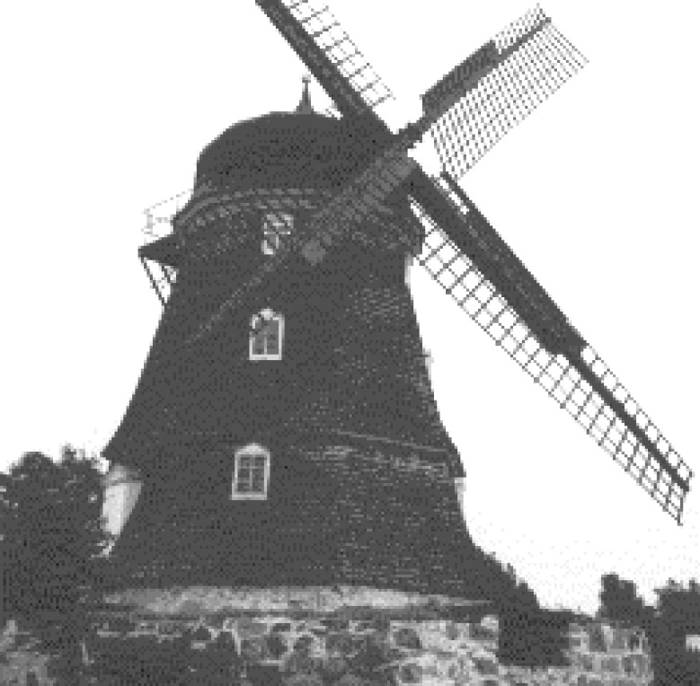
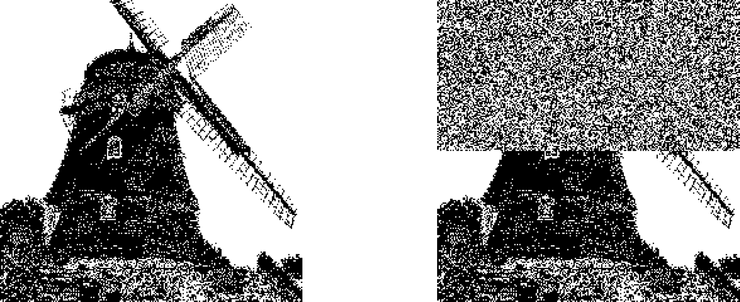
Example
Original
LSBs of Original
LSBs of
Steganographed Version

Slide 34
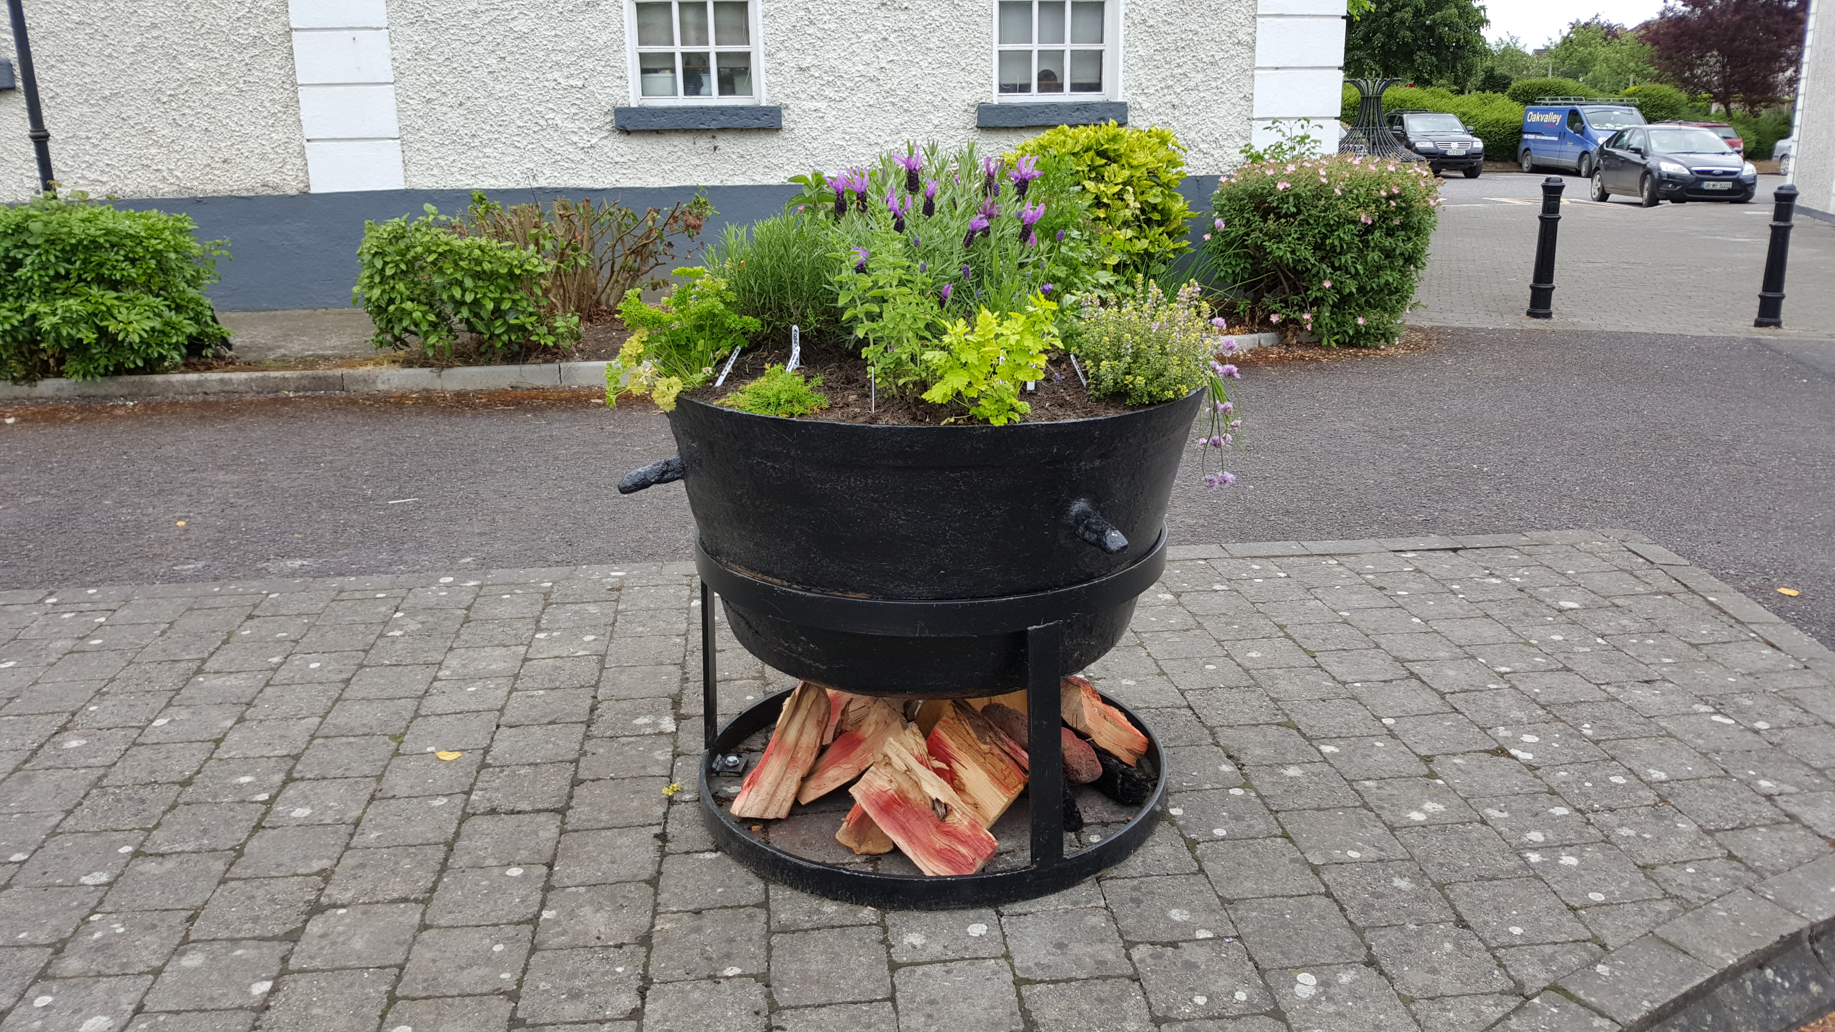

Example 2
Original
Image with Embedded file

Slide 35

When you subtract the two files:

Slide 36
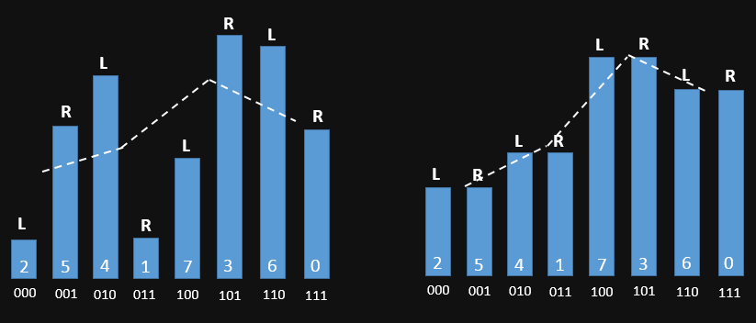
Analysing raster of image
Empty Carrier
Filled Carrier

Slide 37
Exif Data
Exchangeable image file format
  The Metadata stored in image and audio files
  Can have
    ISO, Exposure, Shutter Speed, Aperture, Date & Time
    Geolocation, Artist, Device Name, Camera Firmware version, Sensor size etc.

Slide 38
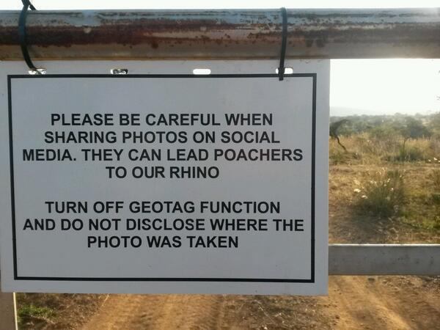
Metadata : more cons than pros
Image taken by Eleni de Wet in South Africa and posted on her twitter on 4 May 2012.

Slide 39
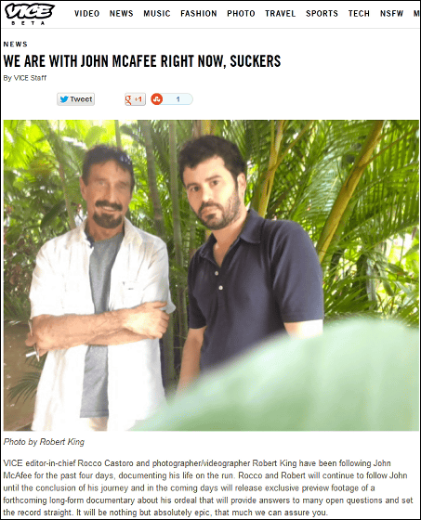

Slide 40
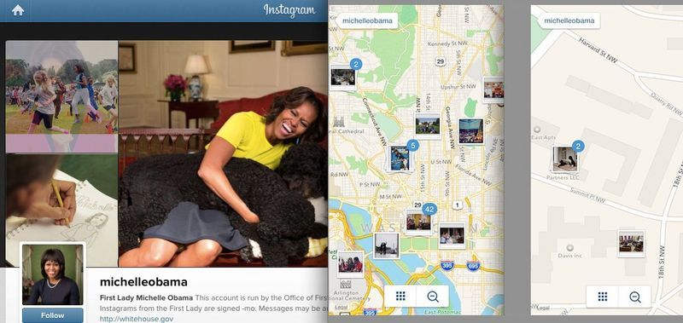

Slide 41
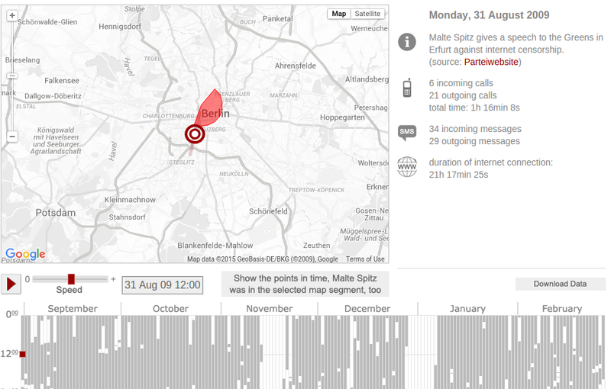
Exposing the individual... and everyone else

Slide 42
Other incidents
Switzerland
  A secret hideout location exposed
Iraq (2007)
  Several AH-64 Apache helicopters located and destroyed

Slide 43
Ways metadata can be stored
Images
PDF files
Text files
Videos
Audio
Communication

Slide 44
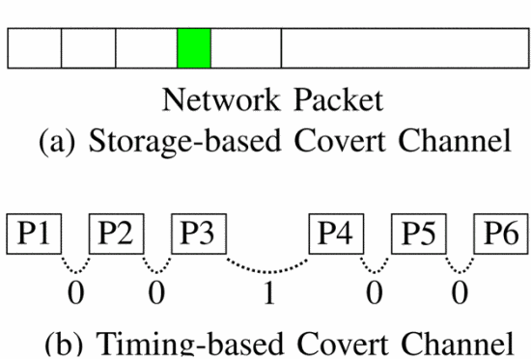
Network Steganography

Slide 45
Project Rook
Uses online First Person Shooter (FPS) games to send data covertly.
Successfully tested on “Team Fortress 2”
A similar framework can be applied to Real Time Stratagy (RTS) games.

Slide 46
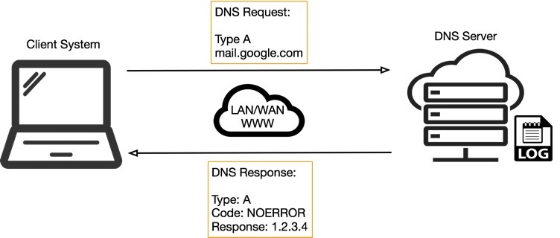
DNS Tunneling
Simplified DNS operation

Slide 47
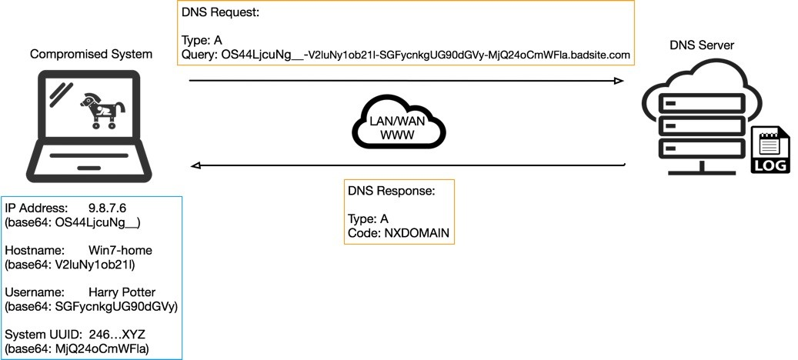
C2 DNS query operation

Slide 48
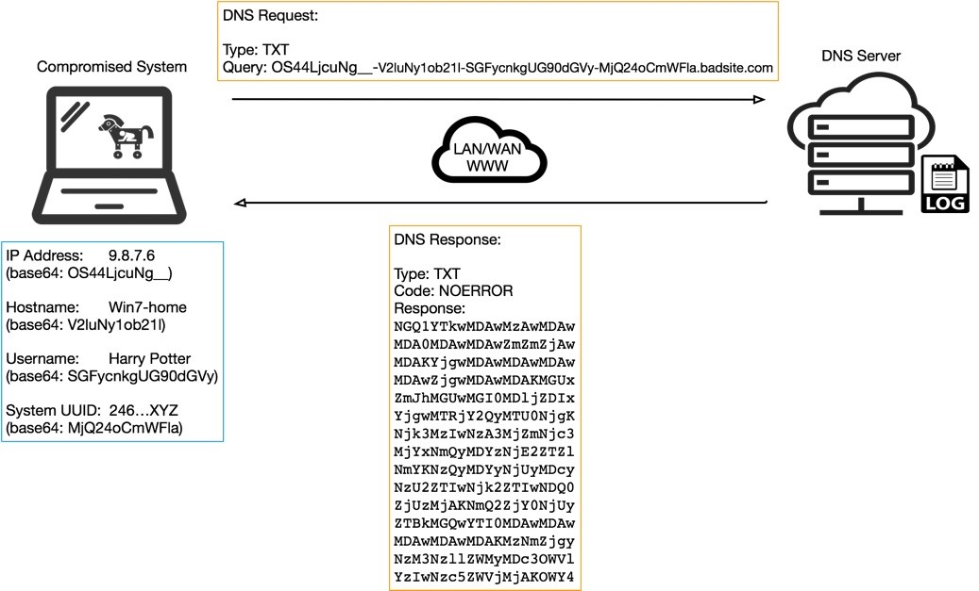
Data Infiltration
C2 DNS query with TXT type response

Slide 49
Thank You

