Slide 1
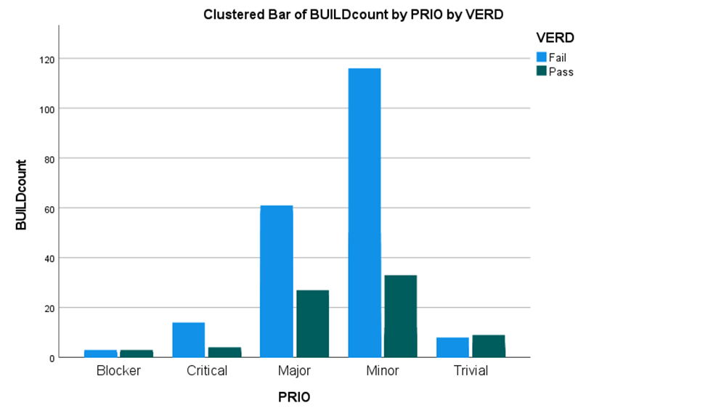
Clustered Bar of BUILDcount by PRIO by VERD
VERD
VERD
Failed
120
Passed
100
Buildcount
80
60
40
20
0
Blocker Critical Major Minor Trivial
PRIO

