Slide 1
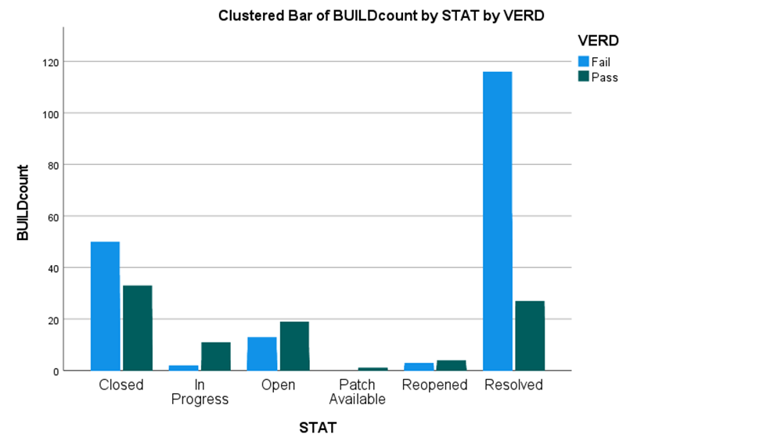
Clustered Bar of BUILDcount by STAT by VERD
VERD
120
Failed
100
Passed
Buildcount
80
60
40
20
0
Closed
In Progress
Open
Reopened
Resolved
Patch
Avail.
Stat

