Slide 1
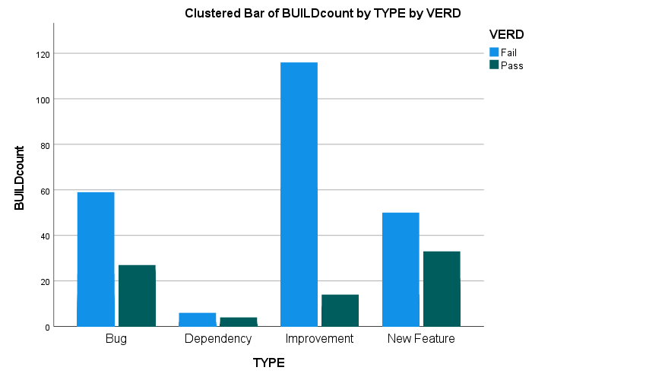
Clustered Bar of BUILDcount by TYPE by VERD
VERD
Failed
120
Passed
100
Buildcount
80
60
40
20
0
Bug Dependency Improvement New Feature
Type

