Slide 1
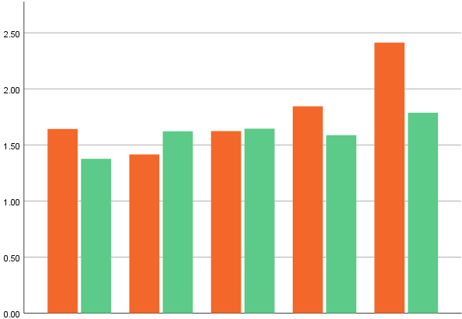
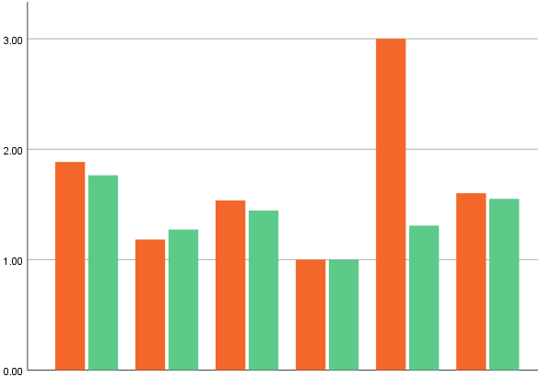
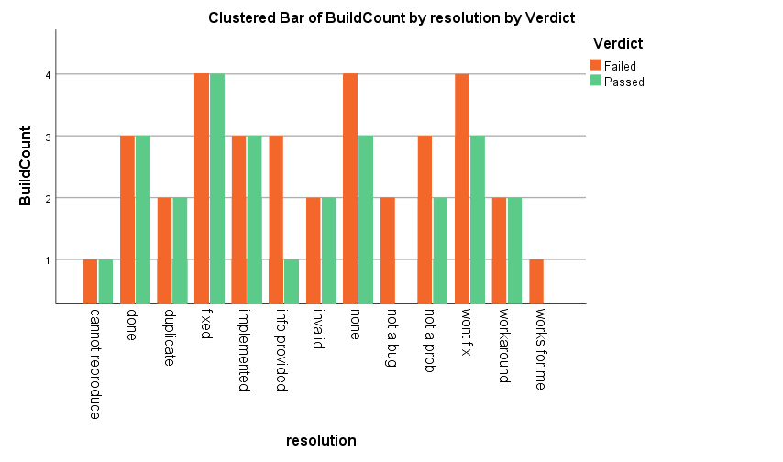
Verdict
Priority
Status
Resolution
Failed
Passed
Build Count
Fixed
Provided
Won’t
Major
Minor
Trivial
Invalid
Open
Done
Info.
None
Fix
Works
Critical
Blocker
Closed
Patch
Resolved
Not A Bug
Problem
For Me
Progress
Available
Reopened
Duplicate
Not A
In
Reproduce
cannot
Implemented
Workaround

