Slide 1

Project Title: Smart Home
Introduction:
The rise of technology has ushered in the era of "smart homes," offering homeowners enhanced convenience, efficiency, and security.
Traditional manual operations for tasks like lighting and security are replaced by automated systems utilizing microcontrollers, sensors, and communication protocols.
Arduino, with its versatility and affordability, is an ideal platform for developing these systems. Smart home projects have gained traction, allowing customization and innovation.
Our project aims to leverage Arduino-based smart home automation to enhance comfort, convenience, and security while promoting energy efficiency and sustainability.
1

Slide 2
Project Statement
Utilizing Arduino Microcontrollers
Our smart home automation project utilizes Arduino microcontrollers to develop an innovative solution for enhancing homeowners' quality of life.
By integrating sensors for environmental monitoring and user activity detection, along with actuators for controlling household systems, the project aims to offer convenience, efficiency, and security through automated control.
Energy Efficiency and Sustainable Living
Additionally, it explores Arduino's potential in promoting energy efficiency and sustainable living practices.
The project provides an affordable and customizable platform, empowering homeowners to transform their houses into intelligent living spaces tailored to their needs.
2

Slide 3
Project Objectives
Automation
To automate various aspects of home management including lighting control, temperature regulation, security monitoring, and energy management.
This will reduce the reliance on manual intervention and enhance the efficiency of household tasks.
User-Friendly Interface
To create a user-friendly interface that allows for intuitive control and monitoring of the smart home automation system.
The interface will provide real-time feedback on device status and enable users to easily manage.
3

Slide 4
Integration
To integrate sensors for environmental monitoring and user activity detection, as well as actuators for controlling light.
This will create a comprehensive system that responds intelligently to changes in the home environment and user preferences.
Energy Efficiency
To optimize energy consumption by implementing smart energy management strategies adaptive control. This will reduce energy waste and contribute to environmental sustainability.
Security Enhancement
To enhance home security through automated monitoring. This will improve the safety and protection of the home and its occupants.
4

Slide 5
Significance of the Project
Convenience and Comfort
Energy Efficiency
Enhanced Security
Optimizing energy consumption reduces utility costs and contributes to environmental sustainability.
Automated security systems improve home safety by detecting and responding to threats in real-time.
Automating routine tasks enhances convenience and creates a more relaxed living environment.
5

Slide 6
Scope of the Project
Lighting Control
Temperature Regulation
Security Systems
Data Monitoring
Automate lights to turn on/off based on time of day and presence detection.
Implement basic security measures using sensors.
Collect and monitor sensor data (temperature, sound, light) for analysis and potential actions.
Maintain a comfortable environment based on temperature readings.
6

Slide 7
Requirement Specification
Functional Requirements
Non-Functional Requirements
Temperature Monitoring: Measure and display temperature.
Reliability: Operate reliably under various conditions.
Provide real-time readings via a user interface. Lighting Control: Automate based on time or sensors.
User Interface: Intuitive interface for easy interaction. Informative feedback.
Security: Strong measures to protect data. Authentication.
Security System: Implement door sensors using keypad password and card scanner (RFID).
Performance: Optimize response times and resource usage.
Door control.
Constraints: Hardware Limitations: Work within Arduino's capabilities.
Power Supply: Ensure stable power. Budget: 1110 birr.
7

Slide 8
Design of the Project
Arduino Board
Sensors and Modules
Arduino IDE
Arduino microcontroller board as the brain of your smart home system. Popular options include Arduino Uno, Arduino Nano, or Arduino Mega.
Temperature Sensor: To monitor environmental conditions.
Essential for coding and uploading to Arduino boards. Downloaded from Arduino's official website.
Sound Sensor: To measure sound levels for automation purposes.
Relay Module: For controlling appliances or devices .
8

Slide 9
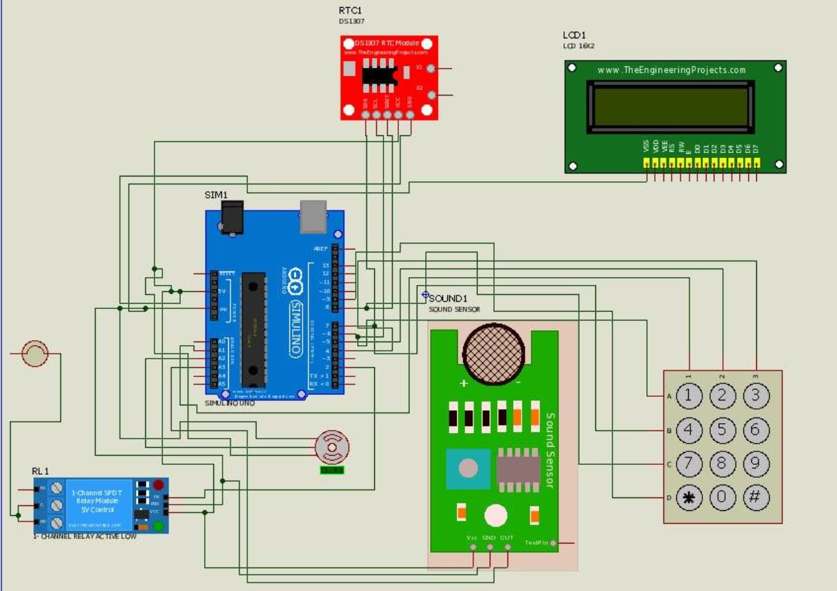
Semantic View (PCB)
9

Slide 10
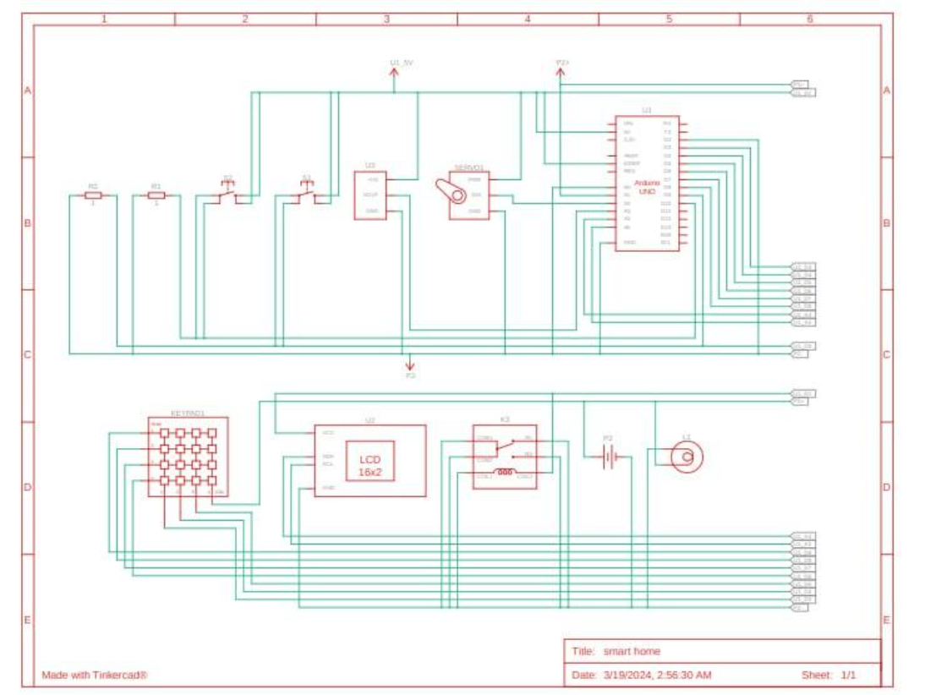
Circuit View
10

Slide 11
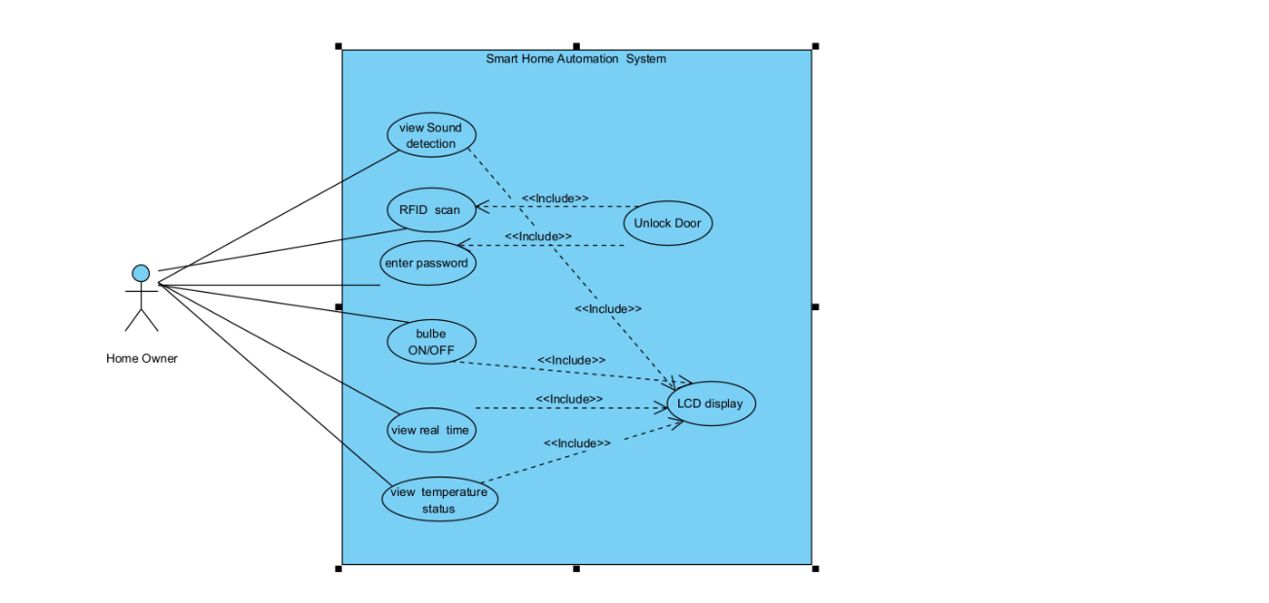
System Use Case
11

Slide 12
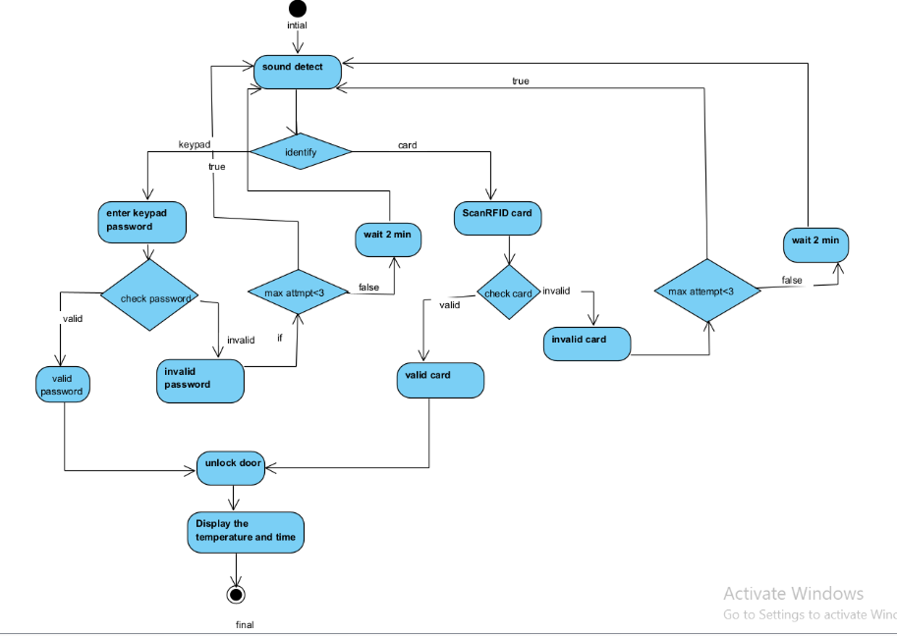
Activity diagram
12

Slide 13
Deployment
Deployment Steps
Assembly: Step-by-step hardware assembly instructions with visuals if available.
Installation: Detailed process for uploading software to the Arduino board, including library installation.
Power Up: Instructions for connecting power sources safely.
Verification: Guidance on checking indicators, sensor readings, or accessing the system post-deployment.
13

Slide 14
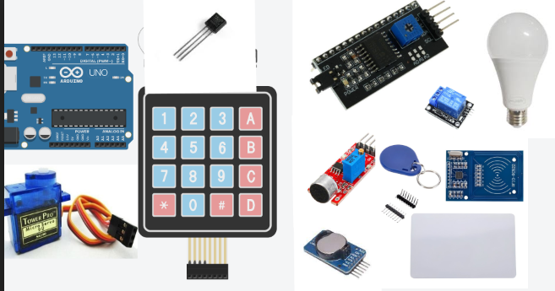
Hardware components
14

Slide 15
Testing and Maintenance
1
Testing
Functional Testing: Ensure the temperature sensor accurately measures ambient temperature. Sound Detection: Confirm sound sensor detects sound within its range. Unauthorized Access: The system effectively prevented unauthorized access attempts and responded appropriately to security threats.
2
Maintenance
Routine Maintenance Tasks: Outline routine tasks such as checking hardware connections, cleaning sensors, verifying power sources, and updating software/firmware.
Maintenance Schedule: Recommend a schedule for users to stay proactive, including weekly, monthly, and yearly tasks, reminders for updates, and preventative measures.
15

