Slide 1
Lending Club Case Study
Sachin Athreya (Group Leader)
Dibyendu Mukherjee

Slide 2
Objective
The Objective of this case study is to implement EDA technique and understanding of risk analytics in banking and financial services and understand how data is used to minimize the risk of losing money while lending to customers.
Problem to be solved: Identify patterns based on the columns which would be used to reject/deny loans, reduce the loan amount or charge higher interest rate.

Slide 3
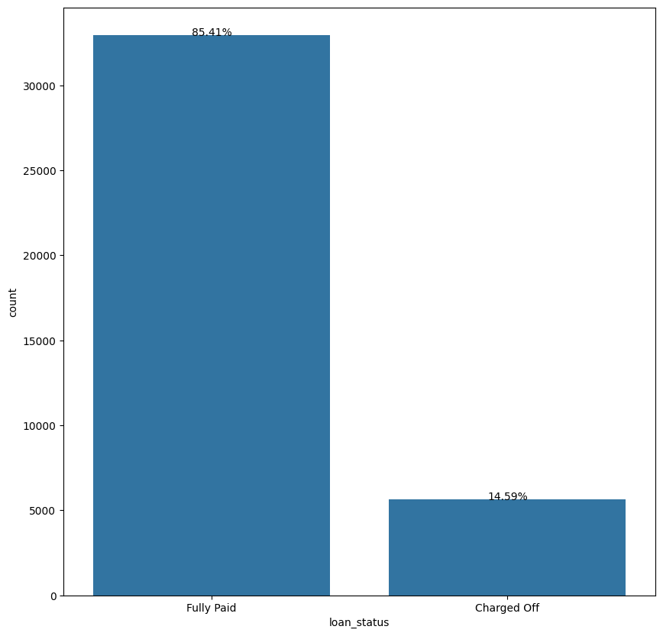
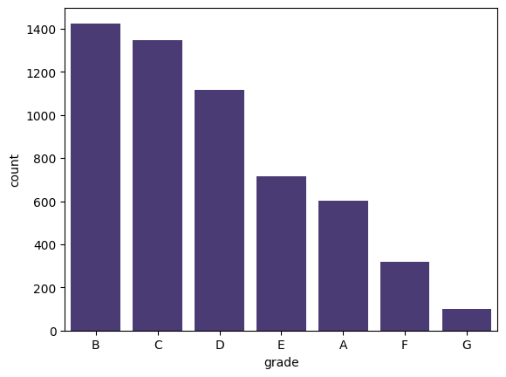
Loan Status and Grade
Loan Status: The number of charged off loan is much smaller(14.5%) compared to total count.
Grades: Grades 'B','C','D' and 'E' have higher defaults as compared to 'A','F' and 'G'. Within these grades, there are no huge variations observed with these plots.

Slide 4
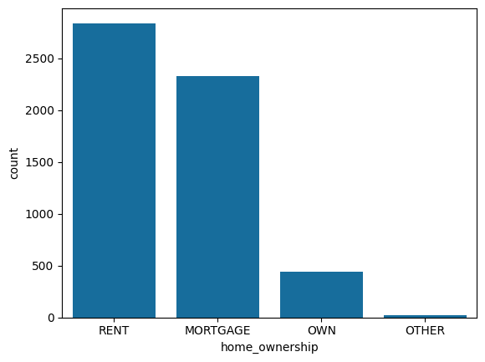
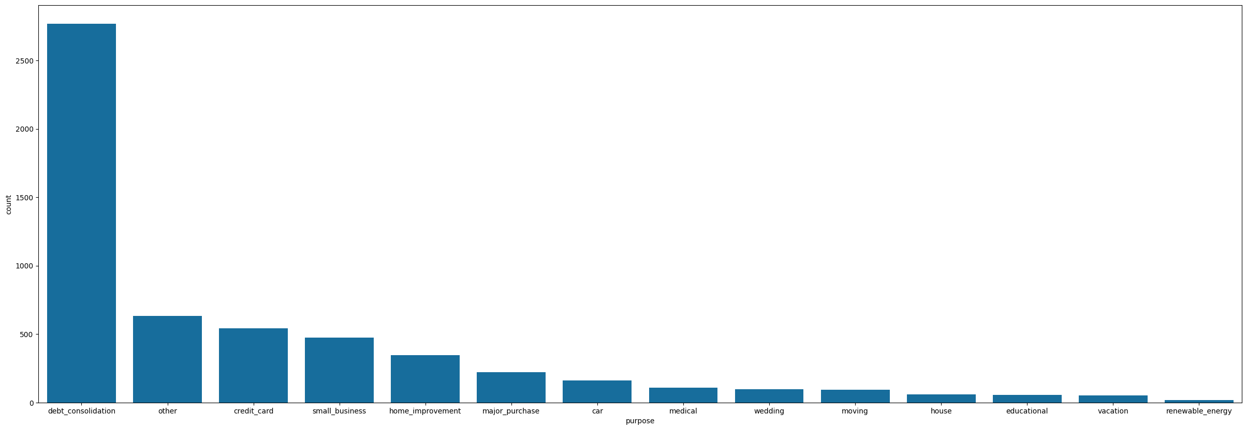
Home Ownership & Purpose
Annual Income : From the table above, consumers whose have rented their homes and are paying mortgage are more likely to defaut than other category.
Purpose: From the above data, people, who are planning to consolidate debt are more likely to default than other category.

Slide 5
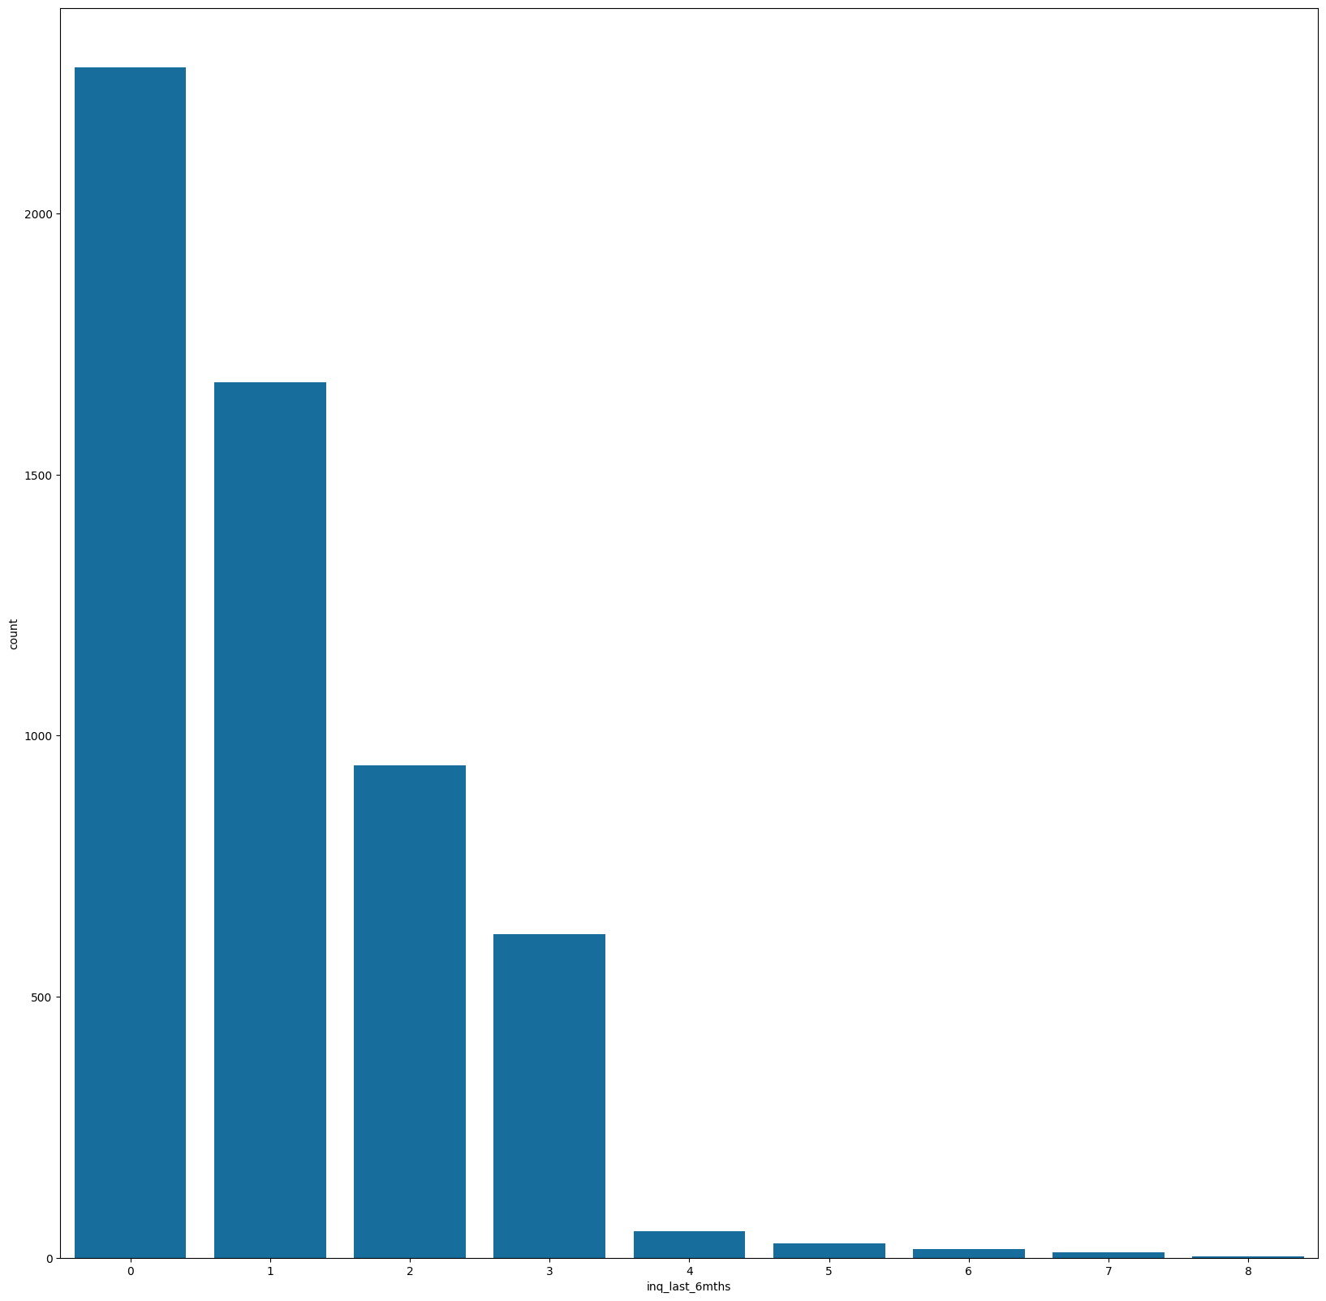
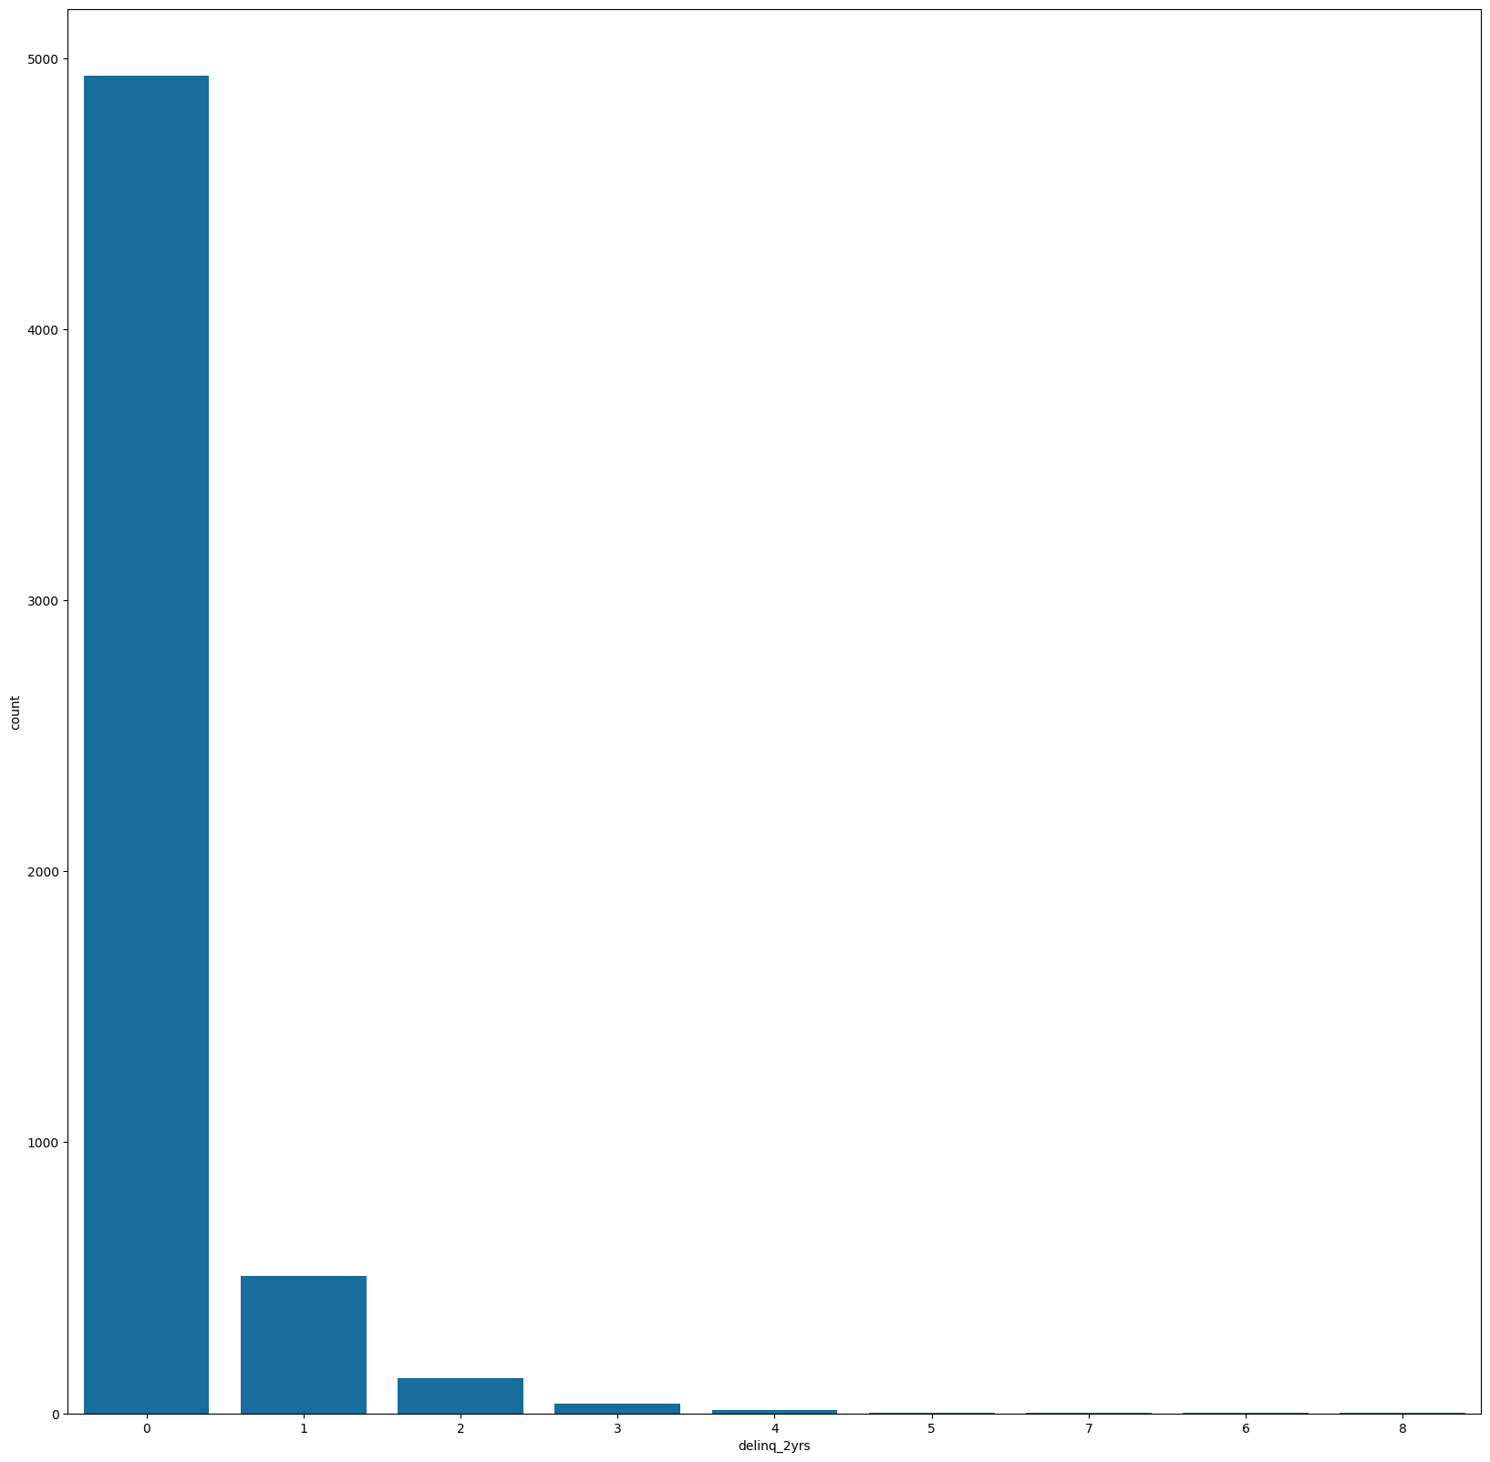
Deliquency & Inquiry Status
From the charts above, having no delinquency or multiple inquiries does not indicate a consumer would be not default.

Slide 6
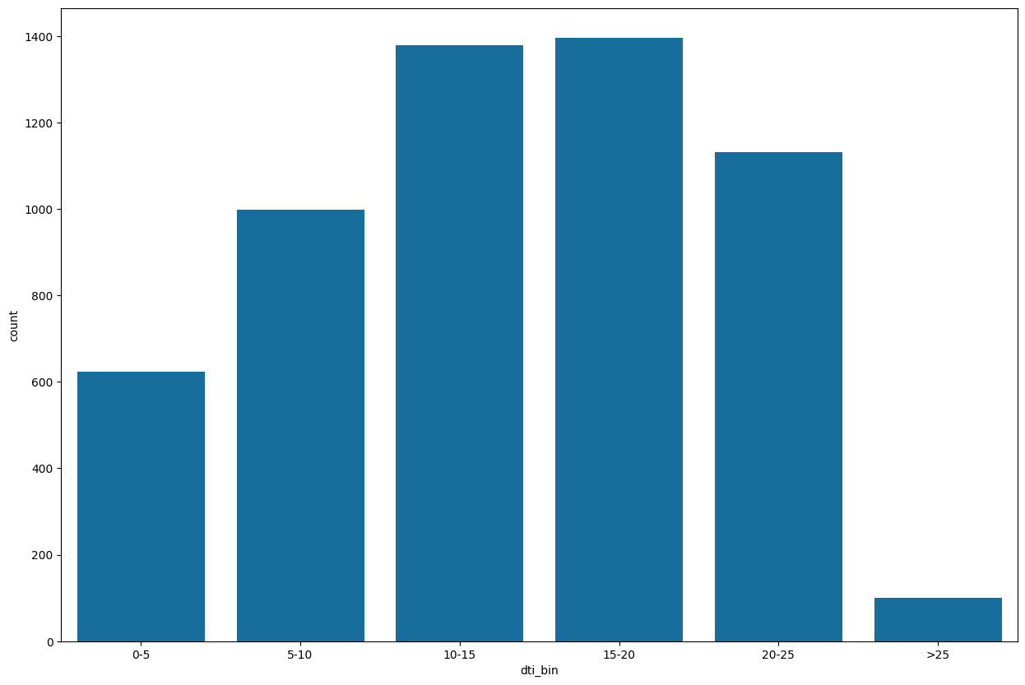
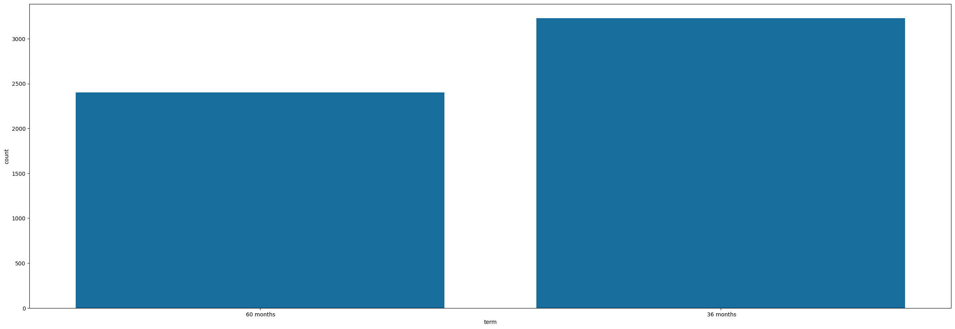
Term & dti
Loan Term: Lesser Term like 36 Months are more likely to default, although the ratio is mariginal.
Dti: Based on analysis of dti bin data, dti value of 5-25 are more likely to default with dti ratio of 15-20 having max defaults.

Slide 7
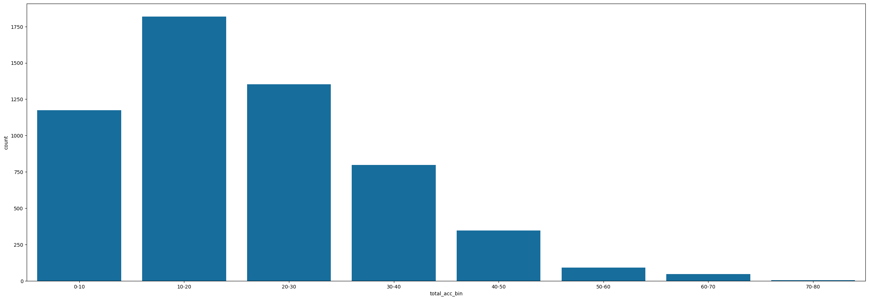
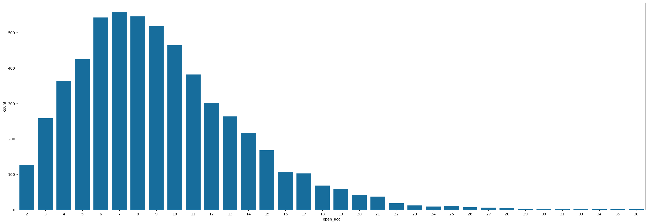
Total Accounts and Charge off
Total Accounts
Open Accounts
More the number of accounts, more the default – this is only true for consumers having upto 30 accounts. In any case, more than 30 accounts does not indicate possibility of default. The plot of open Accounts follow similar to normal curve with the peak of the charge off lying between 6 - 8 accounts.

Slide 8
Conclusion
Considerations for 'defaults' :
Borrrowers whose dti values lie between 5 – 25 are more likely to default with max defaulters like between 15-20.
Borrowers who live in Rented homes or paying mortgages are more likely to default.
Grades 'B','C','D' and 'E' have higher defaults as compared to 'A','F' and 'G'. Within these grades, there are no huge variations observed with these plots.
Borrowers from large urban cities are less likely to default than in rural areas. This indicates more of rural distress.
Loan amount for charged off loans span between 900 - 35K. Analysis of loan data indicates many are smaller loan size, with more defaults happening between USD 0-7000 followed by 7K-14K and 14K-21K.

