Slide 1
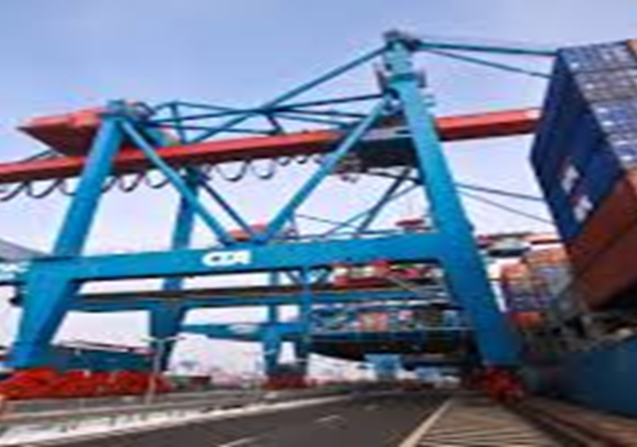
A non-scary Halloween

Slide 2

About the company – Ensemble (not real name)
Small business that designs and manufactures costumes apparel and accessories
Has retail distributions locally and abroad
Competes with large business that can move products on-time at lowest shipping costs

Slide 3

Failed to attend Costume and Apparel Expo last year in Shanghai, China
The logistics agent (non-vessel operator) failed to deliver the products to the exhibit before deadline
Cited port congestion in Shanghai during that peak season

Slide 4

This year, Ensemble partnered with a shipping carrier and they delivered on-time
Standing on the shoulder of a giant
Carriers (vessel operators) can supply logistics insights and real-time shipment status
Use of technology tools that can forecast demand, position inventory properly and give accurate on-time delivery date

Slide 5
Wrap-up
Demand forecast models can help understand customer engagements
Products where and when customer needs it will transform the company related to pricing and product planning
Forecast of expected sales plus consumer analysis plus cost will produce competitive pricing decisions

Slide 6
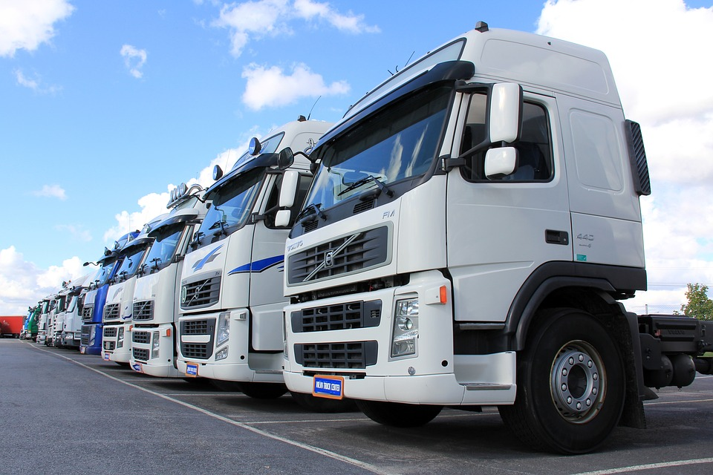
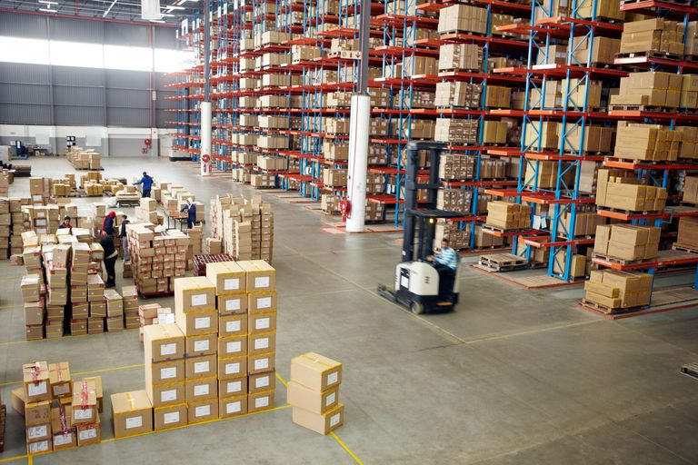
Forwarding Agent vs Carriers
- Delivery time is not guaranteed
- Contingency in case of shipment delay is not certain
- Give accurate promised delivery dates
- Negotiation and bargaining influence in case of disruption
- Delivery time is not guaranteed
- Contingency in case of shipment delay is not certain

Slide 7
How an accurate promised delivery date is done
Use Historical Data
Optimize Delivery Routes
Prediction
Adjustment base on Real-Time data

Slide 8

END

