Slide 1
Heart Disease Prediction: Using LR & ANN
Team Members
Karun Lamsal | THA081BCT013
Kishan Kumar Shah | THA081BCT014
Under the Supervision of:
Asst. Prof. Prajwal Pakka
Department of Electronics and Computer Engineering
Institute of Engineering, Thapathali Campus
March 17, 2025

Slide 2
Presentation Outline
Introduction
Math Formulation
Dataset & Cleaning
EDA
Feature Engineering
Model Development
Evaluation
Results & Conclusion

Slide 3
Introduction
Goal: Predict heart disease (yes/no) from 13 clinical features
Dataset: UCI Heart Disease - 302 records
Models: Logistic Regression vs ANN
Why?
CVDs kill 17.9M people/year (WHO)
- early detection saves lives
Notes:
Binary classification: disease or no disease from 13 clinical features (age, cholesterol, chest pain type, etc.)
Comparing a simple model (LR) vs a neural network on a small clinical dataset
Motivation: CVDs = leading cause of death globally

Slide 4
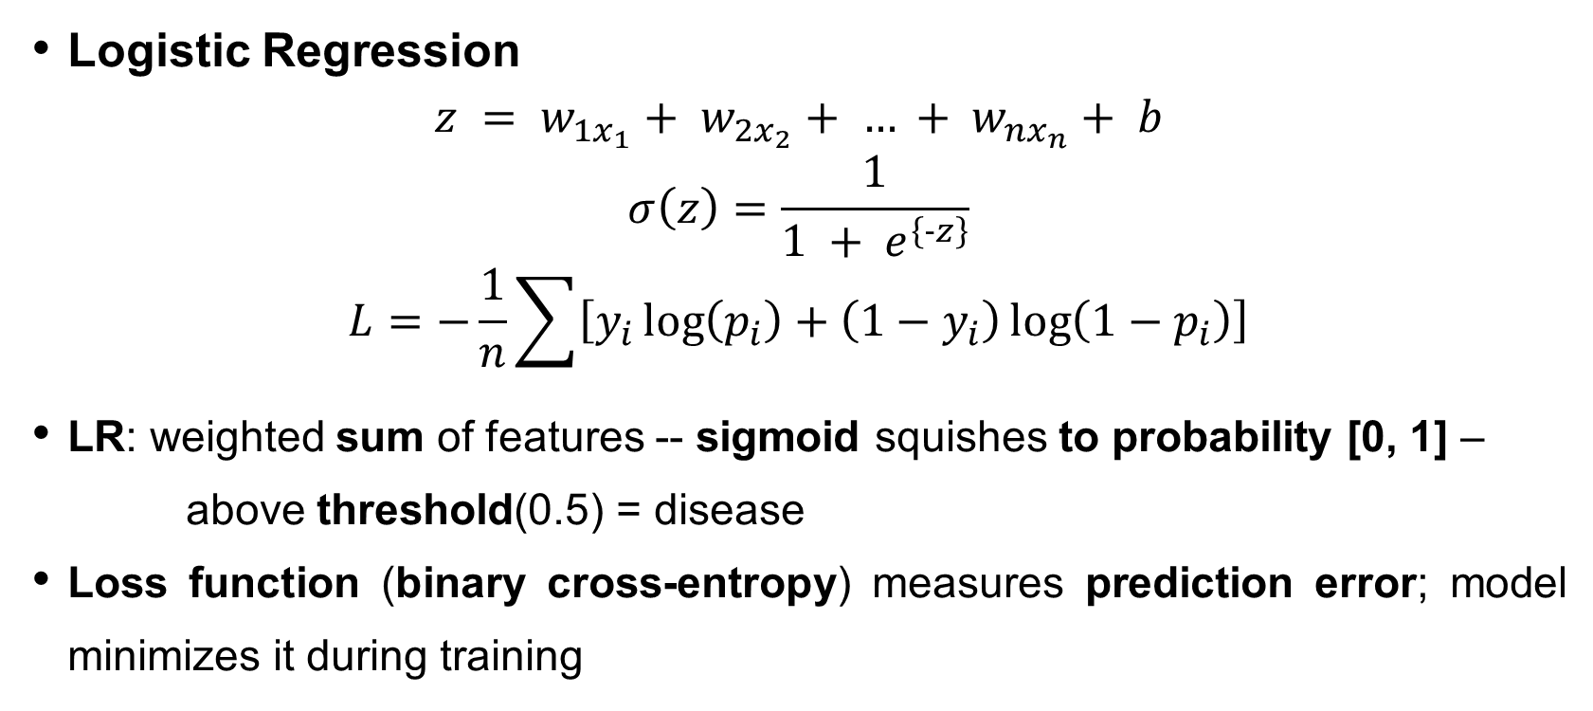
Mathematical Formulation[1]
Logistic Regression
$$z = w_{1x_{1}}+ w_{2x_{2}}+ … + w_{nx_{n}}+ b$$
$$σ\left(z\right)=\frac{1}{1 + e^{\left\{-z\right\}}}$$
$$L=−\frac{1}{n}\sum{\left[y_{i}\log\left(p_{i}\right)+\left(1−y_{i}\right)\log\left(1−p_{i}\right)\right]}$$
LR: weighted sum of features -- sigmoid squishes to probability [0, 1] –
above threshold(0.5) = disease
Loss function (binary cross-entropy) measures prediction error; model minimizes it during training

Slide 5
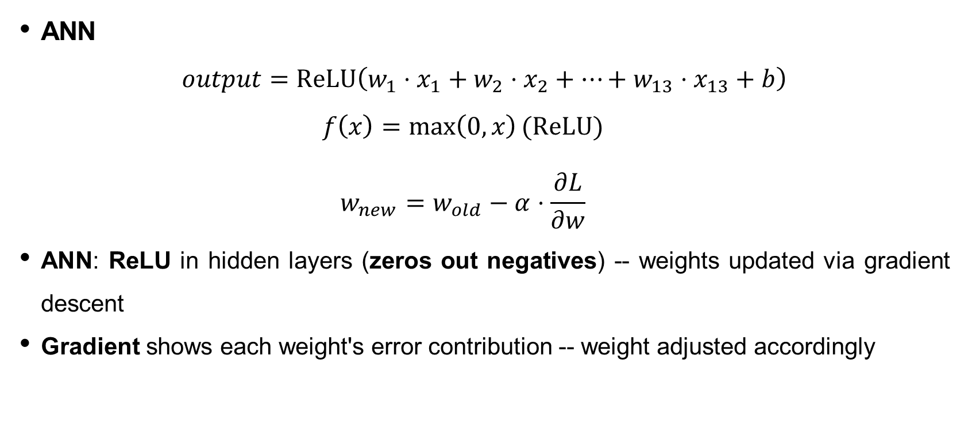
Mathematical Formulation[2]
ANN
$$output=\text{ReLU}\left(w_{1}⋅x_{1}+w_{2}⋅x_{2}+…+w_{13}⋅x_{13}+b\right)$$
$$f\left(x\right)=\max\left(0,x\right)\text{(}\text{ReLU}\text{)}$$
$$w_{new}=w_{old}−α⋅\frac{∂L}{∂w}$$
ANN: ReLU in hidden layers (zeros out negatives) -- weights updated via gradient descent
Gradient shows each weight's error contribution -- weight adjusted accordingly

Slide 6
Dataset Description & Data Cleaning
UCI Heart Disease Dataset - 302 × 14
Feature | Type | Feature | Type
age | Continuous | exang | Binary
sex | Binary | oldpeak | Continuous
cp | Categorical | slope | Categorical
trestbps | Continuous | ca | Ordinal
chol | Continuous | thal | Categorical
fbs | Binary | target | Binary
restecg | Categorical | thalach | Continuous
No NaN values, no duplicates
Cleaning: thal=0 (2 rows) and ca=4 (4 rows) - invalid, replaced with median
Final: 302 samples ready
Notes:
13 features + binary target (1 = disease, 0 = no disease)
No NaN values, but invalid entries found: thal=0 (2 rows), ca=4 (4 rows)
Root cause: '?' in original UCI files -> Kaggle CSV replaced with 0 and 4 instead of NaN
Fixed via median imputation
mode not used because it's skewed (ca mode=0 appears 57.9%)
All 302 records preserved, no rows dropped

Slide 7
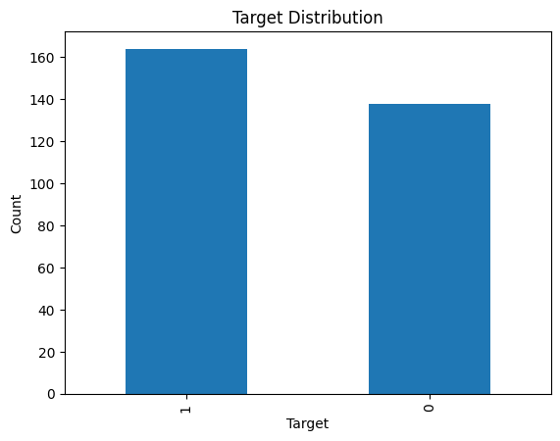
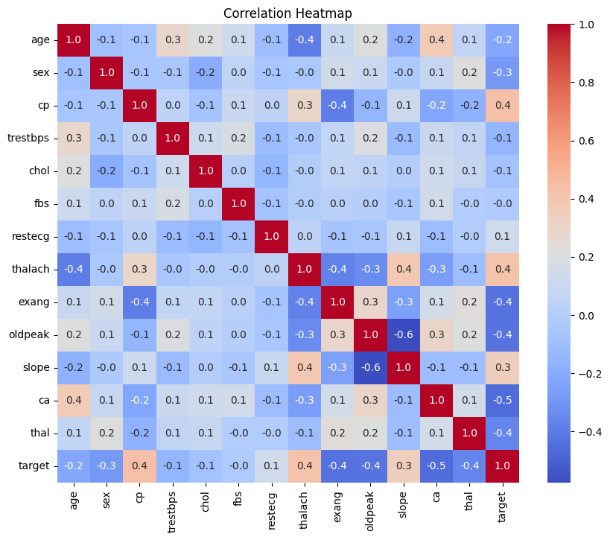
Exploratory Data Analysis
Target: 164 disease (54%) / 138 healthy (46%) – balanced
Top correlations: cp (+0.4), thalach (+0.4), ca (−0.4), exang (−0.4)
Notes:
Classes roughly balanced: 54% disease, 46% healthy -> no oversampling needed
Heatmap: cp (chest pain type) and thalach (max heart rate achieved during exercise ) = strongest positive correlation with disease
Ca (number of major blood vessels colored by fluoroscopy (0 to 3) and exang (exercise induced chest pain (1 = yes, 0 = no) = strongest negative correlation
- These features expected to be most important

Slide 8
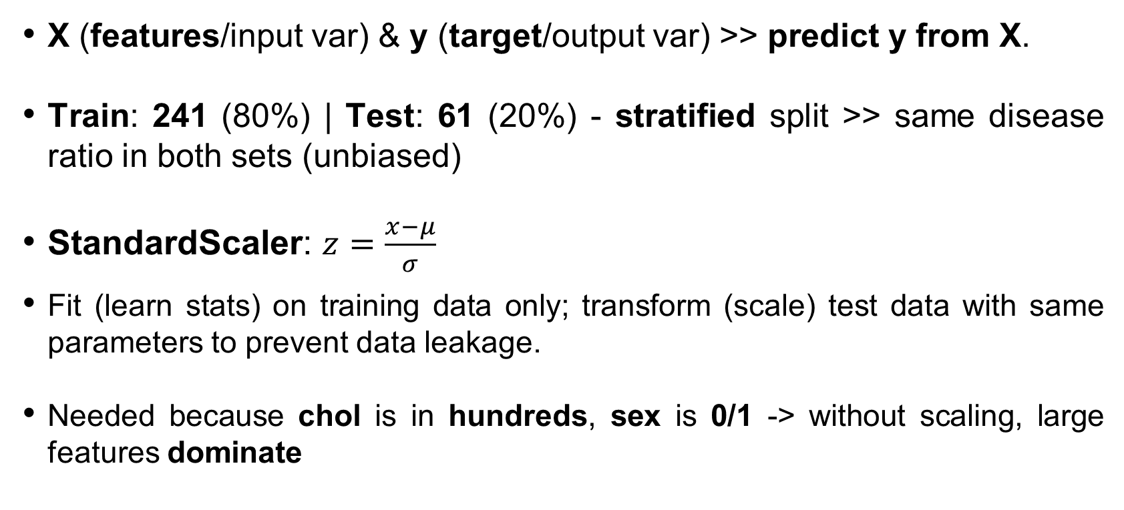
Feature Engineering & Preprocessing
X (features/input var) & y (target/output var) >> predict y from X.
Train: 241 (80%) | Test: 61 (20%) - stratified split >> same disease ratio in both sets (unbiased)
StandardScaler:​ $​z=\frac{x−μ}{σ}$
Fit (learn stats) on training data only; transform (scale) test data with same parameters to prevent data leakage.
Needed because chol is in hundreds, sex is 0/1 -> without scaling, large features dominate
Notes:
Fit = learn parameters (e.g., mean, std) from training data; transform = apply those parameters to scale the data

Slide 9
Model Development [LR] [1]
GridSearchCV (5-fold CV) : tests C values to balance underfitting (low C) & overfitting (high C).
Penalty: L1 removes useless features; L2 shrinks weights toward zero.
Result: selects the best parameter combination.
cv = 5: model trains on 4 and tests on 1, repeating for all folds.
ie: moderate regularization (C = 0.1) with L2 penalty (shrinks weights) and the liblinear solver to give the best for small dataset.
Parameter | Best
C | 0.1
penalty | L2
solver | liblinear
Notes:
Classification model : uses sigmoid to output probability (0–1).
Liblinear : best weights for the logistic regression equation by minimizing the loss function
l1 = can zero out useless features, it adds |WEIGHT| to loss eg. zeroed our age,chol etc.
l2 = shrinks all features a bit, adds |WEIGHT|^2 to loss, srinks all to 0 but never fully removes
5-fold CV : cv = 5: training data is split into 5 parts; the model trains on 4 and tests on 1, repeating for all folds.

Slide 10
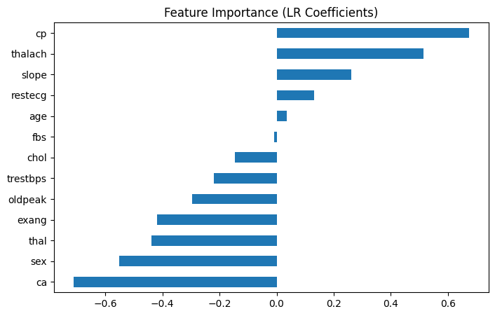
Model Development [LR] [2]
Top features: cp (+0.60), thalach (+0.38), ca (−0.44)
Notes:
Only ~8 of 13 features actually matter
Bar chart: positive coeff. -> pushes toward disease, negative -> away
Top predictor: chest pain type (+0.60); strongest negative: ca (−0.44)

Slide 11
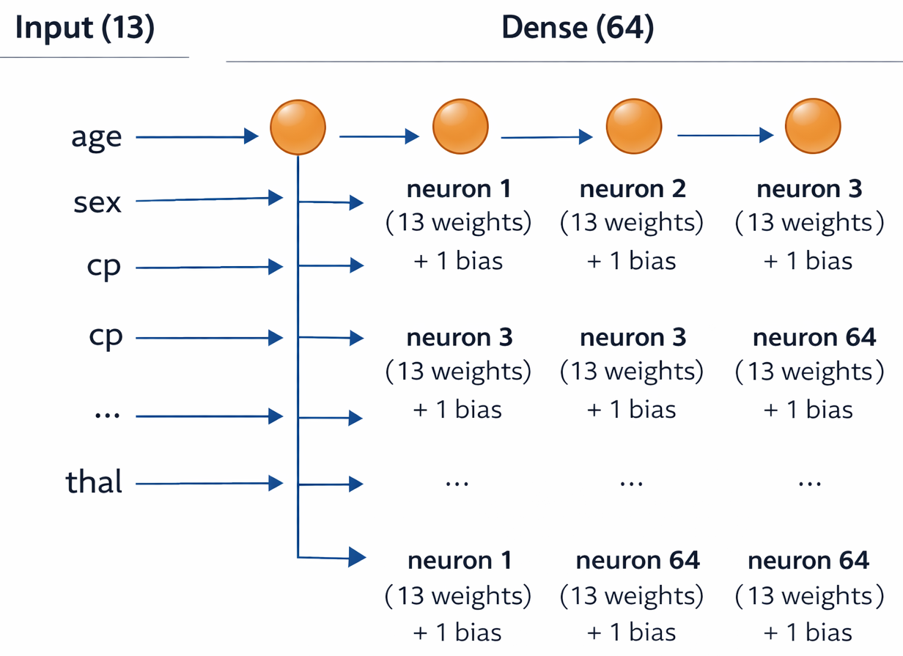
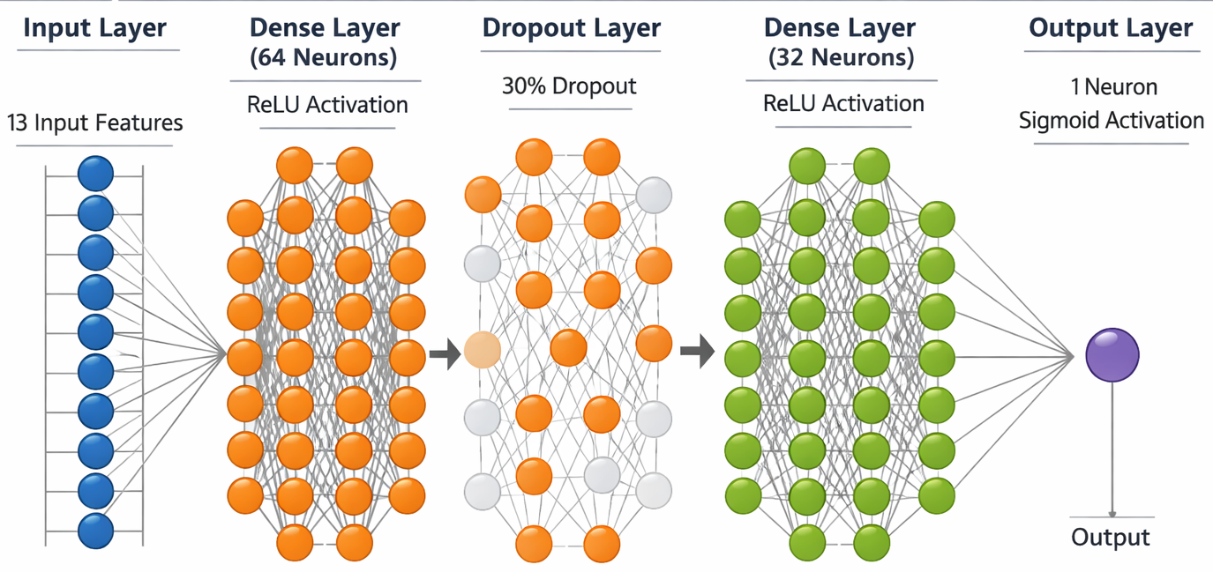
Model Development [ANN] [1]
Each neuron: 13 weights + 1 bias = 14 parameters; 64 neurons >> 896 parameters, each learning different feature pattern
Dense: every input connects to every neuron.
Notes:
- 3 layers: 64 neurons -> 32 -> 1 output
ReLU zeros out negatives in hidden layers; sigmoid at output -> probability
Dropout: randomly disables 30% of neurons each pass -> prevents memorization-

Slide 12
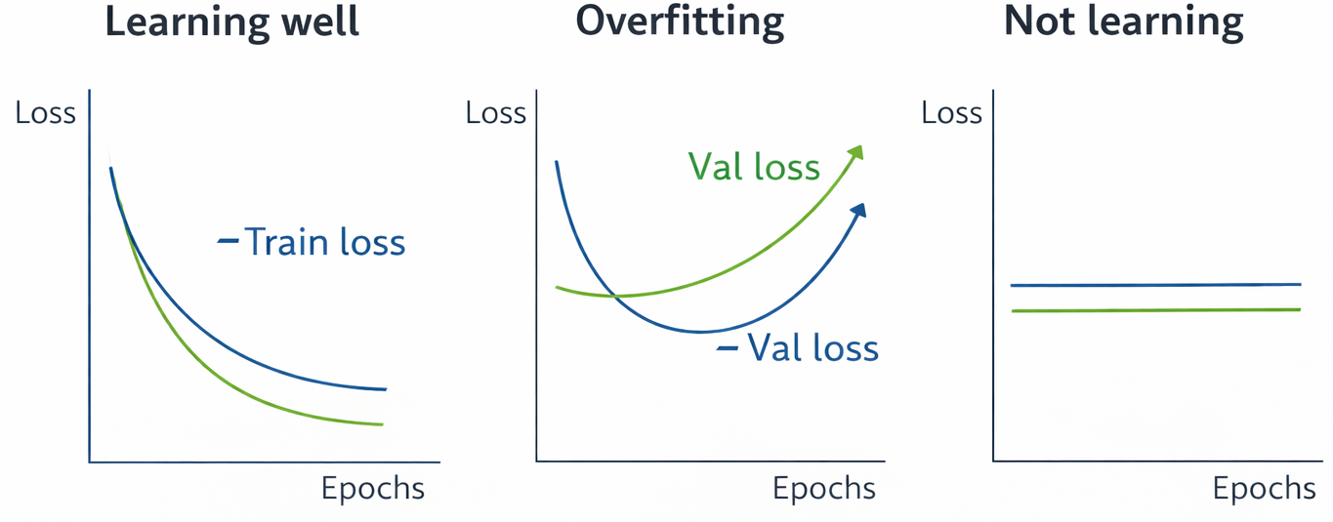
Model Development [ANN] [2]
Dropout(0.3): ignores 30% neurons → reduces overfitting (small dataset)
Optimizer: Adam (adaptive learning rate) | Loss: Binary Cross-Entropy
Train loss: error on training data | Val loss: error on validation data
Notes:
- 3 layers: 64 neurons -> 32 -> 1 output
ReLU zeros out negatives in hidden layers; sigmoid at output -> probability
Dropout: randomly disables 30% of neurons each pass -> prevents memorization-

Slide 13
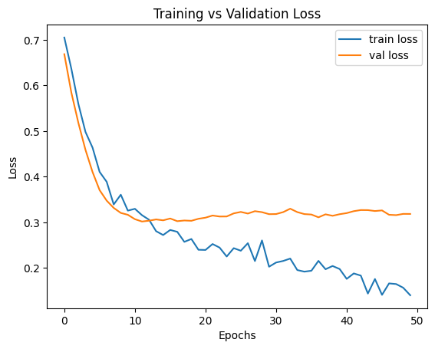
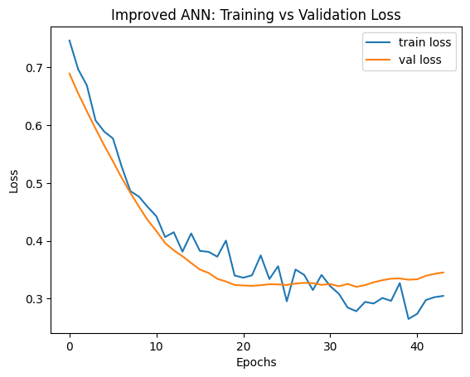
Model Development [ANN] [2]
>> 50/50 split: initially learned, later overfitting.
64 -> 0.3 -> 32 -> 1 (all) 32 -> 0.4 -> 16 -> 1 (earlyStop)
Notes:
- 3 layers: 64 neurons -> 32 -> 1 output
ReLU zeros out negatives in hidden layers; sigmoid at output -> probability
Dropout: randomly disables 30% of neurons each pass -> prevents memorization-

Slide 14
Metrics
Precision = of those flagged as disease, how many actually had it
Recall = of actual disease cases, how many were caught ->
most important in healthcare
(missing a sick patient is worse than false alarm)
Metric | Formula | Why it matters
Accuracy | correct / total | Overall correctness
Precision | TP / (TP + FP) | Fewer false alarms
Recall | TP / (TP + FN) | Catch sick patients
F1-Score | 2PR / (P + R) | Balance of precision & recall
Notes:
- 3 layers: 64 neurons -> 32 -> 1 output
ReLU zeros out negatives in hidden layers; sigmoid at output -> probability
Dropout: randomly disables 30% of neurons each pass -> prevents memorization-

Slide 15
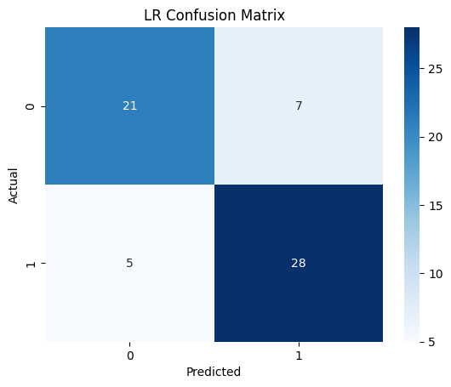
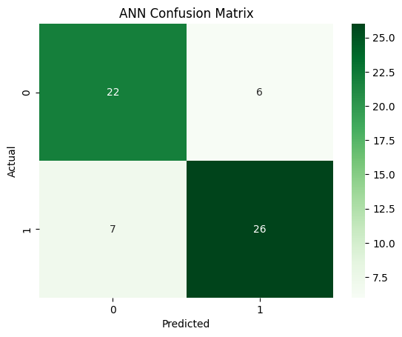
Confusion Matrices
Confusion matrices: LR caught 28/33 disease cases, ANN caught 26/33
LR missed fewer sick patients
Notes:
- 3 layers: 64 neurons -> 32 -> 1 output
ReLU zeros out negatives in hidden layers; sigmoid at output -> probability
Dropout: randomly disables 30% of neurons each pass -> prevents memorization-

Slide 16
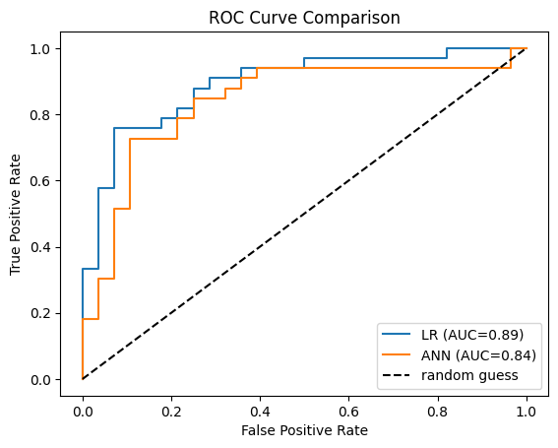
ROC Curves & AUC
ROC curve: TPR vs FPR across threshold (diagonal = random, AUC = 0.5)
AUC: single summary (1 = perfect, 0.5 = random)
LR = 0.86, ANN = 0.84: both good, LR slightly better
Notes:
- 3 layers: 64 neurons -> 32 -> 1 output
ReLU zeros out negatives in hidden layers; sigmoid at output -> probability
Dropout: randomly disables 30% of neurons each pass -> prevents memorization-

Slide 17
Results & Interpretation
LR wins 4/5 metrics
ANN: slightly higher precision but misses more sick patients
Reason: dataset small (302 samples); ANNs need more data
LR advantage: interpretable coefficients → shows important features
Top features: chest pain type, max heart rate, major vessels
Model | Accuracy | Precision | Recall | F1 | AUC
LR | 0.803 | 0.800 | 0.848 | 0.824 | 0.892
ANN | 0.787 | 0.813 | 0.788 | 0.800 | 0.839
Notes:
- 3 layers: 64 neurons -> 32 -> 1 output
ReLU zeros out negatives in hidden layers; sigmoid at output -> probability
Dropout: randomly disables 30% of neurons each pass -> prevents memorization-

Slide 18
Conclusion & Ethics
Conclusion
Both models achieved ~80% accuracy
LR slightly beat ANN ; more complex ≠ always better
LR provides interpretability - coefficients reveal which features drive predictions
Ethics:
Patient privacy important; dataset from one hospital >> may not generalize
Must never replace a doctor - assistive screening tool only
Future: larger datasets could favor ANN; ensemble methods (Random Forest) worth exploring
Notes:
- 3 layers: 64 neurons -> 32 -> 1 output
ReLU zeros out negatives in hidden layers; sigmoid at output -> probability
Dropout: randomly disables 30% of neurons each pass -> prevents memorization-

Slide 19
References
Mohan et al. (2019) - IEEE Access
Ali et al. (2021) - Computers in Biology and Medicine
UCI ML Repository - Heart Disease Dataset
Kaggle - Heart Disease UCI Dataset
Krish Naik - Heart Disease Classification (YouTube)
StatQuest - Logistic Regression (YouTube)
3Blue1Brown - Neural Networks (YouTube)
GitHub - huda-alq, kristipati, jhanvigoyal
scikit-learn, Keras, pandas, NumPy Docs
Tools: Python, pandas, NumPy, Matplotlib, Seaborn, scikit-learn, TensorFlow/Keras

Slide 20
Thank You

