Slide 1
AWS Big data cost
DEMM – Filippo Gaudenzi

Slide 2
AWS e i servizi BIG DATA
Two Approaches:
Manual (Building your own cluster and using HDFS)
Using EMR (Amazon Elastic Map Reduce is a managed cluster platform that simplifies running big data frameworks, such as Apache Hadoop and Apache Spark)

Slide 3
AWS EMR
Amazon EMR fornisce un framework Hadoop gestito che consente di elaborare grandi quantità di dati su un numero dinamico di istanze Amazon EC2, rendendo l'operazione più semplice, più rapida e più economica. In Amazon EMR è anche possibile eseguire altri framework distribuiti comuni, quali Apache Spark, HBase, Presto e Flink, nonché interagire con i dati contenuti in altri datastore AWS come Amazon S3 e Amazon DynamoDB.
Amazon EMR è una soluzione sicura e affidabile per un'ampia gamma di casi d'uso per Big Data, ideale per una vasta gamma di casi di utilizzo: analisi di log, indicizzazione Web, trasformazione dei dati (ETL), apprendimento automatico, analisi finanziarie, simulazioni scientifiche e ricerche bioinformatiche.

Slide 4
YELP Use Case
Why Amazon Web Services
Yelp originally depended upon giant RAIDs to store their logs, along with a single local instance of Hadoop. When Yelp made the move to Amazon Elastic MapReduce (Amazon EMR), they replaced the RAIDs with Amazon Simple Storage Service (Amazon S3) and immediately transferred all Hadoop jobs to Amazon Elastic MapReduce.
“We were running out of hard drive space and capacity on our Hadoop cluster,” says Yelp search and data-mining engineer Dave Marin.
Yelp uses Amazon S3 to store daily logs and photos, generating around 1.2TB of logs per day. The company also uses Amazon EMR to power approximately 20 separate batch scripts, most of those processing the logs. Features powered by Amazon Elastic MapReduce include:
People Who Viewed this Also Viewed
Review highlights
Auto complete as you type on search
Search spelling suggestions
Top searches
Ads
Their jobs are written exclusively in Python, while Yelp uses their own open-source library, mrjob, to run their Hadoop streaming jobs on Amazon EMR, with boto to talk to Amazon S3. Yelp also uses s3cmd and the Ruby Elastic MapReduce utility for monitoring.
Yelp developers advise others working with AWS to use the boto API as well as mrjob to ensure full utilization of Amazon Elastic MapReduce job flows. Yelp runs approximately 250 Amazon Elastic MapReduce jobs per day, processing 30TB of data and is grateful for AWS Support that helped with their Hadoop application development.
The Benefits
Using Amazon Elastic MapReduce Yelp was able to save $55000 in upfront hardware costs and get up and running in a matter of days not months. However, most important to Yelp is the opportunity cost. “With AWS, our developers can now do things they couldn’t before,” says Marin. “Our systems team can focus their energies on other challenges.”

Slide 5
EMR COST
Tariffa minima 1min – costo lineare
Un cluster con 10 nodi in esecuzione per 10 ore costa esattamente come un cluster con 100 nodi in esecuzione per un’ora
Tariffa Oraria
Dipende dal tipo di istanza in uso (standard, CPU extra, memoria extra, storage extra, ecc.)
Fatturazione viene calcolata al secondo

Slide 6
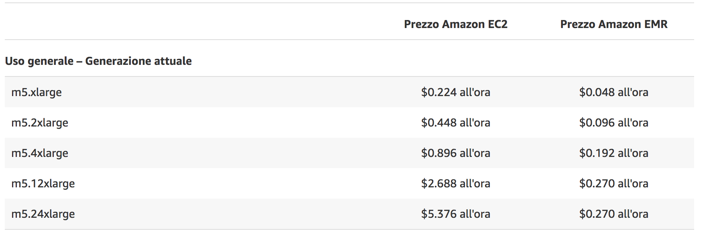
EMR COST
Tariffa minima 1min – costo lineare
Un cluster con 10 nodi in esecuzione per 10 ore costa esattamente come un cluster con 100 nodi in esecuzione per un’ora
Tariffa Oraria
Dipende dal tipo di istanza in uso (standard, CPU extra, memoria extra, storage extra, ecc.)
Fatturazione viene calcolata al secondo

Slide 7
EMR COST
Tariffa minima 1min – costo lineare
Un cluster con 10 nodi in esecuzione per 10 ore costa esattamente come un cluster con 100 nodi in esecuzione per un’ora
Tariffa Oraria
Dipende dal tipo di istanza in uso (standard, CPU extra, memoria extra, storage extra, ecc.)
Fatturazione viene calcolata al secondo
A questo va aggiunto lo storage

Slide 8
AWS STorage – s3
S3 - Amazon S3 stores data as objects in a flat environment (without a hierarchy). Each object (file) in the storage contains a header with associated sequence of bytes from 0 byte to 5 TB. Objects in Amazon S3 are associated with a unique identifier (key), so access to them can be obtained through web requests from anywhere. For example, any authorized node in your own datacenter or external user can get access to any object in your Amazon S3 bucket.
Amazon S3 also allows hosting static website content. You can get access to it either from your Amazon S3 bucket or through content delivery network AWS CloudFront.
Amazon S3 is highly scalable storage service with famous "eleven nines" data durability (99,999999999%). That means that the chance of your data to be lost somewhere inside AWS datacenters is minimal.

Slide 9
AWS STorage – EBS
EBS: Amazon EBS is designed to store data in volumes of a provisioned size attached to an Amazon EC2 instance, similar to a local disk drive on your physical machine. Amazon EBS only allows to attach the volume to another EC2 instance or keep it in a standby mode. It’s important as once you configure the volume in Amazon EBS, it can’t be easily scaled. If you need more storage space, you will need to buy and configure a new volume of a bigger size.
General Purpose (SSD) Volumes
Provisioned IOPS (SSD) Volumes
Magnetic Volumesì

Slide 10
AWS STorage – EFS
EFS: At some point, it became clear that EBS may be good for setting up a drive for virtual machines, and S3 is good for storage, but what if you want to run an application with high workloads that need scalable storage and relatively fast output? Amazon Elastic File System was created to fulfill those needs.
Amazon EFS is automatically scalable - that means that your running applications won't have any problems if the workload suddenly becomes higher - the storage will scale itself automatically. If the workload decreases - the storage will scale down, so you won't pay anything for the storage you don't use.
You can mount EFS to various AWS services and access it from various virtual machines. Amazon EFS is especially helpful for running servers, shared volumes (like NAS devices), big data analysis, and any scalable workload you can think of.

Slide 11
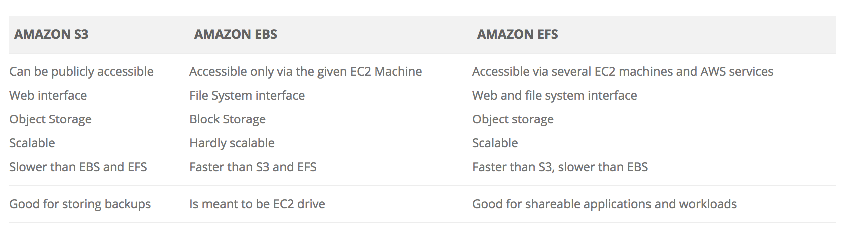
AWS STorage – EFS

Slide 12
Problem
Cost Analysis of Building Hadoop Clusters Using Cloud Technologies
A programmatic ad-tech platform generates terabytes of data on a daily basis. To effectively process and leverage this data, we use big data tools like Hadoop for reporting and analytics. Our infrastructure is hosted in Amazon AWS across multiple locations globally.
Problem Definition
Build a Hadoop cluster that can be used to analyze hundreds of terabytes of data in the most efficient way possible. The work load will include a mix of hourly/daily scheduled jobs as well as ad-hoc queries for on spot data analysis (100 TB of data in the cluster with 480 mappers and 160 reducers).
The two most important factors that govern setting up a Hadoop cluster are:
Total HDFS cluster space required to store all data that needs to be analyzed
Adequate number of mappers and reducers configured to handle varying cluster workload

Slide 13
Solutions
Running static Hadoop cluster with EC2 instances in AWS
Elastic Map Reduce (EMR), EC2 and S3

Slide 14
Solution 1
In a static Hadoop cluster, data that needs to be crunched has to be stored in HDFS. For the sample problem statement, let’s assume that we need to build a Hadoop cluster which can store 100 TB of data in the cluster (480 mappers, 160 reducers).
HDFS storage required = Data to be stored * Replication Factor / Recommended HDFS utilization %
Replication Factor: Hadoop framework was built to take care of machine failures by replicating data over several machines. Generally, it is recommended that 3 copies of data should be stored in 3 different machines, so if one machine fails, other machines can provide the data.
HDFS utilization %: While processing data on Hadoop framework, we run jobs which generate some transient and output data which needs to be stored in HDFS as well. Hence, it is recommended that at any given time, HDFS space utilized should not be more than 60%.
For someone having a 100TB data usage, cost of static Hadoop cluster will come out to be ~$78,000

Slide 15
Solution 1 COST (IRELAND)
http://calculator.s3.amazonaws.com/index.html
STORAGE
We use EC2 instances as storage
Using m1.xlarge -> cost 0.379€/h
m1.xlarge has 1.6TB of HD
HDFS storage required= 100 *3 /0.6 = 500T -> 500/1.6= 312VM
Total Cost= 0.379*24*30*312=85k €
COMPUTE
Storage nodes can be used ad computational node:
eight mappers per node (m1.xlarge) -> 312*8= 2496 Fair enough
Three reducers per node (m1.xlarge) -> 312*3= 932 Fair enough
Total Cost 0

Slide 16
Solution 1I
S3 is the HDFS equivalent in EMR. Basically in this case, you form a cluster using EC2 instances. Whenever a job is executed, data is copied from S3 to HDFS of the cluster. There is an abstraction layer involved and the user need not bother about S3 intricacies; EMR take cares of this internally. EMR cluster can be scaled up or down manually either by click of a button or by calling AWS API. Using S3 as storage instead of HDFS has huge cost implicationssince S3 storage is cheaper. Since S3 guarantees 99.99% availability, there is no need to replicate data as well. However in EMR, one has to pay processing/computational cost separately.

Slide 17
Solution 1I COST (IRELAND)
http://calculator.s3.amazonaws.com/index.html
STORAGE
We use S3 as storage
100TB Storage ->
We won’t drill down into transfer cost
COMPUTE
We use EMR+EC2 for computational purpose (we need 640ma:
eight mappers per node (m1.xlarge) -> 480/8= 60
three reducer per node (m1.xlarge) -> 160/3= 53
Total Cost=>2,5k

Slide 18
HomeWOrK
Which is the cost using just the number of machine we need and EBS? It may be helpful to use different size machine.

