Slide 1
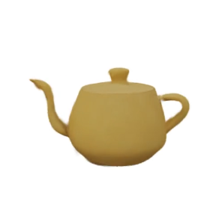
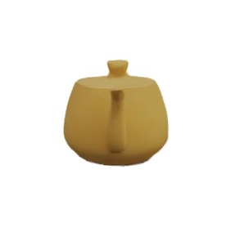
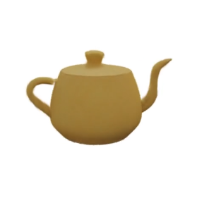
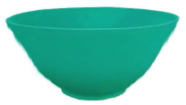
# 1/3 : Teapot – Bowl – Ours
Source
Source
Source
Morphing
Morphing
Morphing
View 1
View 2
View 3
Target
Target
Target
View 1
View 2
View 3

