Slide 1
Optimising Level Generators for General Video Game AI
-Olve Drageset, Mark H.M. Winands -Raluca D. Gaina, Diego Perez-Liebana

Slide 2
INTRODUCTION
a comparison baseline for GVGAI level generators, which is more flexible and robust than the existing alternatives
composite fitness evaluation function for levels based on AI playtesting.
a new parameterized generator and a Meta Generator for performing parameter search on such generators are introduced.

Slide 3
GVGAI

Slide 4
GVGAI
General Video Game AI (GVGAI) framework is a Java benchmark, evolved from the original Py-VGDL implemented by Tom Schaul
Provides AI challenges around the concept of a general video game
Platform for learning, planning and tackling content generation problems in games described in VGDL(Video game description language).

Slide 5
Games
Games are written in the Video Game Description Language (VGDL)
Allows games to be easily created around sprites with certain properties and behaviours and their interactions
Game Description file consists of 4 sets:
Sprite Set: entities in the game
Interaction set: effects of sprites
Termination set: endgame condition
Level Mapping: connection between sprites and ascii characters

Slide 6
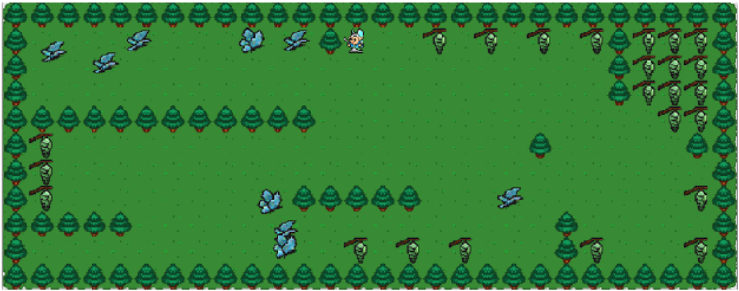
Games
Butterflies: player must capture as many butterflies as possible before all cocoons in the level are opened, in which case the game is lost. When all butterflies are captured, the game is over and won. All butterflies move at random

Slide 7
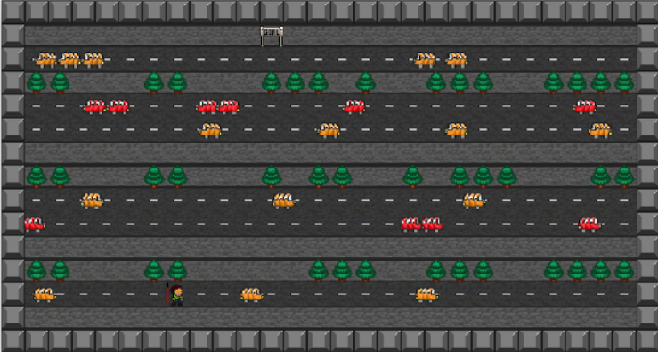
Games
Freeway: puts the player in control of an agent that must cross consecutive roads with incoming traffic. Every time the player gets hit by a vehicle, they lose 1 life (out of 5 available). The player wins if they are able to reach the randomly positioned goal at the other end of the crossings.

Slide 8
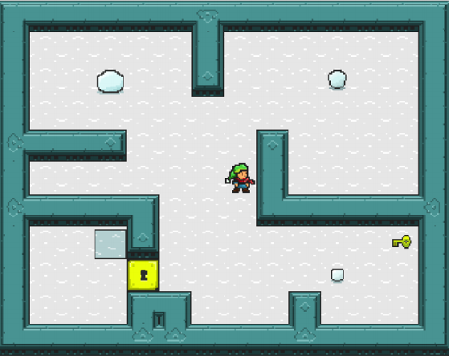
Games
The Snowman: player must push different parts of a snowman (body, trunk and head) into a platform, in the natural body to head order. Parts of the level may be locked that can only be opened if the player collects a key. Points are awarded for correctly placing each part of the snowman.

Slide 9
Game-playing Agents
Do-Nothing: Action NIL is applied at each step
One step lookahead(OSLA): explores every game state reachable from the current state using the FM(Forward Model)
YOLOBOT:
Not provided by the GVAI
Developed by Jopen et al
combination of two different methods: a heuristic-guided Best First Search used in deterministic games, and a Monte Carlo Tree Search used for stochastic environments

Slide 10
GVAI Level Generation
Introduced in 2016
Participants must submit generator to generate level for a game within 5 hours of CPU computation
Generators have access of the following information:
Avatar sprites
Solid sprites
Harmful sprites
Collectible sprites
Other
Generator must provide a 2-dimensional array of characters that forms the level

Slide 11
GVAI Level Generation
GVGAI Level Generation track was initially proposed in tandem with three distinct level generators
RANDOM:
Picks a level size by looking at the number of solid sprites
After placing a solid sprites it places at least 1 of each type
80% of the space is let open
Fills empty spaces from the set of sprites
Advantageous as all essential sprites are placed without even looking at the semantics
Player has more free space to move around.

Slide 12
GVAI Level Generation
CONSTRUCTIVE:
Uses same level size selection and includes frame of static sprites.
Makes connecting walls coming out of the frame and makes sure all the open spaces on the board are connected
It places the enemies at a distance from the player so that the player doesn’t die immediately on spawning
This makes an interesting labyrinth looking level
Does not guarantee that all sprites will spawn on the level

Slide 13
GVAI Level Generation
GENETIC:
Initializes a population of levels using the constructive or random generators before using a fitness function
Population is made using constructive or random generator
Separates population of feasible and non-feasible levels

Slide 14
Level Generators

Slide 15
Percentage-wise Generator(PWG)
Designed to minimize the number of assumptions made about a game during level generation and to increase generality by minimizing the reliance human injection bias
Loosely based on random level generator
Biggest difference is the parameters that PWG takes into account wile generating a level:
Percentage of each sprite should be used
Whether the (x,y) co-ordinates of each sprite should be sampled from Gaussian distribution
Mean, Standard deviation of distribution
Size of the level and whether a border of static wall should be placed around a level
Uses information about only three types of rites i.e. avatar, walls and open spaces

Slide 16
Meta Generator
Why is it needed?
current methods for simulation-based level fitness evaluation are relatively expensive
It was hypothesized that genetic level generators rely on having a good population initialization in order to find a good solution in time
Using a genetic algorithm on an already generated population to improve the quality of levels
Initial good population is required to give the best level
Idea behind the meta generator is to optimize the parameters of a fast generator
The best levels generated can be used as the initialization set for genetic search, or the best level found so far can be returned directly
Additionally the player can be provided with a continuous stream by keeping the meta generator running in the background

Slide 17

Meta Generator
Parameter Optimization Algorithm:
mutation and crossover to search the parameter space of the PWG
Upper Confidence Bounds to select in which direction to guide its search
Vi = value estimation of generator
C = exploration parameter
N = Total number of levels
ni = levels generated so far

Slide 18
Meta Generator
UCB balances the exploration of areas that have not been explored and the exploration of areas that are promising
Meta Generator focuses its search on the generator with the highest UCB value, using a (1,λ) roulette wheel
Each time a generator is selected for reproduction, one more level is generated using its parameters before continuing
This encourages the noisy fitness parameters of the more promising generator parameters to be more accurate

Slide 19
Experiments
IBM System X iDataPlex dx360 M3 Server, Intel Xeon E5645 6 core processor, 2GB of RAM of JVM Heap Memory.
5 hours of computing time

Slide 20
Results

Slide 21
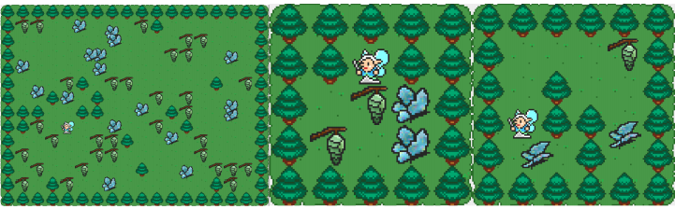
Results
Butterflies:
simple game in which a random spread of sprites can lead to a level that is challenging and plays well
Meta Generator only makes marginal gains on the baselines
small difference in fitness actually accounts for the fact that the Meta Generator is able to build levels of much larger size
Make the game longer contributing to the length factor of the game hence making it more engaging

Slide 22
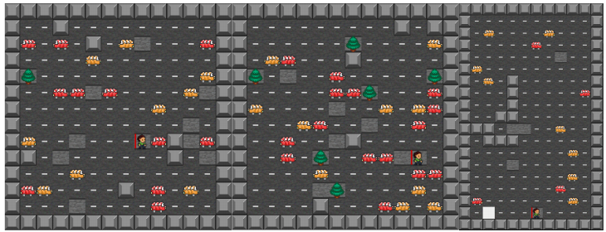
Results
Freeway:
This is a more complicated game because it is stochastic and has more sprite types
traditional Freeway levels are all structured in a specific way: the car spawners are located in key places in order for the game to be recognizable and make sense to humans
Constructive generator makes a labyrinth like level which is not beneficial for the game
PWG and meta generator and no way of placing the sprites in a specific way
Sprites are scattered over the map

Slide 23
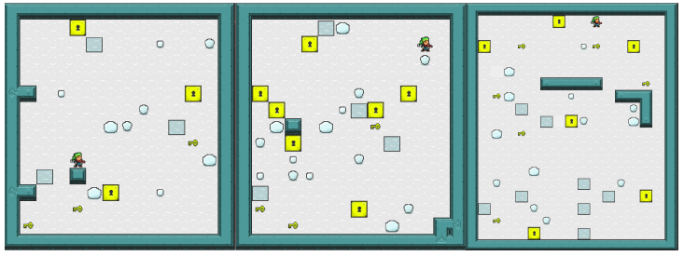
Results
Snowman:
Only puzzle based game
largest difference in fitness is observed
Meta Generator outperforms the constructive and random generators, who do not generate any levels that are solvable by YOLOBOT
uses the parameters of the successful PWG as a basis for further exploration
Some levels are easier to solve for humans but are too cluttered and large to solve for YOLOBOT

Slide 24
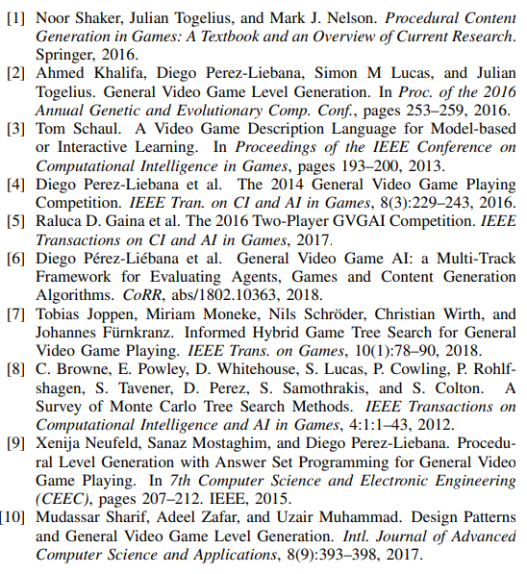
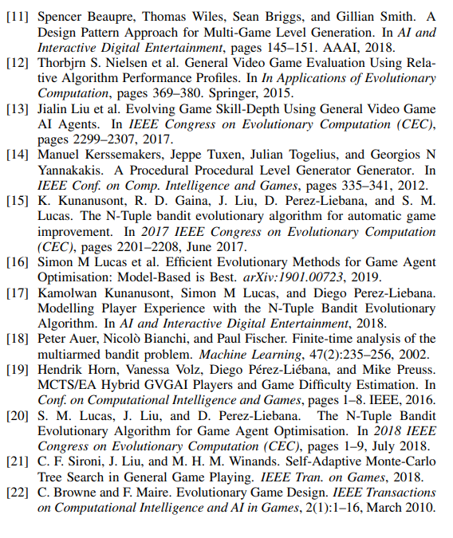
REFERENCES

