Slide 1
Humanoid Robot
Team Members:
Vijay Belurkar
Jaipal Deval
Mentors:
Saurav Shandilya
Vishwanathan Iyer

Slide 2
Project Idea
Build a Humanoid Robot with basic modes of locomotion
Work Assigned
Tasks | Description | Duration
1 | Literature survey-understanding the basic concepts of humanoid robot. | 3 days
2 | Analysis and improvement in existing design and testing its stability with appropriate microcontroller or design and building of new robot structure. | 8 days
4 | Adding intelligence to the mechanism . | 7 days
5 | Calculating the power requirement and accordingly designing the power supply circuit. | 2 days
6 | Interfacing sensors like gyro for auto stability and making a GUI for controlling the robot. | As time permits
7 | Interfacing camera to the system and performing image processing. | As time permits

Slide 3
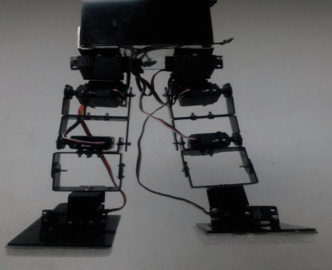
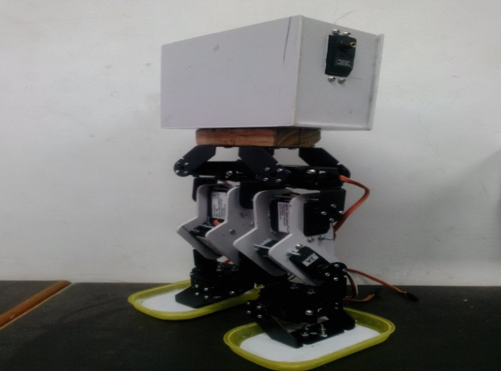
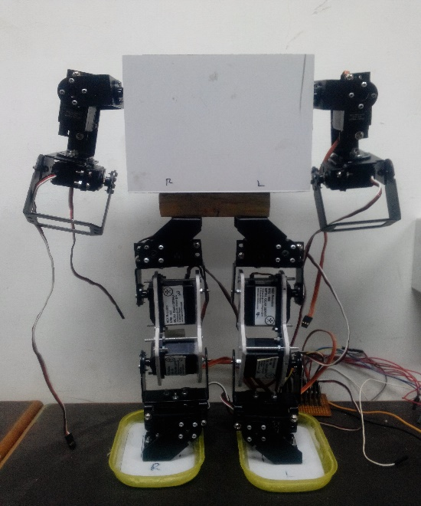
Completion status
The assessment of existing robot structure carried out and design faults were figured out.
After the assessment of the given robot structure ,the existing structure was discarded and new structure was designed and built.
Understand the basic working of servo and interfacing the required number of servo motors with Atmega640 using timers.

Slide 4
Experience of last two weeks
Good working environment.
Very supportive and enthusiastic mentors
Conceptually got to learn about the human biomechanics.
Hands on experience with some new hardware and software kits.
Experience of posting on forums to get instant help from the mentors.

Slide 5
Plan for next 4 week
Adding intelligence to the robot such as walking, side walking, sitting and many more….
Interfacing servos for hand movements and similarly trying different moves with hands as well
After interfacing required number of servos then proceed with the calculation of power requirement and accordingly designing the power supply circuit

