Slide 1
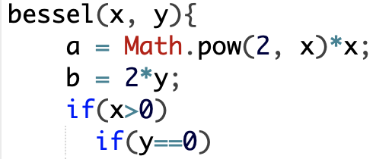
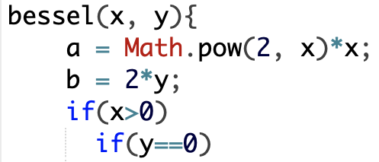
Regression Failures
P
P′
Changes
Unintended different behaviors
between the base and the changed version of the program
Notes:
Program slicing is an analysis technique for understanding and debugging the program

Slide 2
Program Slicing for Debugging
Program slicing computes a subset of program statements
that are related to a particular variable in a statement [*]
Project | # buggy versions | Statements
 |  | # trace | # slice | % reduction
Chart | 23 | 5,913 | 29 | 95.11
Closure | 95 | 92,663 | 1,027 | 98.7
Lang | 49 | 3,091 | 110 | 89.57
Math | 633 | 8,801 | 148 | 94.49
Mockito | 26 | 3,115 | 68 | 97.8
Time | 22 | 13,038 | 75 | 99.03
Defects4J Avg. | 278 | 36,017 | 419 | 95.78
~35k statements
> 95% reduction of the code to inspect
~500 statements
[*] Weiser M, Program slicing, IEEE Transactions on Software Engineering, 1984
Notes:
Program slicing is an analysis technique for understanding and debugging the program

Slide 3

Context-Aware Refinement-Based Slicing for Debugging Regression Failures
V1
V2
1
2
3
4
5
6
7
8
9
10
11
12
13
14
15
16
17
18
19
20
21
22
23
24
public static void main(String[] args){
String format = “yyyyMMddHH:mm:ss”;
Date date = new Date();
date.year = “003”;
date.month = “01”;
date.day = “10”;
Da
te.time = “15 33 20”;
assertEquals(format, getFormat(date));
}
public String getFormat(Date date){
String result;
if (date.year.length() == 2) [false]
year = “yy”;
else
year = “yyyy”;
int tokenLen = date.month.length();
result = result+
= date.day.length();
result = result+getDayFormat(tokenLen);
tokenLen = date.
result = Func1(year);
return result;
}
1
2
3
4
5
6
7
8
9
10
11
12
13
14
15
16
17
18
19
20
21
22
23
24
public static void main(String[] args){
String format = “yyyyMMddHH:mm:ss”;
Date date = new Date();
date.year = “003”;
date.month = “01”;
Dat
e.day = “10”;
date.time = “15 33 20”;
assertEquals(format, getFormat(date));
}
public String getFormat(Date date){
String result;
if (date.year.length() >= 4) [false]
year = “yyyy”;
else
year = “yy”;
int tokenLen = date.month.length();
result =
tokenLen = date.day.length();
result = result+getDayFormat(tokenLen);
tokenLen = date.tim ();
result = Func1(year);
return result;
}
Primary statements
Primary statements
Update
int tokenLen = date.month.length();
result = year+getMonthFormat(tokenLen);
tokenLen = date.day.length();
result = result+getDayFormat(tokenLen);
tokenLen = date.time.length();
17
18
19
20
21
int tokenLen = date.month.length();
result = year+getMonthFormat(tokenLen);
tokenLen = date.day.length();
result = result+getDayFormat(tokenLen);
tokenLen = date.time.length();
17
18
19
20
21
Secondary statements

Slide 4
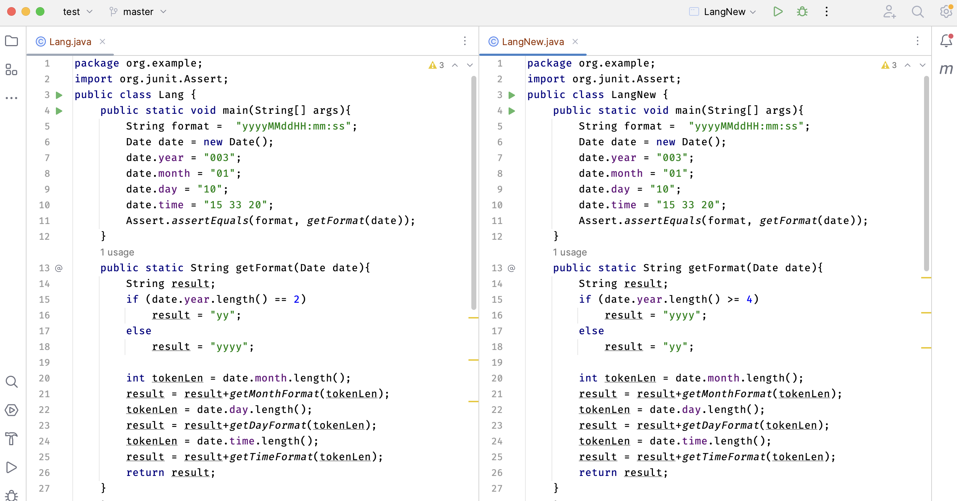
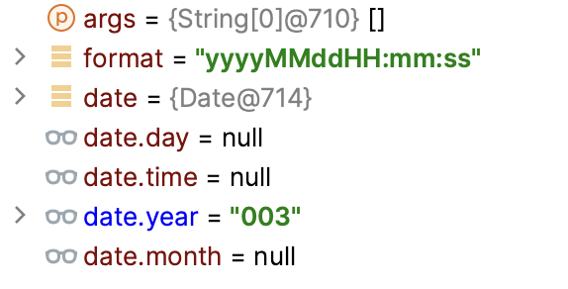
Focusing on Necessary Information
1
2
3
4
5
6
7
8
12
13
14
15
16
17
18
19
20
21
22
23
24
25
26
27
28
package org.example; import org.junit.Assert; public class Lang { public static void main(String[] args){ String format = "yyyyMMddHH:mm:ss"; Date date = new Date(); date.year = "003"; ... Assert.assertEquals(format, getFormat(date)); } public static String getFormat(Date date){ ... if (date.year.length() == 2) year = "yy"; else year = "yyyy"; int tokenLen = date.month.length(); String result = year+getMonthFormat(tokenLen); tokenLen = date.day.length(); result = result+getDayFormat(tokenLen); tokenLen = date.time.length(); result = result+getTimeFormat(tokenLen);
return result; } public static String getMonthFormat(int tokenLen){...}
1
2
3
4
5
6
7
8
12
13
14
15
16
17
18
19
20
21
22
23
24
25
26
27
28
package org.example; import org.junit.Assert; public class Lang { public static void main(String[] args){ String format = "yyyyMMddHH:mm:ss"; Date date = new Date(); date.year = "003"; ... Assert.assertEquals(format, getFormat(date)); } public static String getFormat(Date date){ ... if (date.year.length() >= 4) year = "yyyy"; else year = "yy";
int tokenLen = date.month.length(); String result = year+getMonthFormat(tokenLen); tokenLen = date.day.length(); result = result+getDayFormat(tokenLen); tokenLen = date.time.length(); result = result+getTimeFormat(tokenLen); return result; } public static String getMonthFormat(int tokenLen){...}
Highlight the executed changes
Highlight the executed changes

Slide 5
Focusing on Necessary Information
1
2
3
4
5
6
7
8
12
13
14
15
16
17
18
19
20
21
22
23
24
25
26
27
28
package org.example; import org.junit.Assert; public class Lang { public static void main(String[] args){ String format = "yyyyMMddHH:mm:ss"; Date date = new Date(); date.year = "003"; ... Assert.assertEquals(format, getFormat(date)); } public static String getFormat(Date date){ ... if (date.year.length() == 2) year = "yy"; else year = "yyyy"; int tokenLen = date.month.length(); String result = year+getMonthFormat(tokenLen); tokenLen = date.day.length(); result = result+getDayFormat(tokenLen); tokenLen = date.time.length(); result = result+getTimeFormat(tokenLen);
return result; } public static String getMonthFormat(int tokenLen){...}
1
2
3
4
5
6
7
8
12
13
14
15
16
17
18
19
20
21
22
23
24
25
26
27
28
package org.example; import org.junit.Assert; public class Lang { public static void main(String[] args){ String format = "yyyyMMddHH:mm:ss"; Date date = new Date(); date.year = "003"; ... Assert.assertEquals(format, getFormat(date)); } public static String getFormat(Date date){ ... if (date.year.length() >= 4) year = "yyyy"; else year = "yy";
int tokenLen = date.month.length(); String result = year+getMonthFormat(tokenLen); tokenLen = date.day.length(); result = result+getDayFormat(tokenLen); tokenLen = date.time.length(); result = result+getTimeFormat(tokenLen); return result; } public static String getMonthFormat(int tokenLen){...}
Keeping Primary statements

Slide 6
Focusing on Necessary Information
1
2
3
4
5
6
7
8
12
13
14
15
16
17
18
19
20
21
22
23
24
25
26
27
28
package org.example; import org.junit.Assert; public class Lang { public static void main(String[] args){ String format = "yyyyMMddHH:mm:ss"; Date date = new Date(); date.year = "003"; ... Assert.assertEquals(format, getFormat(date)); } public static String getFormat(Date date){ ... if (date.year.length() == 2) year = "yy"; else year = "yyyy"; int tokenLen = date.month.length(); String result = year+getMonthFormat(tokenLen); tokenLen = date.day.length(); result = result+getDayFormat(tokenLen); tokenLen = date.time.length(); result = result+getTimeFormat(tokenLen);
return result; } public static String getMonthFormat(int tokenLen){...}
1
2
3
4
5
6
7
8
12
13
14
15
16
17
18
19
20
21
22
23
24
25
26
27
28
package org.example; import org.junit.Assert; public class Lang { public static void main(String[] args){ String format = "yyyyMMddHH:mm:ss"; Date date = new Date(); date.year = "003"; ... Assert.assertEquals(format, getFormat(date)); } public static String getFormat(Date date){ ... if (date.year.length() >= 4) year = "yyyy"; else year = "yy";
int tokenLen = date.month.length(); String result = year+getMonthFormat(tokenLen); tokenLen = date.day.length(); result = result+getDayFormat(tokenLen); tokenLen = date.time.length(); result = result+getTimeFormat(tokenLen); return result; } public static String getMonthFormat(int tokenLen){...}
Graying out Secondary statements

Slide 7
Focusing on Necessary Information
1
2
3
4
5
6
7
8
12
13
14
15
16
17
18
19
20
21
22
23
24
25
26
27
28
package org.example; import org.junit.Assert; public class Lang { public static void main(String[] args){ String format = "yyyyMMddHH:mm:ss"; Date date = new Date(); date.year = "003"; ... Assert.assertEquals(format, getFormat(date)); } public static String getFormat(Date date){ ... if (date.year.length() == 2) year = "yy"; else year = "yyyy"; int tokenLen = date.month.length(); String result = year+getMonthFormat(tokenLen); tokenLen = date.day.length(); result = result+getDayFormat(tokenLen); tokenLen = date.time.length(); result = result+getTimeFormat(tokenLen);
return result; } public static String getMonthFormat(int tokenLen){...}
1
2
3
4
5
6
7
8
12
13
14
15
16
17
18
19
20
21
22
23
24
25
26
27
28
package org.example; import org.junit.Assert; public class Lang { public static void main(String[] args){ String format = "yyyyMMddHH:mm:ss"; Date date = new Date(); date.year = "003"; ... Assert.assertEquals(format, getFormat(date)); } public static String getFormat(Date date){ ... if (date.year.length() >= 4) year = "yyyy"; else year = "yy";
int tokenLen = date.month.length(); String result = year+getMonthFormat(tokenLen); tokenLen = date.day.length(); result = result+getDayFormat(tokenLen); tokenLen = date.time.length(); result = result+getTimeFormat(tokenLen); return result; } public static String getMonthFormat(int tokenLen){...}
Folding Irrelevant statements
Folding Irrelevant methods

Slide 8

Focusing on Necessary Information
1
2
3
4
5
6
7
8
12
13
14
15
16
17
18
19
20
21
22
23
24
25
26
27
28
package org.example; import org.junit.Assert; public class Lang { public static void main(String[] args){ String format = "yyyyMMddHH:mm:ss"; Date date = new Date(); date.year = "003"; ... Assert.assertEquals(format, getFormat(date)); } public static String getFormat(Date date){ ... if (date.year.length() == 2) year = "yy"; else year = "yyyy"; int tokenLen = date.month.length(); String result = year+getMonthFormat(tokenLen); tokenLen = date.day.length(); result = result+getDayFormat(tokenLen); tokenLen = date.time.length(); result = result+getTimeFormat(tokenLen);
return result; } public static String getMonthFormat(int tokenLen){...}
1
2
3
4
5
6
7
8
12
13
14
15
16
17
18
19
20
21
22
23
24
25
26
27
28
package org.example; import org.junit.Assert; public class Lang { public static void main(String[] args){ String format = "yyyyMMddHH:mm:ss"; Date date = new Date(); date.year = "003"; ... Assert.assertEquals(format, getFormat(date)); } public static String getFormat(Date date){ ... if (date.year.length() >= 4) year = "yyyy"; else year = "yy";
int tokenLen = date.month.length(); String result = year+getMonthFormat(tokenLen); tokenLen = date.day.length(); result = result+getDayFormat(tokenLen); tokenLen = date.time.length(); result = result+getTimeFormat(tokenLen); return result; } public static String getMonthFormat(int tokenLen){...}
Unfolding the irrelevant statements

Slide 9
Focusing on Necessary Information
1
2
3
4
5
6
7
8
12
13
14
15
16
17
18
19
20
21
22
23
24
25
26
27
28
package org.example; import org.junit.Assert; public class Lang { public static void main(String[] args){ String format = "yyyyMMddHH:mm:ss"; Date date = new Date(); date.year = "003"; ... Assert.assertEquals(format, getFormat(date)); } public static String getFormat(Date date){ ... if (date.year.length() == 2) year = "yy"; else year = "yyyy"; int tokenLen = date.month.length(); String result = year+getMonthFormat(tokenLen); tokenLen = date.day.length(); result = result+getDayFormat(tokenLen); tokenLen = date.time.length(); result = result+getTimeFormat(tokenLen);
return result; } public static String getMonthFormat(int tokenLen){...}
1
2
3
4
5
6
7
8
12
13
14
15
16
17
18
19
20
21
22
23
24
25
26
27
28
package org.example; import org.junit.Assert; public class Lang { public static void main(String[] args){ String format = "yyyyMMddHH:mm:ss"; Date date = new Date(); date.year = "003"; ... Assert.assertEquals(format, getFormat(date)); } public static String getFormat(Date date){ ... if (date.year.length() >= 4) year = "yyyy"; else year = "yy";
int tokenLen = date.month.length(); String result = year+getMonthFormat(tokenLen); tokenLen = date.day.length(); result = result+getDayFormat(tokenLen); tokenLen = date.time.length(); result = result+getTimeFormat(tokenLen); return result; } public static String getMonthFormat(int tokenLen){...}
Unexecuted statements

Slide 10
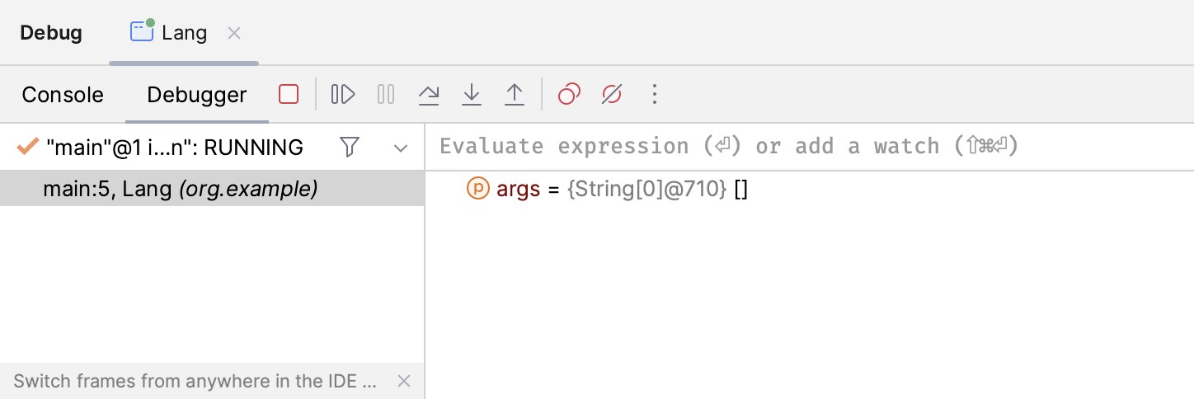
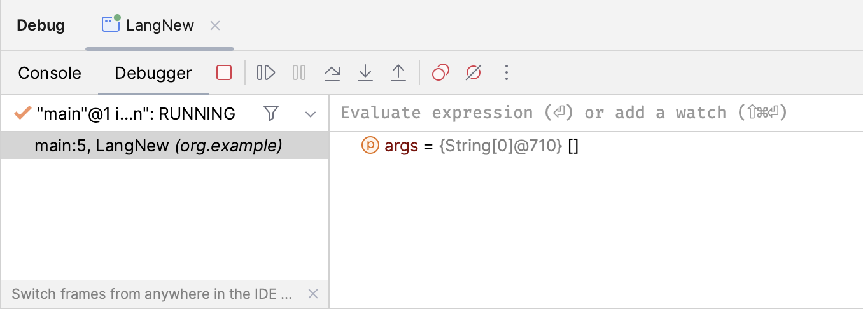
Debugging Essential Statements
1
2
3
4
5
6
7
8
12
13
14
15
16
17
18
19
20
21
22
23
24
25
26
27
28
package org.example; import org.junit.Assert; public class Lang { public static void main(String[] args){ String format = "yyyyMMddHH:mm:ss"; Date date = new Date(); date.year = "003"; ... Assert.assertEquals(format, getFormat(date)); } public static String getFormat(Date date){ ... if (date.year.length() == 2) year = "yy"; else year = "yyyy"; int tokenLen = date.month.length(); String result = year+getMonthFormat(tokenLen); tokenLen = date.day.length(); result = result+getDayFormat(tokenLen); tokenLen = date.time.length(); result = result+getTimeFormat(tokenLen);
return result; } public static String getMonthFormat(int tokenLen){...}
1
2
3
4
5
6
7
8
12
13
14
15
16
17
18
19
20
21
22
23
24
25
26
27
28
package org.example; import org.junit.Assert; public class Lang { public static void main(String[] args){ String format = "yyyyMMddHH:mm:ss"; Date date = new Date(); date.year = "003"; ... Assert.assertEquals(format, getFormat(date)); } public static String getFormat(Date date){ ... if (date.year.length() >= 4) year = "yyyy"; else year = "yy";
int tokenLen = date.month.length(); String result = year+getMonthFormat(tokenLen); tokenLen = date.day.length(); result = result+getDayFormat(tokenLen); tokenLen = date.time.length(); result = result+getTimeFormat(tokenLen); return result; } public static String getMonthFormat(int tokenLen){...}
date.year = "003";
date.year = "003";
Skipping irrelevant statements
7
7

Slide 11


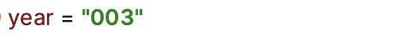
Debugging Essential Statements
1
2
3
4
5
6
7
8
12
13
14
15
16
17
18
19
20
21
22
23
24
25
26
27
28
package org.example; import org.junit.Assert; public class Lang { public static void main(String[] args){ String format = "yyyyMMddHH:mm:ss"; Date date = new Date(); date.year = "003"; ... Assert.assertEquals(format, getFormat(date)); } public static String getFormat(Date date){ ... if (date.year.length() == 2) year = "yy"; else year = "yyyy"; int tokenLen = date.month.length(); String result = year+getMonthFormat(tokenLen); tokenLen = date.day.length(); result = result+getDayFormat(tokenLen); tokenLen = date.time.length(); result = result+getTimeFormat(tokenLen);
return result; } public static String getMonthFormat(int tokenLen){...}
1
2
3
4
5
6
7
8
12
13
14
15
16
17
18
19
20
21
22
23
24
25
26
27
28
package org.example; import org.junit.Assert; public class Lang { public static void main(String[] args){ String format = "yyyyMMddHH:mm:ss"; Date date = new Date(); date.year = "003"; ... Assert.assertEquals(format, getFormat(date)); } public static String getFormat(Date date){ ... if (date.year.length() >= 4) year = "yyyy"; else year = "yy";
int tokenLen = date.month.length(); String result = year+getMonthFormat(tokenLen); tokenLen = date.day.length(); result = result+getDayFormat(tokenLen); tokenLen = date.time.length(); result = result+getTimeFormat(tokenLen); return result; } public static String getMonthFormat(int tokenLen){...}
Assert.assertEquals(format, getFormat(date));
Assert.assertEquals(format, getFormat(date));
Displays only important variables
12
11

Slide 12

Debugging Essential Statements
1
2
3
4
5
6
7
8
12
13
14
15
16
17
18
19
20
21
22
23
24
25
26
27
28
package org.example; import org.junit.Assert; public class Lang { public static void main(String[] args){ String format = "yyyyMMddHH:mm:ss"; Date date = new Date(); date.year = "003"; ... Assert.assertEquals(format, getFormat(date)); } public static String getFormat(Date date){ ... if (date.year.length() == 2) year = "yy"; else year = "yyyy"; int tokenLen = date.month.length(); String result = year+getMonthFormat(tokenLen); tokenLen = date.day.length(); result = result+getDayFormat(tokenLen); tokenLen = date.time.length(); result = result+getTimeFormat(tokenLen);
return result; } public static String getMonthFormat(int tokenLen){...}
1
2
3
4
5
6
7
8
12
13
14
15
16
17
18
19
20
21
22
23
24
25
26
27
28
package org.example; import org.junit.Assert; public class Lang { public static void main(String[] args){ String format = "yyyyMMddHH:mm:ss"; Date date = new Date(); date.year = "003"; ... Assert.assertEquals(format, getFormat(date)); } public static String getFormat(Date date){ ... if (date.year.length() >= 4) year = "yyyy"; else year = "yy";
int tokenLen = date.month.length(); String result = year+getMonthFormat(tokenLen); tokenLen = date.day.length(); result = result+getDayFormat(tokenLen); tokenLen = date.time.length(); result = result+getTimeFormat(tokenLen); return result; } public static String getMonthFormat(int tokenLen){...}
19
19

Slide 13
Selecting Which Statements to Debug on
Essentials
Secondary
All
1
2
3
4
5
6
7
8
12
13
14
15
16
17
18
19
20
26
27
28
package org.example; import org.junit.Assert; public class Lang { public static void main(String[] args){ String format = "yyyyMMddHH:mm:ss"; Date date = new Date(); date.year = "003"; ... Assert.assertEquals(format, getFormat(date)); } public static String getFormat(Date date){ ... if (date.year.length() == 2) year = "yy"; else year = "yyyy"; int tokenLen = date.month.length(); String result = year+getMonthFormat(tokenLen); tokenLen = date.day.length(); result = result+getDayFormat(tokenLen); tokenLen = date.time.length(); result = result+getTimeFormat(tokenLen);
return result; } public static String getMonthFormat(int tokenLen){...}
1
2
3
4
5
6
7
8
12
13
14
15
16
17
18
19
20
26
27
28
package org.example; import org.junit.Assert; public class Lang { public static void main(String[] args){ String format = "yyyyMMddHH:mm:ss"; Date date = new Date(); date.year = "003"; ... Assert.assertEquals(format, getFormat(date)); } public static String getFormat(Date date){ ... if (date.year.length() >= 4) year = "yyyy"; else year = "yy";
int tokenLen = date.month.length(); String result = year+getMonthFormat(tokenLen); tokenLen = date.day.length(); result = result+getDayFormat(tokenLen); tokenLen = date.time.length(); result = result+getTimeFormat(tokenLen); return result; } public static String getMonthFormat(int tokenLen){...}

Slide 14




Debugging Essential Statements
1
2
3
4
5
6
7
8
12
13
14
15
16
17
18
19
20
21
22
23
24
25
26
27
28
package org.example; import org.junit.Assert; public class Lang { public static void main(String[] args){ String format = "yyyyMMddHH:mm:ss"; Date date = new Date(); date.year = "003"; ... Assert.assertEquals(format, getFormat(date)); } public static String getFormat(Date date){ ... if (date.year.length() == 2) year = "yy"; else year = "yyyy"; int tokenLen = date.month.length(); String result = year+getMonthFormat(tokenLen); tokenLen = date.day.length(); result = result+getDayFormat(tokenLen); tokenLen = date.time.length(); result = result+getTimeFormat(tokenLen);
return result; } public static String getMonthFormat(int tokenLen){...}
1
2
3
4
5
6
7
8
12
13
14
15
16
17
18
19
20
21
22
23
24
25
26
27
28
package org.example; import org.junit.Assert; public class Lang { public static void main(String[] args){ String format = "yyyyMMddHH:mm:ss"; Date date = new Date(); date.year = "003"; ... Assert.assertEquals(format, getFormat(date)); } public static String getFormat(Date date){ ... if (date.year.length() >= 4) year = "yyyy"; else year = "yy";
int tokenLen = date.month.length(); String result = year+getMonthFormat(tokenLen); tokenLen = date.day.length(); result = result+getDayFormat(tokenLen); tokenLen = date.time.length(); result = result+getTimeFormat(tokenLen); return result; } public static String getMonthFormat(int tokenLen){...}
return result;
return result;
19
[Diff]
19
[Diff]
:func(year)
:func(year)
Different values
Different values

Slide 15
Side-by-Side Debugging
1
2
3
4
5
6
7
8
12
13
14
15
16
17
18
19
20
21
22
23
24
25
26
27
28
package org.example; import org.junit.Assert; public class Lang { public static void main(String[] args){ String format = "yyyyMMddHH:mm:ss"; Date date = new Date(); date.year = "003"; ... Assert.assertEquals(format, getFormat(date)); } public static String getFormat(Date date){ ... if (date.year.length() == 2) year = "yy"; else year = "yyyy"; int tokenLen = date.month.length(); String result = year+getMonthFormat(tokenLen); tokenLen = date.day.length(); result = result+getDayFormat(tokenLen); tokenLen = date.time.length(); result = result+getTimeFormat(tokenLen);
return result; } public static String getMonthFormat(int tokenLen){...}
1
2
3
4
5
6
7
8
12
13
14
15
16
17
18
19
20
21
22
23
24
25
26
27
28
package org.example; import org.junit.Assert; public class Lang { public static void main(String[] args){ String format = "yyyyMMddHH:mm:ss"; Date date = new Date(); date.year = "003"; ... Assert.assertEquals(format, getFormat(date)); } public static String getFormat(Date date){ ... if (date.year.length() >= 4) year = "yyyy"; else year = "yy";
int tokenLen = date.month.length(); String result = year+getMonthFormat(tokenLen); tokenLen = date.day.length(); result = result+getDayFormat(tokenLen); tokenLen = date.time.length(); result = result+getTimeFormat(tokenLen); return result; } public static String getMonthFormat(int tokenLen){...}
Sync the debugging
return result;
return result;
19
[Diff]
19
[Diff]
:func(year)
:func(year)

Slide 16
Textual Explanations
1
2
3
4
5
6
7
8
12
13
14
15
16
17
18
19
20
21
22
23
24
25
26
27
28
package org.example; import org.junit.Assert; public class Lang { public static void main(String[] args){ String format = "yyyyMMddHH:mm:ss"; Date date = new Date(); date.year = "003"; ... Assert.assertEquals(format, getFormat(date)); } public static String getFormat(Date date){ ... if (date.year.length() == 2) year = "yy"; else year = "yyyy"; int tokenLen = date.month.length(); String result = year+getMonthFormat(tokenLen); tokenLen = date.day.length(); result = result+getDayFormat(tokenLen); tokenLen = date.time.length(); result = result+getTimeFormat(tokenLen);
return result; } public static String getMonthFormat(int tokenLen){...}
1
2
3
4
5
6
7
8
12
13
14
15
16
17
18
19
20
21
22
23
24
25
26
27
28
package org.example; import org.junit.Assert; public class Lang { public static void main(String[] args){ String format = "yyyyMMddHH:mm:ss"; Date date = new Date(); date.year = "003"; ... Assert.assertEquals(format, getFormat(date)); } public static String getFormat(Date date){ ... if (date.year.length() >= 4) year = "yyyy"; else year = "yy";
int tokenLen = date.month.length(); String result = year+getMonthFormat(tokenLen); tokenLen = date.day.length(); result = result+getDayFormat(tokenLen); tokenLen = date.time.length(); result = result+getTimeFormat(tokenLen); return result; } public static String getMonthFormat(int tokenLen){...}
The variable result is assigned in line 21 based on the value of year (line 19) and the output of the method getMonthFormat. It is further reassigned in lines 23 and 25, based on its previous value and the output of the methods getDayFormat (line 23) and getTimeFormat (line 25) applied on tokenLen.
The variable result is assigned in line 21 based on the value of year (line 19) and the output of the method getMonthFormat. It is further reassigned in lines 23 and 25, based on its previous value and the output of the methods getDayFormat (line 23) and getTimeFormat (line 25) applied on tokenLen.

