Slide 1
MINI PROJECT DS
Bandung Street Jam forecast

Slide 2
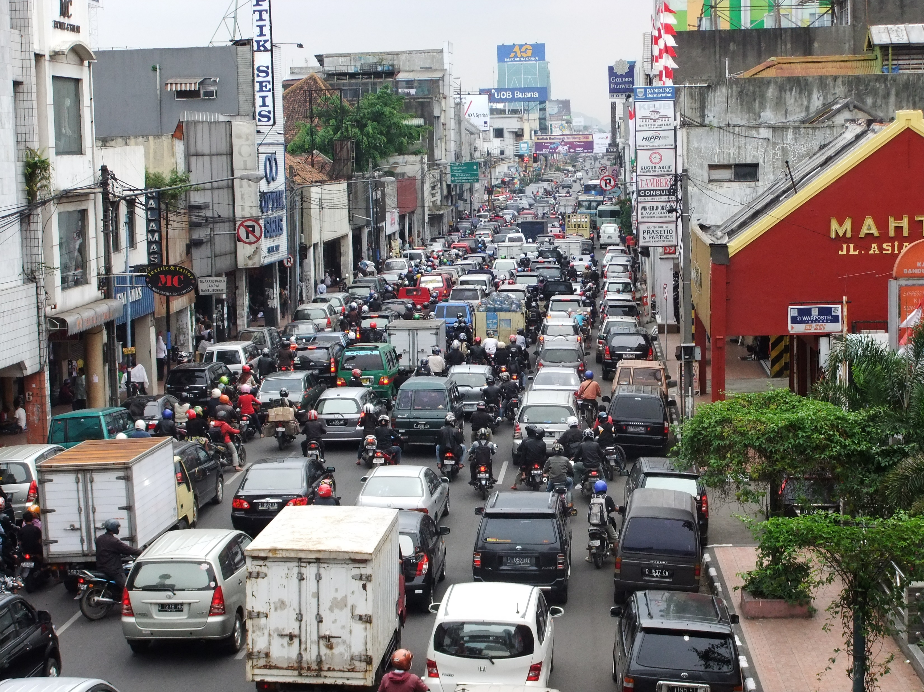
Objective
To provide the user with an accurate answer to specific road at specific time whether it’s a traffic jam or not.
Data Used
Data used are from aggregate median jams. The columns used in this data are:
Date time (hour, day of the week)
Street
Median Level

Slide 3
Data Cleaning
Dropping Values
Dropping the row where street is null since we want to use the street for classifying
Grouping and Jam Labeling
Since there are some duplicates within street and timeframe, we group the data and label it to jam ( <=2 median level) or not jam
Converting TimeFrame
Converting datetime data to Hour and Day of Week
Dropping street that have frequency less than the mean
There are a lot of street and the data might not have enough input to help the algorithm predict the jam. Therefore we drop the street which appear less than mean freq

Slide 4

Data Preprocessing
Stratified Train Test Split
Splitting the train and test data for testing the performance of the model stratified by the balance proportion of street between train and test data
One Hot encoding
Converting the value in the street to columns

Slide 5
Modelling Consideration
Random forest Classifier - comprised of trees. It is said that the more trees it has, the more robust a forest is. Random forests creates decision trees on randomly selected data samples, gets prediction from each tree and selects the best solution by means of voting.
KNeighborsClassifier - based on the k nearest neighbors of a sample, which has to be classified. The number 'k' is an integer value specified by the user. This is the most frequently used classifiers of both algorithms.
LogisticRegression – Part of linear classifiers which is fast, uncomplicated and conventents, used especially for binary classification
Gausian Naives Bayes – Extension of Naïve Bayes (probability algorithm for classification function based on Bayes theorem)

Slide 6
Evaluation Metrics
Precision Score
ratio of True Positives count to total True Positive count made by the model.
Precision = TP/(TP+FP)
Recall Score
ratio of True Positives count to the total Actual Positive count.
Recall = TP/(TP+FN)
F1 score
harmonic mean of recall & precision. The harmonic mean is more sensitive to low values, so the F1 will be high only when both precision & recall are high
Roc Auc
Receiver Operating Characteristics. It is a graph of True Positive Rate (TPR) vs False Positive Rate(FPR).
Goal: Maximizing ROC AUC
Since we care equally about positive and negative classes, it is also good for imbalanced data. We are going to try all the modeling consideration and find which modelling have better performance in terms of ROC AUC

Slide 7
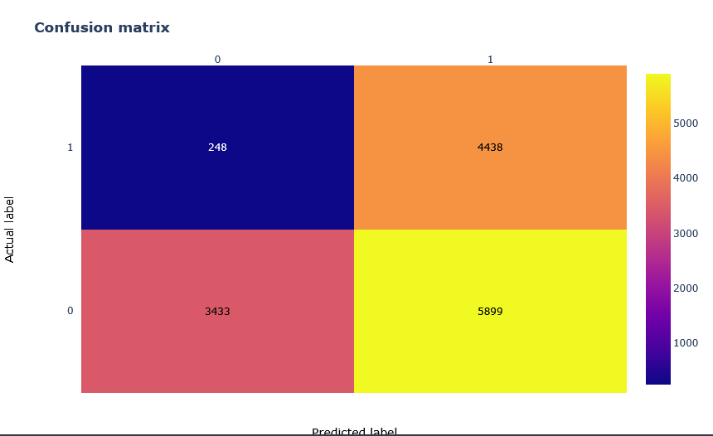
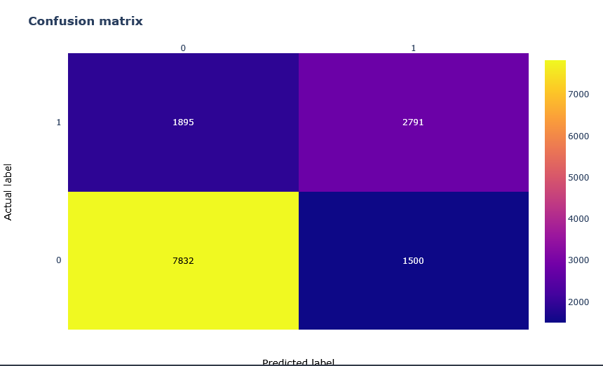
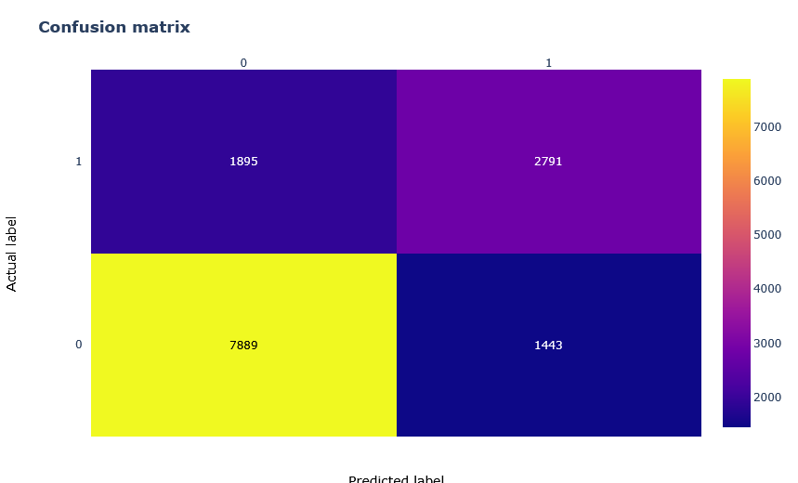
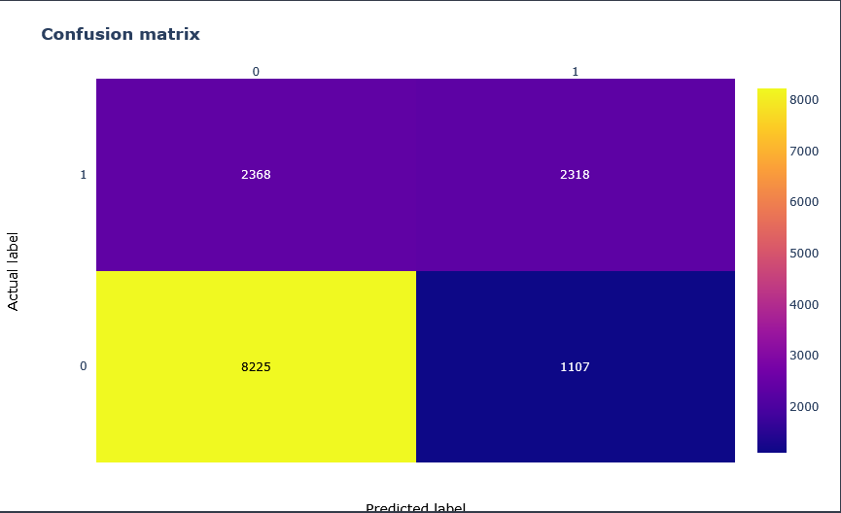
Modelling
Random Forest
Kneighbor Classifier
LogisitcRegression
Gaussian Naïve Bayes
roc_auc train: 0.805842961364123
roc_auc pred: 0.7174333392057655
roc_auc train: 0.7857117995312535
roc_auc pred: 0.7204873469211533
roc_auc train: 0.6868464338667082
roc_auc pred: 0.6880204351490491
roc_auc train: 0.6616716863839616
roc_auc pred: 0.6574751898890256
Random Forest and KNN have great performance. Meanwhile Gaussian Naïve Bayes have good TPR, but since we want to focus on balance result between the confussion matrix we will focus on roc_auc. Both Random Forest and KNN have great performance on it.

Slide 8
Imbalance Data - Smothe
Since the data is imbalance. This might affect the performance of the model. Smothe help to make a data augmentation that can create synthesized data for balancing the sample

Slide 9
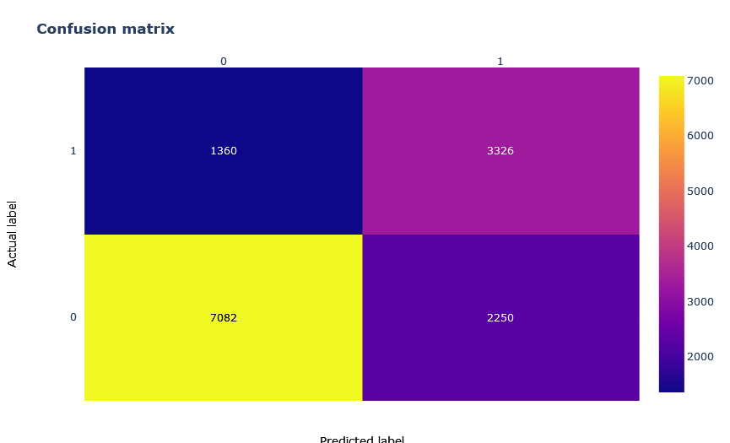
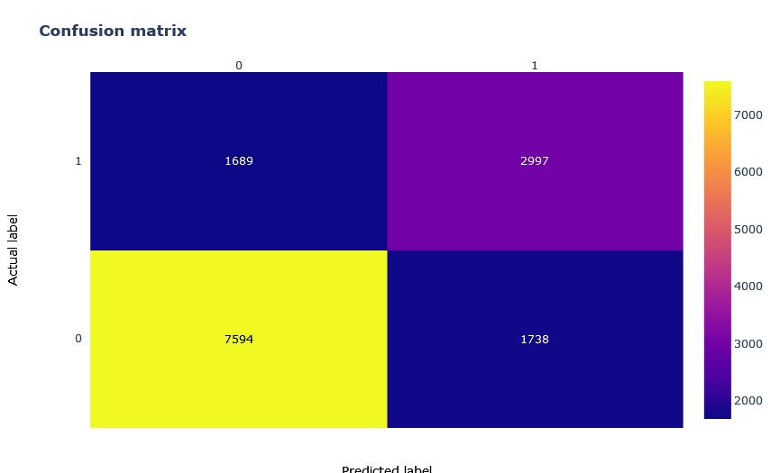
Modelling After Smothe
Random Forest
Random Forest (Smothe)
Kneighbor Classifier
Kneighbor Classifier(Smothe)
Increase in Roc_auc in prediction,
More stable between tpr and fpr
Increase in Roc_auc in prediction,
More stable between tpr and fpr
roc_auc train: 0.805842961364123
roc_auc pred: 0.7174333392057655
roc_auc train: 0.8419601618350857
roc_auc pred: 0.7343339610066848
roc_auc train: 0.7857117995312535
roc_auc pred: 0.7204873469211533
roc_auc train: 0.8043537934573751
roc_auc pred: 0.7266618845677423
After Smothe Random Forest has better performance compare to KNN after smothe. Therefore, Random Foreset can be tuned further

Slide 10
Hyperparameter Tuning
N_Estimators
Number of trees in random forest
Max_features
Number of features to consider at every split
Max_depth
Maximum number of levels in tree
Min_samples_split
Minimum number of samples required to split a node
Min_sample_leaf
Minimum number of samples required to each leaf node
Bootstrap
Method of selecting samples for training each tree
This parameter will be randomized search cv to find the most optimal value for each for the increase in ROC_AUC

Slide 11
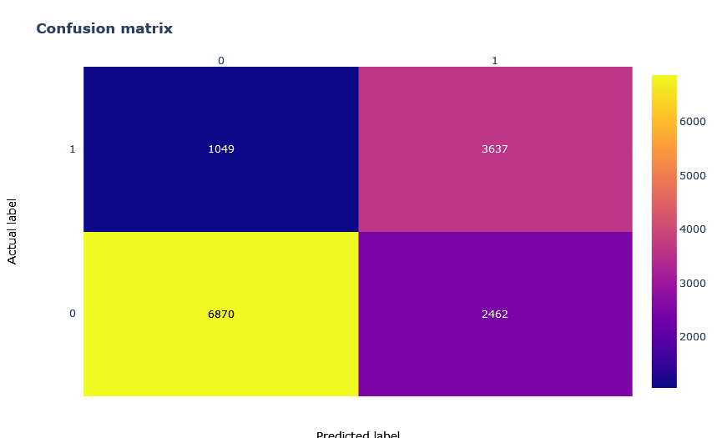
Modelling After Hyperparameter Tuning
Random Forest
Random Forest (Smothe)
Random Forest (Tuned)
Best Parameters
N_estimator = 800
Min_sample_split = 5
Min_sample_leaf = 2
Max_features = auto
Max_depth = None
Bootstrap = True
Increase in Roc_auc in prediction
More stable between tpr and fpr
Increase in Roc_auc in prediction,
More stable between tpr and fpr
roc_auc train: 0.805842961364123
roc_auc pred: 0.7174333392057655
roc_auc train: 0.8419601618350857
roc_auc pred: 0.7343339610066848
roc_auc train: 0.8197794459893303
roc_auc pred: 0.7561591476667876
There are increase from smothe and from hyperparameter tuning.

Slide 12
Feature Importances
Weight | Feature
0.0687 ± 0.0041 | Hour
0.0256 ± 0.0048 | Dow
0.0085 ± 0.0011 | 162
0.0085 ± 0.0010 | 82
0.0076 ± 0.0007 | 177
0.0051 ± 0.0008 | 156
0.0050 ± 0.0008 | 91
0.0049 ± 0.0011 | 204
0.0048 ± 0.0004 | 135
0.0045 ± 0.0006 | 1
0.0045 ± 0.0008 | 63
0.0044 ± 0.0012 | 180
0.0044 ± 0.0011 | 9
0.0043 ± 0.0010 | 183
0.0042 ± 0.0004 | 23
0.0041 ± 0.0010 | 75
0.0039 ± 0.0010 | 205
0.0035 ± 0.0006 | 208
0.0035 ± 0.0005 | 158
0.0035 ± 0.0003 | 74
Hour and Day of week play major role in determining whether the street is going to have a jam or not

Slide 13
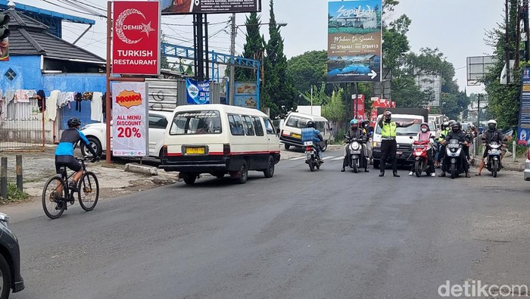
Conclusion
Hours and days play major role in determining whether this street is jam or not
The result is not that great but can be useful to at least predict before going through the street to avoid jam
Some street cant be predicted since there is only small amount of data can be trained. This might be because the road is rarely passed by people or maybe it is usually just not crowded and people don’t report it

Slide 14
References
https://www.datacamp.com/tutorial/random-forests-classifier-python
https://python-course.eu/machine-learning/k-nearest-neighbor-classifier-with-sklearn.php
https://realpython.com/logistic-regression-python/
https://www.upgrad.com/blog/gaussian-naive-bayes/
https://machinelearningmastery.com/smote-oversampling-for-imbalanced-classification/
https://towardsdatascience.com/hyperparameter-tuning-the-random-forest-in-python-using-scikit-learn-28d2aa77dd74

