Slide 1

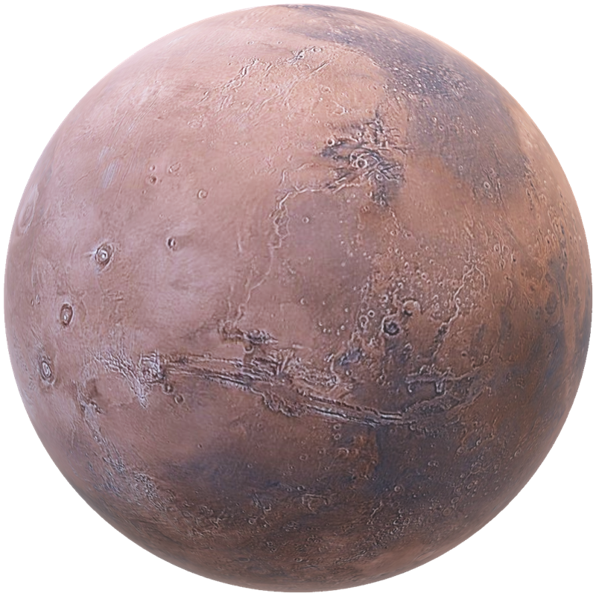
MARS ATLAS
Go beyond the known.
A layered surface map for the first humans to walk on Mars.
NASA SPACE APPS · INTERPLANETARY SURVIVAL GUIDE: MARTIAN MAP
Notes:
Mars Atlas. Our answer to the Interplanetary Survival Guide challenge: one layered map that pulls NASA data together so the first crew on Mars can plan and walk a safe, science-rich Marswalk.

Slide 2
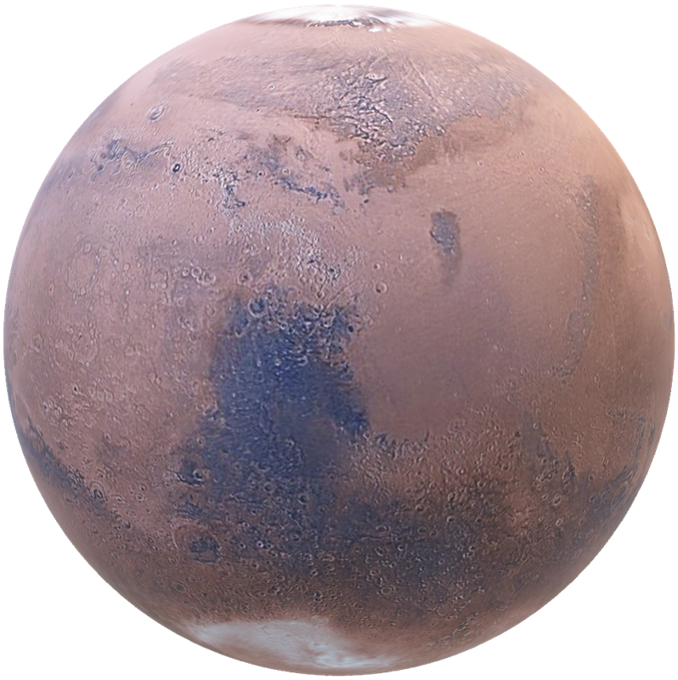
THE CHALLENGE
Global maps can’t plan a single Marswalk.
Jezero Crater
One Marswalk ≈ 15 km
Decades of NASA orbiter and rover data exist, but no map layers it for one crew, one route, one day: the path, the hazards and the oxygen to get there.
Notes:
NASA has mapped Mars for decades from orbit and from rovers like Perseverance in Jezero Crater. But tools like Mars Trek are built for global views. A crew on a Marswalk needs the next 15 kilometres: the route, the hazards, and the air to get there.

Slide 3
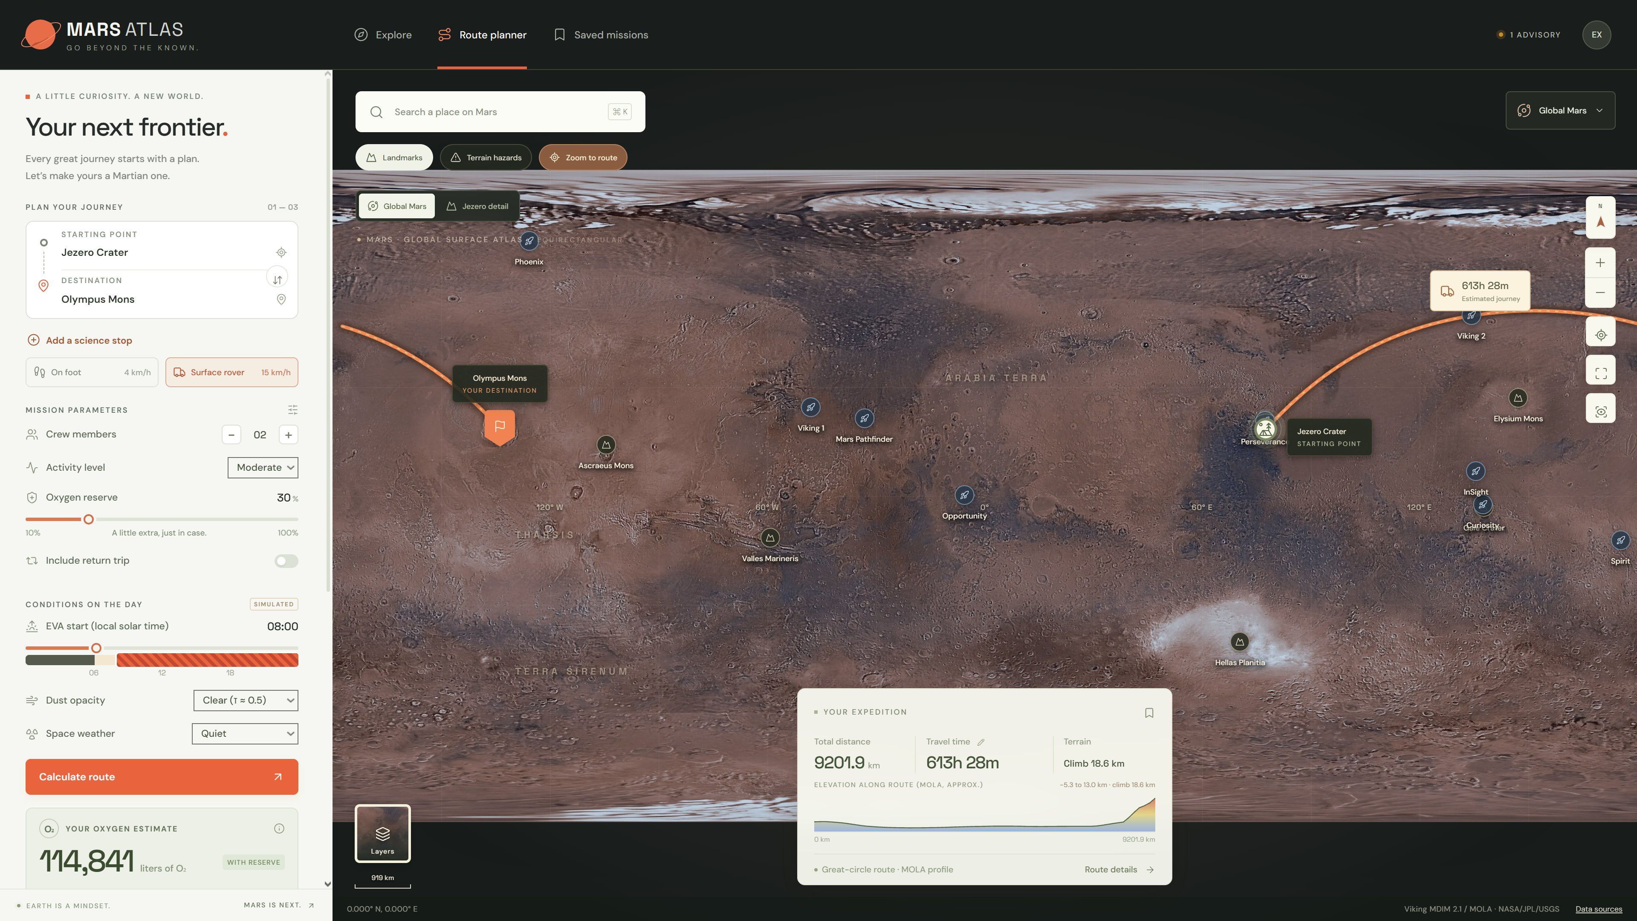
OUR SOLUTION
Meet Mars Atlas
4 NASA data layers · 9 landing sites · global + Jezero
Notes:
Meet Mars Atlas. Planner on the left, a layered NASA map on the right: Viking color and MOLA elevation globally, ESA and NASA HRSC imagery at Jezero, and every NASA landing site. Here it plans a rover expedition from Jezero to Olympus Mons, with an elevation profile along the way.

Slide 4
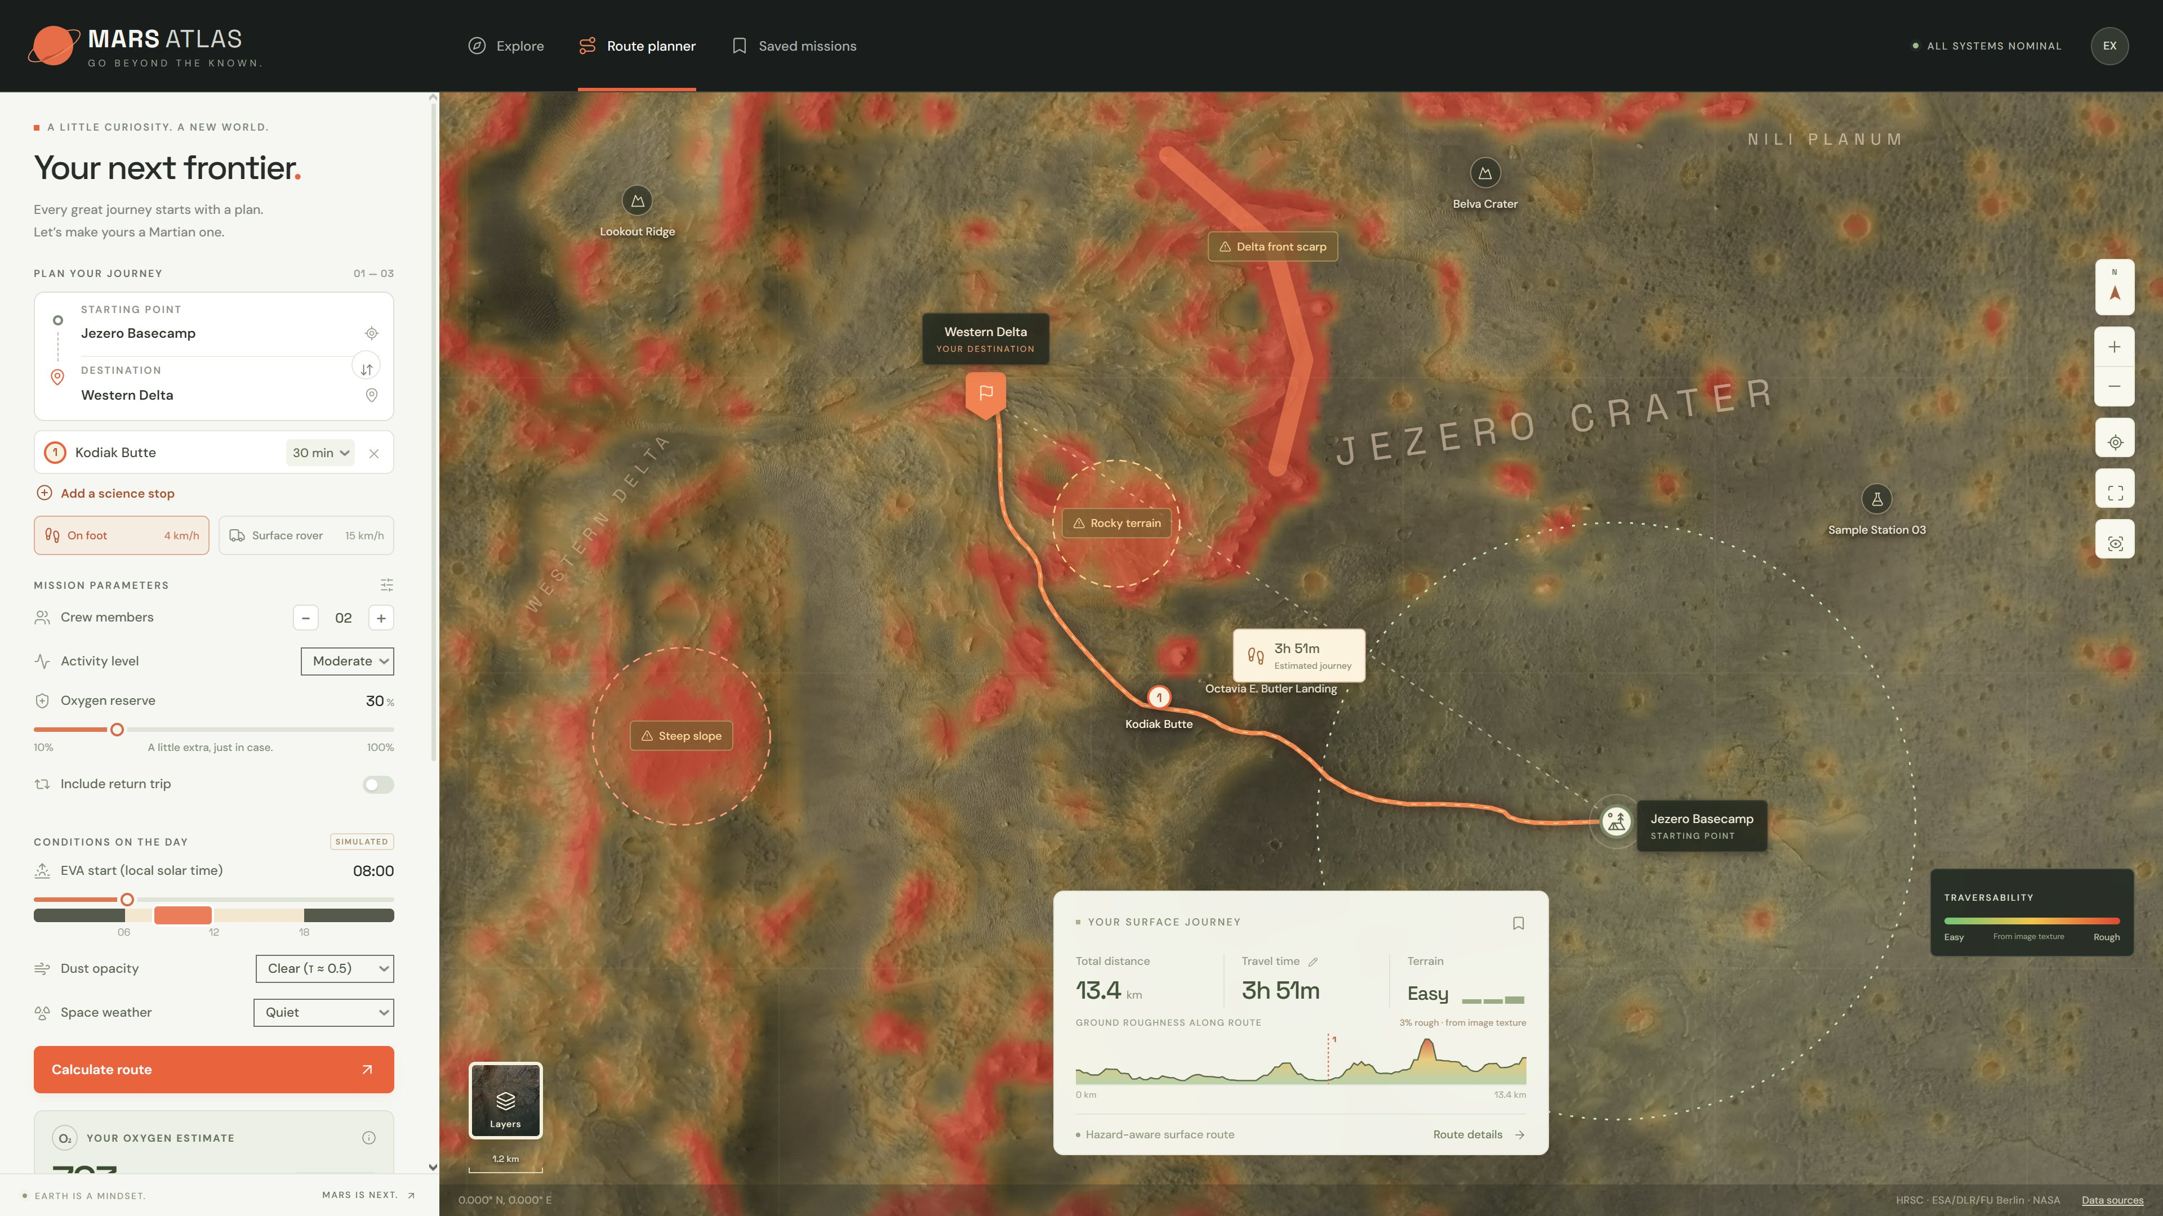
HAZARD-AWARE ROUTING
Red = rough ground, from image texture
A path, not a line
Least-cost search over the terrain, with science stops.
Steers around rocky ground
Science stop · Kodiak Butte · 30 min
Notes:
Zoom into Jezero. Instead of a straight line, Mars Atlas finds the least-cost path across a terrain grid built from orbital imagery. Red marks rough ground. The route steers around rocky terrain and steep slopes, and stops at Kodiak Butte for thirty minutes of science on the way to the delta.

Slide 5
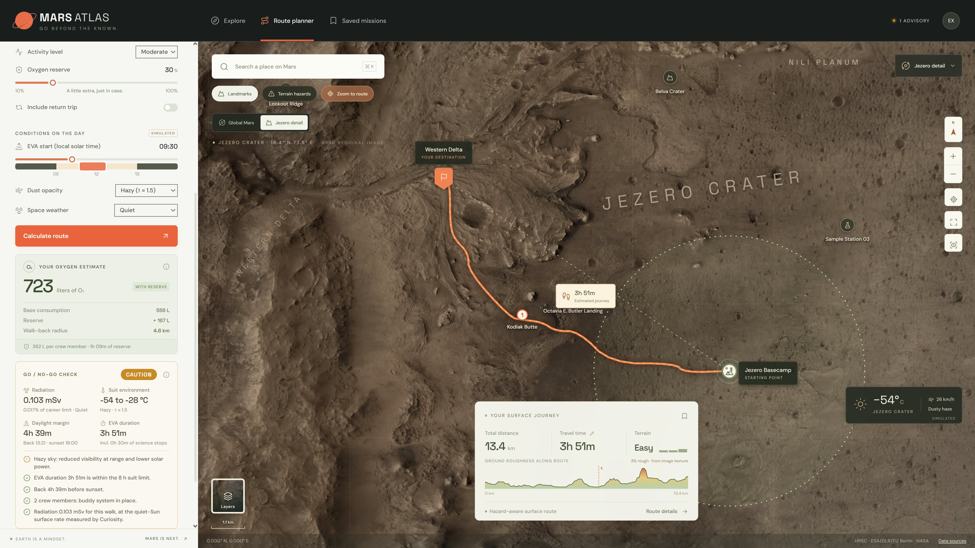
SAFETY FIRST
A GO / NO-GO call for every plan
723 L
oxygen for 2 crew, 30% reserve
4.6 km
walk-back radius on reserve O₂
0.103 mSv
dose, at Curiosity RAD’s measured rate
4h 39m
back before sunset
CAUTION
Hazy sky: reduced visibility and solar power
Also checks the 8-hour suit limit, the buddy rule, daylight, dust storms and solar particle events.
Notes:
Safety first. Every plan gets a go or no-go call. Oxygen with reserve, and the walk-back radius: how far the crew could walk home on reserve air if the rover fails. Radiation uses the dose rate Curiosity measured on the surface. It also checks daylight, the eight-hour suit limit, the buddy rule, dust and solar storms. Here a hazy sky makes it a caution.

Slide 6
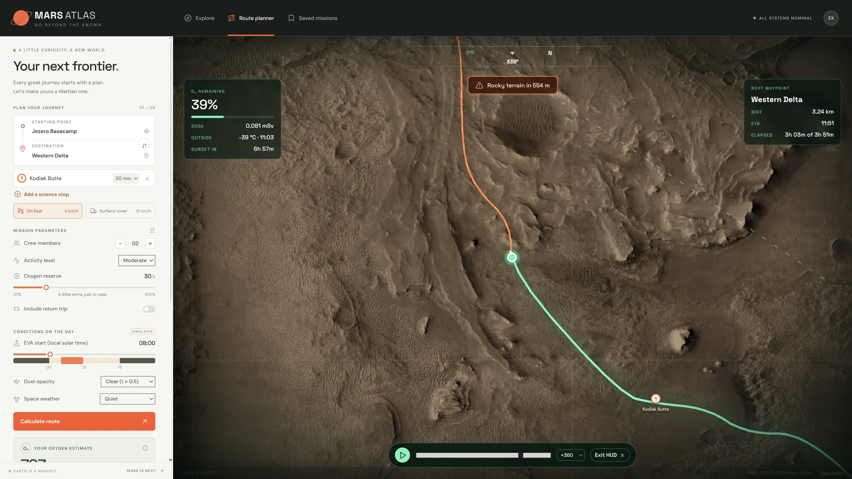
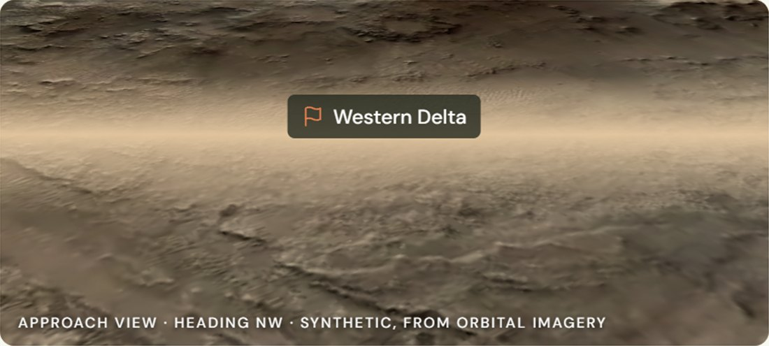
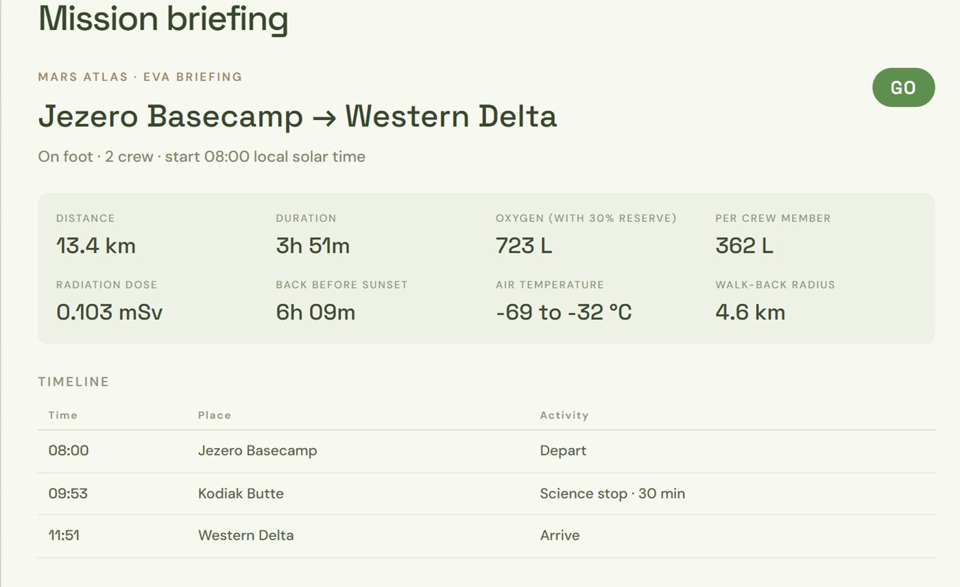
ASTRONAUT VIEWS
Built for the walk itself
GROUND-LEVEL APPROACH VIEW
ONE-PAGE EVA BRIEFING
Helmet HUD walk-through
Notes:
Then the walk itself. The helmet HUD plays the Marswalk with a compass, oxygen remaining, dose, sunset countdown and hazard alerts, like rocky terrain 554 metres ahead. Each stop has a ground-level approach view, and the whole plan prints as a one-page EVA briefing. A share link reopens the exact plan.

Slide 7
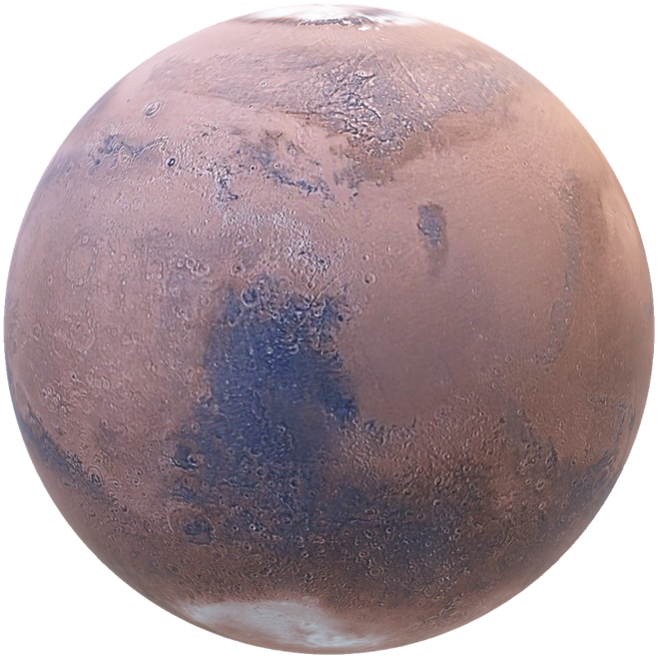
Earth is a mindset.
Mars is next.
NEXT ON THE ROADMAP
01 HiRISE slope maps · true terrain-accurate routing
02 CRISM mineral maps · science targets from spectra
03 Live MEDA + RAD feeds · real weather and space weather
MARS ATLAS · Thank you
Notes:
Next: real HiRISE slope maps for true terrain routing, CRISM minerals to pick science targets, and live weather and space weather. Earth is a mindset. Mars is next. Thank you.

