Slide 1
JAVASCRIPT:
JavaScript is one of the 3 languages all web developers must learn:
1. HTML to define the content of web pages
2. CSS to specify the layout of web pages
3. JavaScript to program the behavior of web pages
JavaScript was invented by Brendan Eich in 1995, and became an ECMA standard in 1997.ECMA-262 is the official name of the standard. ECMAScript is the official name of the language.
JavaScript is a lightweight, cross-platform, single-threaded, and interpreted
compiled programming language. It is well-known for the development of web pages, and many non-browser environments also use it. No compiler is needed.
JavaScript is a modern scripting language that is popular worldwide among developers.
JavaScript can be used for Client-side developments as well as Server-side .
JavaScript is both an imperative and declarative type of language.
is both an imperative and declarative type of language.

Slide 2
JavaScript is considered lightweight due to the fact that it has low CPU usage, is easy to implement, and has a minimalist syntax. Minimalist syntax as in, has no data types. Everything is treated here as an object. It is very easy to learn because of its syntax similar to C++ and Java.
JavaScript runs in the browser even though it has complex paradigms and logic which means it uses fewer resources than other languages. It has fewer in-built libraries or frameworks, contributing as another reason for it being lightweight. However, this brings a drawback in that we need to incorporate external libraries and frameworks.

Slide 3
Client-side: It supplies objects to control a browser and its Document Object Model (DOM). Like if client-side extensions allow an application to place elements on an HTML form and respond to user events such as mouse clicks, form input, and page navigation. Useful libraries for the client side are AngularJS, ReactJS, VueJS, and so many others.
Server-side: It supplies objects relevant to running JavaScript on a server. For if the server-side extensions allow an application to communicate with a database, and provide continuity of information from one invocation to another of the application, or perform file manipulations on a server. The useful framework which is the most famous these days is node.js
developments.vaScript
Imperative language – In this type of language we are mostly concerned about how it is to be done. It simply controls the flow of computation. The procedural programming approach, object, oriented approach comes under this as async await we are thinking about what is to be done further after the async call.
Declarative programming – In this type of language we are concerned about how it is to be done, basically here logical computation requires. Her main goal is to describe the desired result without direct dictation on how to get it as the arrow function does.

Slide 4
How to Link/Add JavaScript File in HTML ?
These are the basic approaches for doing this:
Add JavaScript Code inside Head Section
Add JavaScript Code inside Body Section
External JavaScript
JavaScript can be added to HTML file in two ways: Scripts can be placed inside the body or the head section of an HTML page or inside both the head and body. We can also place JavaScript outside the HTML file which can be linked by specifying its source in the script tag.
JavaScript code is inserted between <script> and </script> tags when used in an HTML document.
Scripts can be placed inside the body or the head section of an HTML page or inside both the head and body.
We can also place JavaScript outside the HTML file which can be linked by specifying its source in the script tag.
SYNTAX:
<script> // JavaScript Code </script>
Single line comments // Change heading:
Multi Line Comments /*Hi Welcome To your first class */
JavaScript Syntax is used to define the set of rules to construct a JavaScript code.

Slide 5
How to Link/Add JavaScript File in HTML ?
Internal JS: We can add JavaScript directly to our HTML file by writing the code inside the <script> tag. The <script> tag can either be placed inside the <head> or the <body> tag according to the requirement.
External JS: We can write JavaScript code in another files having an extension.js and then link this file inside the <head> tag of the HTML file in which we want to add this code.
<!DOCTYPE html>
html lang="en">
<head>
<title>
Basic Example to Describe JavaScript
</title>
</head>
<body>
<!-- JavaScript code can be embedded inside
head section or body section -->
<script>
console.log("Welcome to Lovely Professional University");
</script>
</body>
</html>
Advantages of External JavaScript
Cached JavaScript files can speed up page loading.
It makes JavaScript and HTML easier to read and maintain.
It separates the HTML and JavaScript code.
It focuses on code reusability which is one JavaScript Code that can run in various HTML files.
Output: The output will display on the console.
Welcome to Lovely Professional University

Slide 6
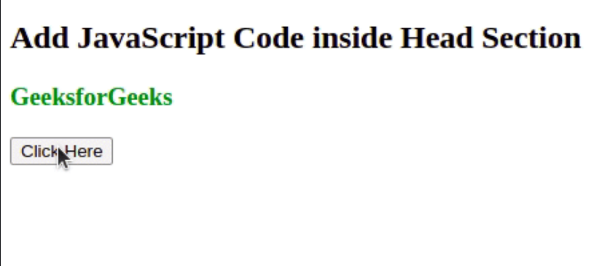
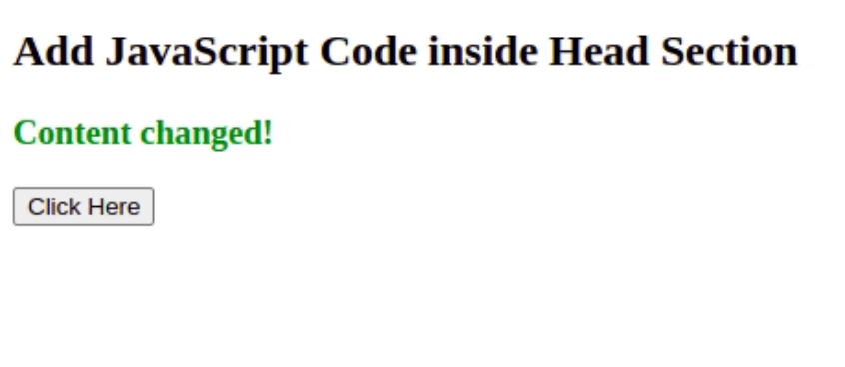
<!DOCTYPE html>
<html>
<head>
<title>
Add JavaScript Code inside Head Section
</title>
<script>
function myFun() {
document.getElementById("demo")
.innerHTML = "Content changed!";
}
</script>
</head>
<body>
<h2>
Add JavaScript Code
inside Head Section
</h2>
OUTPUT
JavaScript code is placed inside the head section of an HTML page and uses the <script> element. Insert the <script> tag between the opening <head> and closing </head> tags, and place your JavaScript code inside. This ensures the script is loaded and executed when the page loads.

Slide 7
JavaScript Syntax is used to define the set of rules to construct a JavaScript code.
Syntax:
console.log("Basic Print method in JavaScript");
Variables
In JavaScript, variables are used to store and manage data. They are created using
the var, let, or const keyword.
var : Declares a variable. It has a function-scoped or globally-scoped behavior.
var x = 10;
Example: In this example, we will declare variables using var.
var a = "Hello Geeks"
var b = 10;
var c = 12;
var d = b + c;
console.log(a);
console.log(b);
console.log(c);
console.log(d);

Slide 8
let: Introduces block-scoped variables. It’s commonly used for variables that may change their value.
let y = "Hello";
Example: In this example, we will declare variables using let.
let a = "Hello learners"
let b = "joining";
let c = " 12";
let d = b + c;
console.log(a);
console.log(b);
console.log(c);
console.log(d);
const: Declares variables that cannot be reassigned. It’s block-scoped as well.
const PI = 3.14;
const a = "Hello learners"
console.log(a);
const b = 400;
console.log(b);
const c = "12";
console.log(c);
// Can not change a value for a constant
//c = "new"
//console.log(c) will show error

Slide 9
JAVASCRIPT Identifiers are the unique names given to variables with some restrictions
Names can contain letters, digits, underscores, and dollar signs.
Names must begin with a letter.
Names can also begin with $ and _
Names are case sensitive (a and A are different variables).
Reserved words (like JavaScript keywords) cannot be used as names.
abstract arguments boolean break byte
case catch char const continue
debugger default delete do double
else eval false final finally
float for function goto if
implements in instanceof int interface
long native new null package
private protected public return short

Slide 10
DATATYPE:
The latest ECMAScript standard defines eight data types Out of which seven data types are Primitive(predefined) and one complex or Non-Primitive.
Primitive Data Types
The predefined data types provided by JavaScript language are known as primitive data types. Primitive data types are also known as in-built data types.
Number: JavaScript numbers are always stored in double-precision 64-bit binary format. Unlike other programming languages, you don’t need int, float, etc to declare different numeric values.
String: JavaScript Strings are similar to sentences. They are made up of a list of characters, which is essentially just an “array of characters, like “Hello LPU” etc.
Boolean: Represent a logical entity and can have two values: true or false.
Null: This type has only one value that is null.
Undefined: A variable that has not been assigned a value is undefined.
Symbol: Symbols return unique identifiers that can be used to add unique property keys to an object that won’t collide with keys of any other code that might add to the object.
BigInt: BigInt is a built-in object in JavaScript that provides a way to represent whole numbers larger than 253-1.

Slide 11
Non-Primitive Data Types
The data types that are derived from primitive data types of the JavaScript language are known as non-primitive data types. It is also known as derived data types or reference data types.
Object: It is the most important data type and forms the building blocks for modern JavaScript. We will learn about these data types in detail in further articles.
// It store string data type
let txt = "LOVELY PROFESSIONAL UNIVERSITY";
// It store integer data type
let a = 5;
let b = 5;
// It store Boolean data type
(a == b )
// To check Strictly (i.e. Whether the datatypes
// of both variables are same) === is used
(a === b)---> returns true to the console
// It store array data type
let places= ["LPU", "Computer", "Hello"];
// It store object data (objects are
// represented in the below way mainly)
let Student = {
firstName:"Johnny",
lastName:"Diaz",
age:35,
mark:"blueEYE"}

Slide 12
JAVASCRIPT OPERATORS:
JavaScript operators are symbols that are used to compute the value or in other words, we can perform operations on operands.
Arithmetic operators ( +, -, *, / ) are used to compute the value
Assignment operators ( =, +=, %= ) are used to assign the values to variables.
// Variable Declarations
let x, y, sum;
// Assign value to the variables
x = 3;
y = 23;
// Use arithmetic operator to
// add two numbers
sum = x + y;
console.log(sum);

Slide 13
JAVASCRIPT EXRESSION:
Expression is the combination of values, operators, and variables. It is used to compute the values.
Example: This example shows a JavaScript expression.
// Variable Declarations
let x, num, sum;
// Assign value to the variables
x = 20;
y = 30
// Expression to divide a number
num = x / 2;
// Expression to add two numbers
sum = x + y;
console.log(num + "<br>" + sum);
JavaScript Keyword
The keywords are the reserved words that have special meanings in JavaScript.
// let is the keyword used to
// define the variable
let a, b;
// function is the keyword which tells
// the browser to create a function
function GFG(){};

Slide 14
JAVASCRIPT FUNCTIONS:
JavaScript functions are the blocks of code used to perform some particular operations. JavaScript function is executed when something calls it. It calls many times so the function is reusable.
The JavaScript function can contain zero or more arguments.
Example: This example shows the use of Javascript functions.
function functionName( par1, par2, ....., parn ) {
// Function code
}
// Function definition
function func() {
// Declare a variable
let num = 45;
// Display the result
console.log(num);
}
// Function call
func();

Slide 15
JavaScript Output defines the ways to display the output of a given code.
The output can be displayed by using different approaches which are listed below:
Using innerHTML
Using document.write()
Using window.alert():
Using console.log()
Using window.prompt()
Using appendChild()

Slide 16
Using innerHTML:
SYNTAX:
It is used to access an element. It defines the HTML content.
<!DOCTYPE html>
<html lang="en">
<head>
<title>JavaScript Output</title>
</head>
<body>
<h1>LOVELY PROFESSIONAL UNIVERSITY</h1>
<h2>
JavaScript Display Possibilities
Using innerHTML
</h2>
<p id="LPU"></p>
<!-- Script to use innerHTML -->
<script>
document.getElementById("GFG").innerHTML
= 10 * 2;
</script>
</body>
</html>
document.getElementById("id").innerHTML;

Slide 17
Using document.write()
It is used for testing purpose.
Syntax:
document.write();
<!DOCTYPE html>
<html lang="en">
<head>
<title>JavaScript Output</title>
</head>
<body>
<h1>GeeksforGeeks</h1>
<h2>
JavaScript Display Possibilities
Using document.write()
</h2>
<p id="GFG"></p>
<!-- Script to uses document.write() -->
<script>
document.write(10 * 2);
</script>
</body>
</html>

Slide 18
Using window.alert():
It displays the content using an alert box.
Syntax:
window.alert();
<!DOCTYPE html>
<html lang="en">
<head>
<title>JavaScript Output</title>
</head>
<body>
<h1>GeeksforGeeks</h1>
<h2>
JavaScript Display Possibilities
Using window.alert()
</h2>
<p id="GFG"></p>
<!-- Script to use window.alert() -->
<script>
window.alert(10 * 2);
</script>
</body>
</html>

Slide 19
Using console.log()
It is used for debugging purposes.
Syntax:
console.log();
Example: This example uses the console.log() property to display data.
<!DOCTYPE html>
<html lang="en">
<head>
<title>JavaScript Output</title>
</head>
<body>
<h1>GeeksforGeeks</h1>
<h2>
JavaScript Display Possibilities
Using console.log()
</h2>
<p id="GFG"></p>
<!-- Script to use console.log() -->
<script>
console.log(10 * 2);
</script>
</body>
</html>

Slide 20
Using window.prompt()
It Allows to take input from user.
Syntax:
window.prompt();
<!DOCTYPE html>
<html lang="en">
<head>
<title>JavaScript Output</title>
</head>
<body>
<h1>GeeksforGeeks</h1>
<h2>
JavaScript Display Possibilities
Using window.alert()
</h2>
<p id="GFG"></p>
<!-- Script to use window.alert() -->
<script>
window.prompt("Please Enter your Input");
</script>
</body>
</html>

Slide 21
Using appendChild()
This method allows you to append content to an HTML
element.
Syntax:
element.appendChild(node);
Example: In this example, we are using
appendChild() method.
<!DOCTYPE html>
<html lang="en">
<head>
<meta charset="UTF-8">
<meta name="viewport"
content="width=device-width,
initial-scale=1.0">
<title>JavaScript Output Examples</title>
</head>
<body>
<h1>JavaScript Output Example</h1>
<script>
var outputContainer = document.createElement("div");
var userInput = window.prompt('Enter something:');
var output = document.createElement("p");
output.appendChild(document
.createTextNode('You entered: ' + userInput));
outputContainer.appendChild(output);
document.body.appendChild(outputContainer);
</script>
</body>
</html>

