Slide 1

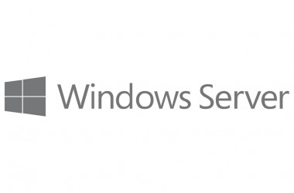
Windows
Administration
& Programming
openClass by-
akshaySaini

Slide 2
Windows
Microsoft Windows (or simply Windows) is a meta-family of graphical operating systems developed, marketed, and sold by Microsoft.
It consists of several families of operating systems, each of which cater to a certain sector of the computing industry with the OS typically associated with IBM PC compatible architecture.
Active Windows families include Windows NT, Windows Embedded and Windows Phone; these may encompass subfamilies, e.g. Windows Embedded Compact (Windows CE) or Windows Server.

Slide 3
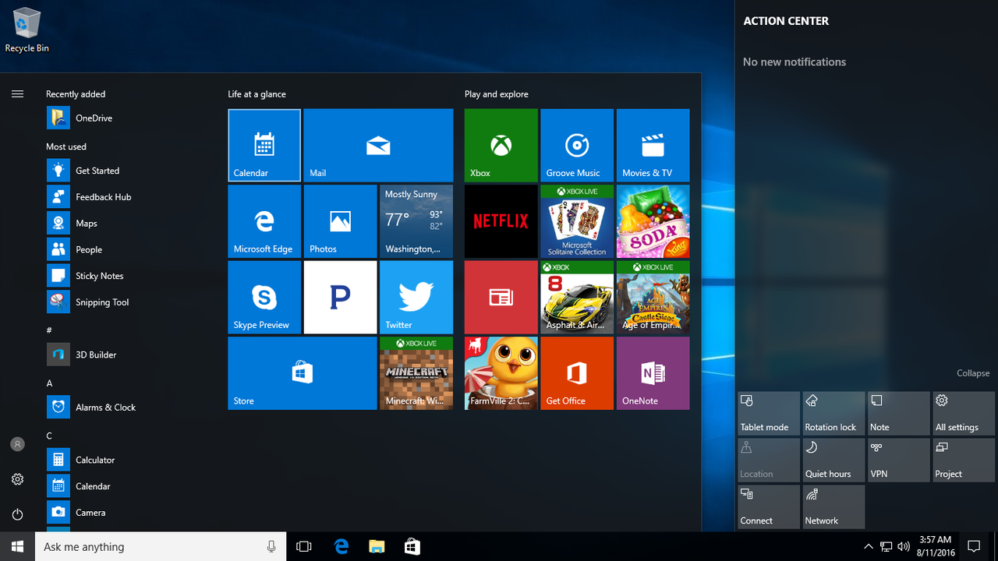
Windows Today

Slide 4

This is what we learnt

Slide 5
getStartedWith
Software Installation

Slide 7
Active Directory

