Slide 1

Linux
Administration & Programming
-Akshay Saini akkilsl522@gmail.com anonyxhappie.github.io

Slide 2
Linux is itself a Magic

Slide 3
Designer Developer Administrator

Slide 4

Everything in Linux is about
File/Process

Slide 5

Root or Admin

Slide 6


My OS Linux or
GNU/Linux

Slide 7



















Distros

Slide 8
Install / Copy

Slide 9

Its types
Linux Installation
Multi-OS
Partitioning
File System

Slide 10
Viola!! We've achieved a MILESTONE.

Slide 11
Linux Architecture

Slide 12
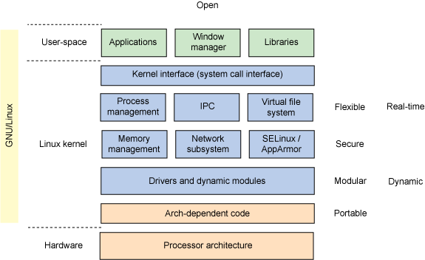

Slide 13


Slide 14
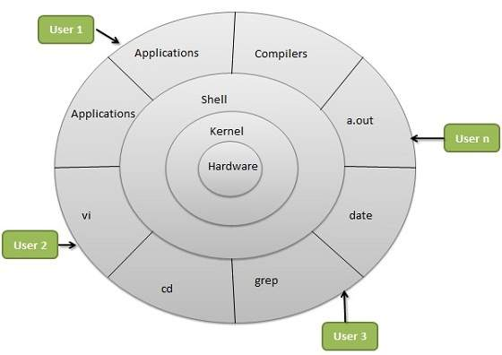

Slide 15
Boot
&
Kernel threads

Slide 16
CLI
Terminal
Shell bash dash tcsh zsh

Slide 17
Basic Commands
man, info, date, cal,
ls, pwd,
(absolute/relative path)cd,
cp, mv, rm,
touch, mkdir, rmdir,
vi, vim, cat, echo,
more, less, head, tail,
Ifconfig

Slide 18
Basic Symbols
#, $, @, *, ~, >, >>, <, |

Slide 19
Thanks to alias, sort, diff, grep, find

Slide 20
Directory as a File tar, gzip, gunzip

Slide 21
Awk & Sed

Slide 22
The Script

Slide 23
useradd/adduser
→ /etc/passwd
→ /etc/shadow
→ /etc/gshadow
→ /etc/group
→ /etc/skel
→ /var/spool/mail
→ /home
→ permissions to ~

Slide 24
Permissions / Security chmod, chown, chgrp, sticky-bit

Slide 25
ACL

Slide 26
RPM

Slide 27
YUM

Slide 28
LAMP Server

Slide 29
Sources For You edx

Slide 30
Feel free to contact :-
Akshay Saini akkilsl522@gmail.com anonyxhappie@gmail.com
+91 98 724 725 65 anonyxhappie.github.io

