Slide 1
Scribus
Beginner's Guide for Publication Design
Anuchit Chalothorn
<anuchit@sipa.or.th>

Slide 2
About Me
Senior Software Engineer @ SIPA
Fedora Ambassador @ Fedora Project
Ubuntu LocoTeam @ Ubuntu Club

Slide 3
What's Scribus
Desktop publishing application
Release under the GNU General Public License
It's Free Software and also Open Source Software
Available for Linux, Unix, Mac OS X, OS/2 and Microsoft Windows

Slide 4
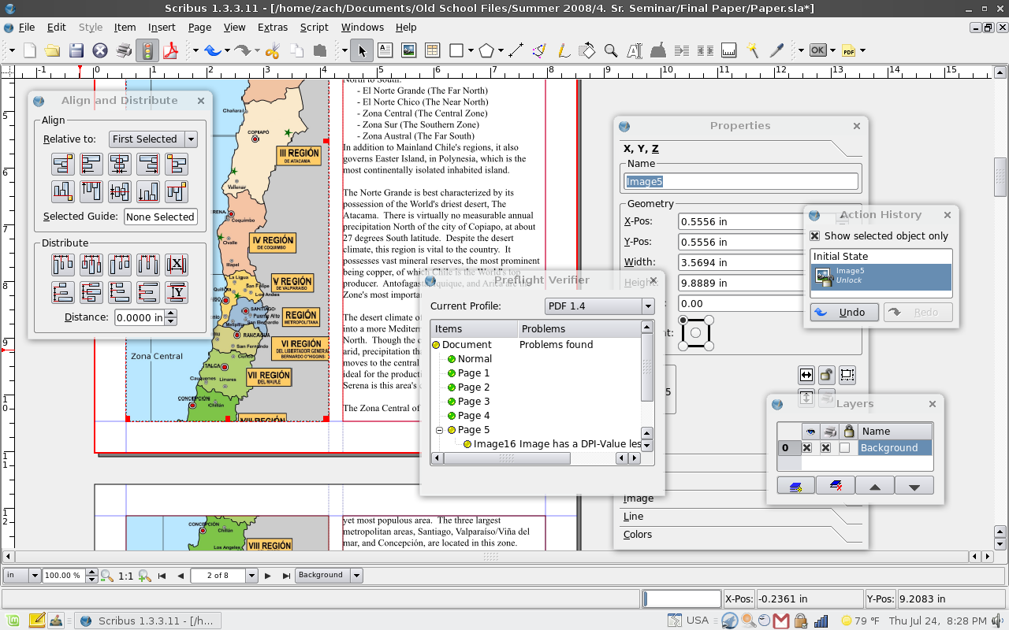
Screenshot
Scribus on Linux Mint

Slide 5
Feature Comparable
Adobe PageMaker
PagePlus
QuarkXPress
Adobe InDesign

Slide 6
Features
Support major image format include scalable vector graphics (SVG)
CMYK and ICC color management support
Built-in scripting using Python
Internal 3 Levels Postscript

Slide 7
Features
Internal 3 Levels Postscript
Export to PDF
Text can be import from OpenDocument, RTF, Microsoft Word and HTML format
Unicode charactor encoding support
File format call SLA

Slide 8
What you can do with Scribus ?
Magazines
Newsletters
Print-advertising
Brochures
Calendars
etc.

Slide 9

Full Circle Magazine

Slide 10
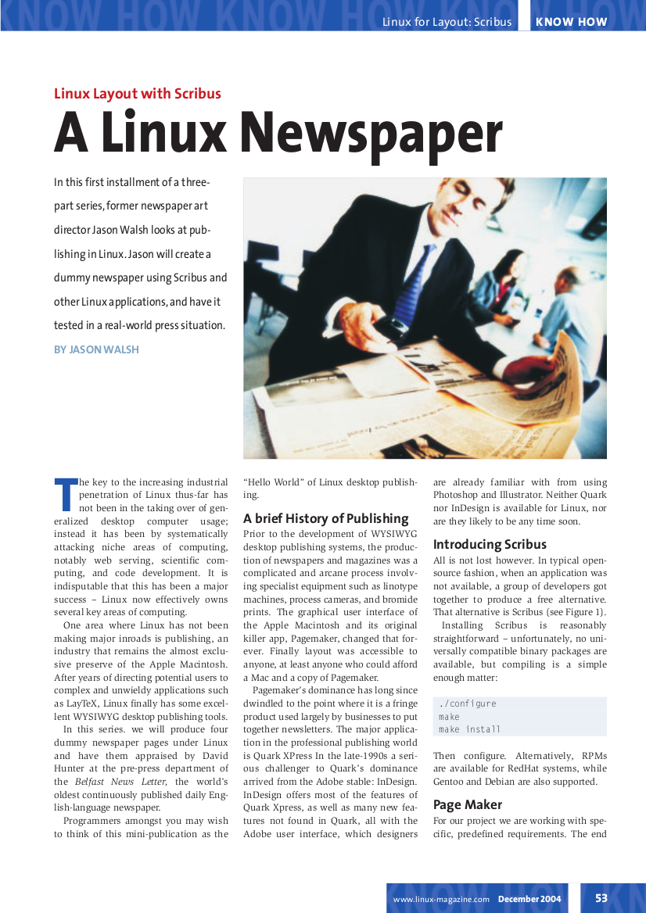
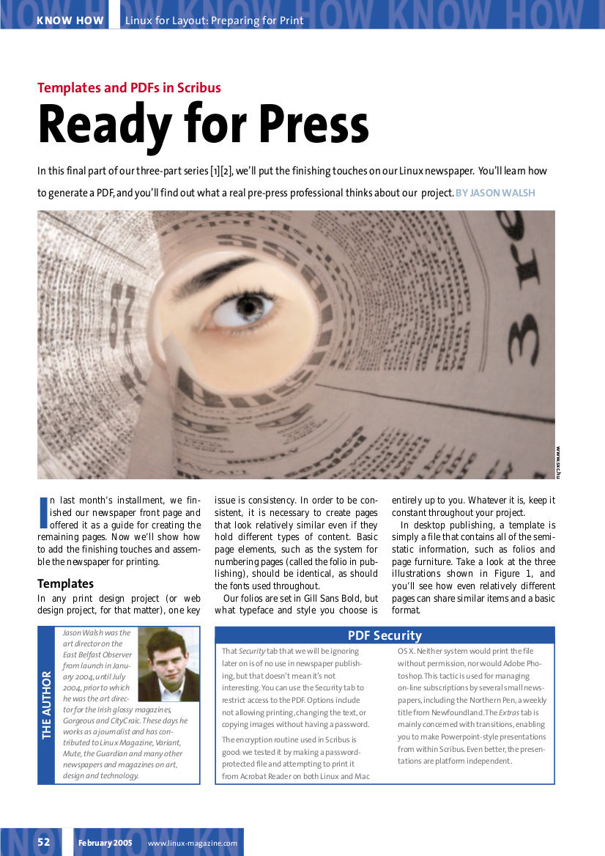
Linux Magazine

Slide 11

CrossOver
Won the 2009 Plantin Moretus Award
for the best-designed Belgian book
in the category non-fiction
CrossOver: Kunst, media en
technologie in Vlaanderen

Slide 12

Scribus for Windows

Slide 13
Scribus and Its Sisters
Scribus
AdobeReader
GhostScript (for Windows User)
Little CMS (for Linux User) or
ICC Profiles

Slide 14
The Heart of Scribus
Text-frame
Picture-frame
Object Property
Story Editor
Master Page

Slide 15
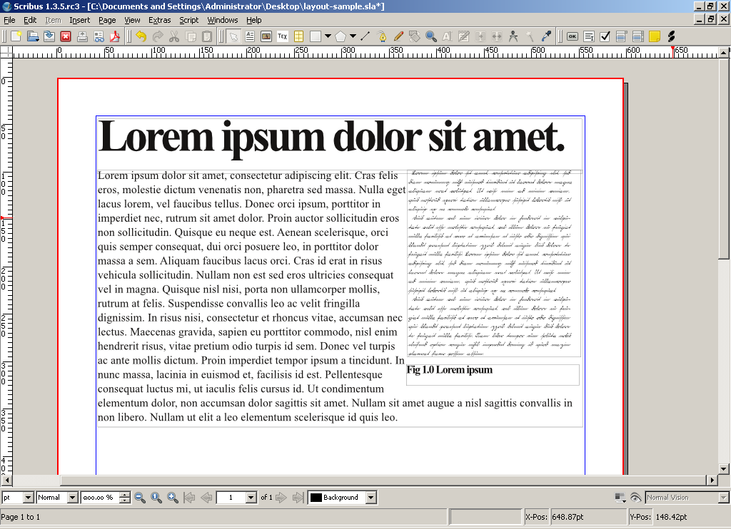
Our Workshop
Page Layout and Style

Slide 16
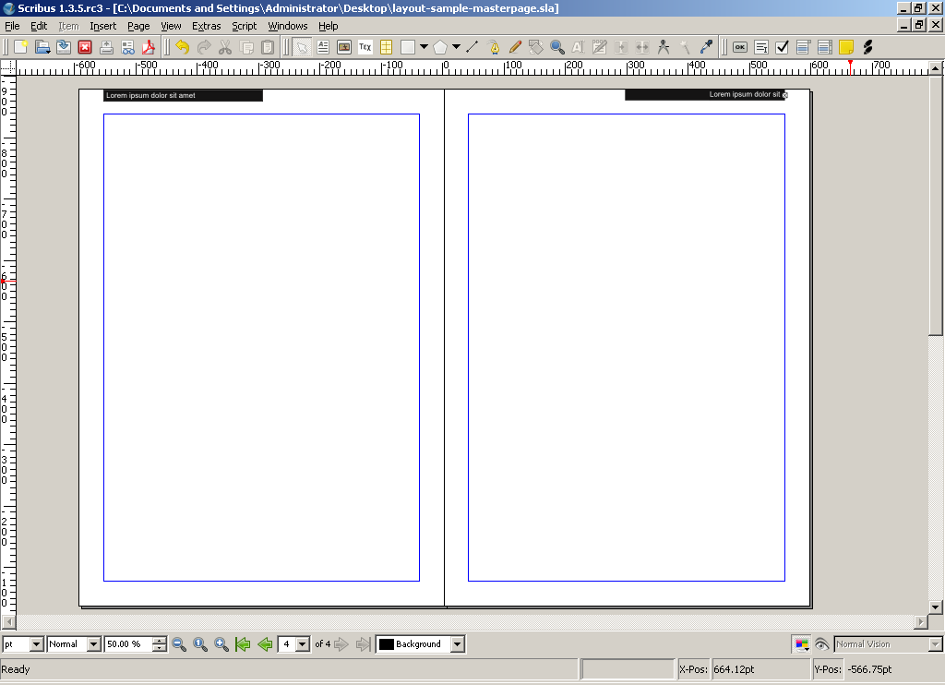
Our Workshop
Master Page

Slide 17
Sample Layout

Slide 18
Sample Layout
Text-Frame
Text-Frame
Picture-Frame
Text-Frame

Slide 19
Quick Workshop
Create new document with A4 size dual page
Top margin 40mm
Bottom margin 40mm
Left margin 40mm
Right margin 40mm
Inner 40mm

Slide 20
Quick Workshop
Insert text-frame as 'Header Text'
Insert text-frame as 'Body Text'
Insert picture-frame as 'Figure1'
Insert text-frame as 'Fig1Caption'

Slide 21
Quick Workshop
Adjust property to contour text for picture and figure text

Slide 22
Quick Workshop
Header Text
Body Text
Figure Caption
Adjust property to contour text for picture and figure text

Slide 23
Style
Header Text
Time News Roman 48pt
Body Text
Time News Roman 12pt
Figure Caption
Time News Roman 12pt Bold

Slide 24
Quick Workshop

Slide 25
Quick Workshop
Page Left
Page Right
Create a Master Page file import and adjust to your document

Slide 26
Quick Workshop
Export 2 EPS
Export 2 PDF
Export 2 PDF Pre-press

Slide 27
Q & A

Slide 28
Thank You

Slide 29

CC-BY-SA

