Slide 1
Ubuntu Quick Guide
Anuchit Chalothorn
<anuchit.ch@sipa.or.th>

Slide 2
About
Senior Software Engineer @ SIPA
Fedora Ambassador @ Fedora Project
Ubuntu LocoTeam @ Ubuntu Club

Slide 3
Debian ~ Ubuntu

Slide 4
Introduction to Debian
1993 by Ian Merdock
"Debbara" + "Ian" = Debian
100% Free Software
15,000+ Packages
1,000 Official Developers

Slide 5
Debian Advantage
Support many CPU architectures
Many packages
All Free Software
Package Management (apt-get)
Very Stable for Server

Slide 6
Debian Disadvantage
Difficult to use/install
Not for Desktop
Very Slow Release Cycle (rolling release)

Slide 7
What we want!
Bleeding-Edge Software
Predictable Release
Free Distribution
Debian Compatible
Commercial Support

Slide 8

Mark Shuttleworth
Multi-Millionaires from Security Industry
First African in Space
Canonical Founder

Slide 9
Ubuntu
"Humanity to other" or
'I am what I am because of who we all are'

Slide 10
Ubuntu Policy
Based on Debian Sid
6 months release cycle
18 months support
Desktop User (Gnome)
Chosen Application (OpenOffice.Org, GIMP, Firefox, Evolution, Pidgin)
Single CD

Slide 11
Ubuntu Package
Multiverse
(Not in Debian)
Universe
(Debian)
Main
(Ubuntu)
Restricted
(Non-Free)

Slide 12
Ubuntu Release
Past
  8.10 Hardy Heron (October 2008)
Current Release
  9.04 Jaunty Jackalop (April 2009)
Next
  9.10 Karmic Koala (October 2009)

Slide 13
Ubuntu Edition
Ubuntu Desktop
Ubuntu Server Edition
Ubuntu MID Edition
Ubuntu on ARM

Slide 14
Derivative Distro
Edubuntu
Kubuntu
Xubuntu
Goubuntu
Ubuntu Studio
Mythbuntu

Slide 15
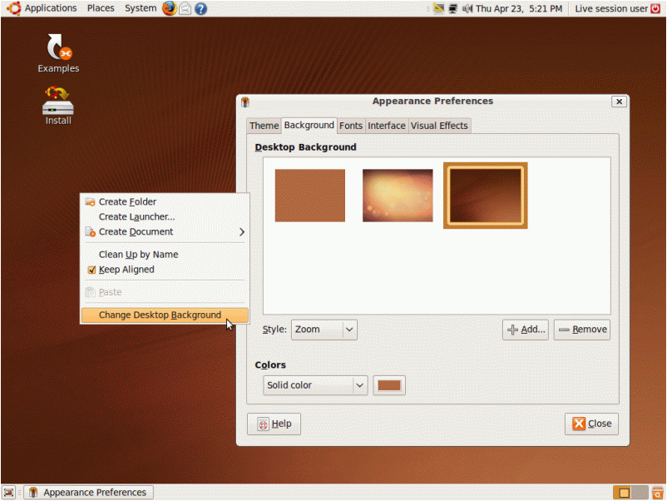
Ubuntu

Slide 16
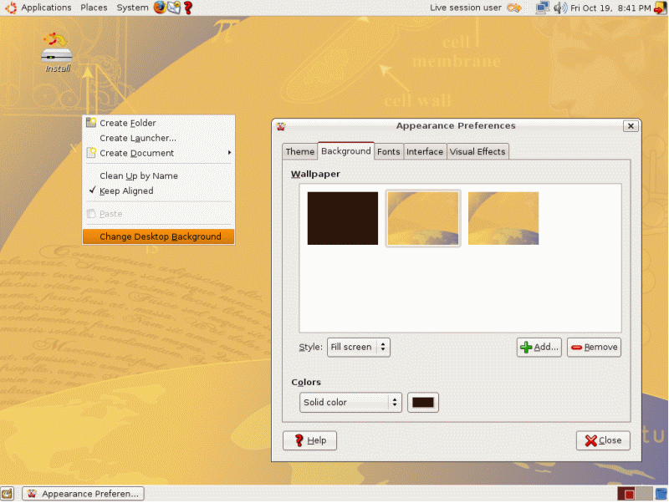
Edubuntu

Slide 17
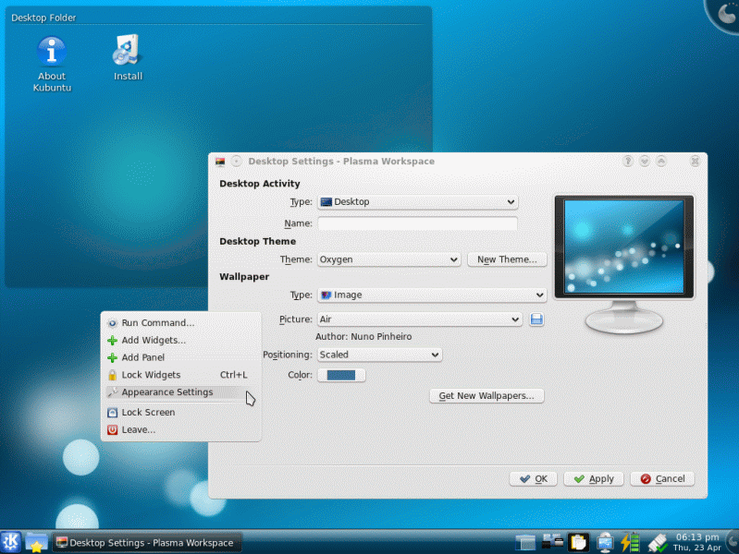
Kubuntu

Slide 18
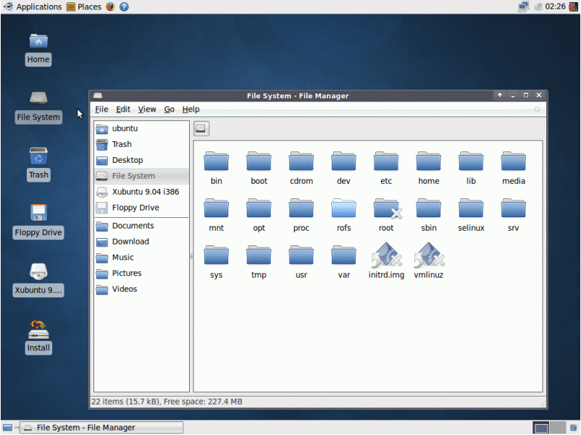
Xubuntu

Slide 19
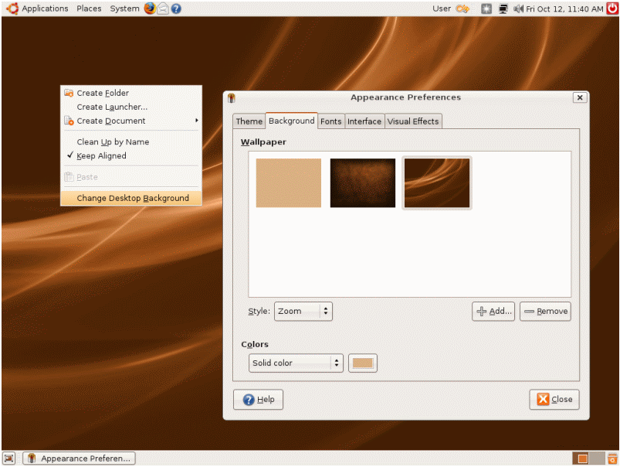
Gobuntu

Slide 20
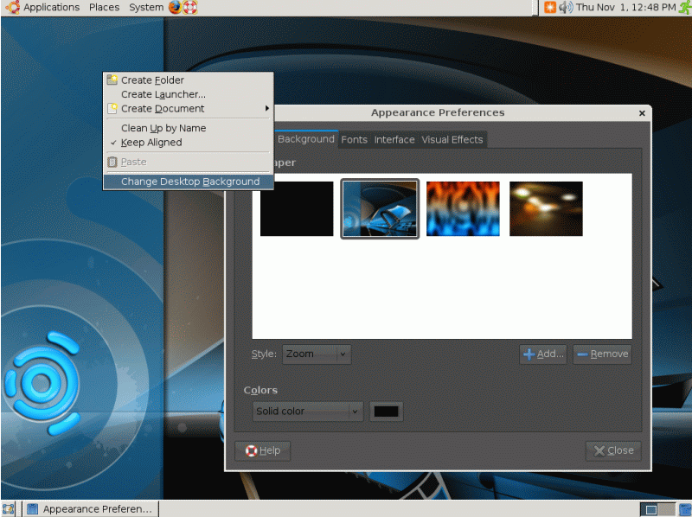
Ubuntu Studio

Slide 21
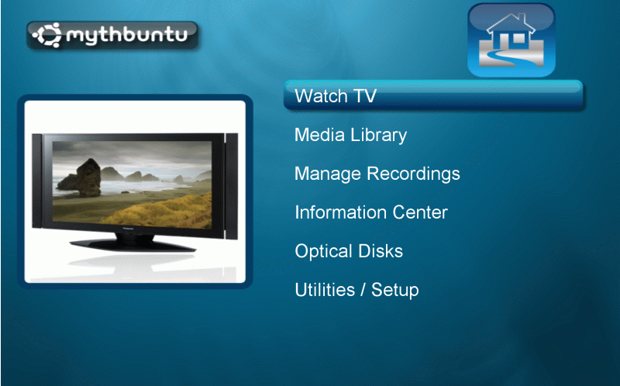
Mythbuntu

Slide 22
How to get Ubuntu
Download from ubuntu.com for mirror.in.th
Order via ShipIt
Order at local distributor like ubuntuclub.com

Slide 23
Ubuntu Support
Ubuntu Forum
Ubuntu IRC #ubuntu
Ubuntu Club Forum
Ubuntu Club IRC #ubuntu-th
Local support via vendors

Slide 24
Ubuntu Club Distro Edition
Ubuntu Re-master
For non hi-speed Internet user
Support Thai language
Multimedia codecs
Add more useful programs
Free!!

Slide 25
Link
Ubuntu Official Site http://www.ubuntu.com
Ubuntu Club http://www.ubuntuclub.com
Thai Open Source http://www.thaiopensource.org

Slide 26
Q & A

Slide 27
Thank You

Slide 28

CC-BY-SA

